Slide 1
Notes:
SCRIPT: Welcome to Shapes for Leaders.

Slide 2
Welcome & Overview
Notes:
SCRIPT: This is a communications course designed to help you strengthen your role as a leader by communicating more effectively.
NOTE: Take 2-3 minutes to introduce yourself to the group.

Slide 3
Welcome from Susan Hite, CEO of PsychoGeometrics
Dear Leaders,
We are excited to share a simple and effective way to strengthen your leadership by communicating more effectively. Our hope is that you find this course to be extremely impactful to your continuous growth and professional development, especially as you lead and influence others.
By participating in Shapes for Leaders, you will learn more about your leadership strengths, as well as your challenges. You will then learn how to maximize, manage, modify, and leverage your leadership style, while still being your authentic self.
Although leadership is anything but easy, I think you will find PsychoGeometrics, the science of behavior and the art of communication, easy to understand, remember, and apply. What you believe and who you are can remain the same, but after this course, you will find that how you act, interact, relate, and communicate will vary depending upon the situation and the different types of people you lead.
You may also notice a shift in how you see yourself and others. Suddenly, you will understand why you enjoy some aspects of leadership more than others, or why you find some people easier or more challenging to lead.
Understanding is the key to effective leadership. On behalf of our team at PsychoGeometrics, here’s to strengthening your leadership by communicating effectively!
Sincerely,
Susan Hite
CEO of PsychoGeometrics
Notes:
SCRIPT: Let’s start with a welcome letter from Susan Hite the CEO of PsychoGeometrics.
NOTE: Give participants a minute to read the letter. Review the letter and emphasize the points that most resonate with you and what you think will resonate most with your participants.

Slide 4
Workshop Day One Agenda
Welcome & Overview
Course Agenda,
Course Objectives
Resources
Introductions
Modules 1 – 3
Module 1: Introduction to PsychoGeometrics
Module 2: Shape Perception
Module 3: Shape Flexing
Review & Wrap Up
Day One Review
Day Two Preview
Notes:
SCRIPT: This course is designed to be engaging and interactive. You will have the opportunity to participate in small group activities and discussions throughout the course. There are five learning modules of PsychoGeometrics. These learning modules are Introduction to PsychoGeometrics, Shape Perception, Shape Flexing, Shape Motivation, and Strategic Shaping. Today, we will focus on modules one through three and tomorrow, we will go through modules four and five. With each module, you will notice a pattern of teaching and applying what you learn.
NOTE: This course can be modified to a shorter or longer course by removing or expanding activities and applications.

Slide 5
Course Objectives
Understand your communication style as a leader, including your strengths and challenges, and the communication style of others.
Recognize the possible positive and negative perceptions of your communication and leadership style, and the communication style of others.
Learn the skill of Shape Flexing to strengthen the effectiveness of your communication, approach, and responsiveness as a leader.
Discover what motivates and demotivates you and others and adjust your communication and leadership approach accordingly.
Apply the Strategic Shaping Model for planning, problem solving, and conflict resolution to strengthen your leadership effectiveness.
Notes:
SCRIPT: Here are the course objectives. After completing this workshop, you will be able to strengthen your role as a leader by communicating more effectively.

Slide 6
Know your Resources
In your Shapes for Leaders Toolkit, you will find…
Shapes Participant Workbook
Communicating Beyond Our Differences Book
Shapes Card Game
Written “Scratch Off” Shapes Assessment
Shapes Guide
Shape Traits/Communicating with each Shape Card
Notes:
SCRIPT: Before we get started, let’s take a look at your resources. In your Shapes for Leaders Toolkit, you will find the Shapes for Leaders Participant Workbook, a copy of Communicating Beyond Our Differences, the Shapes Card Game, the written scratch off assessment or the online assessment with profile report, the Shapes Guide, either the hard copy or online version, and one Shape Traits/Communicating with each Shape Reference Card. You will also find a listing of these resources in your Participant Workbook.

Slide 7
Introductions
Notes:
SCRIPT: Let’s begin with an activity to help us get to know each other. In your Shapes Toolkit, please find the Shapes Card Game.

Slide 8
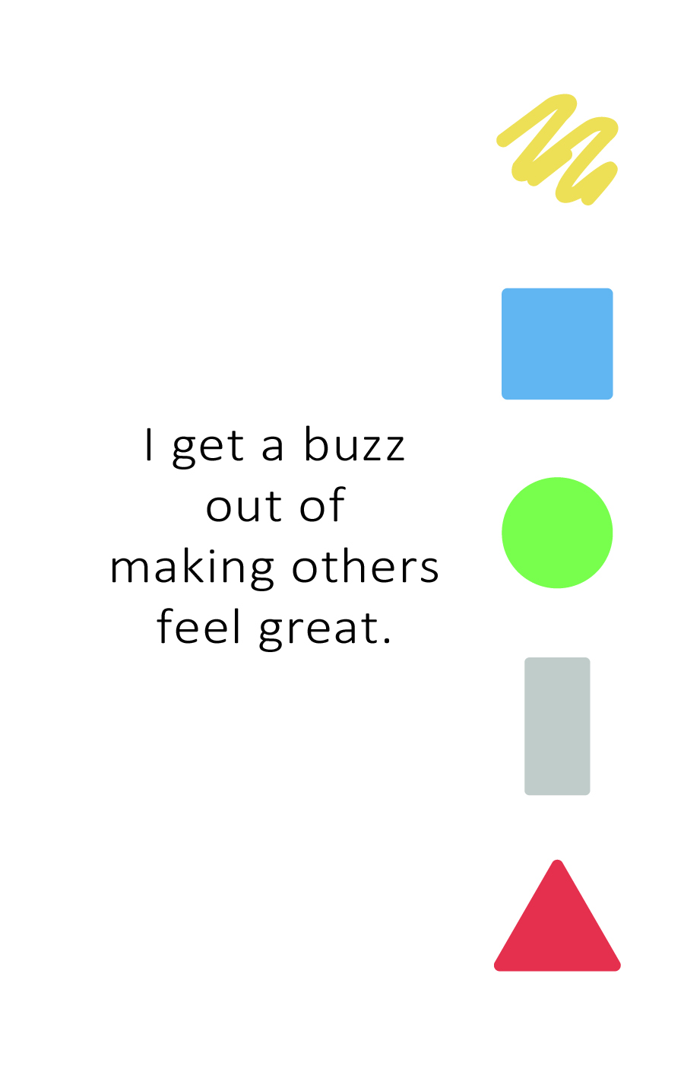
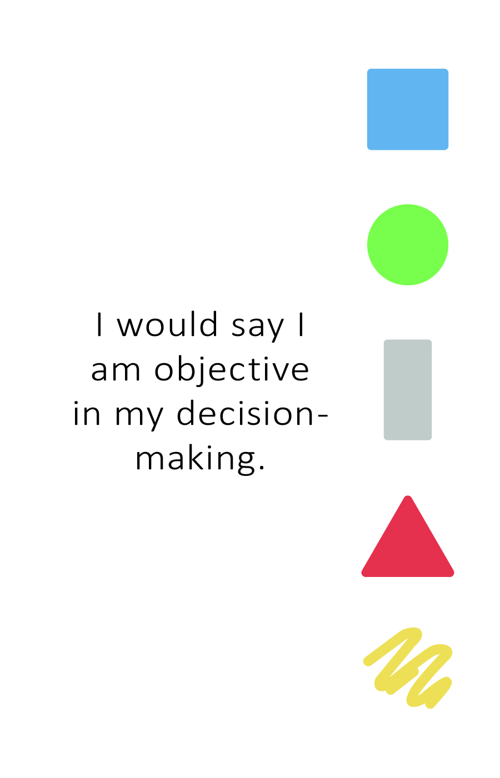
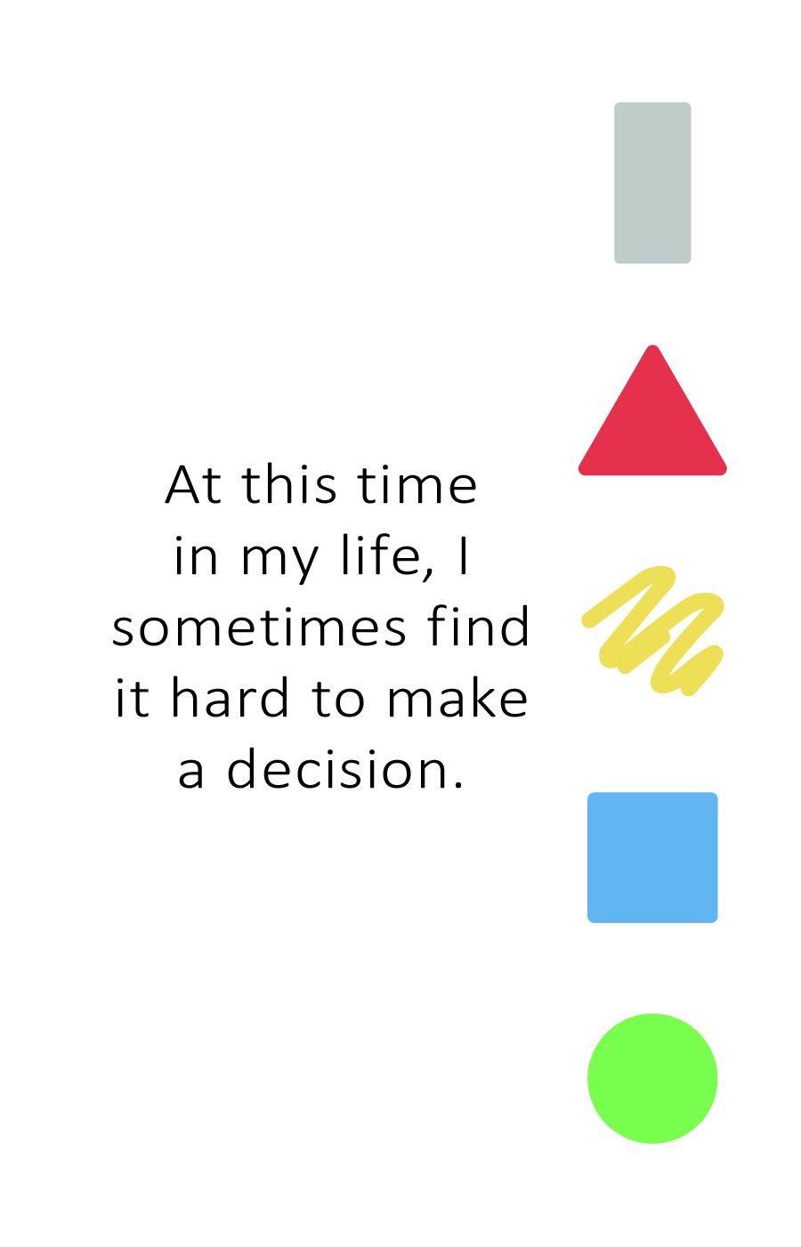
The Shapes Card Game
Share your name.
Share where you live.
Read the statement on the card.
Does it describe you? Why or why not?
How do the cards you shared impact your leadership style? Give an example.
Notes:
SCRIPT: Let’s get started. With your deck of 10 cards, read the statement on each card and make two piles. One pile of cards with statements that describe you and one pile of cards with statements that do not describe you.
NOTE: Give participants 1-2 minutes to make their two piles.
SCRIPT: Now, we are going to introduce ourselves. When it is your turn, please tell us your name and where you live, then pick one card from each of your piles, read the statements, and tell us why or why not the statement describes you. Finally, explain how the cards you shared impact your leadership style.
NOTE: Have participants one by one introduce themselves. Note, participants should be reading two cards – one that describes them and one that does not.
SCRIPT: Thank you all for participating. I enjoyed learning a little more about each of you.
NOTE: If your class size is too big to have each participant introduce themselves to the whole group, have participants find a partner and do the same exercise. You can have participants change partners up to three times and read a different card each time. See specific instructions below.
NOTE: You can facilitate this activity virtually by using breakout rooms.
ACTIVITY: Shapes Card Game Partner Instructions (modification to take less time):
•Instruct participants to separate their cards into two piles; one pile for cards that describe them and one pile for cards that do not describe them.
•Have participants find a partner.
•Give the participants 3-5 minutes to do the following with their partner.
Share their name.
Share where they live.
Pick a card from each of their piles (one that describes them and one that does not)
Read each statement and tell their partner why or why not the statement describes them.
Share how the cards impact their leadership style. Give an example.
•After the 3-5 minutes, have participants find a new partner and repeat the same process with two different cards from their piles. (You can have participants repeat this with up to 3 partners).
•Bring participants back together for large group discussion.
Ask for a few volunteers to share an “ah-ha” or notable moment from their conversations.

Slide 9
Module 1: Introduction to
PsychoGeometrics
Notes:
SCRIPT: Now we will move into our first module – Introduction to PsychoGeometrics.

Slide 10
About PsychoGeometrics
Notes:
SCRIPT: What is PsychoGeometrics?

Slide 11
About PsychoGeometrics
What is it?
The science of behavior and the art of communication.
Featuring five geometric Shapes.
Each Shape represents a different communication style.
Learn your Shape when you take the Shapes Assessment.
The Shapes Assessment consists of three parts:
Traits
Behaviors
How you relate to others
Notes:
SCRIPT: PsychoGeometrics is the science of behavior and the art of communication. It was created in 1978 by Susan Dellinger, Ph.D. as a communication system featuring five geometric Shapes representing five communication styles. In June of 2020, Susan Hite, president of Hite Resources, Inc. and PsychoGeometrics consultant and facilitator for nearly 20 years, purchased the PsychoGeometrics company from Dr. Dellinger. As the CEO and Innovator of PsychoGeometrics, Susan Hite has updated the original work by developing new content and applications. Today, PsychoGeometrics blends the science and the art by identifying the “what” and the “how” to strengthen relationships by communicating effectively.
Your Shape is determined by taking the Shapes Assessment. The Shapes Assessment consists of three sections which are traits, behaviors, and how you relate to others. We will discuss the Shapes Assessment and how it impacts your leadership, a little more specifically in the coming slides.

Slide 12
The Shapes Assessment
Notes:
SCRIPT: Let’s talk about the Shapes Assessment.

Slide 13
The Shapes Assessment
The Shapes Assessment By Sight
Choose your favorite Shape.
Choose your second favorite Shape.
Choose your least favorite Shape.
Notes:
SCRIPT: Before we do the online (or written assessment), we are going to take the Shapes Assessment by sight. Please look at the five Shapes and choose your favorite Shape, second favorite Shape, and least favorite Shape.
NOTE: Anticipate the question – does color have anything to do with it? Yes – and we will talk about that after you take the assessment.

Slide 14
Take The Shapes Assessment
How it Works There are three sections. Each part typically takes less than five minutes to complete. Part 1 – Traits Part 2 – Behavior Part 3 – Relating to Others You will not be timed, but it is best not to over-think your choices. Go with your first choice.
What to Know Relax! This is not a test, it’s an assessment. It’s meant to be FUN! You won’t get a grade, but you will get a Shapes score. It doesn’t matter what you score, but it does matter that you understand your score, and know how to use it to communicate more effectively.
Notes:
SCRIPT: You will soon take the Online (or written) Shapes Assessment but before you do, I want to share a few details about the assessment. First, the Shapes Assessment consists of three sections, Traits, Behaviors, and Relating to Others. Traits describe who you are. Behaviors describe what you do and how you act. Relating is how you relate to others. Please note that this assessment is not timed, however, it is best to go with your initial response and not over-think it.
This is an assessment, not a test, so that means there are no wrong answers. There is no pre-work or preparation required. It is important to be your natural self to ensure the most accurate results. You will not receive a grade, but you will receive a Shapes score that will help you understand and interpret your results. And finally, it’s a simple, quick, easy, and fun assessment that should only take 15 minutes or less.

Slide 15
Take the Shapes Assessment Now
Notes:
SCRIPT: Now we will take the Shapes Assessment.
NOTE: If using the written Shapes Assessment, instruct participant to find the Shapes Assessment in their Shapes Toolkit. If using the online Shapes Assessment, provide the Shapes Assessment Link (or access code) to participants by writing it on the board/flip chart (in-person) or putting it in the chat (virtual). Give participants 15 minutes to take the Shapes Assessment and review their Shapes report.

Slide 16
The Five Shapes
Notes:
SCRIPT: Now that you know your primary and secondary Shapes, let’s take a deeper look at the communication style represented by each Shape and how it impacts your leadership.
NOTE: Optional Question to ask Participants “Was the Shape you originally chose in the sight test either your primary or secondary Shape?” 84% of the time, what you choose by sight alone is either your primary or secondary Shape.

Slide 17
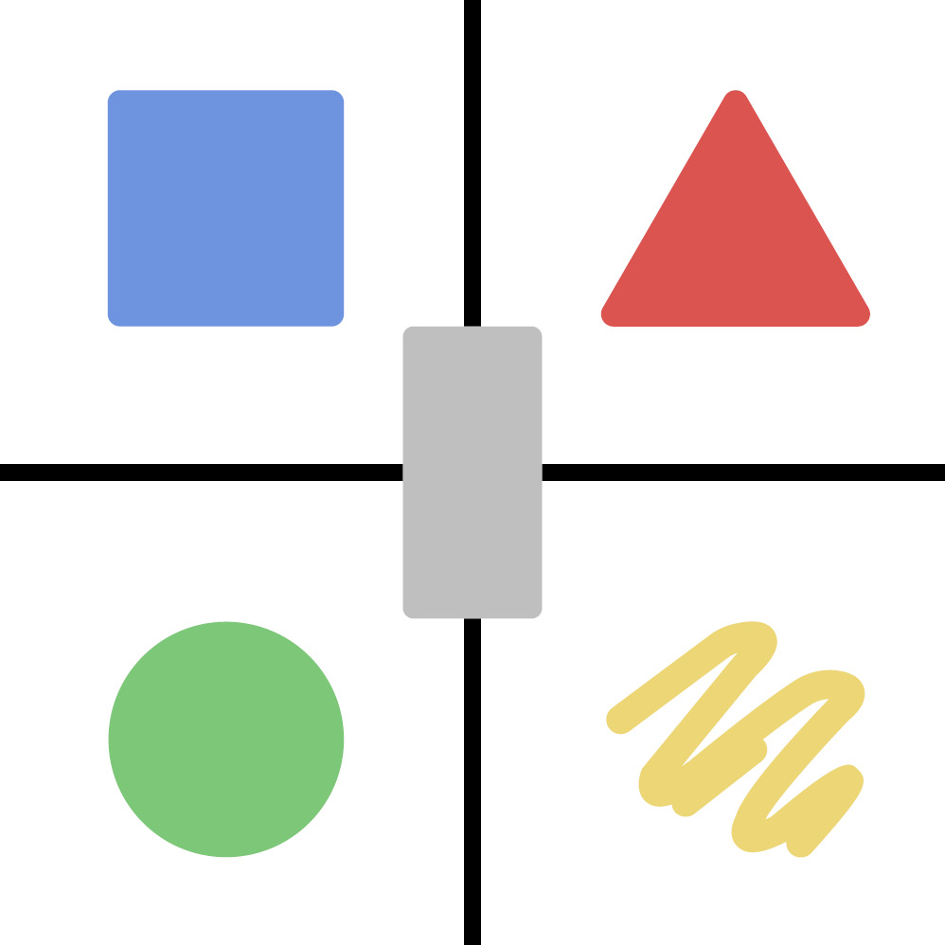
Things to Know About All Five Shapes
Each Shape represents a trait or behavior and has value, power, strengths, and challenges.
You have all five Shapes within you.
You tend to use one or two Shapes the most because they are your natural strengths.
It is wise to consider and leverage the behaviors of all five Shapes to communicate and lead effectively.
Task
Goal
INWARD
OUTWARD
Relationships
People
Notes:
SCRIPT: Here is what you need to know about all five Shapes. Each Shape represents a trait or behavior that makes up your communication style. Every Shape has value and power. It is important to know that no Shape is better than another. All Shapes have strengths and challenges. The behavior you exhibit most is likely a combination of your primary and secondary Shapes, which represent your natural Shape strengths. In other words, what you are naturally good at doing. However, this does not mean 100% of your communication comes from just these two Shapes. It simply means your natural behavior, including your natural leadership style, comes from the blend of these two Shapes and is typically what you use most of the time. The rest of your communication and leadership style comes from the remaining three Shapes. Your primary Shape is indicated by the Shape in which you score the highest number of points. Your secondary Shape is indicated by the Shape in which you score the second-highest number of points. It is possible to have a tie. If this happens, it may mean your general behavior is derived from the blend of three Shapes, not just two. Remember, we have all five Shapes within us, some Shapes just come more naturally, and some require a little more effort.
Take a look at the image on the screen or in your Shapes Participant Workbook. The Box and Circle are your inward Shapes (introverted) and the Triangle and Squiggle are your outward Shapes (extroverted). Notice that the Rectangle is in the middle. This means the Rectangle can be any one of the other four Shapes, either consciously or unconsciously. We will talk more about the Rectangle later in the Workshop. The Box is task oriented while the Triangle is goal oriented. The Circle is relationship oriented while the Squiggle is people oriented.

Slide 18
Understanding Your Score
UNDERSTANDING YOUR SCORE
0-3 LOW – does not mean below average
4-6 MEDIUM – does not mean average
7+ HIGH – does not mean above average
Just because you score “high” in a Shape does not necessarily mean you are good at using that Shape.
It means you have a high percentage of that Shape within you naturally, and you have the potential to be great at using it.
Notes:
SCRIPT: It is also important to understand your score. Anything from 0-3 is considered low, anything from 4-6 is medium, and anything 7 or higher is high. The total number of possible points is 21. I want to emphasize that low does not mean below average, medium does not mean average, and high does not mean above average. Your score simply determines how much of that Shape you have naturally within you. Think about it in percentages. If you score 8 in Triangle and 6 in Circle, it means 2/3 (66.67%) of your natural communication and leadership style comes from these two Shapes. The remaining 1/3 of your natural communication and leadership style (33.33%) comes from the points in the other three Shapes.

Slide 19
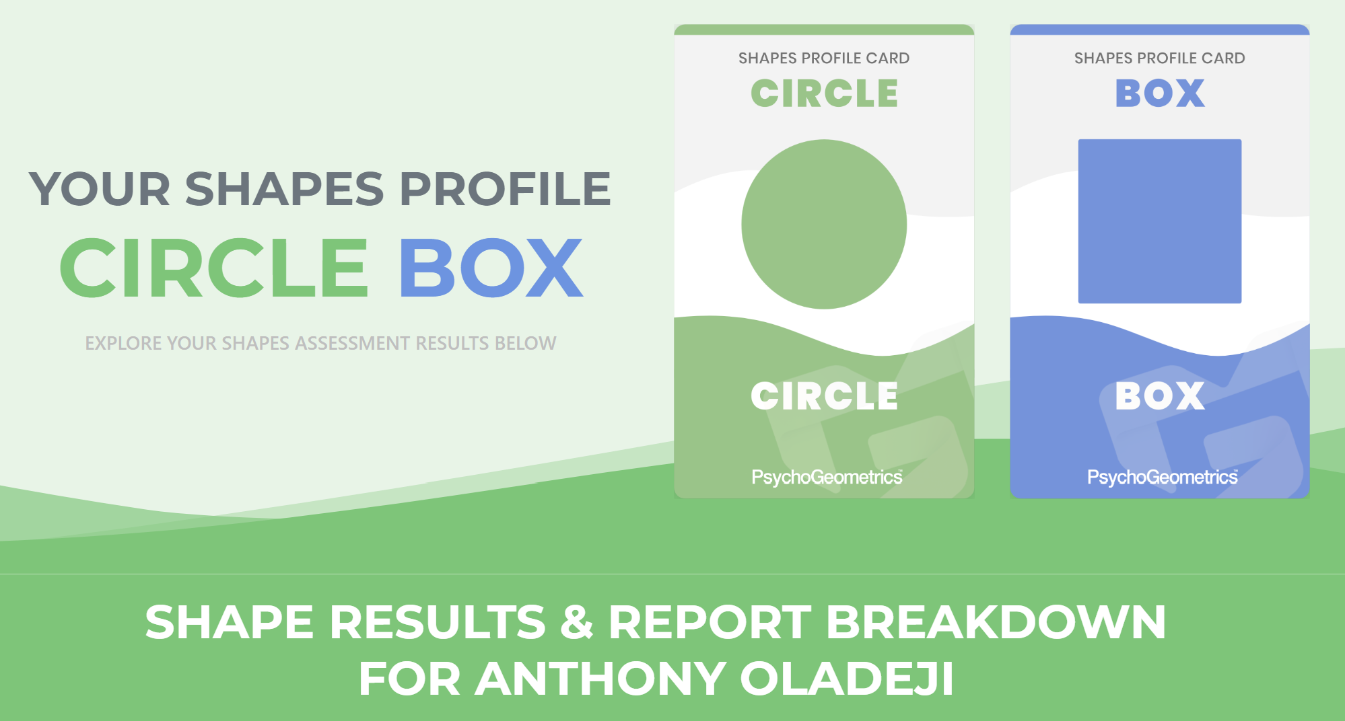
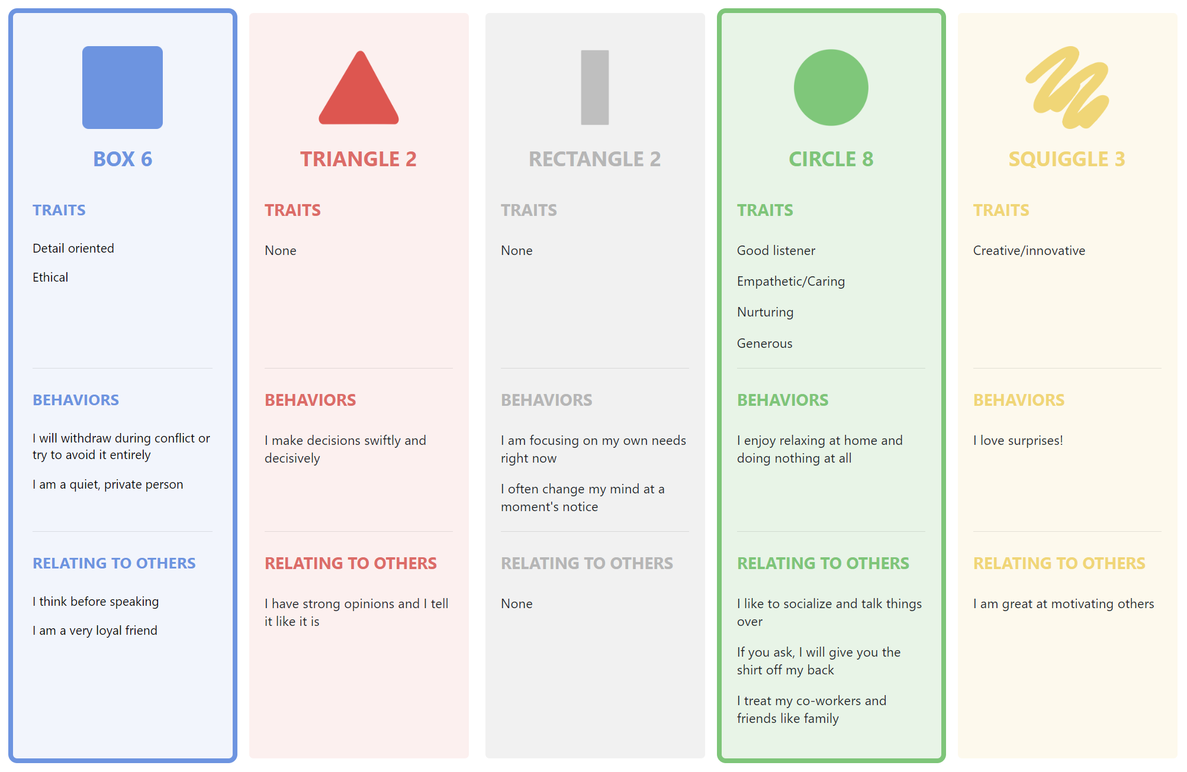
Understanding Your Scores in each Section – Traits, Behaviors, and Relating to Others
Secondary
Primary
YOUR NAME HERE
Shape Profile Report Example
TRAITS
BEHAVIORS
RELATING TO OTHERS
Notes:
SCRIPT: Understanding your Shapes and your Shapes Scores makes it easier to understand why you think, feel, act, or relate like you do. Once you understand the why, then you can determine what you need. Let’s take a look at this example of a Shapes Profile Report. It provides such clues as to what this person may need to effectively lead people, manage stress, or navigate change. These are just a few examples. You will also notice in the Shapes Profile Report how the points for each Shape are distributed among the three categories:
TRAITS – Who You Are
BEHAVIOR – What You Do
RELATE – How You Interact with Others
Since this person is a primary Circle with a score of 8 and a secondary Box with a score of 6, these two Shapes and their three sections of traits, behaviors, and relating to others are outlined in green and blue, respectively. This is important because it shows the specific traits, behaviors, and natural interactions with others that are representative of their Shape. For example, let’s look at the primary Circle and the specific Circle traits. We see Good listener, Empathetic/Caring, Nurturing, and Generous. Because this person has these four Circle traits, they counteract, or neutralize, some of the Box traits like non-emotional. This is why even though you may be a secondary Box, you won’t necessarily relate to every trait, behavior, or interaction of the Box if your other Shape is, for example, Circle. This type of reasoning applies to any primary and secondary Shape combination. Also, keep in mind how the other Shapes and their distribution of points impacts the Primary and Secondary Shapes. What assumptions could you make about this person’s communication style? What about their leadership style? Now look at your own Shapes Profile Report. How are your 21 points distributed? What can you learn or reinforce about your communication or leadership style by the way your points are distributed?

Slide 20
The Five Shapes
Left-Brain
Logical, Linear, Factual
Right-Brain
Creative, Innovative, Emotional
INFO & STRUCTURE
ACTION &
RESULTS
CHANGE &
GROWTH
CONNECTION & HARMONY
ENERGY & CREATIVITY
Notes:
SCRIPT: PsychoGeometrics uses the left brain/right brain theory developed by Roger W. Sperry in the 1960s. Sperry was awarded the Nobel Prize in 1981. Although we know the brain is much more complex than just two sides, thinking of the Shapes as either left brain or right brain makes the Shapes easier to categorize, explain, and describe. Here are the Shapes from left to right. The Box and Triangle are left-brain Shapes. The Circle and Squiggle are right brain Shapes. All four are considered a primary or secondary Shape. The Rectangle is a transitional Shape and can pull from either side of the brain, consciously or subconsciously. If you have two left-brain Shapes as your primary and secondary Shapes, the Rectangle will subconsciously use more of the left side of the brain, and especially at first, when experiencing change, but it can also access the right-hand side, especially if it’s a conscious choice. If you have two right-brain Shapes, the opposite is true. If you have one of each, one left-brain and one right-brain Shape, your Rectangle will tend to lean more to your primary Shape first, then your secondary Shape. Let’s learn a little more about each Shape, starting with the Box – When you think of Box behavior, traits such as structured, detailed, process-oriented, logical, slow to make a decision, efficient and practical come to mind. The Triangle - When you think of Triangle behavior, descriptions such as direct, driven, goal-focused, action-oriented, quick to make a decision, bottom-line and to the point, are used. The Circle – When you think of Circle traits – words such as harmony, nurture, mentor, inclusive, relationship-oriented, and sensitive come to mind. The Squiggle – The Squiggle behavior can be described as creative, innovative, energized, spontaneous, and unique. The Rectangle is neither - When you think of Rectangle behavior, think exploring, open-minded, undecided, a turning point, and growth.

Slide 21
Let’s learn more about your Shapes
Notes:
SCRIPT: Let’s dive even deeper with each Shape. As you are learning, consider not only how this Shape shows up in your communication style, but also how it impacts your leadership style.

Slide 22
The Shapes
Because the BOX is composed of equal lines and angles, it represents structure and stability.
Calm, consistent, logical.
Most organized of the Shapes.
Likes to know the facts and “think about it” before deciding.
Tends to be a perfectionist.
Can be poker-faced, shows little emotion.
“I’d rather finish right than finish first and get it wrong.”
Likes to stay on task and may not be pleased if you “pop in.”
Doesn’t like to be put on the spot and prefers working alone.
Trustworthy, dependable, you can count on the Box.
BOX
“If you want it done right, do it yourself.”
Notes:
SCRIPT: As I just noted, the Box represents structure. Notice the Shape of the Box. Four equal sides that literally makes the Shape of a square. However, to be consistent with the Shapes language, you should call it the Box, not the square.
NOTE: The reason it is not called “square” in the Shapes language is because some people may already have a pre-conceived notion of what it means to be “square.” Box is a more universal, objective term.
SCRIPT: Think of the Box as a building block, using one block at a time to build the foundation of a building, for example. Boxes don’t roll or spring into action. Instead, they turn like a flywheel, one “crank,” at a time.
NOTE: You may want to use your hands and facial expressions to physically show what it is like to “crank” a heavy flywheel one slow turn at a time until you slowly build up momentum. In some cases, you may want to provide the definition of a flywheel or ask someone to look it up, put it in the chat box, or raise their hand and share. According to Oxford Languages, a flywheel is “a heavy revolving wheel in a machine that is used to increase the machine’s momentum and thereby provide greater stability or a reserve of available power during interruptions in the delivery of power to the machine.”
SCRIPT: With each turn, the Box builds momentum. This step-by-step, or turn-by-turn, method is part of the process, even though the process doesn’t always feel or look like progress at the time. The Box knows there is a cumulative value of doing the little things consistently over time. This creates stability, credibility, and reliability. Also note the color of the Box. Blue stands for calmness and trust.
NOTE: There is such a thing as Shapes psychology and Color psychology. For example, shapes and colors can influence the way we think or feel. This is part of the science that factors into choosing your favorite Shapes by sight. If a company is trying to communicate trust, it may use a Box like shape and/or blue color in its logo.
SCRIPT: Now, let’s look at the way the Box is described. If you are a primary or secondary Box, this means you could be someone who is calm, consistent, logical, and organized. In fact, the Box is the most organized of the five Shapes. They are disciplined, task-oriented, and thrive on routine and a schedule. This is why a Box may seem annoyed when you “pop in” on them without an appointment or advance notice. Boxes are busy working to get things done. It’s best not to ask a Box to commit on the spot. Instead, the Box needs time to process and “think about it,” before saying “yes” or “no.” This is because when the Box makes a commitment, the Box follows through. Be careful not to assume the Box is not interested or doesn’t care. Their intentional pause, blank stare, non-emotional facial expressions, or monotone tone has nothing to do with whether they like you or not, or even if they are interested in what you are communicating. It’s more about logic. Boxes like to be respected and recognized for what they know. Boxes tend to be perfectionists and prefer working alone. Notice I didn’t say Boxes can’t work with others. It’s just that the natural preference of the Box is to be efficient, and to the Box, working alone takes less time and is more effective than having to work as a team.
Boxes can be resistant to change and don’t like to be rushed or put “on the spot.”
Keep in mind, you are not just one Shape. Unless you scored 21 in Box, you have other Shapes within you. It’s important to know that you may not resonate with every trait or description of the Box, because your secondary Shape may counteract or neutralize it.
NOTE: In addition to the questions on the following slide, you can also use the questions below for leaders.
Examples of questions to ask yourself or others, and either reflect or discuss:
1.Are you a primary or secondary Box? Why or why not?
2.How does the Box, or lack thereof, impact, strengthen, or weaken my communication style and/or relationships?
3.Think of someone who is a Box: spouse, family member, friend, co-worker, boss, or leader. What do you appreciate about the Box in this person? What annoys you about the Box in this person?
4.How does the Box show care, concern, or love?

Slide 23
The Shapes
Breakout Discussion
Is anyone in your group a primary or secondary Box?
Is there someone on your team that you think may be a Box?
What does the Box bring to leadership?
BOX
“If you want it done right, do it yourself.”
Notes:
SCRIPT: Now that you know a little bit more about the Box, you are going to have an opportunity to discuss with a group. In your groups, answer the following questions, 1) Is anyone in your group a primary or secondary Box? 2) Is there someone on your team that you think may be a Box? 3) What does the Box bring to leadership?
NOTE: Assign about three to four people in a group and give them about five to seven minutes to answer the questions. After the five minutes, have participants return to the larger group and ask for any “ah-hah” moments.

Slide 24
The Shapes
Because the TRIANGLE is built like a pyramid, with an upward pointed tip, it represents ambition and high achievement.
Driven, competitive, and likes being in control.
Makes the decision then works to make it right.
Can be seen as too direct and intense.
Can’t stand indecision.
“I don’t need to hear the whole story.”
Politically correct. Knows how to work the system.
Fast thinkers, decision makers, strong opinions.
Quick to get to the point, lives a fast-paced life.
Bottom line, doesn’t want a lot of details.
TRIANGLE
“When I want your opinion,
I will give you mine.”
Notes:
SCRIPT: Let’s move on to the Triangle. The Triangle shares some traits with the Box like being organized and focused. But if the Box is “slow to make a decision,” then the Triangle makes the decision quickly and confidently. Unlike the Box that wants to gather all the facts then make the best decision, the Triangle just wants to make a decision and work to make it right.
The Triangle represents action, ambition, and high achievement. Notice the Shape of the Triangle. It is literally bottom line and to the point.
NOTE: If possible, use your cursor or stylus to point to the bottom of the Triangle from left to right, when you say “bottom-line.” If you are using a flip chart, you can use your marker to draw the bottom of a Triangle. Or, you can use your hand or finger to “draw” a horizontal line (in the air). Then using your cursor, stylus, marker, hand, or finger to draw or move upward to the top of the Triangle, say “and to the point.”
SCRIPT: Think of the Triangle as a pyramid, pointing upward, climbing upward, striving to reach the top of the mountain, or obtain its goal. Also, note that the upward point of the Triangle can provide direction as to which way to go. The Triangle is also politically correct.
The color red stands for passion, "bullseye” target, strength, and confidence.
Now, let’s look at the way the Triangle is described. If you are a primary or secondary Triangle, this means you could be someone who is highly competitive and driven to win. The Triangle makes everything a contest or a game. From being first in line or first to finish, the Triangle can be extremely focused and intense. Triangles like options instead of mandates and are most comfortable when they are in control. Triangles like to feel important. Triangles get easily annoyed with people who can’t make up their mind, take too long to make a decision, or who are overly dramatic. The Triangle says, “I don’t need to hear the whole story. Just give me the bottom line.” They are quick to get to the point and live a fast-paced life.
Keep in mind, you are not just one Shape. Unless you scored 21 in Triangle, you have other Shapes within you. It’s important to know that you may not resonate with every trait or description of the Triangle, because your secondary Shape may counteract or neutralize it.
NOTE: In addition to the questions on the following slide, you can also use the questions below for leaders.
Examples of questions to ask yourself or others, and either reflect or discuss:
1.Are you a primary or secondary Triangle? Why or why not?
2.How does the Triangle, or lack thereof, impact, strengthen, or weaken my communication style and/or relationships?
3.Think of someone who is a Triangle: spouse, family member, friend, co-worker, boss, or leader. What do you appreciate about the Triangle in this person? What annoys you about the Triangle in this person?
4.How does the Triangle show care, concern, or love?

Slide 25
The Shapes
Breakout Discussion
Is anyone in your group a primary or secondary Triangle?
Is there someone on your team that you think may be a Triangle?
What does the Triangle bring to leadership?
TRIANGLE
“When I want your opinion,
I will give you mine.”
Notes:
SCRIPT: Now that you know a little bit more about the Triangle, you are going to have an opportunity to discuss with a group. In your groups, answer the following questions, 1) Is anyone in your group a primary or secondary Triangle? 2) Is there someone on your team that you think may be a Triangle? 3) What does the Triangle bring to leadership?
NOTE: Assign about three to four people in a group and give them about five to seven minutes to answer the questions. After the five minutes, have participants return to the larger group and ask for any “ah-hah” moments.

Slide 26
The Shapes
Because the CIRCLE has no beginning or end, it symbolizes connectedness and unity.
Team player, nurturer, and stabilizer.
Collaborative, sensitive to how others feel, and notices facial expressions and body language.
Make good counselors, mentors, and mediators.
“I’d rather be part of the team than be #1 on the team.”
Focused on the well being of others, maintaining harmony, and tend to put their own needs last.
Can be too accommodating and struggles to hold others accountable.
Would rather save the relationship than solve the problem.
Best empathetic listeners.
Their memos may include a little smiley face.
CIRCLE
“I don’t care how much you know until I know how much you care.”
Notes:
SCRIPT: Moving on to the Circle. If the Box considers the facts, and the Triangle considers the impact, the Circle considers the people. Nothing is more important to the Circle than relationships and connectedness.
The Circle represents harmony and unity. Notice the Shape of the Circle. It has no beginning or end. It is smooth, connected, and without any pointy edges. Think of the Circle as universal and inclusive.
The color green stands for nature, nurture, and peace.
Now, let’s look at the way the Circle is described. If you are a primary or secondary Circle, this means you could be someone who is compassionate and inclusive. The Circle cares more about saving the relationship than solving the problem. Circles are natural caregivers, stabilizers, and often put their own needs last. In fact, the Circle can be too accommodating and has a difficult time saying no. The best listeners of all five Shapes, the Circle is a good team player, can read non-verbal communication, is empathetic and sensitive to the needs of others. Circles like to please and don’t like or cope well with conflict. Their memos, notes, emails, and texts often include a smiley face. The Circle might say, “Don’t worry, be happy,” or “Let’s get together, and together we will work this out.”
It’s important to know when communicating with a Circle that they don’t care how much you know, until they know how much you care. Circles make great mentors and counselors and would rather be part of the team than #1 on the team.
Keep in mind, you are not just one Shape. Unless you scored 21 in Circle, you have other Shapes within you. It’s important to know that you may not resonate with every trait or description of the Circle, because your secondary Shape may counteract or neutralize it.
NOTE: In addition to the questions on the following slide, you can also use the questions below for leaders.
Examples of questions to ask yourself or others, and either reflect or discuss:
1.Are you a primary or secondary Circle? Why or why not?
2.How does the Circle, or lack thereof, impact, strengthen, or weaken my communication style and/or relationships?
3.Think of someone who is a Circle: spouse, family member, friend, co-worker, boss, or leader. What do you appreciate about the Circle in this person? What annoys you about the Circle in this person?
4.How does the Circle show care, concern, or love?

Slide 27
The Shapes
Breakout Discussion
Is anyone in your group a primary or secondary Circle?
Is there someone on your team that you think may be a Circle?
What does the Circle bring to leadership?
CIRCLE
“I don’t care how much you know until I know how much you care.”
Notes:
SCRIPT: Now that you know a little bit more about the Circle, you are going to have an opportunity to discuss with a group. In your groups, answer the following questions, 1) Is anyone in your group a primary or secondary Circle? 2) Is there someone on your team that you think may be a Circle? 3) What does the Circle bring to leadership?
NOTE: Assign about three to four people in a group and give them about five to seven minutes to answer the questions. After the five minutes, have participants return to the larger group and ask for any “ah-hah” moments.

Slide 28
The Shapes
Because the SQUIGGLE is free-forming and abstract, it represents the free-spirit, uniqueness, and flexibility.
Creative, expressive, dramatic, witty.
Innovators, idea producers.
Not good team players naturally; however, can inspire others.
Spontaneous, high energy, bored quickly by routine.
Least organized of the Shapes.
Challenges the status quo.
"Why do we have to do it that way?”
Direct, honest in their communication style. Shares exactly what they think, without thinking through it first.
Doesn’t like deadlines/follow-up but can pull it off brilliantly “just in time.”
SQUIGGLE
“Life is short,
eat dessert first.”
Notes:
SCRIPT: So far, we have learned that Boxes thrive on routine and schedules, Triangles want to be in charge and in control, and Circles want everyone to get along and feel included. So, what about the Squiggle? Squiggles “beat to their own drum.” They are creative, unique individuals who are spontaneous and quickly bored by routine. The Squiggle likes the freedom to be flexible and often challenges the status quo.
Take a look at the shape of the Squiggle. It’s non-conforming, unrestricted, free-flowing, and stands out from the other Shapes. Think of the Squiggle as the free spirit; full of energy and ideas.
The color yellow represents light, joy, and positivity. It’s OK to share the brutal facts with the Squiggle but stay away from “doom and gloom.” Embrace problems, challenges, and obstacles with hope and optimism. After all, the Squiggle will figure out a way to solve it, overcome it, get past it, and have a little fun along the way.
Now, let’s look at the way the Squiggle is described. If you are a primary or secondary Squiggle this means you could be someone who is innovative, expressive, witty, and bright. When faced with a mountain, Squiggles like to encourage and inspire, but unlike the Circle, they don’t have the patience, nor the desire, to hold your hand through the process of getting over it, around it, or tunneling underneath it. In fact, if you can’t do any of those things, the Squiggle will show you how you can turn the mountain into a goldmine!
The Squiggle tends to be unfiltered and speaks before thinking. However, you can count on the Squiggle to be honest, even if it hurts your feelings or they are not politically correct. Squiggles often talk aloud to hear themselves think. The Squiggle tends to run late, frequently breaks, or at least, bends the rules, and needs constant stimulation. The most unorganized of the five Shapes, the Squiggle seems to have a way of pulling it off “just in time.”
Keep in mind, you are not just one Shape. Unless you scored 21 in Squiggle, you have other Shapes within you. It’s important to know that you may not resonate with every trait or description of the Squiggle because your secondary Shape may counteract or neutralize it.
NOTE: In addition to the questions on the following slide, you can also use the questions below for leaders.
Examples of questions to ask yourself or others, and either reflect or discuss:
1.Are you a primary or secondary Squiggle? Why or why not?
2.How does the Squiggle, or lack thereof, impact, strengthen, or weaken my communication style and/or relationships?
3.Think of someone who is a Squiggle: spouse, family member, friend, co-worker, boss, or leader. What do you appreciate about the Squiggle in this person? What annoys you about the Squiggle in this person?
4.How does the Squiggle show care, concern, or love?

Slide 29
The Shapes
Breakout Discussion
Is anyone in your group a primary or secondary Squiggle?
Is there someone on your team that you think may be a Squiggle?
What does the Squiggle bring to leadership?
SQUIGGLE
“Life is short,
eat dessert first.”
Notes:
SCRIPT: Now that you know a little bit more about the Squiggle, you are going to have an opportunity to discuss with a group. In your groups, answer the following questions, 1) Is anyone in your group a primary or secondary Squiggle? 2) Is there someone on your team that you think may be a Squiggle? 3) What does the Squiggle bring to leadership?
NOTE: Assign about three to four people in a group and give them about five to seven minutes to answer the questions. After the five minutes, have participants return to the larger group and ask for any “ah-hah” moments.

Slide 30
The Shapes
Because vertical lines are associated with strength, courage, and progress, the RECTANGLE represents change and growth.
Transitional Shape and is temporary.
Neutral, undecided.
Can be open, exploratory, and excited about change, but also confused, overwhelmed, and indecisive.
“I don’t feel like myself lately.”
Not certain about the future.
Doesn’t want to be “pinned down.”
Needs support and approval.
Can benefit from having a mentor or trusted advisor.
RECTANGLE
“Please listen to me,
then tell me what to do.”
Notes:
SCRIPT: We have learned some of the traits, behaviors, and interactions of the Box, Triangle, Circle, and Squiggle. To summarize, the Box knows, the Triangle knows what to do, the Circle wants to help, and the Squiggle doesn’t worry about what they know or don’t know, they will make it up as they go! But the Rectangle is the Shape of “I don’t know.” It’s the Shape of growth and change.
Unlike the other four Shapes, the Rectangle is neither a primary or secondary Shape. Instead, it is a transitional Shape that indicates a turning point in your life. Personal change can last 3-18 months. Cultural or organizational change, such as a merger, acquisition, or major incident can last 3-7 years.
Take a look at the Shape of the Rectangle. The two vertical lines on the side of the Rectangle are associated with strength, courage, and progress. Evolving from the Shape of the Box, the Rectangle has strength but is less stable with four unequal sides. Yet, its growth in vertical size symbolizes the gateway, passageway, or door from “here” to “there,” which can be both exciting and scary. Through the lens of the Rectangle, you can explore change through the lens of the other four Shapes, consciously or sub-consciously, which is why most people report “not feeling like their typical selves” when experiencing change.
The color gray is neither black or white. It’s a neutral, in between color, sometimes representing the mysterious.
Most people score 3 or less in Rectangle. This is because using the Rectangle as part of your communication style does not come naturally, and most people are not naturally good at embracing, managing, or navigating their way through change. A score of 3 or more can indicate you’re experiencing change or at least thinking about it.
A person in Rectangle mode can be described as exploring, growing, and transitioning. They can also be seen as confused, overwhelmed, indecisive, and “stuck.” The key to navigating your way through change is 1) to be aware of the change, 2) be open, 3) knowing what your Shapes need to embrace and manage change, and 4) who you want to be or become as a result of the change.
It is important that Rectangles have a trusted friend, mentor, or professional therapist who will listen, then provide support, recommendations, or advice. In fact, the Rectangle says, “Please listen to me, then tell me what to do.” You have to earn the right to advise the Rectangle by listening, connecting, and establishing trust first.
Remember, the Rectangle is a temporary Shape, but it is also a powerful Shape if you choose to use the Rectangle as a tool for intentional change and growth. We will touch on that next.
NOTE: As a chaplain in the military, you know better than most that change is constant in the world you live. In addition to the questions on the following slide, you can also use the questions below for leaders.
Examples of questions to ask yourself or others, and either reflect or discuss:
1.What do your primary and secondary Shapes need to embrace, manage, or lead change?
2.How does the Rectangle state of change impact, strengthen, or weaken my communication style and/or relationships?
3.Think of someone who is experiencing a Rectangle change: spouse, family member, friend, co-worker, boss, or leader. What do they (and their Shapes) need most right now? How can you meet these needs? Will it require you to use any of the other Shapes that aren’t your natural Shape strengths?
4.What are the 1, 2, or 3 things you can do to either help yourself or someone else embrace, manage, or lead change?

Slide 31
The Shapes
Breakout Discussion
Is anyone in your group in a Rectangle transition right now?
Is there someone on your team that may be going through a Rectangle phase?
What does the Rectangle bring to leadership?
RECTANGLE
“Please listen to me,
then tell me what to do.”
Notes:
SCRIPT: Now that you know a little bit more about the Rectangle, you are going to have an opportunity to discuss with a group. In your groups, answer the following questions, 1) Is anyone in your group in a Rectangle transition right now? 2) Is there someone on your team that may be going through a Rectangle phase? 3) What does the Rectangle bring to leadership?
NOTE: Assign about three to four people in a group and give them about five to seven minutes to answer the questions. After the five minutes, have participants return to the larger group and ask for any “ah-hah” moments.

Slide 32
The Rectangle – Your Key to Change and Growth
“Tell me more”
Notes:
SCRIPT: We have just learned that the Rectangle is a transitional Shape representing change and growth. But it is also a skill you can learn and use to grow purposefully and intentionally. We have described each Shape in terms of natural communication styles. Later, we will talk about how you can use each Shape as a skill set to make your communication style more effective. Before we move on, it is important to know that the Rectangle is the most powerful skillset you can develop. It provides understanding which is the first step for effective communication.
Notice the Rectangle on this slide or in your workbook. What do you see?
NOTE: You can ask people to raise their hand and share the answer to your question or they can put their comments in the chat if you are doing this workshop virtually.
NOTE: You can anticipate that your participant will 1) notice the keyhole and 2) see the other four Shapes through the keyhole. You will want to acknowledge their answers then continue with your script.
SCRIPT: This is the power of the Rectangle when used as a learned skill-set; to intentionally become more open and knowledgeable as to how each of the Shapes “see,” “hear,” think, feel, act, and relate to others. Later, we will talk more about developing the skill sets of each Shape, especially your new superpower called the Rectangle.

Slide 33
The Shapes
Let’s Review
Info & Structure
Action & Results
Change & Growth
Connection & Harmony
Energy & Creativity
Notes:
SCRIPT: In review of the Shapes – the Box says “Ready? Are we ready? Let’s run one more test.” The Triangle says “Ready, aim, fire!” The Circle says “Is everybody ready? Does everybody feel good about this?” The Squiggle says “Ready, aim, fire…..whoops!” and the Rectangle says “I’m ready, no wait – I’m not sure if I am ready – Where should we aim? I need to know more…”

Slide 34
The Shapes – Individual Reflection & Group Discussion
Individual Reflection
Reflect on one of your favorite leaders and one of your least favorite leaders.
What made them your favorite or least favorite? What specific traits or behaviors did you admire or dislike about that leader?
Can you connect these traits or behaviors to a Shape(s)? If so, which Shape(s)?
Group Discussion
Discuss your responses from the individual reflection with your group.
Notes:
SCRIPT: Now that we know the five Shapes, you will have an opportunity to reflect on your experiences with leaders in your own life and then discuss in small groups. Individually, reflect on one of your favorite and least favorite leaders. Then, answer the following questions 1) What made them your favorite or least favorite leader? What specific traits or behaviors did you admire or dislike about that leader? 2) Can you connect these traits or behaviors to a Shape(s)? If so, which Shape(s)?
NOTE: Give participants about five minutes to answer the Individual Reflection questions. After five minutes, put participants in groups of three or four and give them about ten minutes to discuss. After ten minutes, bring participants back together for a large group discussion. Ask for volunteers to share and facilitate the conversation by asking open-ended questions.

Slide 35
What’s Your Shape?
Notes:
SCRIPT: Now we are going to do a partner activity to help us better understand our communication style as well as the communication style of others.

Slide 36
Understanding More About Yourself and Others
What are your primary and secondary Shapes?
What are the 3 traits that best describe you?
What is the best way to communicate with you?
Notes:
SCRIPT: In a moment, I will ask you to find a partner and with that partner, please answer these three questions. 1) What are your primary and secondary Shapes? 2) What are the three traits that best describe you? 3) What is the best way to communicate with you? In your Participant Workbook, you will find the Shapes Traits/Communicating with each Shape chart. You can use this chart for examples during your discussion. You will have five minutes to discuss with your partner.
NOTE: Give participants about five minutes to discuss in partners. After five minutes, instruct participants to find a new partner. If you want to get your participants up and moving around, ask them to find a partner on the other side of the room. If you are doing a virtual workshop, use breakout rooms for this partner activity. Repeat this process so that each participant has worked with three different partners. After the three rounds of this exercise, , instruct participants to return to their original seat. Ask for any volunteers to share with the larger group.
SCRIPT: Would anyone like to share what they discussed with their partner?
NOTE: Pick two or three volunteers to share with the larger group and acknowledge their responses. If time permits, you can ask open ended questions, so participants elaborate on their responses.
ACTIVITY: Understanding your Shapes Activity Instructions:
•Instruct participants to find a partner.
•Give participants five minutes to discuss the following questions with their partner (use the Shapes Traits Cards for examples of traits and communication styles.)
What are your Shapes?
What are the three traits that best describe you?
What is the best way to communicate with you?
•Have participants repeat this process with up to three people.
•Bring participants back together for large group discussion.
Ask for a few volunteers to share an “ah-ha” or notable moment from their conversations.

Slide 37
The Shapes
Self-Reflection Questions:
What have you learned or reinforced so far about your communication or leadership style?
How do your Shapes impact how you lead?
Notes:
SCRIPT: In your Participant Workbook, take a few minutes to reflect and answer these two questions.
NOTE: Give participants about five minutes to answer these questions. Ask for volunteers to share with the group.

Slide 38
Module 2: Shape Perception
Notes:
SCRIPT: Now that you have an understanding of all five Shapes, we will move on to our second module, Shape Perception.

Slide 39
Shape Perception
Shape Perception Objectives
Introduce the concept of perception and how perceptions are formed.
Learn the PsychoGeometrics term “Shape Perception.”
Acknowledge the possible positive and negative perceptions of your Shapes and communication and leadership style and the Shapes and communication style of others.
Recognize how you may interpret or misperceive the traits and behaviors of others.
Discover why you may have more negative or positive perceptions of some Shapes more than others.
Notes:
SCRIPT: Let’s take a look at the objectives for Shape Perception. We will begin with introducing the concept of perception and explore how perceptions are formed. Then we will learn the PsychoGeometrics term “Shape Perception.” Through self-reflection and small group discussions, we will identify some of the possible positive and negative perceptions of your Shapes and communication and leadership style as well as the Shapes and communication styles of others. We will also identify and discuss any misperceptions we may have of some traits and behaviors and why we might have more positive and or negative perceptions of some Shapes than others. Finally, we will consider if there are any misperceptions of ourselves that we would like to change.

Slide 40
Shape Perception
What is Perception?
The way you understand or interpret something.
A mental Impression.
As a result of using any of your five senses.
Through what you see, hear, touch, smell or taste.
Notes:
SCRIPT: What do we mean by “perception”? Perception can be defined as a way you understand or interpret something, a “mental” impression, as a result of using any of your five senses, that is, what you see, hear, touch, smell or taste. For example, if you see someone walk into a room full of people, not acknowledging or talking to anyone, taking a seat alone, and having an expressionless face, you may perceive that person to be anti-social. However, another may interpret that person as being shy, and yet even another person may perceive them to be rude or apathetic. These different perceptions of the exact same behavior are based upon the personal interpretation of what one sees and hears or doesn’t see or hear.

Slide 41
How would you describe this picture?
Notes:
SCRIPT: Look at this picture. Take a minute and in your Participant Workbook, write down how you would describe the picture.
NOTE: Give participants a minute to write down their observations. Then ask for a volunteer to share how they described this picture.
SCRIPT: Would someone mind sharing how you described this picture?
NOTE: Acknowledge the first response and then ask if anyone wrote down a different description.
SCRIPT: Did anyone have a different description of the photo? Would someone like to share?
NOTE: Once your second volunteer has shared and you have acknowledged their response, emphasize how two people could look at the same picture and have two different ways of describing it.
SCRIPT: Two people who were given the exact same instructions of “How would you describe this picture?” and shown the exact same picture, had completely different descriptions. How is that? Let’s find out how our unique perceptions are formed.

Slide 42
Shape Perception
How are Perceptions formed?
Perceptions are either innate (genetic inheritance) or learned through our experiences.
Factors that can affect perception:
Experiences
Culture
Personal interpretation
Past or present environment
Evolution of perception – Our perception can change and evolve throughout our life based on our past experiences.
Notes:
SCRIPT: Perceptions are either innate, our genetic inheritance, or learned through our experiences. Factors that can affect our perceptions include experiences, culture, personal interpretation, and past or present environment. There is also a term called the evolution of perception – this suggests that our perception can change and evolve throughout our life based on our life experiences. Let’s look at an example of how this might work.

Slide 43
How might an 18-year-old describe this picture?
Notes:
SCRIPT: Take a look at this picture. How do you think an 18-year-old person might describe this couple? Use your Participant Workbook to capture your thoughts.
NOTE: Give the participants 1-2 minutes to write down their thoughts and then ask for a volunteer to share. Comment on the response and then provide some additional insight.
SCRIPT: An 18-year-old might describe the couple in this picture as “older” or even “old.”

Slide 44
How might an 88-year-old describe this picture?
Notes:
SCRIPT: Now, with the same picture but how might an 88-year-old describe this couple differently than the 18-year-old.
NOTE: Give the participants a little bit of time to write down their responses and then ask for a volunteer to share. Comment on the response and then provide some additional insight.
SCRIPT: An 88-year-old might describe this couple as “young” or even “So young! They are just babies!”
As we get older, our perceptions can change. To a person who is 18, a couple in their 50’s or 60’s might seem old. However, to that same person 60 years later who is now 88, a couple in their 50’s or 60’s is still young with so much more life ahead of them.

Slide 45
Shape Perception
What is Shape Perception?
An opinion about someone’s communication style (traits, behaviors, and how they relate to others) based on environment, culture, past experience, or personal interpretation.
Notes:
SCRIPT: Now that we have learned about perception, we are going to look at the PsychoGeometrics term “Shape Perception.” We define Shape Perception as “an opinion about someone’s communication style, which is made up of their traits, behaviors, and how they relate to others, based on environment, culture, past experience, or personal interpretation. Next, we are going to explore what some of possible positive and negative perceptions are of each of the five Shapes.

Slide 46
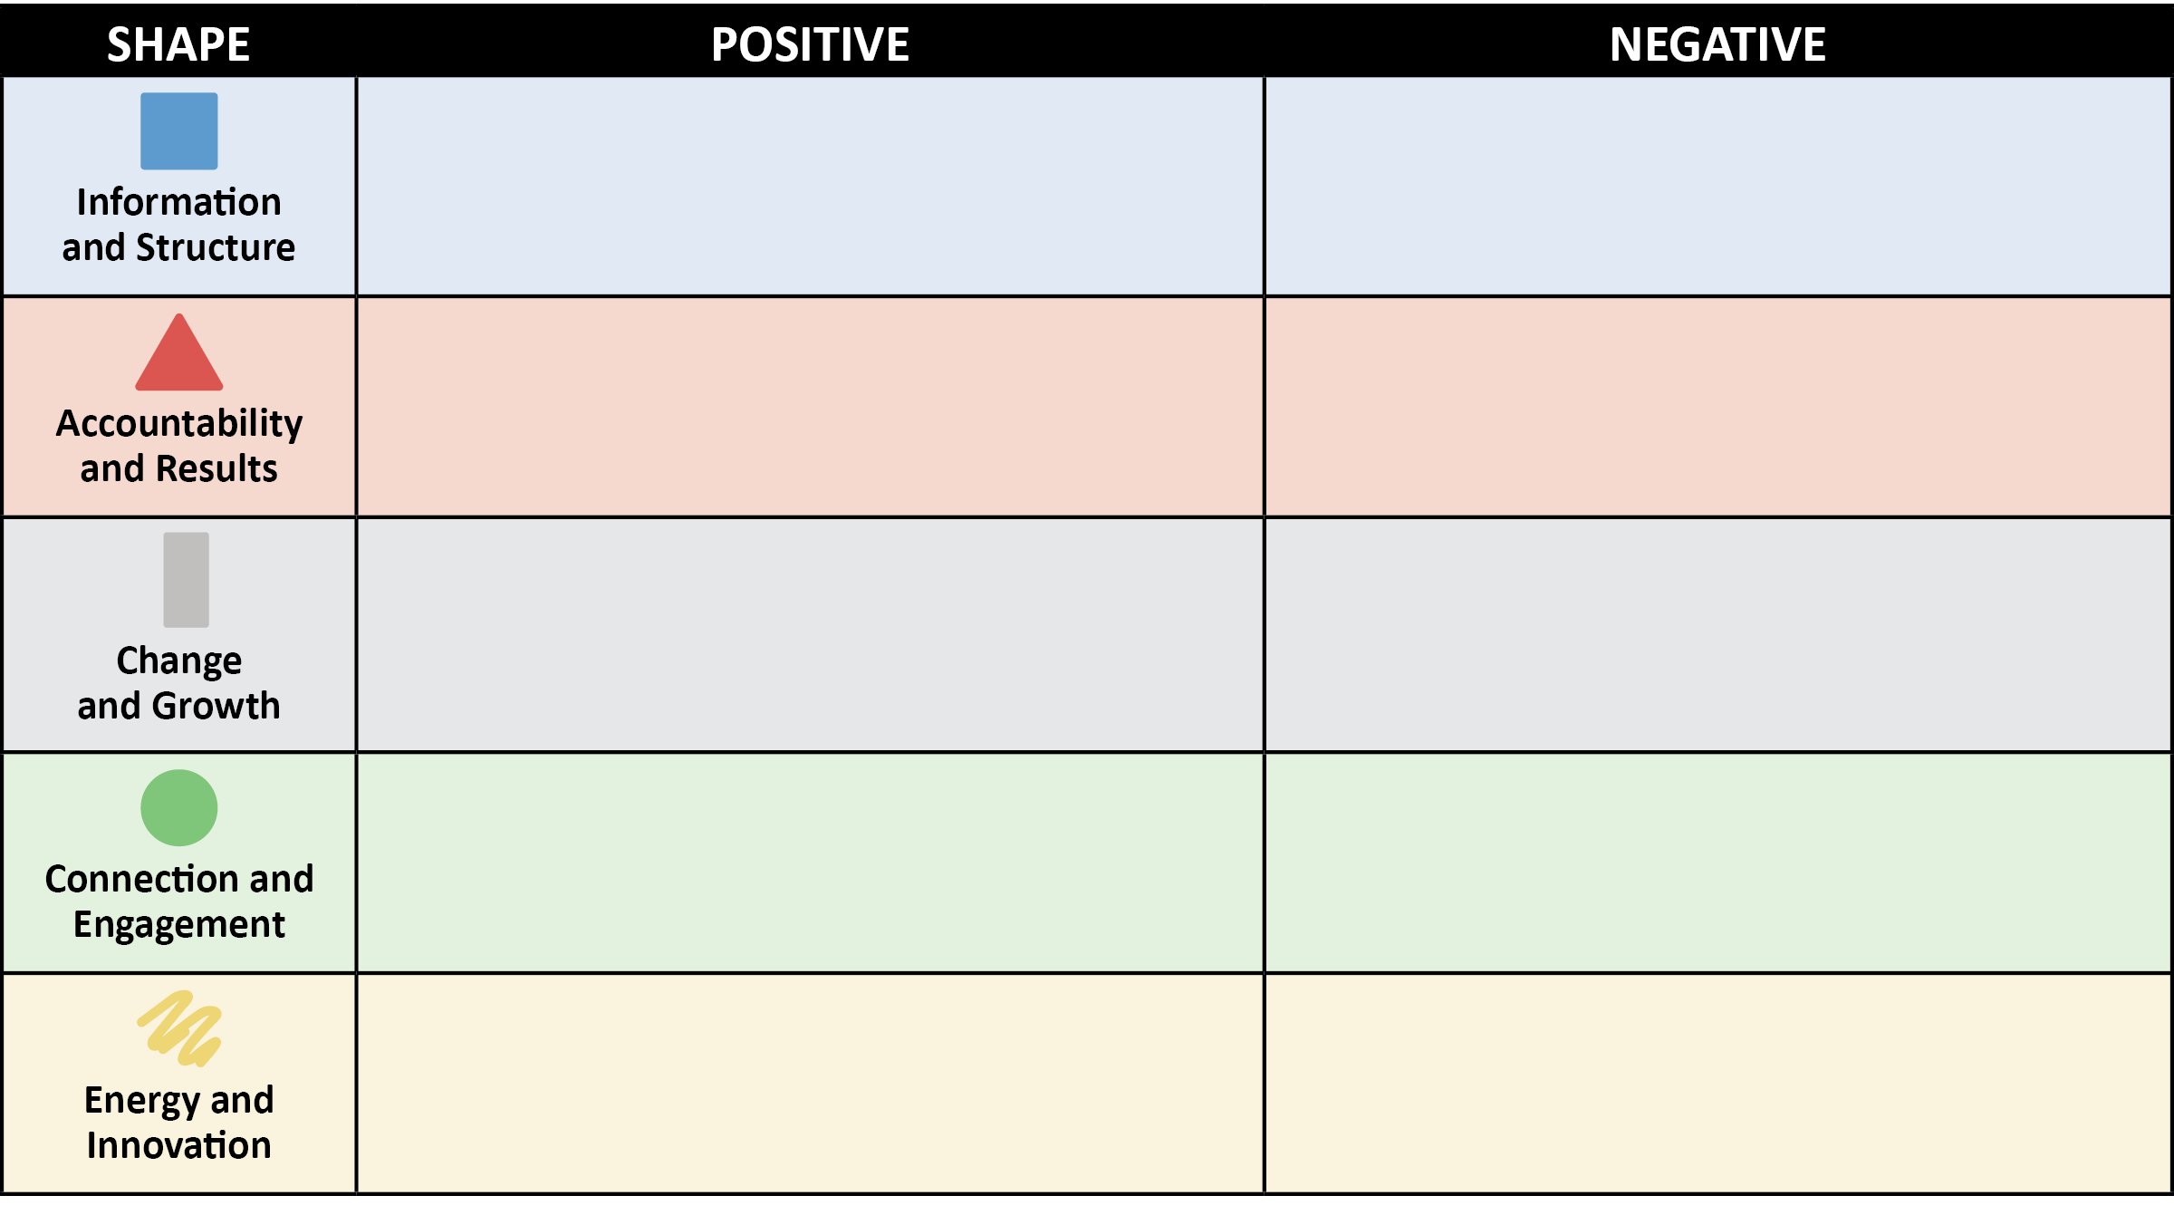
Shape Perception
Self-Reflection
Write down any possible positive and negative perceptions of your primary Shape.
Write down any possible positive and negative perceptions of your secondary Shape.
Notes:
SCRIPT: In your Participant Workbook, you will find a blank Shape Perception chart. You will be using this chart for the next couple of exercises and discussions. On your own, please take a few minutes and write down any possible positive and negative perceptions of your primary Shape. When you are finished, do the same thing for your secondary Shape.
NOTE: Give participants 3-4 minutes to reflect and write down their answers.
SCRIPT: Does everyone have at least one possible positive and negative perception for their primary and secondary Shapes? Great. Now we will expand on this exercise by doing a group activity.

Slide 47
Shape Perception
Group Activity
What could be the positive perceptions of each Shape?
What could be the negative perceptions of each Shape?
How could positive and negative perceptions of Shapes impact how we “see and hear” a leader?
Notes:
NOTE: There are two versions of this activity. One for an in-person workshop and one for a virtual workshop. Please see separate scripts, notes, and instructions below.
IN-PERSON SCRIPT, NOTES, & ACTIVITY INSTRUCTIONS
NOTE: You will need to set up this activity prior to the start of the Workshop. See specific setup instructions in the Activity Instructions below.
SCRIPT: We will now move on to a group activity to raise our awareness of the possible positive and negative perceptions of each Shape. We will be getting into five groups. Please count off by five starting with you.
NOTE: Put participants into five even groups by having them count off to five. Once groups have been formed, assign each group to a flip chart.
SCRIPT: Now, I want Group one to meet at the Box flip chart, Group two meet at the Triangle flip chart, Group three meet at the Circle flip chart, Group four meet at the Squiggle flip chart, and Group five meet at the Rectangle flip chart.
NOTE: Wait until all groups have gathered at their assigned flip chart before moving forward with instructions.
SCRIPT: The top half of the flip chart is for positive perceptions and the bottom half is for negative perceptions. You will have 3 minutes to write down as many possible positive and negative perceptions of your flip chart’s Shape. After three minutes, your group will rotate clockwise to the next flip chart (i.e., Group one, that started at the Box flip chart, will move to the Triangle flip chart.) Once you are at your new flip chart, you will have two minutes to review and add to it. You can also underscore or question anything already written by adding tallies or question marks. You will continue rotating until you get back to the flip chart where you originally started. As a heads up, each time you rotate you will have less time at the next flip chart. Does anyone have questions before we begin? Let’s get started.
NOTE: You will decrease the amount of time given after each rotation. First round – 3 minutes. Second round – 2 minutes. Third round – 1 minute. Forth round – 45 seconds. Fifth round – 30 seconds. Once you have completed all rounds, and groups are back at the flip chart where they started, you will give the next set of instructions.
SCRIPT: Now you will have about five minutes to, as a team, identify the top three positive and top three negative perceptions. Choose one person from your group to present your top three positive and top three negative perceptions and the reasons for your choices. How could these perceptions impact the way we “see and hear” a leader?
NOTE: Give the groups five minutes to identify their top three positive and top three negative perceptions.
SCRIPT: While groups are sharing, please use the blank Shape Perception chart in your Shapes Participant Workbook to capture examples. Let’s start with Group One. Could one person please share the top three positive perceptions and top three negative perceptions of the Box? Then share how these perceptions could impact the way we “see and hear” a leader?
NOTE: Repeat this process until you have discussed the positive and negative perceptions of each Shape.
NOTE: Acknowledge their answers. If time permits or you are looking to expand this workshop, open the conversation to the rest of the groups. Repeat this process until each group has presented.
ACTIVITY – In-Person Flip Chart Group Activity Instructions
Activity Setup (prior to the start of the workshop):
Space the five flip charts out in a circle around the room (leave plenty of space between flip charts).
Draw a horizontal line though the middle of each flip chart and write “Positive” on the top section and “Negative” on the bottom section.
Assign each flip chart with a Shape by drawing the Shape in the top right corner of the flip chart. (Blue for Box, Red for Triangle, Gray/Black for Rectangle, Green for Circle, Yellow/Orange for Squiggle).
Activity Facilitation:
Split participants into 5 equal groups and assign each group to a flip chart.
Give groups 3 minutes to write as many potential positive and negative perceptions for their flip chart’s assigned shape.
After the 3 minutes, groups will rotate one flip chart to their right and repeat the same instructions from the first round.
Please note, participants can review, underscore, add, or question anything on the flip chart by adding tallies or question marks.
Groups rotate until they are back at their original flip chart (decrease time given after each rotation).
Once back at their original flip chart, groups will identify their top three most common positive and negative perceptions and share back with the larger group. Remember to ask each groups to share how these perceptions can impact how they “see and hear” a leader.
VIRTUAL SCRIPT, NOTES, & ACTIVITY INSTRUCTIONS
SCRIPT: We will now move on to a group activity to raise our awareness of the possible positive and negative perceptions of each Shape. In a moment, you will be put into a breakout room and assigned a Shape. Your group’s assigned Shape will be determined by your breakout room number. Breakout Room #1 – Box. Breakout Room #2 – Triangle. Breakout Room #3 – Circle. Breakout Room #4 – Squiggle. Breakout Room #5 – Rectangle. I will also put the Shape assignments in the chat, so you know your group’s assigned Shape. In your breakout room, you and your team will write down as many possible positive and negative perceptions for your assigned Shape using the Shape Perception chart found in your Participant Workbook. You will then identify the top three positive and top three negative perceptions for your group’s assigned Shape. When you return from your breakout room, one person from your group will share your group’s top three positive and top three negative perceptions. Then share how these perceptions could impact how we “see and hear” a leader. Does anyone have questions before you go to your breakout room?
NOTE: Put the Shape assignments for breakout rooms in the chat. Give participants 10 minutes in their breakout rooms to discuss and determine their top three positive and top three negative perceptions for their group’s assigned Shape. After 10 minutes, close breakout rooms and have all participants return to main room.
SCRIPT: Welcome back! While groups are sharing, please use the blank Shape Perception chart to capture examples. Let’s start with Group One. Could one person please share the top three positive perceptions and top three negative perceptions of the Box? Remember to also share how these perceptions could impact how we “see and hear” a leader.
NOTE: Repeat this process until you have discussed the positive and negative perceptions of each Shape.
NOTE: Acknowledge their answers. If time permits or you are looking to expand this workshop, open the conversation to the rest of the groups. Repeat this process until each group has presented.
ACTIVITY – Virtual Group Activity Instructions:
Split participants up into five breakout rooms.
Put Shape assignments for breakout rooms in the chat (Breakout Room #1 – Box. Breakout Room #2 – Triangle. Breakout Room #3 – Circle. Breakout Room #4 – Squiggle. Breakout Room #5 – Rectangle.)
Give groups 10 minutes to discuss and determine their top three positive and top three negative perceptions of their group’s assigned Shape.
Bring participants back from breakout rooms for large group discussion.
Ask each group to present their top three positive and top three negative perceptions. Then share how these perceptions could impact how we “see and hear” a leader.
Facilitate the conversation.

Slide 48
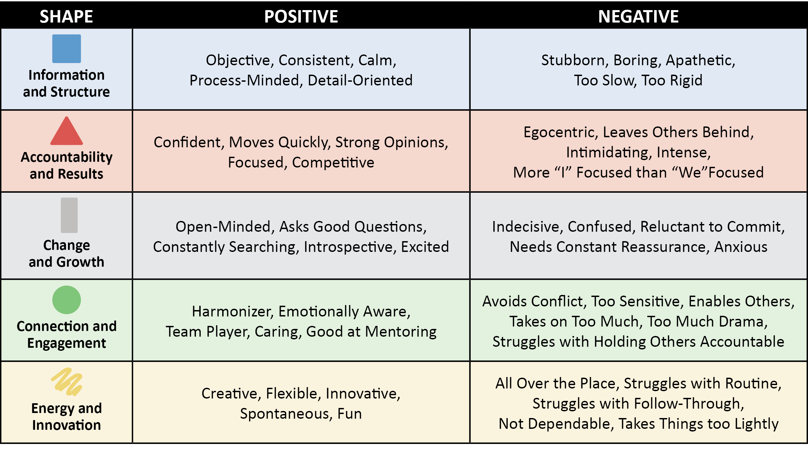
Shape Perception
Notes:
SCRIPT: Here are some of the most common responses of positive and negative perceptions for each Shape.

Slide 49
Application and Discussion
Partner Discussion
Share your primary and secondary Shapes.
Answer and discuss the following questions:
Do you have a possible bias towards or against some Shapes as leaders? If so, which Shapes?
Why do you think you have these biases?
Innate reaction?
Previous experiences?
Cultural?
Past or present environment?
Notes:
SCRIPT: Now we are going to do a partner activity to discuss how these perceptions can impact our relationships. With your partner, share your primary and secondary Shapes and answer the following questions 1)Do you have a possible bias towards or against some Shapes as leaders? If so, which Shapes? 2)Why do you think you have these biases? Innate reaction? Previous experience? Cultural? Past or present environment? You will have ten minutes for this discussion with your partner.
NOTE: After ten minutes, bring participants back to the large group and ask for volunteers to share any “ah-hah” moments.

Slide 50
Shape Perception
Self-Reflection Questions:
Is there a possible misperception of you that you would like to change?
Do you have a possible misperception of someone else on your team?
Notes:
SCRIPT: In your Shapes Participant Workbook, take a few minutes to reflect and answer these two questions.
NOTE: Give participants about five minutes to answer these questions. Ask for volunteers to share with the group.

Slide 51
Module 3: Shape Flexing
Notes:
SCRIPT: Now we will move into our third module – Shape Flexing

Slide 52
Shape Flexing
Shape Flexing Objectives
Introduce the concept and benefits of “flexing.”
Learn the PsychoGeometrics term “Shape Flexing.”
Understand the difference between the Golden Rule and the Platinum Rule.
Identify the steps for Shape Flexing.
Apply the skill of Shape Flexing.
Discover how to use Shape Flexing to enhance and strengthen your communication and leadership style.
Notes:
SCRIPT: In Module Three, we will introduce the concept and benefits of “flexing.” Then we will learn the PsychoGeometrics term “Shape Flexing.” From there, we will define and understand the difference between the golden and platinum rule and how that influences how and why we should flex when communicating. We will identify the steps and apply the skill of Shape Flexing. And finally, you will discover how to use Shape Flexing to enhance and strengthen your communication and leadership style.

Slide 53
Shape Flexing
What is Flexing?
Identifying and adjusting to communication styles that we are presented with at any given time.
A skill, talent, or ability to use.
Conscious or subconscious.
Examples:
Showing more or less emotion.
Speaking pace.
Volume of voice.
Notes:
SCRIPT: Let’s start by defining the word “flexing.” Flexing is identifying and adjusting to communication styles that we are presented with at any given time. It can also be defined as a skill, talent, or ability to use. And lastly, flexing can be conscious or subconscious, meaning you may be aware or unaware that you are flexing while communicating. Some examples of flexing while communicating include showing more or less emotion by adding humor or a smile, showing patience, changing your volume of voice or speaking pace. Some flexing behaviors may be more challenging than others depending on your natural communication stye and how you approach a situation.

Slide 54
Shape Flexing
Benefits of flexing include:
Promotes trust.
Strengthens team loyalty.
Enhances team member engagement.
Improves teamwork and productivity.
Creates better personal and professional relationships.
Notes:
SCRIPT: When you flex to someone, you are communicating with them in a way that makes them feel important, comfortable, and understood. This can promote trust, strengthen team loyalty, enhance team member engagement, improve teamwork and productivity, and create better personal and professional relationships.

Slide 55
Shape Flexing
What is Shape Flexing?
Shape Flexing is the skill set of adding a specific Shape behavior, or combination of Shape behaviors, to strengthen your communication effectiveness.
Notes:
SCRIPT: The PsychoGeometrics term “Shape Flexing” can be defined as the skill set of adding a specific Shape behavior, or combination of Shape behaviors to strengthen you communication effectiveness.

Slide 56
Shape Flexing
Why Shape Flex?
Golden and Platinum Rule
Golden Rule – Treat others how you would like to be treated.
Platinum Rule – Treat others how THEY want to be treated.
Shape Flexing is the key to connectedness.
By Shape Flexing you raise the probability that others understand your communication style, you understand the communication style of others, and negative perceptions change to positive ones.
Notes:
SCRIPT: Most everyone has heard of the Golden Rule – treat others how you want to be treated. But have you heard of the Platinum Rule? The Platinum Rule says to treat others how THEY want to be treated. Shape Flexing is the key to connectedness. When you flex, people see and hear (consciously or subconsciously) that you are aware of their Shape and communication preferences, and you are willing to change your own communication style to meet the needs of others. Finally, Shape Flexing raises the probability that others understand your communication style, you understand the communication style of others, and negative perceptions change to positive ones.

Slide 57
Shape Flexing
Steps for Shape Flexing
Enable your senses – Identify their Shape through verbal or nonverbal communication. “What do you see?” “What do you hear?” The answers serve as clues and help us make assumptions.
Process – Clarify your assumptions through open-ended questions or statements. “Tell me more.”
Connect the dots – Listen to understand. “What are they looking for?” “What do they need?” “What is their situation?”
Flex – Modify your communication style based on what they reveal about themselves and their situation.
Notes:
SCRIPT: Soon we will learn the skills of how to Shape Flex to each of the five Shapes. But how do you know the Shape of others? The first step is to enable your senses. This means to pay attention to what you see and hear. Once we pick up on someone’s verbal or nonverbal behavior, we can begin to make our assumptions as to their Shape. The next step is process, where you clarify your assumptions though opened ended questions or statements like “Tell me more.” Next, it’s time to connect the dots by listening to understand. What are they looking for? What do they need? What’s the situation? The last step of the process is to flex. Modify your communication style based on what they reveal about themselves and their situation. Remember, you can still be true to yourself when Shape Flexing.

Slide 58
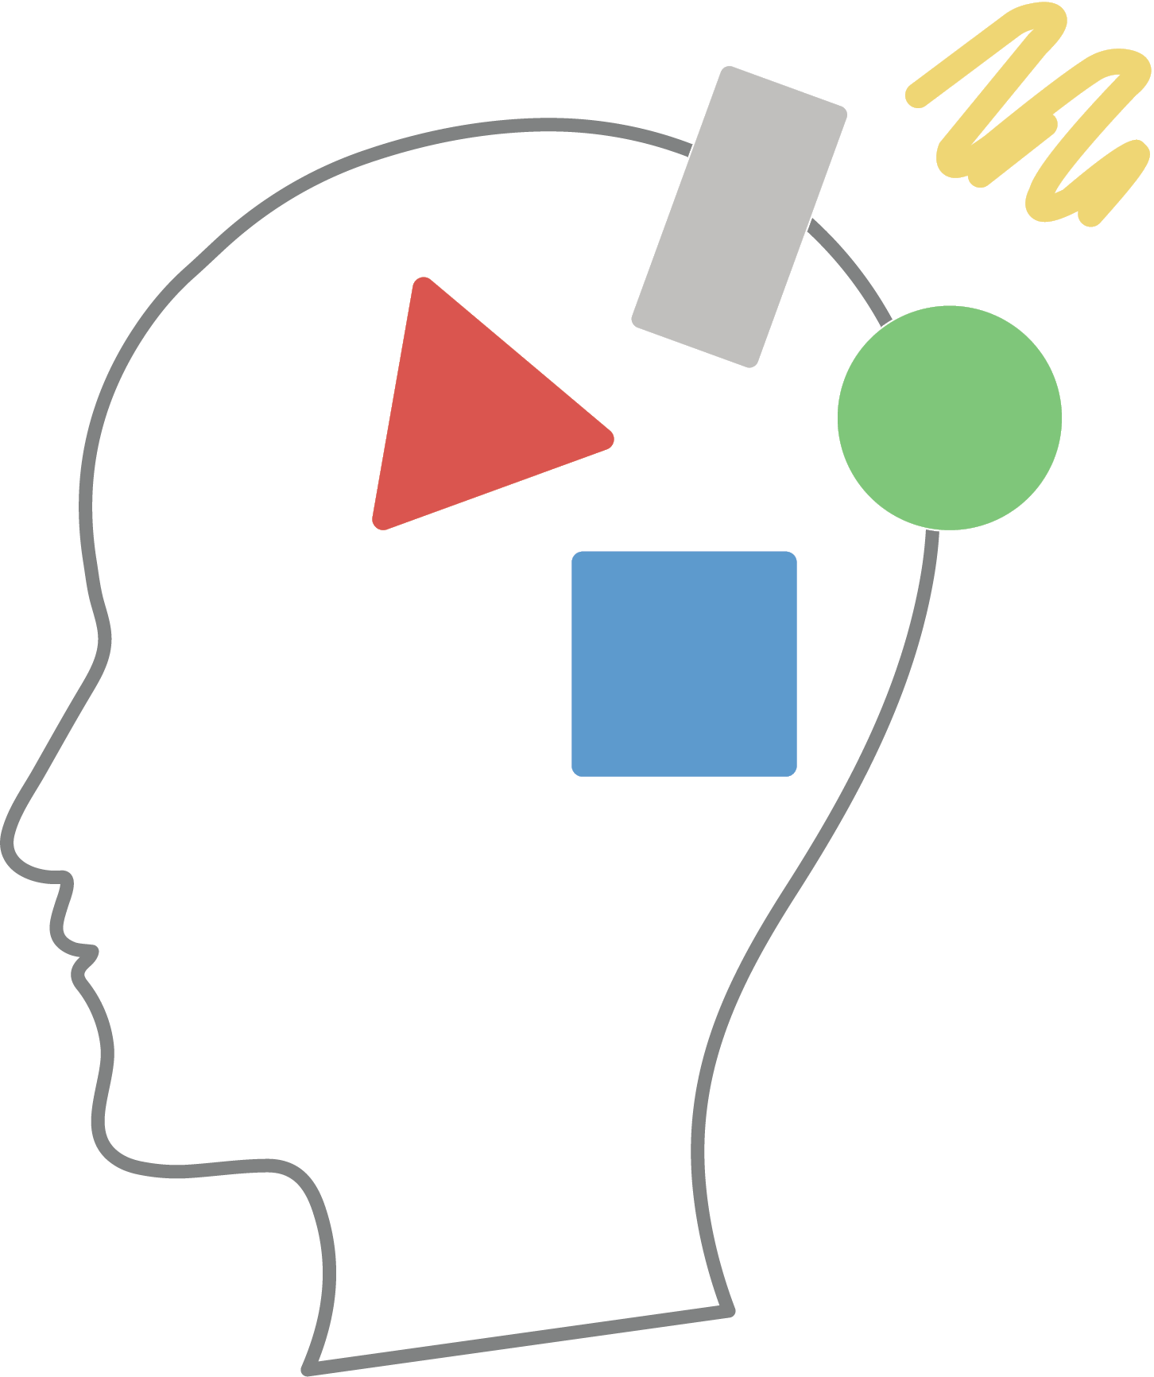
Shape Flexing
What does Shape Flexing look like for each Shape?
Notes:
SCRIPT: Now let’s learn what Shape Flexing looks like for each Shape.

Slide 59
Shape Flexing to Communicate with a Box
Slow it down.
Give a heads up.
Stick to the facts.
Keep it steady.
Don’t push it.
Notes:
SCRIPT: We will start with the Box. When you are Shape Flexing to communicate with a Box consider these flexing tips. 1) Slow it down. The Box will appreciate the time to think and process. 2) Give a heads up. Boxes don’t like to be caught off guard. Give advance notice when possible. 3) Stick to the facts. Boxes make decisions based on data not emotion. 4) Keep it steady. Avoid last minute surprises and keep your commitments. 5) Don’t push it. Don’t pressure the Box to compromise their values. They will respond by digging their heels in deeper.

Slide 60
Shape Flexing to Communicate with a Box
Reflection Questions
Who on your team do you think might be a primary or secondary Box?
What traits or behaviors does this person exhibit that lead you to believe that they might be a primary or secondary Box?
What are some specific ways to increase your communication effectiveness when communicating with this Box on your team?
Notes:
SCRIPT: Now we are going to apply what we’ve just learned to some of your relationships. In your Shapes Participant Workbook, please take a few minutes to answer these questions.
NOTE: Give participants two to three minutes to answer the questions in their Participant Workbook. Once they have had time to write down their answers, put them in groups of three or four and ask them to share with their group.
SCRIPT: Now we are going to get into small groups. With your group, share, and discuss your answers.
NOTE: Give groups about five minutes to discuss and them bring them back for a large group discussion.
SCRIPT: Would anyone like to share an example of someone on their team who might be a Box and possible ways to flex to increase communication effectiveness with that person?
NOTE: Respond to volunteers and facilitate the conversation by asking open-ended questions.

Slide 61
Shape Flexing to Communicate with a Triangle
Less is more.
Get to the point.
Pick up the pace.
Provide three options.
Don’t miss your exit ramp.
Notes:
SCRIPT: Next, we will look at some ways to Shape Flex when communicating with a Triangle. 1) Less is more. Triangles appreciate knowledge but they don’t need to hear the whole story. Triangles value effectiveness in terms of time not quantity. 2) Get to the point. Triangles are busy and will interrupt or finish your sentences for you. 3) Pick up the pace. Start with “this can be brief.” Triangles are more likely to be responsive if they know they can do it quickly. 4) Provide three options. Triangles don’t like to be told what to do; they like having control and making the decision. 5) Don’t miss your exit ramp. Going “on and on and on” will only frustrate the Triangle. They don’t need you to explain it again or underscore anything you have already said. They got it the first time.

Slide 62
Shape Flexing to Communicate with a Triangle
Reflection Questions
Who on your team do you think might be a primary or secondary Triangle?
What traits or behaviors does this person exhibit that lead you to believe that they might be a primary or secondary Triangle?
What are some specific ways to increase your communication effectiveness when communicating with this Triangle on your team?
Notes:
SCRIPT: Now we are going to apply what we’ve just learned to some of your relationships. In your Shapes Participant Workbook, please take a few minutes to answer these questions.
NOTE: Give participants two to three minutes to answer the questions in their Participant Workbook. Once they have had time to write down their answers, put them in groups of three or four and ask them to share with their group.
SCRIPT: Now we are going to get into small groups. With your group, share, and discuss your answers.
NOTE: Give groups about five minutes to discuss and them bring them back for a large group discussion.
SCRIPT: Would anyone like to share an example of someone on their team who might be a Triangle and possible ways to flex to increase communication effectiveness with that person?
NOTE: Respond to volunteers and facilitate the conversation by asking open-ended questions.

Slide 63
Shape Flexing to Communicate with a Circle
Connect.
Be nice and show it!
Don’t be in a hurry.
Be vulnerable and ask for help.
Put people first.
Notes:
SCRIPT: We will now look at ways to Shape Flex when communicating with a Circle. 1) Connect. Ask about something you have in common, such as a recent work holiday, a personal event, or someone you both know. Take an interest in who and what is important to them before moving on to the next thing on your agenda. 2) Be nice and show it! Being friendly and showing that you care is more important than what you know, what you want, or what you need. Use non-verbal communication like facial expressions (smile), body language (arms or hands open) and tone of voice (not too high and not too low) to engage with a Circle. 3) Don’t be in a hurry. Take time to listen and talk it out. The Circle has lots of feelings, and they appreciate being able to verbalize those feelings without being a burden. 4) Be vulnerable and ask for help. This makes the Circle feel comfortable and builds trust, plus Circles like to help. Use emotion and unify by creating a shared consensus or sense of purpose. 5) Put people first. When approaching a Circle, be sure to lead with care and concern for the well-being of others. Link your communication to people, not things. State the impact to people before sharing the details.

Slide 64
Shape Flexing to Communicate with a Circle
Reflection Questions
Who on your team do you think might be a primary or secondary Circle?
What traits or behaviors does this person exhibit that lead you to believe that they might be a primary or secondary Circle?
What are some specific ways to increase your communication effectiveness when communicating with this Circle on your team?
Notes:
SCRIPT: Now we are going to apply what we’ve just learned to some of your relationships. In your Shapes Participant Workbook, please take a few minutes to answer these questions.
NOTE: Give participants two to three minutes to answer the questions in their Participant Workbook. Once they have had time to write down their answers, put them in groups of three or four and ask them to share with their group.
SCRIPT: Now we are going to get into small groups. With your group, share, and discuss your answers.
NOTE: Give groups about five minutes to discuss and them bring them back for a large group discussion.
SCRIPT: Would anyone like to share an example of someone on their team who might be a Circle and possible ways to flex to increase communication effectiveness with that person?
NOTE: Respond to volunteers and facilitate the conversation by asking open-ended questions.

Slide 65
Shape Flexing to Communicate with a Squiggle
Make it fun!
Bring the energy!
Leave some wiggle room.
Don’t be too rigid or controlling.
Be Flexible.
Change it up!
Notes:
SCRIPT: The Squiggle is next. Consider these tips when Shape Flexing to communicate with a Squiggle. 1) Make it fun! If it’s not fun, creative, or unique, you will quickly lose interest from the Squiggle. 2) Bring the energy! Speak quickly. Engage the Squiggle with a new idea, enthusiasm, and positivity. Squiggles can be easily bored. 3) Leave some wiggle room. Anything too structured will not appeal to the Squiggle. Ask for their ideas to make something more engaging or appealing to others. 4) Don’t be too rigid or controlling. Squiggles beat to their own drum. They need the freedom to operate; to figure it out on their own. They don’t respond well to mandates or negativity. 5) Be Flexible. A “go with the flow” attitude goes a long way with a Squiggle. Even in the midst of a challenging or intense situation, the Squiggle can lighten up and find something funny to laugh about. Don’t mistake their laid-back attitude as complacency or a lack of drive. 6) Change it up! A Squiggle needs variety. Don’t be afraid to “catch the Squiggle off-guard.” Squiggles bounce back, can laugh at themselves, and they have a way of landing on their feet.

Slide 66
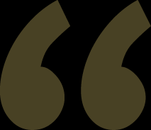
Shape Flexing to Communicate with a Squiggle
Reflection Questions
Who on your team do you think might be a primary or secondary Squiggle?
What traits or behaviors does this person exhibit that lead you to believe that they might be a primary or secondary Squiggle?
What are some specific ways to increase your communication effectiveness when communicating with this Squiggle on your team?
Notes:
SCRIPT: Now we are going to apply what we’ve just learned to some of your relationships. In your Shapes Participant Workbook, please take a few minutes to answer these questions.
NOTE: Give participants two to three minutes to answer the questions in their Participant Workbook. Once they have had time to write down their answers, put them in groups of three or four and ask them to share with their group.
SCRIPT: Now we are going to get into small groups. With your group, share, and discuss your answers.
NOTE: Give groups about five minutes to discuss and them bring them back for a large group discussion.
SCRIPT: Would anyone like to share an example of someone on their team who might be a Squiggle and possible ways to flex to increase communication effectiveness with that person?
NOTE: Respond to volunteers and facilitate the conversation by asking open-ended questions.

Slide 67
Shape Flexing to Communicate with a Rectangle
Be patient.
Provide clear instructions.
Listen for understanding.
Ask open-ended
questions.
Keep Rectangles
focused on what’s important right now.
Notes:
SCRIPT: Finally, let’s take a look at how to Shape Flex to communicate with someone in Rectangle mode. 1) Be patient. The Rectangle is experiencing change and may be indecisive, unsure of themselves, or frustrated. Don’t patronize, rush, or pressure them to “get through it” or “not worry about it.” Validation of their thoughts and feelings is important. More than ever the Rectangle needs to understand and be understood. 2) Provide clear instructions. Ensure that your communication is clear and concise. The Rectangle is likely already feeling overwhelmed. Don’t add to their chaos. 3) Listen for understanding. The Rectangle is not thinking, feeling, or acting like their typical selves. They are processing their thoughts, feelings, and the change itself. Practice active listening by being attentive, summarizing what you hear, and asking for clarification as needed. You earn the right to support, help, or guide by listening. 4) Ask open-ended questions. Give the Rectangle opportunities to talk and work through the change they are experiencing. This will prompt them to talk through their answers, using you as a much-needed sounding board. 5) Keep Rectangles focused on what’s important right now. Since it can take up to 18 months to navigate through personal change, they must “reel themselves back into reality” from time to time and take the steps that are important to their survival and ultimately their success.

Slide 68
Shape Flexing to Communicate with a Rectangle
Reflection Questions
Who on your team do you think might be going through Rectangle change?
What traits or behaviors does this person exhibit that lead you to believe that they might be in a Rectangle phase?
What are some specific ways to increase your communication effectiveness when communicating with a person in Rectangle mode?
Notes:
SCRIPT: Now we are going to apply what we’ve just learned to some of your relationships. In your Shapes Participant Workbook, please take a few minutes to answer these questions.
NOTE: Give participants two to three minutes to answer the questions in their Participant Workbook. Once they have had time to write down their answers, put them in groups of three or four and ask them to share with their group.
SCRIPT: Now we are going to get into small groups. With your group, share, and discuss your answers.
NOTE: Give groups about five minutes to discuss and them bring them back for a large group discussion.
SCRIPT: Would anyone like to share an example of someone on their team who might be in Rectangle mode and possible ways to flex to increase communication effectiveness with that person?
NOTE: Respond to volunteers and facilitate the conversation by asking open-ended questions.

Slide 69
Shape Flexing Group Activity
Notes:
SCRIPT: Now we are going to move into a Shape Flexing Group Activity. For this activity, we will look at five prompts, one for each Shape. Then in groups, you will discuss the prompt and come up with 3-5 specific actions of how you could Shape Flex in the given situation. We will start with the Box.

Slide 70
Shape Flexing
Activity – Shape Flexing
Prompt:
How would you flex to partner with a Box on a project?
Activity:
Discuss and identify 3 – 5 specific actions you would take to Shape Flex.
Be prepared to share back with the larger team.
Notes:
NOTE: This can be an in-person or virtual activity. For in-person, have participants work in groups of five or six depending on overall class size. For virtual, put participants in breakout rooms to discuss the prompts.
SCRIPT: The first prompt is “How would you flex to partner with a Box on a project?” You will have five minutes, in your groups, to discuss the prompt and identify 3-5 specific actions you would take to Shape Flex. Be prepared to share back with larger group.
NOTE: Give groups five minutes to discuss. After five minutes, bring the groups back together and ask groups to share their actions.
SCRIPT: What are some of the actions your group discussed to Shape Flex to partner with a Box on a project?
NOTE: Acknowledge responses and facilitate the conversation by asking open-ended questions.

Slide 71
Shape Flexing
Activity – Shape Flexing
Prompt:
How would you flex to embrace conflict with a Triangle?
Activity:
Discuss and identify 3 – 5 specific actions you would take to Shape Flex.
Be prepared to share back with the larger team.
Notes:
NOTE: This can be an in-person or virtual activity. For in-person, have participants work in groups of five or six depending on overall class size. For virtual, put participants in breakout rooms to discuss the prompts.
SCRIPT: The first prompt is “How would you flex to embrace conflict with a Triangle?” You will have five minutes, in your groups, to discuss the prompt and identify 3-5 specific actions you would take to Shape Flex. Be prepared to share back with larger group.
NOTE: Give groups five minutes to discuss. After five minutes, bring the groups back together and ask groups to share their actions.
SCRIPT: What are some of the actions your group discussed to Shape Flex to embrace conflict with a Triangle?
NOTE: Acknowledge responses and facilitate the conversation by asking open-ended questions.

Slide 72
Shape Flexing
Activity – Shape Flexing
Prompt:
How would you flex to give critical feedback to a Circle?
Activity:
Discuss and identify 3 – 5 specific actions you would take to Shape Flex.
Be prepared to share back with the larger team.
Notes:
NOTE: This can be an in-person or virtual activity. For in-person, have participants work in groups of five or six depending on overall class size. For virtual, put participants in breakout rooms to discuss the prompts.
SCRIPT: The first prompt is “How would you flex to give critical feedback to a Circle?” You will have five minutes, in your groups, to discuss the prompt and identify 3-5 specific actions you would take to Shape Flex. Be prepared to share back with larger group.
NOTE: Give groups five minutes to discuss. After five minutes, bring the groups back together and ask groups to share their actions.
SCRIPT: What are some of the actions your group discussed to Shape Flex to give critical feedback to a Circle?
NOTE: Acknowledge responses and facilitate the conversation by asking open-ended questions.

Slide 73
Shape Flexing
Activity – Shape Flexing
Prompt:
How would you flex to engage a Squiggle in your full day meeting?
Activity:
Discuss and identify 3 – 5 specific actions you would take to Shape Flex.
Be prepared to share back with the larger team.
Notes:
NOTE: This can be an in-person or virtual activity. For in-person, have participants work in groups of five or six depending on overall class size. For virtual, put participants in breakout rooms to discuss the prompts.
SCRIPT: The first prompt is “How would you flex to engage a Squiggle in your full day meeting?” You will have five minutes, in your groups, to discuss the prompt and identify 3-5 specific actions you would take to Shape Flex. Be prepared to share back with larger group.
NOTE: Give groups five minutes to discuss. After five minutes, bring the groups back together and ask groups to share their actions.
SCRIPT: What are some of the actions your group discussed to Shape Flex to engage a Squiggle in your full day meeting?
NOTE: Acknowledge responses and facilitate the conversation by asking open-ended questions.

Slide 74
Shape Flexing
Activity – Shape Flexing
Prompt:
How would you flex to make someone in Rectangle mode feel more comfortable through change?
Activity:
Discuss and identify 3 – 5 specific actions you would take to Shape Flex.
Be prepared to share back with the larger team.
Notes:
NOTE: This can be an in-person or virtual activity. For in-person, have participants work in groups of five or six depending on overall class size. For virtual, put participants in breakout rooms to discuss the prompts.
SCRIPT: The first prompt is “How would you flex to make someone in Rectangle mode feel more comfortable through change?” You will have five minutes, in your groups, to discuss the prompt and identify 3-5 specific actions you would take to Shape Flex. Be prepared to share back with larger group.
NOTE: Give groups five minutes to discuss. After five minutes, bring the groups back together and ask groups to share their actions.
SCRIPT: What are some of the actions your group discussed to Shape Flex to make someone in Rectangle mode feel more comfortable through change?
NOTE: Acknowledge responses and facilitate the conversation by asking open-ended questions.

Slide 75
Shape Flexing
Self-Reflection Questions:
What are your top three takeaways from Shape Flexing?
How will you Shape Flex to best communicate with the members of your team?
Notes:
SCRIPT: In your Shapes Participant Workbook, take a few minutes to reflect and answer these questions.
NOTE: Give participants about five minutes to answer these questions. Ask for volunteers to share with the group.

Slide 76
Review of Day One
Notes:
SCRIPT: Now, we are going to take a minute to recap what we did today.

Slide 77
Modules 1 – 3 Recap
Modules 1 – 3
Module 1: Introduction to PsychoGeometrics
Module 2: Shape Perception
Module 3: Shape Flexing
Notes:
SCRIPT: We spent dedicated time learning about the first three modules of the PsychoGeometrics communication system. You were given time to practice and apply what you learned individually, with a partner, and in small groups.
NOTE: Use this time to talk about your key takeaways or major highlights from each module and the overall day. Ask for volunteers to share their key takeaways and highlights.

Slide 78
Objectives Recap
Do you understand your communication style as a leader, including strengths and challenges, and the communication style of others?
Can you recognize the possible positive and negative perceptions of your communication and leadership style, and the communication style of others?
Do you know how to use Shape Flexing to strengthen the effectiveness of your communication approach and responsiveness as a leader?
Notes:
SCRIPT: Now let’s take some time to review what we set out to achieve today.
NOTE: Read through the objectives and ask if anyone has questions.

Slide 79
Workshop Day Two Agenda
Welcome Back!
Recap of Day One & Preview of Day Two
Modules 4 & 5
Module 4: Shape Motivation
Module 5: Strategic Shaping
Leadership Applications
Building & Shaping Trust
Shaping Your Way through Change
Shapes Awareness Wheel
Leadership Lifeline
Review & Key Takeaways
Review of Five Modules & Objectives
Notes:
SCRIPT: Now we are going to take a quick look at the agenda for Day Two. Day Two will still be filled with small group activities and discussion throughout the day. We will go through modules four and five, which are Shape Motivation and Strategic Shaping. Then we will learn some leadership applications which include Building and Shaping Trust, Shaping Your Way through Change, the Shapes Awareness Wheel, and the Leadership Lifeline exercise. Does anyone have questions?

Slide 80
End of Day One
Notes:
SCRIPT: If there are no questions, this will conclude Day One of the Shapes for Leaders Workshop. Thank you all for your engagement and participation! I am looking forward to another great day tomorrow!
END OF DAY ONE

Slide 81
Start of Day Two
Notes:
START OF DAY TWO

Slide 83
Welcome Back!
Notes:
SCRIPT: Welcome back for Day Two of Shapes for Leaders.

Slide 84
Modules 1 – 3 Recap
Modules 1 – 3
Module 1: Introduction to PsychoGeometrics
Module 2: Shape Perception
Module 3: Shape Flexing
Notes:
SCRIPT: Yesterday, we learned about the first three modules of the PsychoGeometrics communication system, which are Introduction to PsychoGeometrics, Shape Perception, and Shape Flexing.
NOTE: Ask for volunteers to summarize each of the three modules.

Slide 85
Workshop Day Two Agenda
Welcome Back!
Recap of Day One & Preview of Day Two
Modules 4 & 5
Module 4: Shape Motivation
Module 5: Strategic Shaping
Leadership Applications
Building & Shaping Trust
Shaping Your Way through Change
Shapes Awareness Wheel
Leadership Lifeline
Review & Key Takeaways
Review of Five Modules & Objectives
Notes:
SCRIPT: Today, we are going to shift our focus to modules four and five, which are Shape Motivation and Strategic Shaping. Then we will spend some time going through our leadership applications which include Building and Shaping Trust, Shaping Your Way through Change, the Shapes Awareness Wheel, and the Leadership Lifeline exercise. The format will be similar to yesterday and filled with small group activities and discussions.

Slide 86
Module 4: Shape Motivation
Notes:
SCRIPT: It’s now time to move on to Module Four, Shape Motivation.

Slide 87
Shape Motivation
Shape Motivation Objectives
Introduce the concept of motivation and demotivation.
Learn the PsychoGeometrics terms “Shape Motivation” and “Shape Demotivation.”
Know how to apply “motivation awareness” to understand what motivates and demotivates you and others.
Use your knowledge to identify, clarify, and raise the probability that you meet your motivational needs and the needs of others.
Notes:
SCRIPT: In Module Four, we will introduce the concept of motivation and demotivation. Then we will learn the PsychoGeometrics terms “Shape Motivation” and “Shape Demotivation.” From there, we will learn how to apply “motivation awareness” to understand what motivates and demotivates you and others. And finally, you will discover how to raise the probability that you meet your motivational needs and the needs of others.

Slide 88
Shape Motivation
What is Motivation?
A driving force behind all action.
An internal state that stimulates and activates your behavior and gives it direction.
A natural force that can propel you forward.
Notes:
SCRIPT: Let’s start by defining the word “motivation.” Motivation can be defined as the driving force behind all action. It’s an internal state that stimulates and activates your behavior and gives it direction. However, it is important to note that what motivates one person, may not motivate another. Internal motivation is personal. Motivation is also a natural force that can propel you forward. This happens when something externally inspires you to get internally motivated. For example, a family wedding can be the external inspiration to get internally motivated to lose 10 pounds. Here’s another example. Your son is having difficulty in school. You have been considering finding a tutor for your child, but you keep thinking he will eventually get the hang of it. After all, it takes a while to get adjusted to a new school, and he has always pulled through before. However, when mid-term progress reports are sent home, you see that your son is failing English and is also struggling with math. The progress report is the external inspiration that you gets you internally motivated to call a tutor today! Can anyone else think of another example when external inspiration gets you internally motivated to take the action you may have been putting off for a while?
NOTE: When someone shares an example, acknowledge their response. If time permits, ask for another example, also acknowledging their response and asking open ended questions so that they share more details. If you want to expand this workshop into a longer course, take some extra time here for partner or small group discussion about other examples of external inspiration that gets you internally motivated.
SCRIPT: As we can see, inspiration and motivation work hand in hand. It is being motivated that can keep you in a state of forward motion. Think of motivation as every bit as important as the air you breathe. It can contribute to your physical, mental, and emotional growth and overall health. Some people say motivation is just “fluff,” but motivation is truly the first step to productivity. It is also the first step to having the desire, energy, and resiliency to bounce back and keep moving forward, even when you don’t feel like it.

Slide 89
Shape Motivation
What is Demotivation?
An internal state.
Lack of drive or movement.
Natural force, but instead of propelling you forward, it can slow you down.
Can contribute to a lack of energy.
Notes:
SCRIPT: It may sound like a pretty simple question, but what is demotivation? Obviously, it is the opposite of motivation. So, what does that really mean? It’s an internal state, just like motivation, but instead of propelling you forward, it can slow you down, bring you to a standstill, or cause you to fall behind. Being demotivated means you have a lack of drive and energy, while the world continues on without you.

Slide 90
Shape Motivation
What is Shape Motivation?
Shape Motivation is specific to each of the five geometric Shapes of PsychoGeometrics.
It is what specifically motivates each of the Shapes, based on their natural traits, behaviors, and how they relate to others.
Notes:
SCRIPT: The good news is that with awareness, knowledge, skill, and desire, you have the power to raise the probability you stay motivated, get “re-motivated,” and communicate your motivation needs to others. You also have the power to approach others in way that will be motivating to them. In this case, think of yourself as the inspiration that can get others motivated.

Slide 91
Shape Motivation
What is Shape Demotivation?
Shape Demotivation is also specific to each of the five geometric Shapes of PsychoGeometrics.
It is what specifically demotivates each of the Shapes, based on their natural traits, behaviors, and how they relate to others.
Notes:
SCRIPT: Just as motivation is personal and specific to each of the Shapes, demotivation is also personal and specific to the Shapes, as well. Let me underscore that what motivates and demotivates one Shape may be drastically different than what motivates or demotivates another Shape. As is the case with Shapes in general, “one size” does not fit all.

Slide 92
What Motivates and Demotivates – The Leadership Retreat at the Beach
What motivates and demotivates you or others?
Scenario: A Leadership Retreat at the Beach
You have been invited to an ocean-front, Leadership Retreat on the east coast of North Carolina.
The purpose is to get away from the regular routine of work to connect with other leaders and share best-practices of leadership.
Let’s take a look at how each Shape may be motivated or demotivated by this kind of retreat.
Four examples
of motivators and demotivators
Notes:
SCRIPT: Let’s look at a specific example, such as a Leadership Retreat at the beach.
NOTE: Read the details of “The Leadership Retreat at the Beach” scenario on the slide, which can also be found in your facilitator’s guide and in their participant’s workbook, as well.

Slide 93
What Motivates and Demotivates – The Leadership Retreat at the Beach
This could be fun, especially if I get to be the one presenting best practices to everyone else!
But where is the agenda?
I’m not sure I even want to be a leader anymore. And I don’t know if I can commit right now. My wife will be having our second baby around the same time. She would probably tell me to go ahead, but I just don’t know what would be the right thing to do.
This will be so great, getting to know and connect with others, to share our stories about
leadership.
Is sharing the only goal?
Notes:
SCRIPT: Here we have the exact same situation yet, similar to Shape Perception, this exact situation can motivate some and demotivate others. It is important to be aware of not only what motivates and demotivates you, but also what motivates and demotivates others. In the case of “The Leadership Retreat at the Beach,” here is how each of the Shapes might respond.
NOTE: Read each of the bubble quotes on the slide (or in your facilitator’s guide) by each of the Shapes (the blue bubble quote represents the Box, red represents the Triangle, gray represents the Rectangle, green represents the Circle, and yellow represents the Squiggle). Now remind your participants by saying:
SCRIPT: Keep in mind that when we use examples about one specific Shape, or share what each Shape may think, feel, or say, we are referencing 100% of that Shape. Of course, no one is 100% of one Shape, and everyone has more than one Shape that represents their communication style. These “bubble quote” examples are general examples, considering the traits of only one Shape. It is true that a Box needs an agenda for the what, when, where, and why of “sharing,” but a mature, experienced, and “healthy” Box, regardless of their other Shape traits, is smart enough to know that sharing, while hard to quantify on a spreadsheet, can be valuable.

Slide 94
Shape Motivation
“I make decisions based on facts, not emotions.”
“If it’s quick and gets results, I am all in!”
“I am in a state of ‘I don’t know.’ I need someone to listen then advise.”
“I value relationships and being in one accord.”
“If it’s fun, different, and exciting, I’m interested!
Notes:
SCRIPT: Let’s take a look at what might motivate you and others by understanding these quotes by each of the Shapes. One way to strengthen communication is to approach people in the way they would like to be treated. Knowing what motivates people will help you “Shape” your approach and raise the probability that your communication is effective and received in a positive manner.

Slide 95
Shape Motivation
Self-Reflection
Write down what motivates and demotivates your primary Shape.
Write down what motivates and demotivates your secondary Shape.
WHAT MOTIVATES
WHAT DEMOTIVATES
Notes:
SCRIPT: Let’s start with you. In your Shapes Participant Workbook, you will find this blank chart where you can capture what motivates and demotivates you and your primary and secondary Shapes. Write down what motivates and demotivates your primary and secondary Shapes.
NOTE: Give participants 3-4 minutes to reflect and write down their answers.
SCRIPT: Does everyone have at least one example of what motivates and demotivates for their primary and secondary Shapes? Great. Now we will expand on this exercise by doing a group activity.

Slide 96
Shape Motivation
Group Activity
What might motivate each Shape?
What might demotivate each Shape?
WHAT MOTIVATES
WHAT DEMOTIVATES
Notes:
NOTE: This activity can be done in-person or virtually by creating small groups or breakout rooms.
SCRIPT: We will now move on to a group activity. Please get into small groups of five or six (If virtual, place participants in breakout rooms). With your group, discuss and write down examples of what could motivate and demotivate each Shape.
NOTE: Give groups 10 minutes to discuss and write down their examples. After 10 minutes, bring participants back to the larger group and ask for volunteers to share.
SCRIPT: Does anyone have an example of what could motivate the Box? Demotivate?
NOTE: Repeat this process until you have discussed motivators and demotivators of each Shape.
NOTE: When someone shares an example, acknowledge their response. If time permits, ask for another example, also acknowledging their response and asking open ended questions so that they share more details. Repeat this process with each of the Shapes.
.

Slide 97
Shape Motivation
Notes:
SCRIPT: Here are some of the most common responses of motivators and demotivators for each Shape.

Slide 98
Shape Motivation – Application & Discussion
Individual Reflection
Reflect on your current team and select one of your team members.
What specific traits or behaviors motivate this person? Demotivate this person?
Group Discussion
Discuss your responses from the individual reflection with your group.
Notes:
SCRIPT: Now that we have spent some time exploring what motivates and demotivates each of the Shapes, let’s apply what we’ve learned to the people you work with and lead.
NOTE: Give participants about five minutes to answer the Individual Reflection questions. After five minutes, put participants in groups of three or four and give them about ten minutes to discuss. After ten minutes, bring participants back together for a large group discussion. Ask for volunteers to share and facilitate the conversation by asking open-ended questions.

Slide 99
Shape Motivation
Self-Reflection Questions:
Are you getting what you need for self-motivation?
Is your team getting what it needs for motivation?
Could some of your actions be motivating some while demotivating others?
Notes:
SCRIPT: Take a few minutes to answer the Self-Reflection Questions in your Participant Workbook.
NOTE: Give participants about five minutes to answer these questions. Ask for volunteers to share with the group.

Slide 100
Module 5: Strategic Shaping
Notes:
SCRIPT: It’s now time for our final module of the PsychoGeometrics communication system, module five, Strategic Shaping.

Slide 101
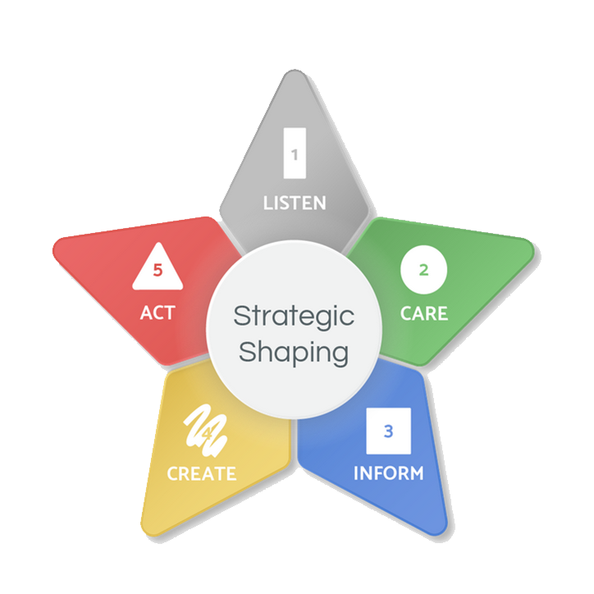
Strategic Shaping
Strategic Shaping Objectives
Introduce the PsychoGeometrics term “Strategic Shaping.”
Understand and learn how to use the Strategic Shaping Model.
Apply and practice using the Strategic Shaping Model in real life scenarios.
Notes:
SCRIPT: Here are the objectives. First, we will introduce the PsychoGeometrics term “Strategic Shaping.” Then we will learn how to use the Strategic Shaping Model to maximize our Shape strengths, manage our Shape challenges, and leverage all five Shapes for the ultimate advantage to communicate and lead effectively.

Slide 102
Strategic Shaping
What is Strategic Shaping?
The process of using all five Shapes to structure your communication for planning, problem solving, and conflict resolution.
Notes:
SCRIPT: Strategic means you have a detailed and planned strategy that has been thoughtfully created to achieve a specific purpose. When you add your knowledge of the Shapes, Strategic Shaping simply means using the strengths of all five Shapes in your approach. It is important to note that while all five Shapes are important to a successful strategy, all five Shapes do not need to be used equally. Similar to a recipe, there may be five important ingredients, but you only need a dash of salt compared to a cup of flour or sugar. The same is true of the five Shapes.
The Strategic Shaping Model is how you create your perfect recipe for effective communication and leadership, especially when it comes to planning, problem solving, and conflict resolution.

Slide 103
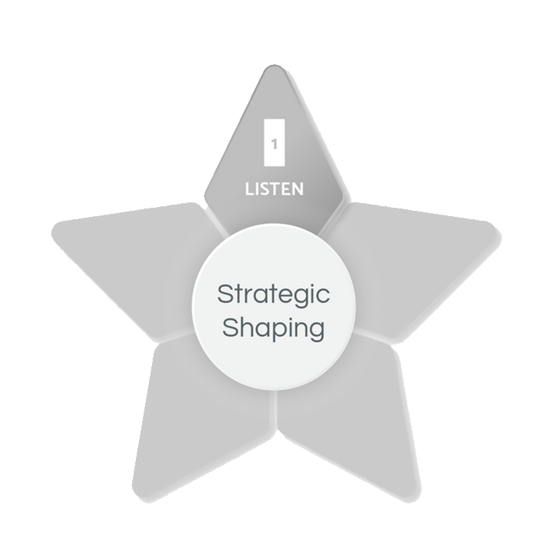
Strategic Shaping
Strategic
Shaping
Model
LISTEN
“I want to understand.
Tell me more.”
Notes:
SCRIPT: Let’s look at the necessary ingredients now.
The first ingredient is the Rectangle. Most people do not think of listening as the first step to creating a successful strategy. However, listening to understand is the key and first step to effective communication, whether it’s planning, problem-solving, or resolving conflict.
For example, let’s say you are trying to solve a problem, or someone has come to you for problem-solving advice. Our natural tendency is to start the problem-solving process by going to our most natural Shapes first, such as your primary and secondary Shapes. Very rarely do we think of the first step of problem solving to be pausing, then asking, and listening. It seems almost counterintuitive to most of us.
This is why the Rectangle is the most valuable skill set we can develop. To train ourselves to start with Rectangle requires conscious thinking since it’s not a natural place for most of us to start.
Think about it. If someone you love asks you to help them solve a problem, how would you naturally respond? A Box would remain calm and ask for the facts. The Triangle would spare you the time it would take to problem solve on your own, and instead, tell you the three things to do, and do now, to relieve your pain. The Circle would want to comfort you. The Squiggle would want to give you 10 ideas then encourage you to try them all until one of them works!
Instead, Strategic Shaping means you intentionally use all five Shapes to help solve the problem. It starts with three little words, “Tell me more.”

Slide 104
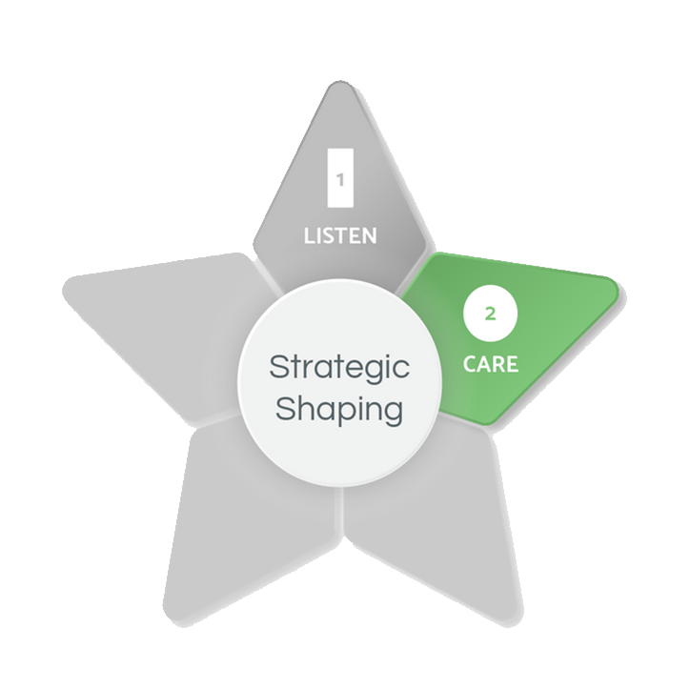
Strategic Shaping
Strategic
Shaping
Model
LISTEN
“I want to understand.
Tell me more.”
CARE
“I want to help.”
Show compassion
or concern.
Notes:
SCRIPT: Secondly, you will definitely need a dose of Circle to ensure a successful recipe. It is implied that you care if you take the time to Rectangle listen for understanding. But to underscore how much you care, the second ingredient is to say it and show it. If the three most important words to problem solving is “tell me more,” then the four most important words to problem solving are, “I want to help.” Make sure your non-verbal communication supports your verbal communication. In other words, if you say you want to help, make sure your facial expressions, body language, and tone of voice is in alignment. Relax your face, soften your tone of voice, and make eye contact as you say you want to help. Extend a hand or, if appropriate in some personal relationships, touch their arm or place your hand on their shoulder to “show” you care. In some cases, when you have a personal relationship already in place with someone, you may even want to offer a hug. Say, “I’m here for you.” The Circle is not only how you show that you care, but also how you connect.

Slide 105
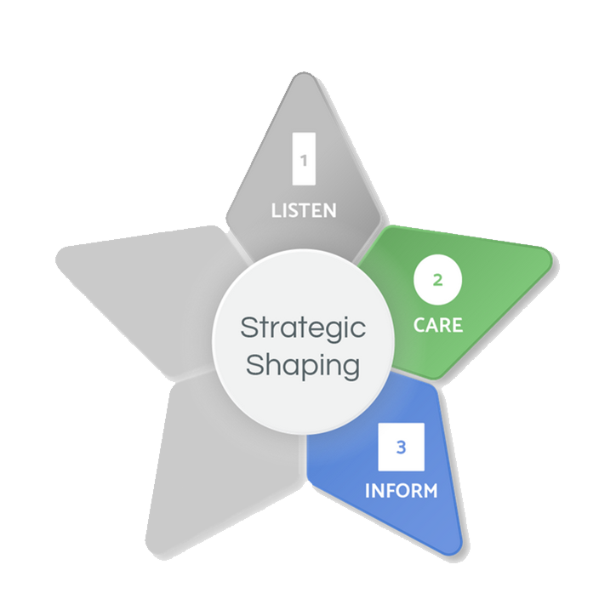
Strategic Shaping
Strategic
Shaping
Model
LISTEN
“I want to understand.
Tell me more.”
CARE
“I want to help.”
Show compassion
or concern.
INFORM
“Let’s consider the facts.”
Be logical.
Notes:
SCRIPT: Next, it’s time to take a step back from emotion and be objective. You can still show you care while wanting to know the facts, as brutal as they may be. It’s hard to help people if you don’t know the non-emotional details of the situation. You can say, “I care about you too much not to know or address the facts. That’s how we will figure this thing out!”

Slide 106
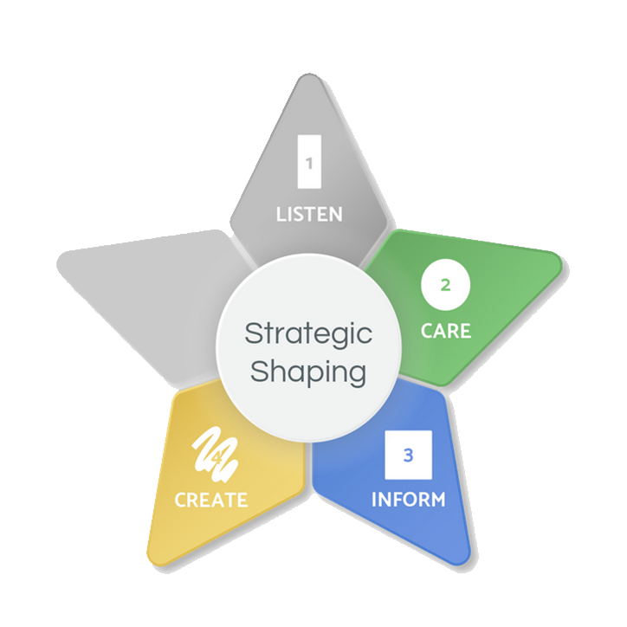
Strategic Shaping
Strategic
Shaping
Model
LISTEN
“I want to understand.
Tell me more.”
CARE
“I want to help.”
Show compassion
or concern.
CREATE
“Let’s find a way!
You got this!”
Be creative.
INFORM
“Let’s consider the facts.”
Be logical.
Notes:
SCRIPT: You have listened to understand. You have said that you care and want to help. You have asked for the facts. Now what? It’s either time to get Squiggle creative, share some inspiration, and words of encouragement. The Squiggle says, “There’s got to be a way. Let’s dig deeper!” Or “If there’s anyone who can do this, it’s you!” The Squiggle may also sense it’s time to take a break and lighten up before continuing the problem-solving process. “Let’s take a break and go have some fun! The problem will still be here tomorrow, and we can tackle it head on then!”

Slide 107
Strategic Shaping
Strategic
Shaping
Model
LISTEN
“I want to understand.
Tell me more.”
ACT
“Let’s get started.”
Take action.
Show responsibility.
CARE
“I want to help.”
Show compassion
or concern.
CREATE
“Let’s find a way!
You got this!”
Be creative.
INFORM
“Let’s consider the facts.”
Be logical.
Notes:
SCRIPT: Let’s recap. You are trying to help someone solve a problem You have used the Strategic Shaping Model for the first four steps.
The person who has come to you for help knows you Rectangle understand and Circle care. They also know you have the Box facts of the situation and that you will Squiggle challenge the status quo, digging deeper for an idea that might not even make sense in the moment, but wind up being the game changer in the end. Now you have earned the right to Triangle advise, recommend, or guide. This is so important to “earn the right.” It starts with the Rectangle. Listening doesn’t mean you have to agree. It means you care enough to understand.
Now is the time to make your recommendation to solve the problem, or initiate responsibility, accountability, and action on the part of the person who has come to you for help. The Triangle may say, “Now that we have talked it out, what do you think should be your next step?”

Slide 108
Strategic Shaping Model – Problem Solving
Strategic Shaping Model for Problem Solving
We tend to communicate using just our natural Shape strengths or using our natural Shape strengths first, sometimes without even thinking about it.
For example, when someone comes to you with a problem, your response typically comes from your primary or secondary Shape, or a blend of both.
shows compassion
stays
calm
wants to
advise
is
innovative
wants to understand
Notes:
SCRIPT: If you want to become a more effective communicator and leader, the most important words you can say is, “Tell me more. I want to understand.” It takes an open mind and the discipline to use all five Shapes, starting with the Rectangle to communicate effectively, instead of jumping to your primary or secondary Shapes. Keep in mind that you show love, care, and concern through your natural Shapes. Instead of listening to understand as the first step of effective communication, you instinctively jump to your “go to Shapes.” These are your primary and secondary Shapes. It’s like breathing. You don’t even think about it. You just do it. That’s why using the Rectangle has to be a learned skill set, since being in an open-state of mind is not natural for most of us.
Whether the objective is to be an active listener to understand your partner, an open-minded leader to connect with your team, or a more creative, collaborative, or strategic problem solver, adding the Rectangle to your communication style is a game changer.

Slide 109
Strategic Shaping – Scenarios
In your group:
Discuss the following questions for your group’s assigned scenario:
How might you naturally respond using only your primary and secondary Shapes?
How might your response look differently using all five Shapes?
Select one member of your group to share when we return from breakout rooms.
Notes:
SCRIPT: Now, you are going to have the opportunity to practice and apply the Strategic Shaping Model. In your Shapes Participant Workbook, you will find five Strategic Shaping Scenarios. We will create small groups and your group will be given a scenario (If virtual, scenarios will be assigned by breakout room i.e., breakout room #1 uses Scenario #1). With your group, read your scenario, and discuss the following questions: 1. How might you naturally respond using only your primary and secondary Shapes? 2. How might your response look differently using all five Shapes? Use your Participant Workbook to capture your thoughts and ideas. Then select one group member to share when we return for large group discussion.
NOTE: Form groups and assign each group with a different scenario. Give groups 10 – 15 minutes to discuss and then bring groups back together. Ask one member from each group to read their scenario and share their group’s strategically shaped response. Acknowledge responses and ask open ended questions to facilitate the conversation.

Slide 110
Strategic Shaping – Scenario #1
Strategic Shaping Scenario #1
One of your direct reports comes to you requesting additional PTO (Personal Time Off). They have already used all their PTO for the year. Your team has a big deadline coming up and you know you will need their support. Strategically Shape your response.
Notes:
NOTE: Share this slide during the large group discussion.

Slide 111
Strategic Shaping – Scenario #2
Strategic Shaping Scenario #2
You have been tasked with a project that requires you to lead a team of 20 people who come from four different departments or regions. The members of your team have very different personalities and communication styles. To meet a tight deadline, you will need everyone to work well together. Strategically Shape how you might “kick off” and structure your first working meeting with the team.
Notes:
NOTE: Share this slide during the large group discussion.

Slide 112
Strategic Shaping – Scenario #3
Strategic Shaping Scenario #3
Two of your direct reports are not getting along. It seems like every interaction escalates and ends with anger and frustration. The tension between them is starting to affect the overall group’s morale and productivity. You decide to meet with them to help resolve their latest conflict. How might you use the Strategic Shaping Model to facilitate and guide the conversation?
Notes:
NOTE: Share this slide during the large group discussion.

Slide 113
Strategic Shaping – Scenario #4
Strategic Shaping Scenario #4
One of your employees has been struggling lately. They are showing up to work late, missing deadlines, and the quality of their work has declined. You schedule a 1:1 “check-in” to talk and provide feedback. Strategically Shape your approach to effectively communicate with your employee about their performance.
Notes:
NOTE: Share this slide during the large group discussion.

Slide 114
Strategic Shaping – Scenario #5
Strategic Shaping Scenario #5
You have received some information about a big change coming soon that will impact how your team operates. As the leader, you can see both “pros and cons” of the change. You are having a team meeting to communicate this change. Strategically Shape your message to your team.
Notes:
NOTE: Share this slide during the large group discussion.

Slide 115
Strategic Shaping
Self-Reflection Question:
What part of the Strategic Shaping Model will help you the most as a leader?
Notes:
SCRIPT: Take a few minutes to answer the Self-Reflection Question in your Participant Workbook.
NOTE: Give participants a few minutes to answer this question. Ask for volunteers to share with the group.

Slide 116
Leadership Applications
Notes:
SCRIPT: Now that we have completed the five modules, we will move on to the Leadership Applications section of our workshop. This section will include Building and Shaping Trust, Shaping Your Way through Change, the Shapes Awareness Wheel, and the Leadership Lifeline exercise.

Slide 117
Building and Shaping Trust
Notes:
SCRIPT: We will begin with Building Trust. In this section we will discuss how to build trust with each Shape.

Slide 118
Building Trust with each Shape
Do what you say you will do, and do it well, consistently. Ask me what I know and what I think.
Be confident, take action, and produce results. Follow me.
Tell me more. Listen to me, be patient with me, support me, and advise me.
Show you care about me, my team, and my family first. Appreciate me.
Just be straight with me. Give me the flexibility to get my job done.
Notes:
SCRIPT: Building trust can look differently for each Shape. A Box may say “Do what you say you will do, and do it well, consistently. Ask me what I know and what I think.”To build trust with a Box, it’s important to have a logical, proven process, or plan.
A Triangle may say “Be confident, take action, and produce results. Follow me.”To build trust with a Triangle, give them some kind of authority, ownership, or influence.
A Circle may say “Show you care about me, my team, and my family first. Appreciate me.” To build trust with a Circle, show them how much you care and take time to show your appreciation.
A Squiggle may say “Just be straight with me. Give me the flexibility to get my job done.”
To build trust with a Squiggle, make it fun or let them have fun, show your willingness to be different or accept differences.
A Rectangle may say “Tell me more. Listen to me, be patient with me, support me, and advise me.” To build trust with a Rectangle, provide them the opportunity to explore and support their growth.

Slide 119
Building and Shaping Trust
Group Discussion
How might you build trust with a direct report who is a primary Box? Triangle? Circle? Squiggle?
How might you build trust with a direct report who is in Rectangle mode?
Notes:
SCRIPT: Now that we have discussed ways of building trust with each Shape, you will have an opportunity to talk in small groups. With your group, please discuss how your approach might look differently when building trust with a direct report as each Shape.
NOTE: Put participants in groups of three or four and give them about ten minutes to discuss. After ten minutes, bring participants back together for a large group discussion. Go through each Shape and ask for volunteers to share an example of how to build trust with that Shape. Ask for any “ah-hah” moments.

Slide 120
Shaping Your Way through Change
Notes:
SCRIPT: Now we will move on to Shaping Your Way through Change. Change is inevitable. It can be both exciting and scary. It is you job as a leader to navigate yourself and your team effectively through it. In order to accomplish this, we will look at what each Shape needs to embrace, manage, and lead change.

Slide 121
How Shapes Respond to Change
Notes:
SCRIPT: First, it’s important to recognize your natural response to change. The Box can be resistant to a change with little information and no proven-track record. Or they could be excited if they get to be part of solving a problem caused by the change. The Triangle can be uncomfortable with change that lessens control but might get excited to overcome a challenge for the big win. The Circle might be concerned or worried about a change that people might not like but they could be motivated by a change that benefits the people they care about in life. The Squiggle is not so worried about change, because after all the Squiggle gets bored easily and change can be fun! But the Squiggle will rebel in response to a change that restricts their independence, freedom, and flexibility. And yet what we sometimes don’t like, don’t want, or causes us to be uncomfortable is exactly what we need for personal growth and change. Regardless of your primary and secondary Shapes, people experiencing a significant change will be thrown into the “unknown” called the Rectangle. Not all people are even aware this is happening, but most people report that when experiencing a significant change in life, they don’t feel like their typical self. A life change can be anything that disrupts your typical thoughts, feelings, moods, behaviors, and interactions with others, such as starting school, finishing school, going back to school, moving to a new city or country, taking a new job, losing or leaving a job, getting married, getting divorced, having a baby, adopting a baby, being an empty nester, losing a close friend or family member, caring for aging parents, experiencing a serious injury or health issue, surviving a natural disaster, or learning how to cope during a pandemic. During significant life changes, you can be both excited and scared. Or a little of both.

Slide 122
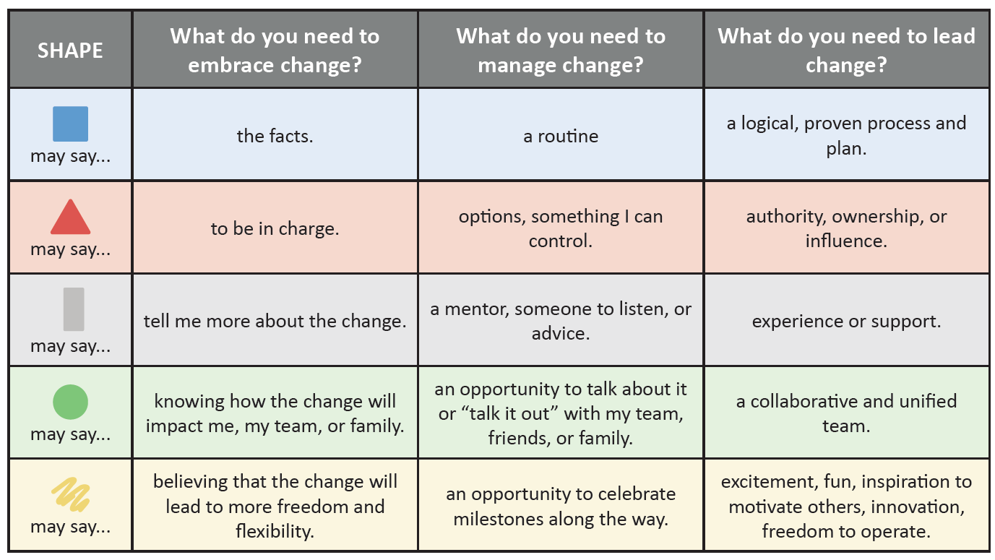
Embracing, Managing, & Leading through Change
Notes:
SCRIPT: Look at what each Shape needs to embrace, manage, and lead change. Take a moment and circle the things that you need most when embracing, managing, and leading change. Please note that the things you circle don’t necessarily have to be in your primary and secondary Shapes. Remember, when going through a change your needs may come from any one of the five Shapes depending upon your specific situation.
NOTE: Give participants a few minutes to circle their answers. After a few minutes, ask for a few volunteers to share and facilitate the conversation by asking open-ended questions.

Slide 123
Self-Reflection
Self-Reflection Questions:
What is your natural response to change?
What do you need to embrace, manage, and lead change?
Notes:
SCRIPT: Now that we’ve learned how each of the five shapes respond, embrace, manage, and lead change, take a moment to reflect on yourself. In your participant workbook, answer these two questions 1. What is your natural response to change? 2. What do you need to embrace, manage, and lead change?
NOTE: Give participants a few minutes to answer these questions and then ask for a couple of volunteers to share. Facilitate the conversation by asking open-ended questions.

Slide 124
Shapes Awareness Wheel
Notes:
SCRIPT: Now we are going to do the Shapes Awareness Wheel activity.

Slide 125
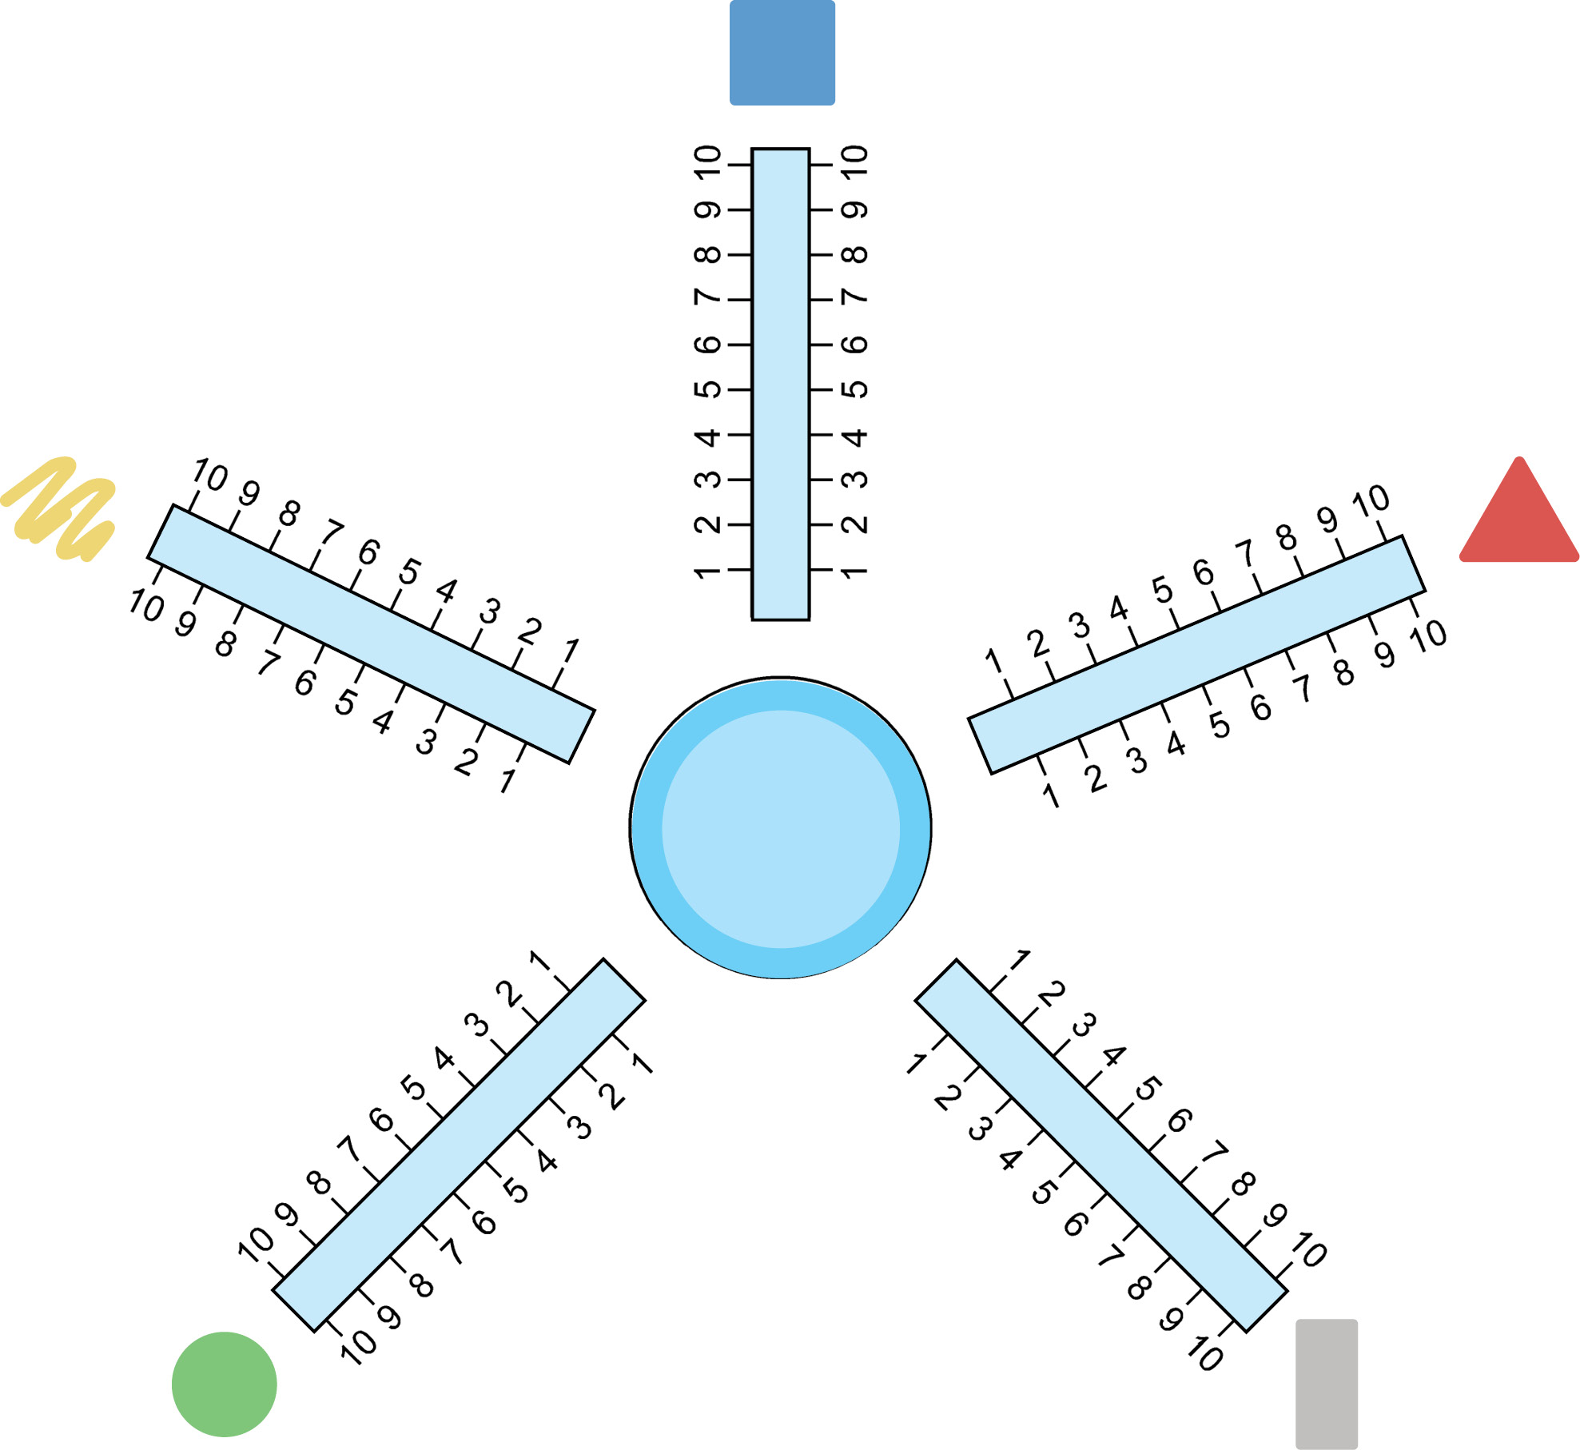
Shapes Awareness Wheel – Self-Assessment
Identify one trait or behavior from each Shape that you need to be an effective leader. Write that trait or behavior on the spoke of the wheel matching the Shape.
On a scale from 1–10, evaluate how frequently and consistently you are using, or incorporating, that Shape trait or behavior in your leadership style.
1 – 3: Rarely
4 – 6: Some of the time
7 – 9: Most of the time
10: Nearly always
Place an “X” on each spoke on the number that best represents your answer, using the above scale.
Notes:
SCRIPT: The Shapes Awareness Wheel is a tool utilized for identifying and clarifying Shape traits or behaviors that you need to be an effective leader. Given that each of the five Shapes plays a significant role in effective communication, we also know that each of the five Shapes plays an important role in your leadership effectiveness, too. Once you have identified a trait or behavior from each Shape, you can then use the Shapes Awareness Wheel to evaluate how frequently and consistently you are using, or incorporating, that trait or behavior in your leadership style. Please use the Shapes Awareness Wheel in your Participant Workbook to complete this activity. Consider what trait or behavior you need from each Shape to be an effective leader. Match the trait or behavior to the correct Shape, then write it on the appropriate “Shape” spoke. Next, you will rate, on a scale from 1 – 10, how frequently and consistently you are using, or incorporating, this Shape trait or behavior in your leadership style by placing an “X” on each of the Spokes. Use the following scale to determine the exact location of your “X” on each spoke: 1 – 3: Rarely; 4 – 6: Some of the time; 7 – 9: Most of the time; or 10: Nearly always. Using the numbers in this scale, place an “X” on that number on each spoke. For example, if your answer is: “I rarely use this Box trait or behavior in my leadership style,” place an X between 1 and 3. Now connect the “X’s” on each spoke of the wheel to draw your tire. Take a look at your wheel. What’s working? What’s not? Where may you have a “bump” or “flat tire” in your leadership effectiveness? What will you change about your “ride?” As you evolve as a leader, you will find that the traits and behaviors you need to be an effective leader will also change. It is recommended that you use the Shapes Awareness Wheel each month, or quarter, to monitor your use of each trait or behavior, or if it’s time to change the Shape traits or behaviors you need to be an effective leader. As objectives, goals, and other things change around you, you may need to use a different trait or behavior in your leadership style to be effective.
NOTE: Give participants about ten minutes to complete the individual section of this activity.

Slide 126
Shapes Awareness Wheel
Partner Discussion
Share the five traits or behaviors you chose to be an effective leader. Why did you choose them?
Share where you placed an “X” on each spoke.
Do you need to raise your level of awareness for using any of the Shapes in your leadership style? If so, which Shape traits or behaviors?
Notes:
SCRIPT: Now you will have an opportunity to discuss your Shapes Awareness Wheel with a partner.
NOTE: Have participants find a partner (if virtual, assign partners in breakout rooms).
SCRIPT: Answer the following questions with your partner:
1) Share the five traits or behaviors you chose to be an effective leader. Why did you choose them? 2) Share where you placed an “X” on each spoke. 3) Do you need to raise your level of awareness for using any of the five Shapes in your leadership style? If so, which Shape traits or behaviors?
NOTE: Give partners, about ten minutes to discuss. Bring participants back to the large group and ask for volunteers to share. After the large group discussion, inform participants that this is a tool they can use moving forward to evaluate often and track their progress.

Slide 127
Leadership Lifeline
Notes:
SCRIPT: Now, you will have the opportunity to reflect on how your life experiences have Shaped and influenced the leader you are today.

Slide 128
The Leadership Lifeline
Leadership Lifeline
Identify key events or significant experiences over the course of your life by placing them above the line as a “highlight” or below the line as a “lowlight.”
HIGHLIGHTS
LOWLIGHTS
Notes:
SCRIPT: In your Participant Workbook, you will find a horizontal line titled “Leadership Lifeline.” You will now have some time to reflect on the events that have Shaped who you are today. On your Leadership Lifeline, write the key events or significant experiences over the course of your life either above or below the line. If you consider the experience to be a “highlight,” write it above the line. If you consider the experience to be a “lowlight,” write it below the line. Once you have completed your Leadership Lifeline, you will have the opportunity to share with the group. To start, take about 15 minutes to complete your lifeline. Once you have finished, we will talk a little more about the presentations.
NOTE: Give participants about 15 minutes to capture their key events and significant experiences on the Leadership Lifeline.

Slide 129
The Leadership Lifeline – Presentations
You will have 5 – 8 minutes to present your Leadership Lifeline. During your presentation, please cover the following:
Summarize your highlights and lowlights.
How have the highlights and lowlights in your life helped you prepare for leadership?
How have they impacted your resiliency, connectedness, and continuous growth as a leader?
Share how your Shapes played a role in your highlights and lowlights, and how you may have evolved in your “Shapes” because of the building stages and turning points in your life.
Notes:
SCRIPT: Now that you have created your Leadership Lifeline, you will have the opportunity to share. You will have 5 – 8 minutes to present your Lifeline. While presenting please cover the following: 1) Summarize your highlights and lowlights. 2) How have the highlights and lowlights in your life helped you prepare for leadership? 3) How have they impacted your resiliency, connectedness, and continuous growth as a leader? 4) Share how your Shapes played a role in your highlights and lowlights, and how you may have evolved in your “Shapes” because of the building stages and turning points in your life. You will now have about 20 minutes to prepare your presentations.
NOTE: After 20 minutes, allow participants to present. Leave time for questions and feedback following each presentation. PLEASE NOTE: Depending on your class size, each participant can present in front of the whole group OR you can have participants present in front of small breakout groups. The curriculum allots 90 minutes for the Leadership Lifeline presentations. Participants have 5 – 8 minutes to present, so if you have 10 or less people in your class, each participant can present to the whole group. If you have more than 10 people in your class, we recommend having participants present in small breakout groups. This activity can be facilitated virtually through breakout rooms.

Slide 130
Review & Wrap Up
Notes:
SCRIPT: Over the course of this workshop, you have learned about PsychoGeometrics, the science of behavior and the art of communication. More specifically, you have learned about your communication and leadership style, the communication style of others, and how to strengthen your relationships by communicating more effectively. It started with the Shapes Card Game by identifying the traits and behaviors that naturally describe you and the ones that do not. While your natural Shape strengths, or as we have learned, your primary and secondary Shapes will stay with you all your life, it doesn’t mean you are limited to using just those two Shapes. You can now further develop your primary and secondary Shapes and add the other Shapes as learned skill sets to your communication style. This gives you the power to leverage all five Shapes to be the best possible version of yourself and to have an even higher probability of strengthening your relationships and becoming an even more effective leader.

Slide 131
The Five Modules Recap
The Five Modules
Module 1: Introduction to PsychoGeometrics
Module 2: Shape Perception
Module 3: Shape Flexing
Module 4: Shape Motivation
Module 5: Strategic Shaping
Notes:
SCRIPT: We spent some dedicated time learning about each of the five modules of the PsychoGeometrics communication system. You were given time to practice and apply what you learned individually, with a partner, and in small groups. Of course, learning is a continuous process, but you should have a good understanding of PsychoGeometrics. Now it’s time for more application and practice as you leave this workshop and return to your leadership role.
NOTE: If time permits, or you are looking to expand the length of this workshop, pause here to provide one more teaching moment. Ask your participants to use their pen and sign their name anywhere in their Shapes Participant Workbook. Now ask them, how did that feel? Did they even think about it, or did they just do it? Was it easy or hard? Now ask them to pick up the same pen in their other hand and sign their name again. Ask how did that feel? More than likely, your participants will tell you that it was awkward, uncomfortable, and that they consciously had to think about how to do it. Ask them how does their second signature look compared to their first signature. Chances are, you may hear someone say it looks like a five-year-old tried to do it. Now ask, do you think you could get better at using your non-dominant hand if you practiced every day? What if your next paycheck depended on it?
While you may never be as good at signing your name with your non-dominant hand as you are with your dominant hand, your signature will get better, and it will feel less awkward the more you practice. And, so it is with Shapes. Keep practicing every day by applying Shape Perception, Shape Flexing, Shape Motivation, and Strategic Shaping to your communication and leadership style. Little is big, and there is a cumulative value of doing the little things consistently over time. Even so, you will still walk away noticing big changes immediately in how you see yourself, others, and the world now that you know and understand the science of behavior and art of communication.

Slide 132
Objectives Recap
Do you understand your communication style as a leader, including strengths and challenges, and the communication style of others?
Can you recognize the possible positive and negative perceptions of your communication and leadership style, and the communication style of others?
Do you know how to use Shape Flexing to strengthen the effectiveness of your communication approach and responsiveness as a leader?
Are you aware of what motivates and demotivates you and others and can you adjust your communication and leadership approach accordingly, as a result?
Will you be able to apply the Strategic Shaping Model for planning, problem solving, and conflict resolution to strengthen your leadership effectiveness?
Notes:
SCRIPT: Now let’s take some time to review what we set out to achieve over the past two days.
NOTE: Give participants a minute to do this, then ask them to go to their last “Self-Reflection” question for today.

Slide 133
Review & Wrap Up
Self-Reflection Questions:
Take a moment to reflect on the workshop.
What were your three biggest takeaways?
How will you implement what you’ve learned to your leadership style?
Notes:
SCRIPT: Before we wrap up, please review your notes in your Shapes Participant Workbook, then reflect and answer these reflection questions.
NOTE: Give participants a few minutes to answer these questions and then ask if anyone would like to share their takeaways.
SCRIPT: Would anyone like to share their biggest takeaway from this workshop?

Slide 134
Congratulations!
You are on your way to being a more effective communicator as a Leader.
Notes:
SCRIPT: Congratulations! You have the knowledge and skill to be a more effective communicator as a Leader.

