Slide 1
Notes:
SCRIPT: Welcome to Shapes for Families. This is a customized workshop for families from the Shapes for Effective Communication curriculum.

Slide 2
Welcome Families!
Notes:
SCRIPT: We are so excited to have everyone here to participate in Shapes for Families! Children of all ages are welcome to participate, however the curriculum is recommended for people 12 years and older. We encourage families to use their own discretion regarding what is best for each family member and who should participate. This is a communications course designed to help strengthen your relationship with your family members by communicating more effectively.
NOTE: Take 2-3 minutes to introduce yourself to the group.

Slide 3
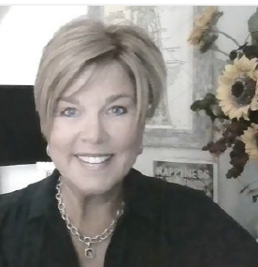
Welcome from Susan Hite, CEO of PsychoGeometrics
Dear Families,
We are excited to share a simple and effective way to strengthen your relationships by communicating more effectively, especially with the people who matter most, your family!
Our hope is that you enjoy this experience, and that “Shapes” becomes your family’s common language with one another. Understanding is the key to connectedness, and “Shapes” can now be your family’s new “superpower!”
As you learn about the science of behavior and the art of communication, you will notice a shift in how you see yourself and the members of your family. Suddenly, you will understand why you feel, think, act, plan, play, learn, love, celebrate, worry, stress, and de-stress like you do, and you will start to recognize the same about each other. Thoughts and feelings of confusion and frustration will turn into clarity, and your family will be able to talk in “Shapes” for simple and effective communication.
On behalf of our team at PsychoGeometrics, here’s to strengthening your communication, turning tension into traction, and being a resilient, high-functioning family.
Sincerely,
Susan Hite
CEO of PsychoGeometrics
Notes:
SCRIPT: Let’s start with a welcome letter from Susan Hite, the CEO of PsychoGeometrics.
NOTE: Give participants a minute to read the letter. Review the letter and emphasize the points that most resonate with you and what you think will resonate most with your participants.

Slide 4
Course Overview
Notes:
SCRIPT: Now, we will move on to brief overview of the course. We will take a look at our agenda, objectives, and resources.

Slide 5
Workshop Agenda
Welcome & Overview
Course Agenda, Objectives, & Resources
Modules 1 – 5
Module 1: Introduction to PsychoGeometrics
Module 2: Shape Perception
Module 3: Shape Flexing
Module 4: Shape Motivation
Module 5: Strategic Shaping
Family Applications
How does each Shape show Love?
Building & Shaping Trust
Shaping your Way through Change
Family Awareness Wheel
Review & Wrap Up
Notes:
SCRIPT: This course is designed to be engaging and interactive. During our time together, you will have the opportunity to participate in small family discussions and games, as well as engage with other families in large group activities and discussions. There are five learning modules of PsychoGeometrics. These learning modules are Introduction to PsychoGeometrics, Shape Perception, Shape Flexing, Shape Motivation, and Strategic Shaping. With each module, you will notice a pattern of teaching and applying what you learn. After we complete the modules, we will go through our Family Applications that are designed specifically for the Shapes for Families curriculum.
NOTE: If you are conducting a modified course, use this time to explain which modules and family applications you will be focusing on.

Slide 6
Course Objectives
Understand your communication style, including your strengths and challenges, and the communication style of your family members.
Recognize the possible positive and negative perceptions of your communication style by your family members, and your positive and negative perceptions of your family members.
Learn the skill of Shape Flexing to strengthen the effectiveness of your communication approach and responsiveness with each member of your family.
Discover what motivates and demotivates you and your family members and adjust your communication accordingly.
Apply the Strategic Shaping Model for planning, problem solving, and conflict resolution, making the hard conversations easier and the result all the better.
Notes:
SCRIPT: Here are the course objectives. After completing this workshop, you will be able to strengthen your relationships by communicating more effectively.

Slide 7
Know your Resources
In your Shapes for Families Toolkit, you will find…
Shapes for Families Participant Workbook
Communicating Beyond Our Differences Book
Shape-MOJO™ Game
Shapes Card Game (Deck of 10 Cards)
Shape Traits/Communicating with each Shape Card
Notes:
SCRIPT: Before we get started, let’s take a look at your resources. In your Shapes for Families Toolkit, you will find one Shapes for Families Participant Workbook, a copy of Communicating Beyond Our Differences, the Shape-MOJO™ Game, the Shapes Card Game, and the Shape Traits/Communicating with each Shape Reference Card. You will find a listing of these resources in your Participant Workbook.

Slide 8
Shapes Card Game
Notes:
SCRIPT: We are going to start off with the Shapes Card Game! In your Shapes for Families Toolkit, please find the deck of playing cards.

Slide 9
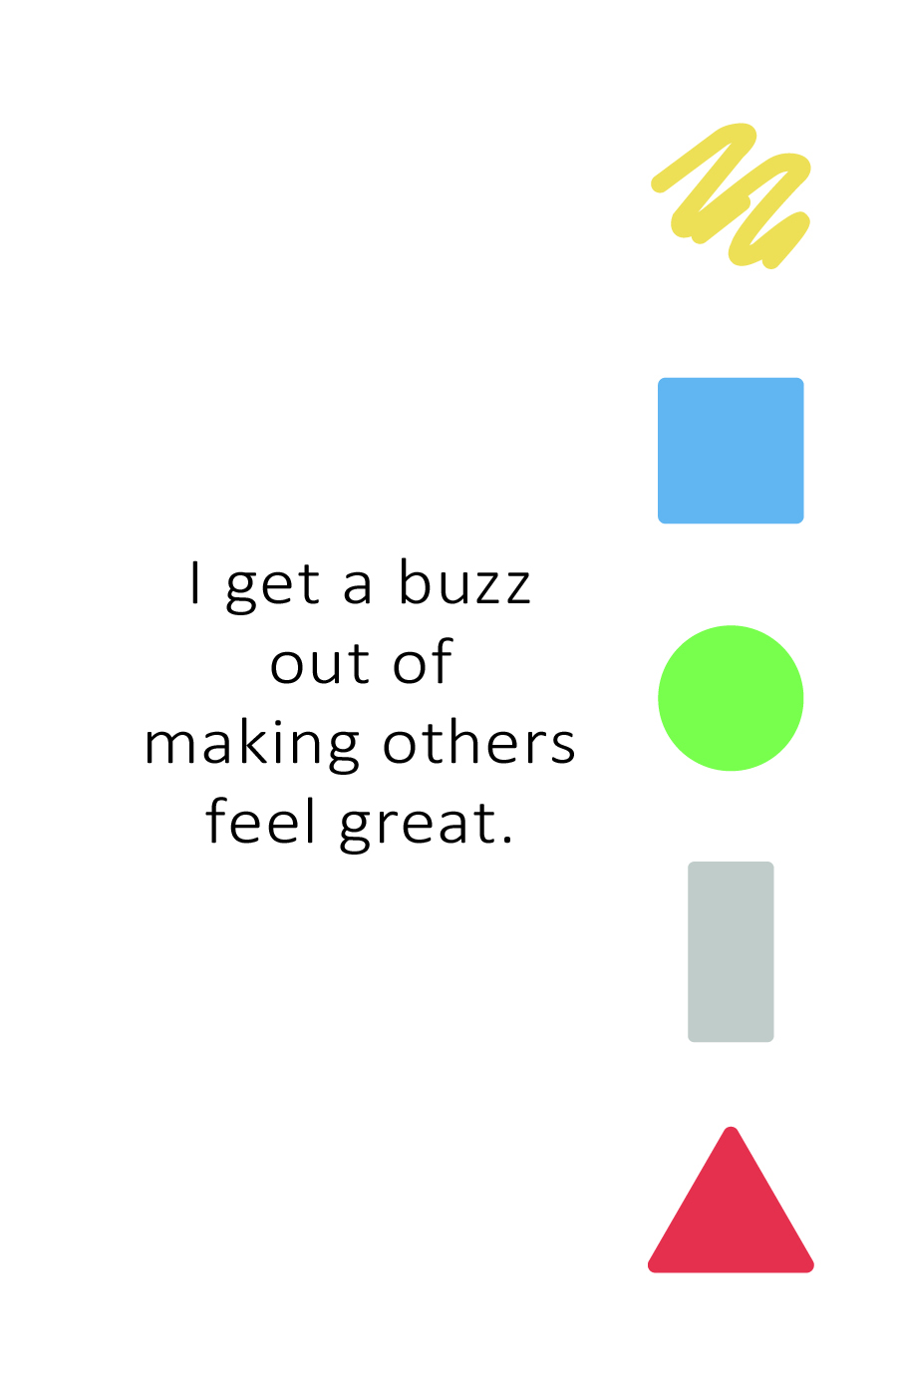
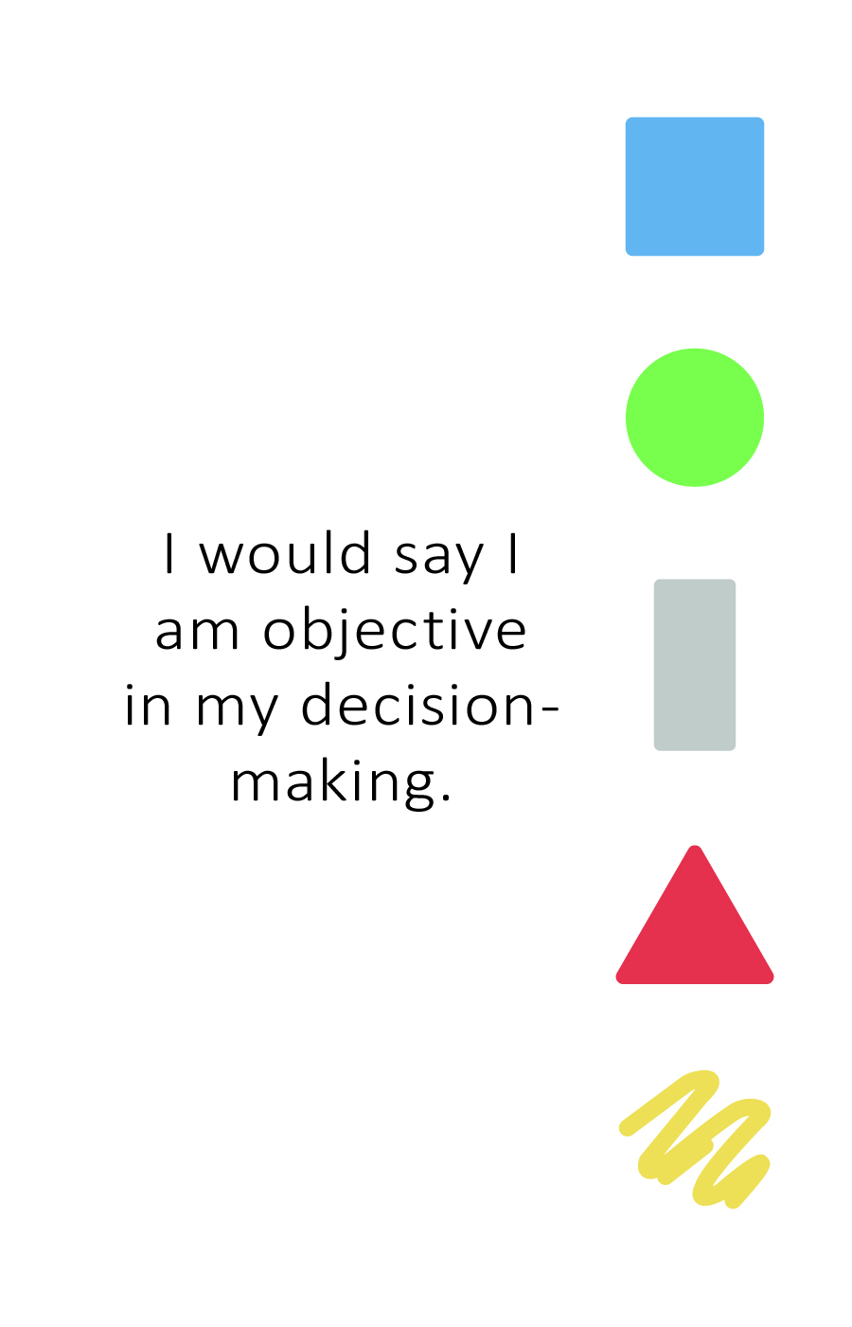
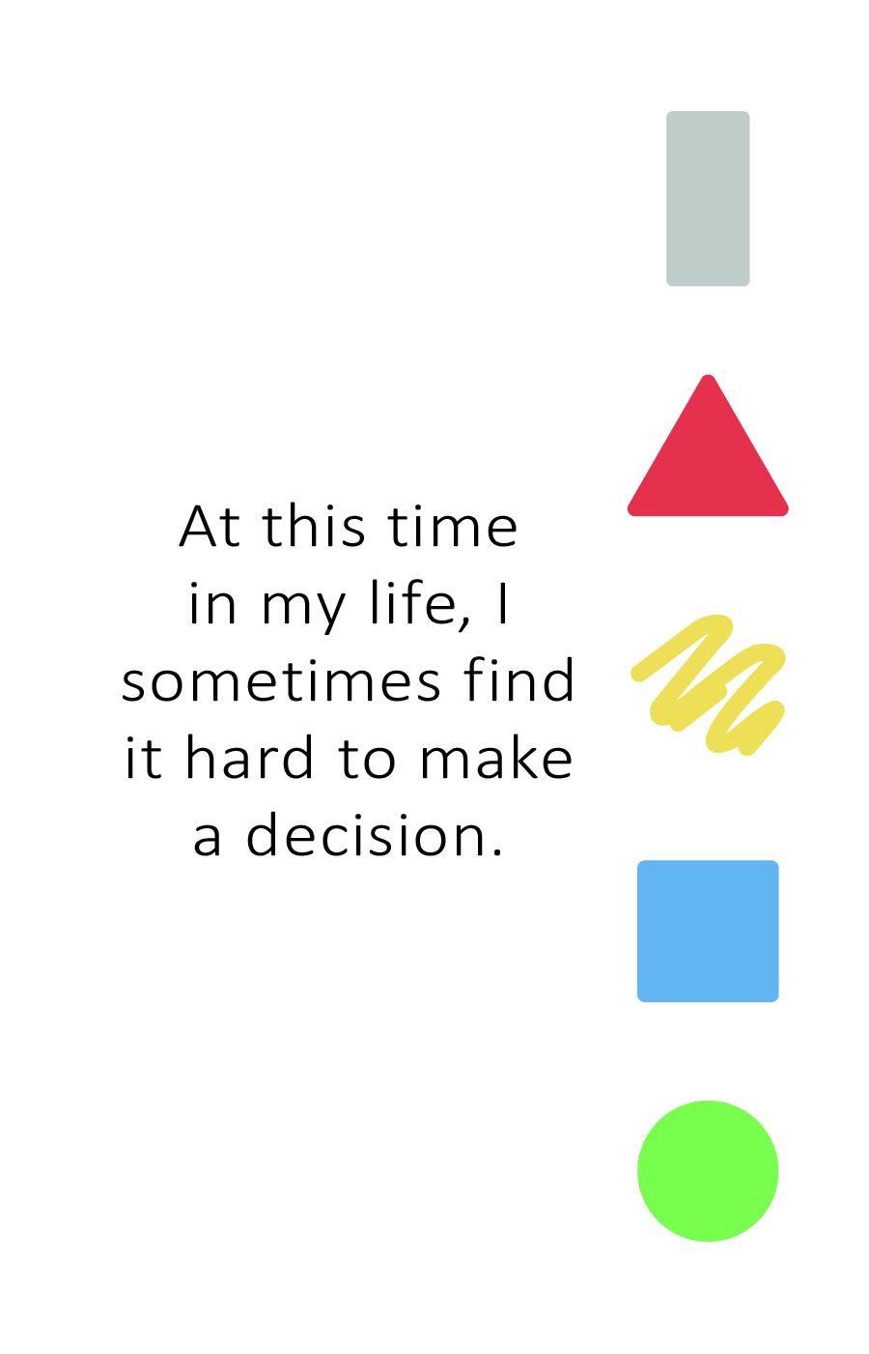
The Shapes Card Game
Pick a card from the deck.
Read the statement on the card.
Who does it describe the most? You? Or one of your family members?
Give the card to who you and your family thinks it describes the most.
Notes:
SCRIPT: Let’s get started. In your Family Toolkit, you should find a deck of 10 playing cards. You will each take turns picking up a card from the top of the deck. To start, have one person pick up a card, read the statement, then have a brief family discussion about who the card describes most. Once you have decided, give the card to that person. Repeat the process until there are no cards left.
NOTE: Give participants about 10 – 12 minutes to complete this process. Ask for a volunteer from each family to introduce themselves and their family, then read one card and explain who it describes in the family.
SCRIPT: Now, we are going to introduce ourselves. One person from each family will introduce their family by sharing their names, then they will pick one card and explain who it describes in the family.
NOTE: Have families one by one introduce themselves. Each family should only be taking about 2 minutes to introduces themselves.
SCRIPT: Thank you all for participating. I enjoyed learning a little more about each of you.
ACTIVITY: Shapes Card Game Family Instructions
• Each family should place their deck of cards in the center on the table so each family member can reach the deck.
• The person going first will pick the card off the top of the deck and read the statement.
• After reading the statement, the family will have a brief discussion on who the card most accurately describes. Once an answer has been determined, they will give the card to that person.
Continue this process with each family member taking a turn until there are no cards left. (Give families about 10 – 12 minutes to complete this process).
Once completed, one person from each family will introduce themselves and their family members by doing the following.
Share their name.
Share the names of their family members.
Read one of the cards their family discussed and explain who in the family it describes and why.
• After each family has had a turn, thank everyone for their participation.

Slide 10
Module 1: Introduction to
PsychoGeometrics
Notes:
SCRIPT: Now we will move into our first module – Introduction to PsychoGeometrics.

Slide 11
About PsychoGeometrics
Notes:
SCRIPT: I will start by telling you a little about PsychoGeometrics and then we will jump right in to taking the Shapes Assessment.

Slide 12
About PsychoGeometrics
What is it?
The science of behavior and the art of communication.
Featuring five geometric Shapes.
Each Shape represents a different communication style.
Learn your Shape when you take the Shapes Assessment.
The Shapes Assessment consists of three parts:
Traits
Behaviors
How you relate to others
Notes:
SCRIPT: PsychoGeometrics is the science of behavior and the art of communication. It was created in 1978 by Susan Dellinger, Ph.D. as a communication system featuring five geometric Shapes representing five communication styles. In June of 2020, Susan Hite, president of Hite Resources, Inc. and PsychoGeometrics consultant and facilitator for nearly 20 years, purchased the PsychoGeometrics company from Dr. Dellinger. As the CEO and Innovator of PsychoGeometrics, Susan Hite has updated the original work by developing new content and applications. Today, PsychoGeometrics blends the science and the art by identifying the “what” and the “how” to strengthen relationships by communicating effectively.
Your Shape is determined by taking the Shapes Assessment. The Shapes Assessment consists of three sections which are traits, behaviors, and how you relate to others. We will discuss the Shapes Assessment a little more specifically in the coming slides.

Slide 13
The Shapes Assessment
Notes:
SCRIPT: Now, time for the fun part! Let’s talk about the Shapes Assessment.

Slide 14
The Shapes Assessment
The Shapes Assessment By Sight
Choose your favorite Shape.
Choose your second favorite Shape.
Choose your least favorite Shape.
Notes:
SCRIPT: Before you take the online (or written assessment), we are going to take the Shapes Assessment by sight. Please look at the five Shapes and choose your favorite Shape, second favorite Shape, and least favorite Shape. In your participant workbook, please take a moment to write down your favorites and least favorite. Parents, please assist your children if needed.
NOTE: Anticipate the question – does color have anything to do with it? Yes – and we will talk about that after you take the assessment.

Slide 15
Take The Shapes Assessment
How it Works There are three sections. Each part typically takes less than five minutes to complete. Part 1 – Traits Part 2 – Behavior Part 3 – Relating to Others You will not be timed, but it is best not to over-think your choices. Go with your first choice.
What to Know Relax! This is not a test, it’s an assessment. It’s meant to be FUN! You won’t get a grade, but you will get a Shapes score. It doesn’t matter what you score, but it does matter that you understand your score, and know how to use it to communicate more effectively.
Notes:
SCRIPT: You will soon take the Online (or written) Shapes Assessment but before you do, I want to share a few details about the assessment. First, the Shapes Assessment consists of three sections, Traits, Behaviors, and Relating to Others. Traits describe who you are. Behaviors describe what you do and how you act. Relating is how you relate to others. Please note that this assessment is not timed, however, it is best to go with your initial response and not over-think it.
This is an assessment, not a test, so that means there are no wrong answers. There is no pre-work or preparation required. It is important to be your natural self to ensure the most accurate results. You will not receive a grade, but you will receive a Shapes score that will help you understand and interpret your results. And finally, it’s a simple, quick, easy, and fun assessment that should only take 15 minutes or less.

Slide 16
Take the Shapes Assessment Now
Notes:
SCRIPT: Now we will take the Shapes Assessment.
NOTE: If using the written Shapes Assessment, instruct participant to find the Shapes Assessment in their Shapes Toolkit. If using the online Shapes Assessment, provide the Shapes Assessment Link (or access code) to participants by writing it on the board/flip chart (in-person) or putting it in the chat (virtual). Give participants 15 minutes to take the Shapes Assessment and review their Shapes report. If taking the online Shapes Assessment, remind parents that each person in their family will need a different email address to use the link and take the assessment. Written Shapes Assessments are available if more appropriate for younger participants.

Slide 17
The Five Shapes
Notes:
SCRIPT: Now that you know your primary and secondary Shapes, let’s take a deeper look at the communication style represented by each Shape.
NOTE: Optional Question to ask Participants “Was the Shape you originally chose in the sight test either your primary or secondary Shape?” 84% of the time, what you choose by sight alone is either your primary or secondary Shape.

Slide 18
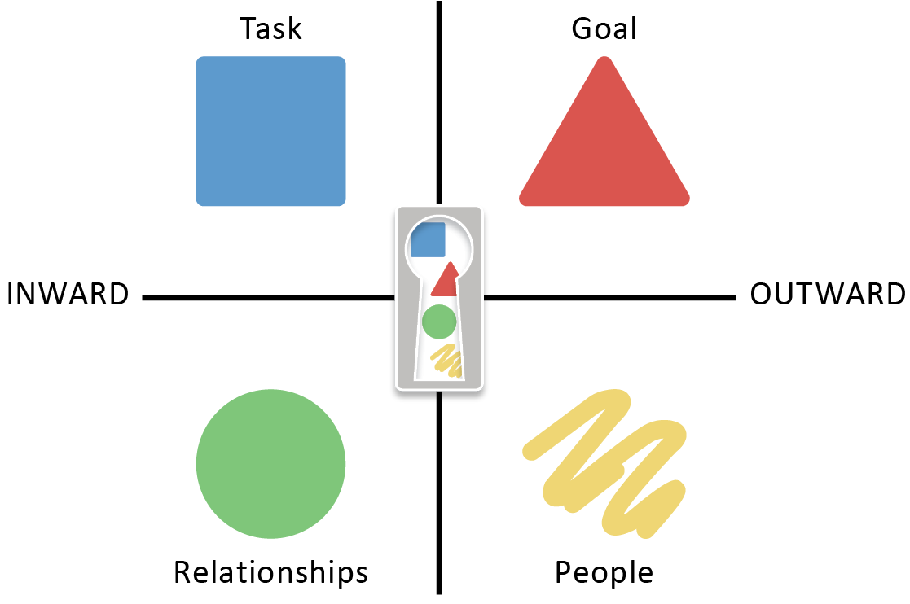
Things to Know About All Five Shapes
Each Shape represents a trait or behavior and has value, power, strengths, and challenges.
You have all five Shapes within you.
You tend to use one or two Shapes the most because they are your natural strengths.
It is wise to consider and leverage the behaviors of all five Shapes to communicate effectively.
Notes:
SCRIPT: Here is what you need to know about all five Shapes. Each Shape represents a trait or behavior that makes up your communication style. Every Shape has value and power. It is important to know that no Shape is better than another. All Shapes have strengths and challenges. The behavior you exhibit most is likely a combination of your primary and secondary Shapes, which represent your natural Shape strengths. In other words, what you are naturally good at doing. However, this does not mean 100% of your communication comes from just these two Shapes. It simply means your natural behavior comes from the blend of these two Shapes and is typically what you use most of the time. The rest of your communication style comes from the remaining three Shapes. Your primary Shape is indicated by the Shape in which you score the highest number of points. Your secondary Shape is indicated by the Shape in which you score the second-highest number of points. It is possible to have a tie. If this happens, it may mean your general behavior is derived from the blend of three Shapes, not just two. Remember, we have all five Shapes within us, some Shapes just come more naturally, and some require a little more effort.
Take a look at the image on the screen or in your Shapes for Families Participant Workbook. The Box and Circle are your inward Shapes (introverted) and the Triangle and Squiggle are your outward Shapes (extroverted). Notice that the Rectangle is in the middle. This means the Rectangle can be any one of the other four Shapes, either consciously or unconsciously. We will talk more about the Rectangle later in the Workshop. The Box is task oriented while the Triangle is goal oriented. The Circle is relationship oriented while the Squiggle is people oriented.

Slide 19
Understanding Your Score
UNDERSTANDING YOUR SCORE
0-3 LOW – does not mean below average
4-6 MEDIUM – does not mean average
7+ HIGH – does not mean above average
Just because you score “high” in a Shape does not necessarily mean you are good at using that Shape.
It means you have a high percentage of that Shape within you naturally, and you have the potential to be great at using it.
Notes:
SCRIPT: It is also important to understand your score. Anything from 0-3 is considered low, anything from 4-6 is medium, and anything 7 or higher is high. I want to emphasize that low does not mean below average, medium does not mean average, and high does not mean above average. Your score simply determines how much of that Shape you have naturally within you.

Slide 20
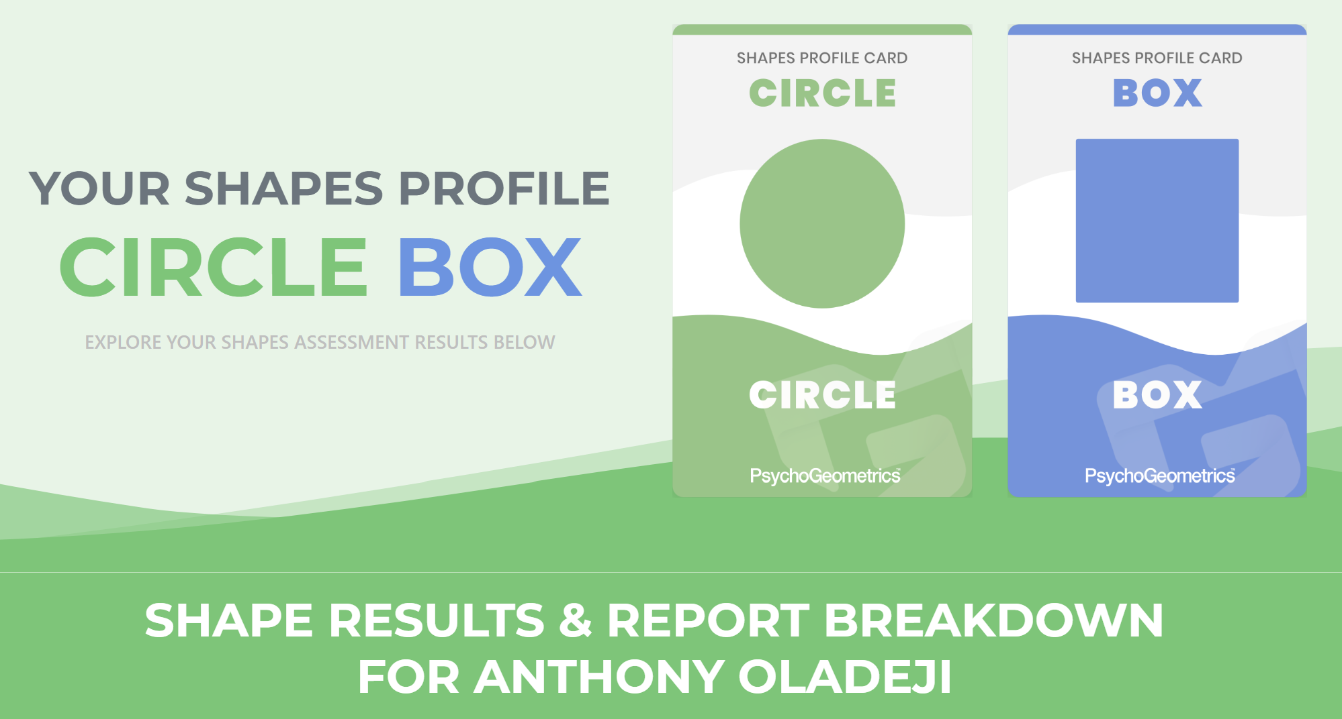
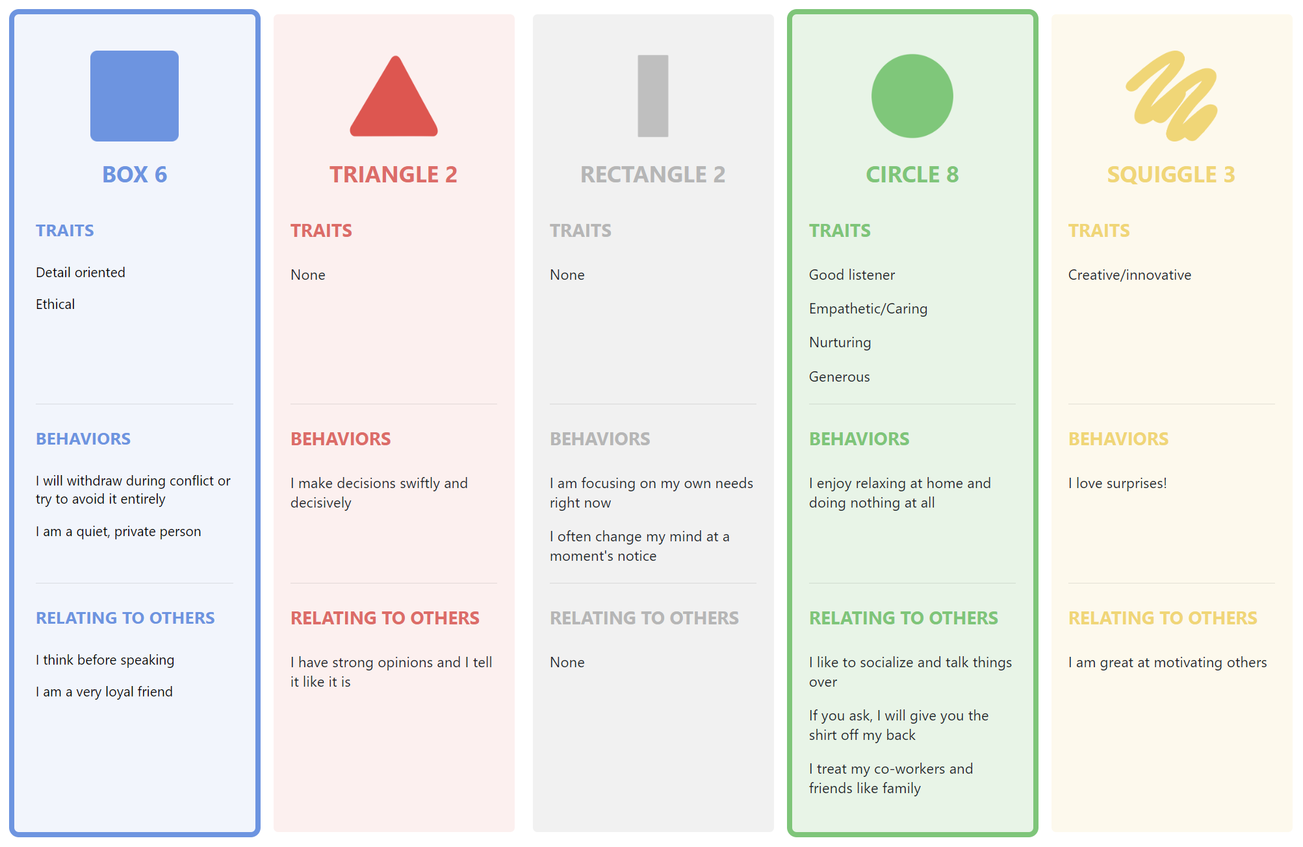
Understanding Your Scores in each Section – Traits, Behaviors, and Relating to Others
Secondary
Primary
Shape Profile Report Example
TRAITS
BEHAVIORS
RELATING TO OTHERS
Notes:
SCRIPT: Understanding your Shapes and your Shapes Scores makes it easier to understand why you think, feel, act, or relate like you do. Once you understand the why, then you can determine what you need. Let’s take a look at this example of a Shapes Profile Report. It provides such clues as to what this person may need to effectively communicate with people, manage stress, or navigate change. These are just a few examples. You will also notice in the Shapes Profile Report how the points for each Shape are distributed among the three categories:
TRAITS – Who You Are
BEHAVIOR – What You Do
RELATE – How You Interact with Others
Since this person is a primary Circle with a score of 8 and a secondary Box with a score of 6, these two Shapes and their three sections of traits, behaviors, and relating to others are outlined in green and blue, respectively. This is important because it shows the specific traits, behaviors, and natural interactions with others that are representative of their Shape. For example, let’s look at the primary Circle and the specific Circle traits. We see Good listener, Empathetic/Caring, Nurturing, and Generous. Because this person has these four Circle traits, they counteract, or neutralize, some of the Box traits like non-emotional. This is why even though you may be a secondary Box, you won’t necessarily relate to every trait, behavior, or interaction of the Box if your other Shape is, for example, Circle. This type of reasoning applies to any primary and secondary Shape combination. Also, keep in mind how the other Shapes and their distribution of points impacts the primary and secondary Shapes. What assumptions could you make about this person’s communication style? Now look at your own Shapes Profile Report. How are your 21 points distributed? What can you learn or reinforce about your communication style by the way your points are distributed?
NOTE: Pause and ask if anyone has anything they would like to share about their communication style or their Shapes Profile Report.

Slide 21
The Five Shapes
Logical, Linear, Factual
Creative, Innovative, Emotional
INFO & STRUCTURE
ACTION &
RESULTS
CHANGE &
GROWTH
CONNECTION & HARMONY
ENERGY & CREATIVITY
Notes:
SCRIPT: Here are the Shapes from left to right. The Box – When you think of Box behavior, traits such as structured, detailed, process-oriented, logical, slow to make a decision, efficient and practical come to mind. The Triangle - When you think of Triangle behavior, descriptions such as direct, driven, goal-focused, action-oriented, quick to make a decision, bottom-line and to the point, are used. The Circle – When you think of Circle traits – words such as harmony, nurture, mentor, inclusive, relationship-oriented, and sensitive come to mind. The Squiggle – The Squiggle behavior can be described as creative, innovative, energized, spontaneous, and unique. The Rectangle - When you think of Rectangle behavior, think exploring, open-minded, undecided, a turning point, and growth.

Slide 22
Let’s learn more about your Shapes
Notes:
SCRIPT: We are going to dive a little deeper and learn more about each of the Shapes.

Slide 23
The Box
Because the BOX is composed of equal lines and angles, it represents structure and stability.
Calm, consistent, logical.
Most organized of the Shapes.
Likes to know the facts and “think about it” before deciding.
Tends to be a perfectionist.
Can be poker-faced, shows little emotion.
“I’d rather finish right than finish first and get it wrong.”
Likes to stay on task and may not be pleased if you “pop in.”
Doesn’t like to be put on the spot and prefers working alone.
Trustworthy, dependable, you can count on the Box.
BOX
“If you want it done right, do it yourself.”
Notes:
SCRIPT: As I just noted, the Box represents structure. Notice the Shape of the Box. Four equal sides that literally makes the Shape of a square. However, to be consistent with the Shapes language, you should call it the Box, not the square.
NOTE: The reason it is not called “square” in the Shapes language is because some people may already have a pre-conceived notion of what it means to be “square.” Box is a more universal, objective term.
SCRIPT: Think of the Box as a building block, using one block at a time to build the foundation of a building, for example. Boxes don’t roll or spring into action. Instead, they turn like a flywheel, one “crank,” at a time.
NOTE: You may want to use your hands and facial expressions to physically show what it is like to “crank” a heavy flywheel one slow turn at a time until you slowly build up momentum. In some cases, you may want to provide the definition of a flywheel or ask someone to look it up, put it in the chat box, or raise their hand and share. According to Oxford Languages, a flywheel is “a heavy revolving wheel in a machine that is used to increase the machine’s momentum and thereby provide greater stability or a reserve of available power during interruptions in the delivery of power to the machine.”
SCRIPT: With each turn, the Box builds momentum. This step-by-step, or turn-by-turn, method is part of the process, even though the process doesn’t always feel or look like progress at the time. The Box knows there is a cumulative value of doing the little things consistently over time. This creates stability, credibility, and reliability. Also note the color of the Box. Blue stands for calmness and trust.
NOTE: There is such a thing as Shapes psychology and Color psychology. For example, shapes and colors can influence the way we think or feel. This is part of the science that factors into choosing your favorite Shapes by sight. If a company is trying to communicate trust, it may use a Box like shape and/or blue color in its logo.
SCRIPT: Now, let’s look at the way the Box is described. If you are a primary or secondary Box, this means you could be someone who is calm, consistent, logical, and organized. In fact, the Box is the most organized of the five Shapes. They are disciplined, task-oriented, and thrive on routine and a schedule. This is why a Box may seem annoyed when you “pop in” on them without an appointment or advance notice. Boxes are busy working to get things done. It’s best not to ask a Box to commit on the spot. Instead, the Box needs time to process and “think about it,” before saying “yes” or “no.” This is because when the Box makes a commitment, the Box follows through. Be careful not to assume the Box is not interested or doesn’t care. Their intentional pause, blank stare, non-emotional facial expressions, or monotone tone has nothing to do with whether they like you or not, or even if they are interested in what you are communicating. It’s more about logic. Boxes like to be respected and recognized for what they know. Boxes tend to be perfectionists and prefer working alone. Notice I didn’t say Boxes can’t work with others. It’s just that the natural preference of the Box is to be efficient, and to the Box, working alone takes less time and is more effective than having to work as a team.
Boxes can be resistant to change and don’t like to be rushed or put “on the spot.”
Keep in mind, you are not just one Shape. Unless you scored 21 in Box, you have other Shapes within you. It’s important to know that you may not resonate with every trait or description of the Box, because your secondary Shape may counteract or neutralize it.

Slide 24
The Box
Notes:
SCRIPT: Here’s an example of an image representing the Box. What do you see that is a Box like trait or behavior?
NOTE: Ask for a few volunteers to share. Responses you may receive could include: Money management, saving money, organization, order, one-by-one (one step at a time), neat, stacked coins in an organized manner, precision.

Slide 25
The Box
Family Discussion
Is anyone in your family a primary or secondary Box?
What value does this Box bring to your family?
Find a meme, picture, video clip, or song that represents the Box.
BOX
“If you want it done right, do it yourself.”
Notes:
SCRIPT: Now that you know a little bit more about the Box, you are going to have an opportunity to discuss with your family. With your family, answer the following questions, 1. Is anyone in your family a primary or secondary Box? 2. What value does this Box bring to your family?
Now, with your family, use a smart device to look up either a meme, picture, video clip, or song that you think illustrates the Box. It can be anything! Have fun with it! Share what you find with your family members and explain what parts make you think of the Box.
NOTE: Give the families about 2 – 3 minutes to discuss the first two questions. Then give families about 5 – 7 minutes to find a meme, picture, video clip, or song and have a discussion.

Slide 26
The Triangle
Because the TRIANGLE is built like a pyramid, with an upward pointed tip, it represents ambition and high achievement.
Driven, competitive, and likes being in control.
Makes the decision then works to make it right.
Can be seen as too direct and intense.
Can’t stand indecision.
“I don’t need to hear the whole story.”
Politically correct. Knows how to work the system.
Fast thinkers, decision makers, strong opinions.
Quick to get to the point, lives a fast-paced life.
Bottom line, doesn’t want a lot of details.
TRIANGLE
“When I want your opinion,
I will give you mine.”
Notes:
SCRIPT: Let’s move on to the Triangle. The Triangle shares some traits with the Box like being organized and focused. But if the Box is “slow to make a decision,” then the Triangle makes the decision quickly and confidently. Unlike the Box that wants to gather all the facts then make the best decision, the Triangle just wants to make a decision and work to make it right.
The Triangle represents action, ambition, and high achievement. Notice the Shape of the Triangle. It is literally bottom line and to the point.
NOTE: If possible, use your cursor or stylus to point to the bottom of the Triangle from left to right, when you say “bottom-line.” If you are using a flip chart, you can use your marker to draw the bottom of a Triangle. Or, you can use your hand or finger to “draw” a horizontal line (in the air). Then using your cursor, stylus, marker, hand, or finger to draw or move upward to the top of the Triangle, say “and to the point.”
SCRIPT: Think of the Triangle as a pyramid, pointing upward, climbing upward, striving to reach the top of the mountain, or obtain its goal. Also, note that the upward point of the Triangle can provide direction as to which way to go. The Triangle is also politically correct.
The color red stands for passion, "bullseye” target, strength, and confidence.
Now, let’s look at the way the Triangle is described. If you are a primary or secondary Triangle, this means you could be someone who is highly competitive and driven to win. The Triangle makes everything a contest or a game. From being first in line or first to finish, the Triangle can be extremely focused and intense. Triangles like options instead of mandates and are most comfortable when they are in control. Triangles like to feel important. Triangles get easily annoyed with people who can’t make up their mind, take too long to make a decision, or who are overly dramatic. The Triangle says, “I don’t need to hear the whole story. Just give me the bottom line.” They are quick to get to the point and live a fast-paced life.
Keep in mind, you are not just one Shape. Unless you scored 21 in Triangle, you have other Shapes within you. It’s important to know that you may not resonate with every trait or description of the Triangle, because your secondary Shape may counteract or neutralize it.

Slide 27
The Triangle
Notes:
SCRIPT: Here’s an example of an image representing the Triangle. What do you see that is a Triangle like trait or behavior?
NOTE: Ask for a few volunteers to share. Responses you may receive could include: Leader, role model, influencer, confidence, strong, determination, ambition, power, powerful.

Slide 28
The Triangle
Family Discussion
Is anyone in your family a primary or secondary Triangle?
What value does this Triangle bring to your family?
Find a meme, picture, video clip, or song that represents the Triangle.
TRIANGLE
“When I want your opinion,
I will give you mine.”
Notes:
SCRIPT: Now that you know a little bit more about the Triangle, you are going to have an opportunity to discuss with your family. With your family, answer the following questions, 1. Is anyone in your family a primary or secondary Triangle? 2. What value does this Triangle bring to your family?
Now, with your family, use a smart device to look up either a meme, picture, video clip, or song that you think illustrates the Triangle. It can be anything! Have fun with it! Share what you find with your family members and explain what part make you think of the Triangle.
NOTE: Give the families about 2 – 3 minutes to discuss the first two questions. Then give families about 5 – 7 minutes to find a meme, picture, video clip, or song and have a discussion.

Slide 29
The Circle
Because the CIRCLE has no beginning or end, it symbolizes connectedness and unity.
Team player, nurturer, and stabilizer.
Collaborative, sensitive to how others feel, and notices facial expressions and body language.
Make good counselors, mentors, and mediators.
“I’d rather be part of the team than be #1 on the team.”
Focused on the well being of others, maintaining harmony, and tend to put their own needs last.
Can be too accommodating and struggles to hold others accountable.
Would rather save the relationship than solve the problem.
Best empathetic listeners.
Their memos may include a little smiley face.
CIRCLE
“I don’t care how much you know until I know how much you care.”
Notes:
SCRIPT: Moving on to the Circle. If the Box considers the facts, and the Triangle considers the impact, the Circle considers the people. Nothing is more important to the Circle than relationships and connectedness.
The Circle represents harmony and unity. Notice the Shape of the Circle. It has no beginning or end. It is smooth, connected, and without any pointy edges. Think of the Circle as universal and inclusive.
The color green stands for nature, nurture, and peace.
Now, let’s look at the way the Circle is described. If you are a primary or secondary Circle, this means you could be someone who is compassionate and inclusive. The Circle cares more about saving the relationship than solving the problem. Circles are natural caregivers, stabilizers, and often put their own needs last. In fact, the Circle can be too accommodating and has a difficult time saying no. The best listeners of all five Shapes, the Circle is a good team player, can read non-verbal communication, is empathetic and sensitive to the needs of others. Circles like to please and don’t like or cope well with conflict. Their memos, notes, emails, and texts often include a smiley face. The Circle might say, “Don’t worry, be happy,” or “Let’s get together, and together we will work this out.”
It’s important to know when communicating with a Circle that they don’t care how much you know, until they know how much you care. Circles make great mentors and counselors and would rather be part of the team than #1 on the team.
Keep in mind, you are not just one Shape. Unless you scored 21 in Circle, you have other Shapes within you. It’s important to know that you may not resonate with every trait or description of the Circle, because your secondary Shape may counteract or neutralize it.

Slide 30
The Circle
Notes:
SCRIPT: Here’s an example of an image representing the Circle. What do you see that is a Circle like trait or behavior?
NOTE: Ask for a few volunteers to share. Responses you may receive could include: Balance, harmony, unity, team, peaceful, family, pleasant, kind, happy, nice, friendly, smiling, and approachable.

Slide 31
The Circle
Family Discussion
Is anyone in your family a primary or secondary Circle?
What value does this Circle bring to your family?
Find a meme, picture, video clip, or song that represents the Circle.
CIRCLE
“I don’t care how much you know until I know how much you care.”
Notes:
SCRIPT: Now that you know a little bit more about the Circle, you are going to have an opportunity to discuss with your family. With your family, answer the following questions, 1. Is anyone in your family a primary or secondary Circle? 2. What value does this Circle bring to your family?
Now, with your family, use a smart device to look up either a meme, picture, video clip, or song that you think illustrates the Circle. It can be anything! Have fun with it! Share what you find with your family members and explain what part make you think of the Circle.
NOTE: Give the families about 2 – 3 minutes to discuss the first two questions. Then give families about 5 – 7 minutes to find a meme, picture, video clip, or song and have a discussion.

Slide 32
The Squiggle
Because the SQUIGGLE is free-forming and abstract, it represents the free-spirit, uniqueness, and flexibility.
Creative, expressive, dramatic, witty.
Innovators, idea producers.
Not good team players naturally; however, can inspire others.
Spontaneous, high energy, bored quickly by routine.
Least organized of the Shapes.
Challenges the status quo.
"Why do we have to do it that way?”
Direct, honest in their communication style. Shares exactly what they think, without thinking through it first.
Doesn’t like deadlines/follow-up but can pull it off brilliantly “just in time.”
SQUIGGLE
“Life is short,
eat dessert first.”
Notes:
SCRIPT: So far, we have learned that Boxes thrive on routine and schedules, Triangles want to be in charge and in control, and Circles want everyone to get along and feel included. So, what about the Squiggle? Squiggles “beat to their own drum.” They are creative, unique individuals who are spontaneous and quickly bored by routine. The Squiggle likes the freedom to be flexible and often challenges the status quo.
Take a look at the shape of the Squiggle. It’s non-conforming, unrestricted, free-flowing, and stands out from the other Shapes. Think of the Squiggle as the free spirit; full of energy and ideas.
The color yellow represents light, joy, and positivity. It’s OK to share the brutal facts with the Squiggle but stay away from “doom and gloom.” Embrace problems, challenges, and obstacles with hope and optimism. After all, the Squiggle will figure out a way to solve it, overcome it, get past it, and have a little fun along the way.
Now, let’s look at the way the Squiggle is described. If you are a primary or secondary Squiggle this means you could be someone who is innovative, expressive, witty, and bright. When faced with a mountain, Squiggles like to encourage and inspire, but unlike the Circle, they don’t have the patience, nor the desire, to hold your hand through the process of getting over it, around it, or tunneling underneath it. In fact, if you can’t do any of those things, the Squiggle will show you how you can turn the mountain into a goldmine!
The Squiggle tends to be unfiltered and speaks before thinking. However, you can count on the Squiggle to be honest, even if it hurts your feelings or they are not politically correct. Squiggles often talk aloud to hear themselves think. The Squiggle tends to run late, frequently breaks, or at least, bends the rules, and needs constant stimulation. The most unorganized of the five Shapes, the Squiggle seems to have a way of pulling it off “just in time.”
Keep in mind, you are not just one Shape. Unless you scored 21 in Squiggle, you have other Shapes within you. It’s important to know that you may not resonate with every trait or description of the Squiggle because your secondary Shape may counteract or neutralize it.

Slide 33
The Squiggle
Notes:
SCRIPT: Here’s an example of an image representing the Squiggle. What do you see that is a Squiggle like trait or behavior?
NOTE: Ask for a few volunteers to share. Responses you may receive could include: Creative, innovative, “making something out of nothing,” re-inventing something basic into something creative, adventure, exciting, fun, imagination, play, not taking themselves too seriously, and making it up as they go.

Slide 34
The Squiggle
Family Discussion
Is anyone in your family a primary or secondary Squiggle?
What value does this Squiggle bring to your family?
Find a meme, picture, video clip, or song that represents the Squiggle.
SQUIGGLE
“Life is short,
eat dessert first.”
Notes:
SCRIPT: Now that you know a little bit more about the Squiggle, you are going to have an opportunity to discuss with your family. With your family, answer the following questions, 1. Is anyone in your family a primary or secondary Squiggle? 2. What value does this Squiggle bring to your family?
Now, with your family, use a smart device to look up either a meme, picture, video clip, or song that you think illustrates the Squiggle. It can be anything! Have fun with it! Share what you find with your family members and explain what part make you think of the Squiggle.
NOTE: Give the families about 2 – 3 minutes to discuss the first two questions. Then give families about 5 – 7 minutes to find a meme, picture, video clip, or song and have a discussion.

Slide 35
The Rectangle
Because vertical lines are associated with strength, courage, and progress, the RECTANGLE represents change and growth.
Transitional Shape and is temporary.
Neutral, undecided.
Can be open, exploratory, and excited about change, but also confused, overwhelmed, and indecisive.
“I don’t feel like myself lately.”
Not certain about the future.
Doesn’t want to be “pinned down.”
Needs support and approval.
Can benefit from having a mentor or trusted advisor.
RECTANGLE
“Please listen to me,
then tell me what to do.”
Notes:
SCRIPT: We have learned some of the traits, behaviors, and interactions of the Box, Triangle, Circle, and Squiggle. To summarize, the Box knows, the Triangle knows what to do, the Circle wants to help, and the Squiggle doesn’t worry about what they know or don’t know, they will make it up as they go! But the Rectangle is the Shape of “I don’t know.” It’s the Shape of growth and change.
Unlike the other four Shapes, the Rectangle is neither a primary or secondary Shape. Instead, it is a transitional Shape that indicates a turning point in your life. Personal change can last 3-18 months. Cultural or organizational change, such as a merger, acquisition, or major incident can last 3-7 years.
Take a look at the Shape of the Rectangle. The two vertical lines on the side of the Rectangle are associated with strength, courage, and progress. Evolving from the Shape of the Box, the Rectangle has strength but is less stable with four unequal sides. Yet, its growth in vertical size symbolizes the gateway, passageway, or door from “here” to “there,” which can be both exciting and scary. Through the lens of the Rectangle, you can explore change through the lens of the other four Shapes, consciously or sub-consciously, which is why most people report “not feeling like their typical selves” when experiencing change.
The color gray is neither black or white. It’s a neutral, in between color, sometimes representing the mysterious.
Most people score 3 or less in Rectangle. This is because using the Rectangle as part of your communication style does not come naturally, and most people are not naturally good at embracing, managing, or navigating their way through change. A score of 3 or more can indicate you’re experiencing change or at least thinking about it.
A person in Rectangle mode can be described as exploring, growing, and transitioning. They can also be seen as confused, overwhelmed, indecisive, and “stuck.” The key to navigating your way through change is 1) to be aware of the change, 2) be open, 3) knowing what your Shapes need to embrace and manage change, and 4) who you want to be or become as a result of the change.
It is important that Rectangles have a trusted friend, mentor, or professional therapist who will listen, then provide support, recommendations, or advice. In fact, the Rectangle says, “Please listen to me, then tell me what to do.” You have to earn the right to advise the Rectangle by listening, connecting, and establishing trust first.
Remember, the Rectangle is a temporary Shape, but it is also a powerful Shape if you choose to use the Rectangle as a tool for intentional change and growth. We will touch on that next.

Slide 36
The Rectangle
Notes:
SCRIPT: Here’s an example of an image representing the Rectangle. What do you see that is a Rectangle like trait or behavior?
NOTE: Ask for a few volunteers to share. Responses you may receive could include: Change, changing, evolving, change of colors, change of seasons, cool, hot, warm, cold; transitions, natural growth and development, new beginnings, reflecting, and open-minded.

Slide 37
The Rectangle
Family Discussion
Is anyone in your family in a Rectangle transition right now?
What value can the Rectangle bring to your family?
Find a meme, picture, video clip, or song that represents the Rectangle.
RECTANGLE
“Please listen to me,
then tell me what to do.”
Notes:
SCRIPT: Now that you know a little bit more about the Rectangle, you are going to have an opportunity to discuss with your family. With your family, answer the following questions, 1. Is anyone in your family in a Rectangle transition right now? 2. What value can the Rectangle bring to your family?
Now, with your family, use a smart device to look up either a meme, picture, video clip, or song that you think illustrates the Rectangle. It can be anything! Have fun with it! Share what you find with your family members and explain what part make you think of the Rectangle.
NOTE: Give the families about 2 – 3 minutes to discuss the first two questions. Then give families about 5 – 7 minutes to find a meme, picture, video clip, or song and have a discussion.

Slide 38
The Rectangle – Your Key to Change and Growth
“Tell me more”
Notes:
SCRIPT: We have just learned that the Rectangle is a transitional Shape representing change and growth. But it is also a skill you can learn and use to grow purposefully and intentionally.
We have described each Shape in terms of natural communication styles. Later, we will talk about how you can use each Shape as a skill set to make your communication style more effective. Before we move on, it is important to know that the Rectangle is the most powerful skillset you can develop. It provides understanding which is the first step for effective communication.
Notice the Rectangle on this slide or in your workbook. What do you see?
NOTE: You can ask people to raise their hand and share the answer to your question or they can put their comments in the chat if you are doing this workshop virtually.
NOTE: You can anticipate that your participant will 1. notice the keyhole and 2. see the other four Shapes through the keyhole. You will want to acknowledge their answers then continue with your script.
SCRIPT: This is the power of the Rectangle when used as a learned skill-set; to intentionally become more open and knowledgeable as to how each of the Shapes “see,” “hear,” think, feel, act, and relate to others. Later, we will talk more about developing the skill sets of each Shape, especially your new superpower called the Rectangle.

Slide 39
The Shapes
Let’s Review
Info & Structure
Action & Results
Change & Growth
Connection & Harmony
Energy & Creativity
Notes:
SCRIPT: In review of the Shapes – the Box says “Ready? Are we ready? Let’s run one more test.” The Triangle says “Ready, aim, fire!” The Circle says “Is everybody ready? Does everybody feel good about this?” The Squiggle says “Ready, aim, fire…..whoops!” and the Rectangle says “I’m ready, no wait – I’m not sure if I am ready – Where should we aim? I need to know more…”

Slide 40
Shape Trait Activity
Notes:
SCRIPT: Now we are going to do a family activity to help us better understand our communication style as well as the communication style of others.

Slide 41
Understanding More About Yourself and Others
What are the 3 traits that best describe you?
What is the best way to communicate with you?
Notes:
SCRIPT: With your family, please answer the following questions. 1. What are the three traits that best describe you? 2. What is the best way to communicate with you? In your Participant Workbook, you will find the Shapes Traits/Communicating with each Shape chart. You can use this chart for examples during your discussion.
NOTE: Give participants about 8 – 10 minutes to discuss with their family.
SCRIPT: Would anyone like to share what they discussed with their family?
NOTE: Ask for volunteers to share with the larger group and acknowledge their responses. If time permits, you can ask open ended questions, so participants elaborate on their responses.

Slide 42
The Shapes
Family-Reflection Questions:
What have you learned or reinforced about your own communication style?
What have you learned about your family member’s communication style?
Notes:
SCRIPT: In your Participant Workbook, take a few minutes to reflect and answer these two questions. Once you have had a chance to reflect individually, share your answers with your family members.
NOTE: Give participants a few minutes to share with their families. Ask for volunteers to share.

Slide 43
Module 2: Shape Perception
Notes:
SCRIPT: Now that you have an understanding of all five Shapes, we will move on to our second module, Shape Perception. We will begin with introducing the concept of perception and explore how perceptions are formed. Then we will look at some examples about how our perceptions can differ from each other. Then we will learn the PsychoGeometrics term “Shape Perception.” Finally, we will look at some examples and discuss how and why we have certain perceptions of some Shapes.

Slide 44
Shape Perception
What is Perception?
The way you understand or interpret something.
A mental Impression.
As a result of using any of your five senses.
Through what you see, hear, touch, smell or taste.
Notes:
SCRIPT: What do we mean by “perception”? Perception can be defined as a way you understand or interpret something, a “mental” impression, as a result of using any of your five senses, that is, what you see, hear, touch, smell or taste. For example, if you see someone walk into a room full of people, not acknowledging or talking to anyone, taking a seat alone, and having an expressionless face, you may perceive that person to be anti-social. However, another may interpret that person as being shy, and yet even another person may perceive them to be rude or apathetic. These different perceptions of the exact same behavior are based upon the personal interpretation of what one sees and hears or doesn’t see or hear.

Slide 45
How would you describe this picture?
Notes:
SCRIPT: Use your five senses to form your perception of this picture. What do you see? And even though this is just a picture, what can you hear, smell, taste, or feel? Discuss your responses with your family.
NOTE: Give participants a couple of minutes to think about this and then ask for a few volunteers to share. You may hear things like: warm, hot popcorn, delicious, kernels popping, sizzling butter, the movie theatre, greasy, buttery, fingers; salty, melt in your mouth, stale, expensive, family, sharing, fattening, fluffy, high in calories and fat, thirsty, crunching, annoying, burned, scorched, and childhood memories.
SCRIPT: Let’s take a look at another experience.

Slide 46
How would you describe this picture?
Notes:
SCRIPT: Here is another picture. Same instructions as the last picture. Use your five senses to form your perception of this picture. What do you see? And even though this is just a picture, what can you hear, smell, taste, or feel? Discuss your responses with your family.
NOTE: Give participants a few minutes to discuss. You may want to remind each family to write down some of the words used to describe this picture in their Participant Workbook. Then ask for a volunteer to share how they described this picture.
SCRIPT: Would someone share how you described this picture?
NOTE: Acknowledge the first response then ask if anyone wrote down a different description.
SCRIPT: Did anyone have a different description of the photo? Would someone like to share?
NOTE: Once your second volunteer has shared and you have acknowledged their response, emphasize how two people could look at the same picture and have two different ways of describing it. You may hear responses such as exciting, thrilling, screaming, breath taking, butterflies, scary, dangerous, horrible, fun, sick, pale, clammy, heart racing, sweaty palms, force, pressure, laughing, yelling, clinched hands, click-clacking, jerking, free-falling, sinking feeling, and loss of breath.
SCRIPT: Two people who were given the exact same instructions of “How would you describe this picture?” and shown the exact same picture, had completely different descriptions. How is that? Let’s find out how our unique perceptions are formed.

Slide 47
Shape Perception
How are Perceptions formed?
Perceptions are either innate (genetic inheritance) or learned through our experiences.
Factors that can affect perception:
Experiences
Culture
Personal interpretation
Past or present environment
Evolution of perception – Our perception can change and evolve throughout our life based on our past experiences.
Notes:
SCRIPT: Perceptions are either innate, our genetic inheritance, or learned through our experiences. Factors that can affect our perceptions include experiences, culture, personal interpretation, and past or present environment. There is also a term called the evolution of perception – this suggests that our perception can change and evolve throughout our life based on our life experiences. Let’s look at an example of how this might work.
NOTE: Depending upon the ages of the children, you may want to briefly touch on this slide, and move on.

Slide 48
How might someone 25 or younger describe this picture?
Notes:
SCRIPT: Take a look at this picture. If you are 25 or younger, how would you describe this picture? Use your Participant Workbook to capture your thoughts.
NOTE: Give the participants 1 – 2 minutes to write down their thoughts and then ask for a volunteer to share. Comment on the response and then provide some additional insight.
SCRIPT: Someone 25 or younger might describe this picture as older or old couple, grandparents, aunt and uncle, happy, nice, or fake.

Slide 49
How might someone 25 or older describe this picture?
Notes:
SCRIPT: Take a look at this same picture. If you are 25 or older, how would you describe this picture? Use your Participant Workbook to capture your thoughts.
NOTE: Give the participants 1 – 2 minutes to write down their thoughts and then ask for a volunteer to share. Comment on the response and then provide some additional insight.
SCRIPT: Someone 25 or older might describe this picture as a middle-aged couple, happy, friends, established, and healthy.

Slide 50
How might someone 85 or older describe this picture?
Notes:
SCRIPT: We are going to look at this picture one more time, but now with the perspective of an 85-year-old. How do you think someone 85 or older would describe this picture? Use your Participant Workbook to capture your thoughts.
NOTE: Give the participants 1 – 2 minutes to write down their thoughts and then ask for a volunteer to share. Comment on the response and then provide some additional insight.
SCRIPT: Someone 85 or older might describe this picture as young, babies, the good days, healthy, happy, and “remember this moment as long as you can.” As we get older, our perceptions can change. To a person who is 25 or younger, a couple in their 40’s or 50’s might seem old. However, to that same person 60 years later who is now 85, a couple in their 40’s or 50’s is still young with their whole life ahead of them.

Slide 51
Shape Perception
What is Shape Perception?
An opinion about something or someone’s communication style (traits, behaviors, and how they relate to others) based on environment, culture, past experience, or personal interpretation.
Notes:
SCRIPT: Now that we have learned about perception, we are going to look at the PsychoGeometrics term “Shape Perception.” We define Shape Perception as “an opinion about something or someone’s communication style, which is made up of their traits, behaviors, and how they relate to others, based on environment, culture, past experience, or personal interpretation. Next, we are going to explore what some of possible positive and negative perceptions are of each of the five Shapes.

Slide 52
What Shape first comes to mind when you see this picture? Why?
Notes:
SCRIPT: When you see this picture, what Shape first comes to mind and why?
NOTE: Ask for volunteers to share the Shape they think of first. You will most likely hear the response, “Circle” and words like caring, empathy, compassion, a hug, relationship, mother and daughter, sisters, or best friends.
SCRIPT: Does anyone see another Shape besides Circle? If so, what Shape and why?
NOTE: Give the participants 1-2 minutes to write down and discuss their thoughts among their family and then ask for a volunteer to share. Comment on the response and then provide some additional insight. Another response may be “Rectangle” and words like change, uncertainty, or gray.

Slide 53
What Shape first comes to mind when you see this picture? Why?
Notes:
SCRIPT: Here is another one. When you see this picture, what Shape first comes to mind and why? Let’s see how many descriptions come to mind. Raise your hand and share a word that describes this picture and the Shape it represents.
NOTE: Move around the room calling on at least five different people to share a descriptive word and corresponding Shape. You may hear things like fun and innovative – Squiggle; or family, harmony, smiles – Circle.
SCRIPT: Let’s do another one.

Slide 54
What Shape first comes to mind when you see this picture? Why?
Notes:
SCRIPT: What Shape do you see and why?
NOTE: Have people call out the Shape and the words they associate with that Shape. You may hear responses such as intense, focused, determined, competitive – Triangle.
SCRIPT: Does anyone see another Shape besides Triangle? If so, what Shape and why?
NOTE: Give the participants 1-2 minutes to write down and discuss their thoughts among their family and then ask for a volunteer to share. Comment on the response and then provide some additional insight. Another response may be “Squiggle” and words like fun, spontaneous, game. Be sure to acknowledge any other Shape responses.

Slide 55
What Shape first comes to mind when you see this picture? Why?
Notes:
SCRIPT: Last one! What Shape first comes to mind and why?
NOTE: Have people call out the Shape and the word(s) they associate with that Shape. You may hear responses such as “ooopsie,” fun, adventurous, went off the beaten path – Squiggle.
SCRIPT: How else could you describe this picture? Any other Shapes come to mind? If so, why?
NOTE: You may get a different perspective from someone who may be responsible for cleaning up after this mess. Be sure to acknowledge different perspectives.
SCRIPT: Notice how your responses may have been different among your family members.

Slide 56
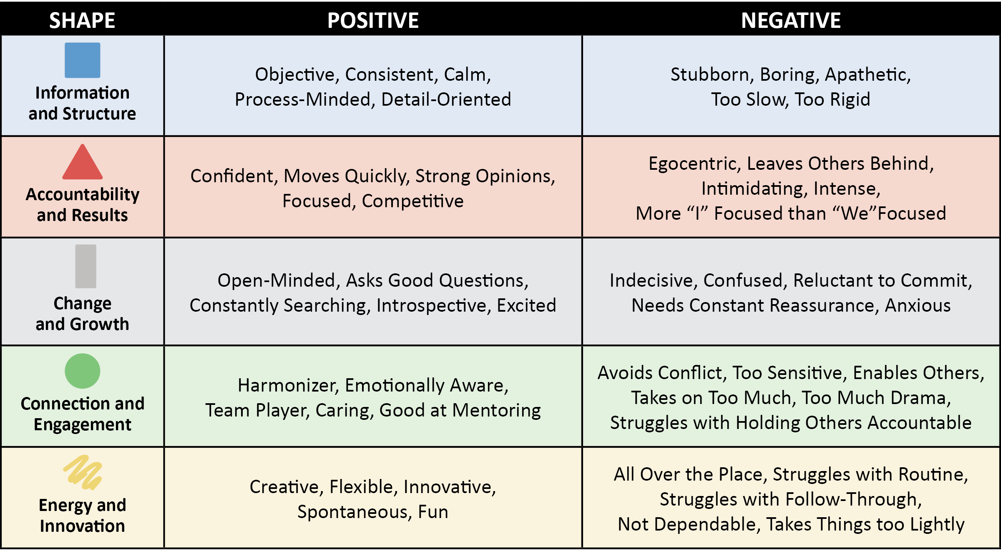
Shape Perception
Notes:
SCRIPT: Now that you’ve had the opportunity to practice identifying Shape traits and behaviors, let’s take a look at the possible positive and negative perceptions of each Shape. Please note, these are just examples and may not necessarily all relate to you. Although, it is important to be aware of the possible perceptions of our Shapes, we don’t want to overcorrect. You will find a blank “Shape Perception” chart in your participant workbook. Feel free to write down any examples from this list that you would like to capture.
NOTE: Give participants a few minutes to capture any notes or thoughts.

Slide 57
Shape Perception
Family-Reflection Questions:
Is there a possible misperception of you that you would like to change?
Do you have a possible misperception of someone else in your family?
Notes:
SCRIPT: Take a few minutes to reflect and answer these two questions. Once you have had a chance to reflect individually, share your answers with your family members.
NOTE: Give participants a few minutes to share with their families. Ask for volunteers to share.

Slide 58
Module 3: Shape Flexing
Notes:
SCRIPT: In Module Three, we will introduce the concept and benefits of “flexing.” Then we will learn the PsychoGeometrics term “Shape Flexing.” From there, we will define and understand the difference between the golden and platinum rule and how that influences how and why we should flex when communicating. We will identify the steps and apply the skill of Shape Flexing. And finally, you will discover how to use Shape Flexing to enhance and strengthen your communication style.

Slide 59
Shape Flexing
What is Flexing?
Identifying and adjusting to communication styles that we are presented with at any given time.
A skill, talent, or ability to use.
Conscious or subconscious.
Examples:
Showing more or less emotion.
Speaking pace.
Volume of voice.
Notes:
SCRIPT: Let’s start by defining the word “flexing.” Flexing is identifying and adjusting to communication styles that we are presented with at any given time. It can also be defined as a skill, talent, or ability to use. And lastly, flexing can be conscious or subconscious, meaning you may be aware or unaware that you are flexing while communicating. Some examples of flexing while communicating include showing more or less emotion by adding humor or a smile, showing patience, changing your volume of voice or speaking pace. Some flexing behaviors may be more challenging than others depending on your natural communication stye and how you approach a situation.

Slide 60
Shape Flexing
What is Shape Flexing?
Shape Flexing is the skill set of adding a specific Shape behavior, or combination of Shape behaviors, to strengthen your communication effectiveness.
Notes:
SCRIPT: The PsychoGeometrics term “Shape Flexing” can be defined as the skill set of adding a specific Shape behavior, or combination of Shape behaviors to strengthen you communication effectiveness.

Slide 61
Shape Flexing
Why Shape Flex?
Golden and Platinum Rule
Golden Rule – Treat others how you would like to be treated.
Platinum Rule – Treat others how THEY want to be treated.
Shape Flexing is the key to connectedness.
By Shape Flexing you raise the probability that others understand your communication style, you understand the communication style of others, and negative perceptions change to positive ones.
Notes:
SCRIPT: Most everyone has heard of the Golden Rule – treat others how you want to be treated. But have you heard of the Platinum Rule? The Platinum Rule says to treat others how THEY want to be treated. Shape Flexing is the key to connectedness. When you flex, people see and hear (consciously or subconsciously) that you are aware of their Shape and communication preferences, and you are willing to change your own communication style to meet the needs of others. Finally, Shape Flexing raises the probability that others understand your communication style, you understand the communication style of others, and negative perceptions change to positive ones.

Slide 62
Shape Flexing
Steps for Shape Flexing
Enable your senses – Identify their Shape through verbal or nonverbal communication. “What do you see?” “What do you hear?” The answers serve as clues and help us make assumptions.
Process – Clarify your assumptions through open-ended questions or statements. “Tell me more.”
Connect the dots – Listen to understand. “What are they looking for?” “What do they need?” “What is their situation?”
Flex – Modify your communication style based on what they reveal about themselves and their situation.
Notes:
SCRIPT: Soon we will learn the skills of how to Shape Flex to each of the five Shapes. But how do you know the Shape of others? The first step is to enable your senses. This means to pay attention to what you see and hear. Once we pick up on someone’s verbal or nonverbal behavior, we can begin to make our assumptions as to their Shape. The next step is process, where you clarify your assumptions though opened ended questions or statements like “Tell me more.” Next, it’s time to connect the dots by listening to understand. What are they looking for? What do they need? What’s the situation? The last step of the process is to flex. Modify your communication style based on what they reveal about themselves and their situation. Remember, you can still be true to yourself when Shape Flexing.

Slide 63
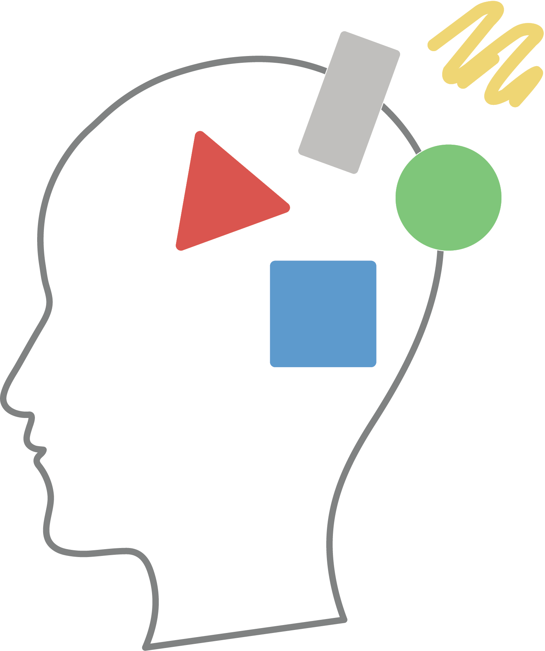
Shape Flexing
What does Shape Flexing look like for each Shape?
Notes:
SCRIPT: Now let’s learn what Shape Flexing looks like for each Shape.

Slide 64
Shape Flexing to Communicate with a Box
Slow it down.
Give a heads up.
Stick to the facts.
Keep it steady.
Don’t push it.
Notes:
SCRIPT: We will start with the Box. When you are Shape Flexing to communicate with a Box consider these flexing tips. 1. Slow it down. The Box will appreciate the time to think and process. 2. Give a heads up. Boxes don’t like to be caught off guard. Give advance notice when possible. 3. Stick to the facts. Boxes make decisions based on data not emotion. 4. Keep it steady. Avoid last minute surprises and keep your commitments. 5. Don’t push it. Don’t pressure the Box to compromise their values. They will respond by digging their heels in deeper.

Slide 65
Shape Flexing to Communicate with a Box
Family Discussion Questions
Who in your family is a primary or secondary Box?
How does/do the Box(es) in your family like to be approached?
What are a few examples of how you can flex to communicate with the Box(es) in your family?
Notes:
SCRIPT: We are now aware of some specific ways of how to flex to communicate with a Box. With your family, you will now discuss some real ways to flex to the actual Box in your life. Take a moment to determine who in your family is either a primary or secondary Box. That/Those person(s) is/are now the leader(s) of the conversation. They will explain the best ways to flex to communicate with them. If no one in your immediate family is a primary or secondary Box, think of a friend or someone in your extended family that may be a Box. Put yourself in the shoes of the Box and discuss how you, as the Box, would want people to flex towards you.
NOTE: Give families about five minutes to discuss. Ask for volunteers to share what they discussed. Respond to volunteers and facilitate the conversation by asking open-ended questions.

Slide 66
Shape Flexing to Communicate with a Triangle
Less is more.
Get to the point.
Pick up the pace.
Provide three options.
Don’t miss your exit ramp.
Notes:
SCRIPT: Next, we will look at some ways to Shape Flex when communicating with a Triangle. 1. Less is more. Triangles appreciate knowledge but they don’t need to hear the whole story. Triangles value effectiveness in terms of time not quantity. 2. Get to the point. Triangles are busy and will interrupt or finish your sentences for you. 3. Pick up the pace. Start with “this can be brief.” Triangles are more likely to be responsive if they know they can do it quickly. 4. Provide three options. Triangles don’t like to be told what to do; they like having control and making the decision. 5. Don’t miss your exit ramp. Going “on and on and on” will only frustrate the Triangle. They don’t need you to explain it again or underscore anything you have already said. They got it the first time.

Slide 67
Shape Flexing to Communicate with a Triangle
Family Discussion Questions
Who in your family is a primary or secondary Triangle?
How does/do the Triangle(s) in your family like to be approached?
What are a few examples of how you can flex to communicate with the Triangle(s) in your family?
Notes:
SCRIPT: We are now aware of some specific ways of how to flex to communicate with a Triangle. With your family, you will now discuss some real ways to flex to the actual Triangle in your life. Take a moment to determine who in your family is either a primary or secondary Triangle. That/Those person(s) is/are now the leader(s) of the conversation. They will explain the best ways to flex to communicate with them. If no one in your immediate family is a primary or secondary Triangle, think of a friend or someone in your extended family that may be a Triangle. Put yourself in the shoes of the Triangle and discuss how you, as the Triangle, would want people to flex towards you.
NOTE: Give families about five minutes to discuss. Ask for volunteers to share what they discussed. Respond to volunteers and facilitate the conversation by asking open-ended questions.

Slide 68
Shape Flexing to Communicate with a Circle
Connect.
Be nice and show it!
Don’t be in a hurry.
Be vulnerable and ask for help.
Put people first.
Notes:
SCRIPT: We will now look at ways to Shape Flex when communicating with a Circle. 1. Connect. Ask about something you have in common, such as a recent work holiday, a personal event, or someone you both know. Take an interest in who and what is important to them before moving on to the next thing on your agenda. 2. Be nice and show it! Being friendly and showing that you care is more important than what you know, what you want, or what you need. Use non-verbal communication like facial expressions (smile), body language (arms or hands open) and tone of voice (not too high and not too low) to engage with a Circle. 3. Don’t be in a hurry. Take time to listen and talk it out. The Circle has lots of feelings, and they appreciate being able to verbalize those feelings without being a burden. 4. Be vulnerable and ask for help. This makes the Circle feel comfortable and builds trust, plus Circles like to help. Use emotion and unify by creating a shared consensus or sense of purpose. 5. Put people first. When approaching a Circle, be sure to lead with care and concern for the well-being of others. Link your communication to people, not things. State the impact to people before sharing the details.

Slide 69
Shape Flexing to Communicate with a Circle
Family Discussion Questions
Who in your family is a primary or secondary Circle?
How does/do the Circle(s) in your family like to be approached?
What are a few examples of how you can flex to communicate with the Circle(s) in your family?
Notes:
SCRIPT: We are now aware of some specific ways of how to flex to communicate with a Circle. With your family, you will now discuss some real ways to flex to the actual Circle in your life. Take a moment to determine who in your family is either a primary or secondary Circle. That/Those person(s) is/are now the leader(s) of the conversation. They will explain the best ways to flex to communicate with them. If no one in your immediate family is a primary or secondary Circle, think of a friend or someone in your extended family that may be a Circle. Put yourself in the shoes of the Circle and discuss how you, as the Circle, would want people to flex towards you.
NOTE: Give families about five minutes to discuss. Ask for volunteers to share what they discussed. Respond to volunteers and facilitate the conversation by asking open-ended questions.

Slide 70
Shape Flexing to Communicate with a Squiggle
Make it fun!
Bring the energy!
Leave some wiggle room.
Don’t be too rigid or controlling.
Be Flexible.
Change it up!
Notes:
SCRIPT: The Squiggle is next. Consider these tips when Shape Flexing to communicate with a Squiggle. 1. Make it fun! If it’s not fun, creative, or unique, you will quickly lose interest from the Squiggle. 2. Bring the energy! Speak quickly. Engage the Squiggle with a new idea, enthusiasm, and positivity. Squiggles can be easily bored. 3. Leave some wiggle room. Anything too structured will not appeal to the Squiggle. Ask for their ideas to make something more engaging or appealing to others. 4. Don’t be too rigid or controlling. Squiggles beat to their own drum. They need the freedom to operate; to figure it out on their own. They don’t respond well to mandates or negativity. 5. Be Flexible. A “go with the flow” attitude goes a long way with a Squiggle. Even in the midst of a challenging or intense situation, the Squiggle can lighten up and find something funny to laugh about. Don’t mistake their laid-back attitude as complacency or a lack of drive. 6. Change it up! A Squiggle needs variety. Don’t be afraid to “catch the Squiggle off-guard.” Squiggles bounce back, can laugh at themselves, and they have a way of landing on their feet.

Slide 71
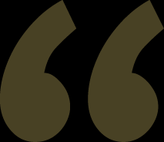
Shape Flexing to Communicate with a Squiggle
Family Discussion Questions
Who in your family is a primary or secondary Squiggle?
How does/do the Squiggle(s) in your family like to be approached?
What are a few examples of how you can flex to communicate with the Squiggle(s) in your family?
Notes:
SCRIPT: We are now aware of some specific ways of how to flex to communicate with a Squiggle. With your family, you will now discuss some real ways to flex to the actual Squiggle in your life. Take a moment to determine who in your family is either a primary or secondary Squiggle. That/Those person(s) is/are now the leader(s) of the conversation. They will explain the best ways to flex to communicate with them. If no one in your immediate family is a primary or secondary Squiggle, think of a friend or someone in your extended family that may be a Squiggle. Put yourself in the shoes of the Squiggle and discuss how you, as the Squiggle, would want people to flex towards you.
NOTE: Give families about five minutes to discuss. Ask for volunteers to share what they discussed. Respond to volunteers and facilitate the conversation by asking open-ended questions.

Slide 72
Shape Flexing to Communicate with a Rectangle
Be patient.
Provide clear instructions.
Listen for understanding.
Ask open-ended
questions.
Keep Rectangles
focused on what’s important right now.
Notes:
SCRIPT: Finally, let’s take a look at how to Shape Flex to communicate with someone in Rectangle mode. 1. Be patient. The Rectangle is experiencing change and may be indecisive, unsure of themselves, or frustrated. Don’t patronize, rush, or pressure them to “get through it” or “not worry about it.” Validation of their thoughts and feelings is important. More than ever the Rectangle needs to understand and be understood. 2. Provide clear instructions. Ensure that your communication is clear and concise. The Rectangle is likely already feeling overwhelmed. Don’t add to their chaos. 3. Listen for understanding. The Rectangle is not thinking, feeling, or acting like their typical selves. They are processing their thoughts, feelings, and the change itself. Practice active listening by being attentive, summarizing what you hear, and asking for clarification as needed. You earn the right to support, help, or guide by listening. 4. Ask open-ended questions. Give the Rectangle opportunities to talk and work through the change they are experiencing. This will prompt them to talk through their answers, using you as a much-needed sounding board. 5. Keep Rectangles focused on what’s important right now. Since it can take up to 18 months to navigate through personal change, they must “reel themselves back into reality” from time to time and take the steps that are important to their survival and ultimately their success.

Slide 73
Shape Flexing to Communicate with a Rectangle
Family Discussion Questions
Who in your family is going through a Rectangle change?
How does/do the person(s) in Rectangle mode like to approached?
What are a few examples of how you can flex to communicate with the person going through a Rectangle phase?
Notes:
SCRIPT: We are now aware of some specific ways of how to flex to communicate with someone in Rectangle mode. With your family, you will now discuss some real ways to flex to the actual person in your life who is going through a Rectangle change. Take a moment to determine who in your family scored above a three in Rectangle. That/Those person(s) is/are now the leader(s) of the conversation. They will explain the best ways to flex to communicate with them. If no one in your immediate family is going through a Rectangle transition, think of a friend or someone in your extended family who may be in Rectangle mode. Put yourself in the shoes of the Rectangle and discuss how you, as the person in a Rectangle phase, would want people to flex towards you.
NOTE: Give families about five minutes to discuss. Ask for volunteers to share what they discussed. Respond to volunteers and facilitate the conversation by asking open-ended questions.

Slide 74
Speed Shaping
Notes:
SCRIPT: Now, we are going to play a fun game that gets us up and moving around.

Slide 75
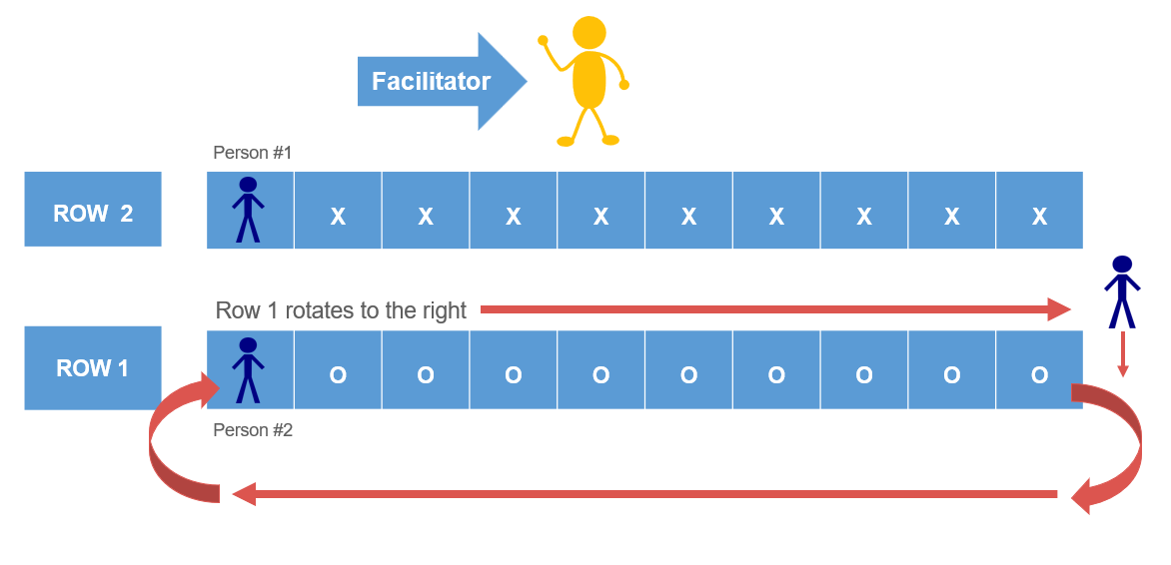
Speed Shaping Setup
Speed Shaping
Practice Shape Flexing by assuming the role of the assigned Shape!
Notes:
NOTE: You will need a fairly large amount of space for this activity. It may be a good opportunity to go outside, but keep in mind that your participants will need to be able to hear you say the prompts for this game and you will need to have a way to time it in15-second intervals once you begin. If moving outside is not an option, you can try using a hallway or moving a few tables to clear a space to form two, parallel rows of people facing each other. If you have a total of 60 people you would have two rows of 30 people facing each other, regardless of location, whether you stay in the workshop room, go outside, or move to a hallway.
SCRIPT: It’s now time to practice what we have learned when it comes to Shape Flexing. This is a fun and fast-paced activity called Speed Shaping! Here’s how it works. You will begin by picking a partner. Then you will determine who will be person #1 and person #2.
NOTE: Give participants a minute to find a partner and assign who will be person #1 and person #2.
SCRIPT: Now, we are going to make two parallel rows of people, approximately three feet apart, facing each other. There will be row 1 and row 2. If you are person #1 you will be in row 1 and if you are person #2 you will be in row 2. You will be standing directly in front of your partner. Please see the image on the screen if you are having trouble imaging what the two rows should look like.
NOTE: Give a few minutes for participants to get set up in their two rows. You may have to guide and direct people to the appropriate places if they are struggling on where to go. If there is an uneven amount of people, have the extra person stand at the end of row one (they will still be participating). There will be multiple rounds of this activity and they will sub in after the first round. Once everyone is standing in their rows, stand so that row 1 is facing you, as the facilitator, and row 2 has their back to you.
SCRIPT: Great! I will now ask row 1 to turn so they can see me and that row 2 stand facing their partner. Row 2’s backs should be toward me.
NOTE: At this time, you can either begin the activity or do one final check to make sure everyone is in the right place. You can do this check by asking your participants to do the following;
Raise your hand if you are in row 1. If everyone else in your row is also raising their hand and you can see me, you are in the right place.
Raise your hand if you are in row 2. If everyone else in your row is also raising their hand, and your back is toward me, you are also in the right place.
Now point your finger at your partner. If your partner is directly across from you, facing you, then everyone is in the right place!
SCRIPT: Now that we are all in the right places, I will explain how the game works. I will begin by giving you a prompt and holding up a large SHAPE CARD so only the people in row 1 can see the Shape. The people in row 1 will assume the role of the Shape on the card and give the people in row 2 clues so the people in row 2 can guess the Shape. So, row 1 will be the clue givers and row 2 will be the guessers. After the prompt is given, you will have 15 seconds to give clues and guess the answers. After every round, row 1 will “rotate” by moving one space to your right. Row 2, you will not “rotate” but since row 1 will be “rotating”, you will have a different partner every round. For row 1, when you get to the end of your row, walk around the back to the beginning of your row facing a new partner. Make sense?
NOTE: Pause and ask if anyone has any questions. Be careful not to over explain or complicate this activity. People tend to learn and “get it” more as the game goes on. Please note, if there are an odd number of people, the extra person will stand at the end of row 1 and wait until the next round to “rotate” in. There will be one person that sits out each round, but please remember rounds are only 15 seconds long so no one will be sitting out for long.
SCRIPT: Let’s start with a practice round. Everybody ready? Row 1 – tell your partner something that would motivate this Shape by finishing this sentence: “This Shape likes it when ________________”.
NOTE: You will use the large SHAPE CARDS to hold up one card at a time so that row 1 can see the Shape on the card. Let’s say the first Shape you hold up is a Circle. The people in row 1 would say to the person directly across from them in row 2 something like: “when you include them.” Other responses might be when you smile at them or give them a hug, when you work together as a team, or when you thank them or appreciate them. Give them a little longer than 15 seconds to do this first one. After about 30 seconds or so, ask someone to share what they said to their partner. Then ask the partner to share what they guessed. This is a good time to reinforce that this game is meant to be fun and to have the time to practice what they are learning. No pressure to get it right. As long as we are learning, we are winning!
SCRIPT: Great job! Would someone in row 1 share what you said and what your partnered guessed? Anyone else want to share? Any questions?
NOTE: After making sure everyone understands and questions are answered, you are ready to begin! Depending upon your group, you may find that they are on the quiet side at first, but with every set of clues and guesses, they will get more comfortable with the game. The laughter and the chatter will increase, and you may find you need to use a microphone or talk loudly when it’s time to rotate. You can also use a bell, or other sound, to signal it’s time to rotate, asking row 1 to repeat and finish the same prompt but flexing to another Shape that you hold up on your large card for everyone in row 1 to see.
SCRIPT: Okay – let’s start Shape Flexing and guessing! We will keep the same prompt for now. So, each time I say rotate, row 1 you will finish the same sentence according to the Shape on the card that only your row can see, and row 2 you will guess which Shape they are describing. Here we go! Row 1, this Shape likes it when ______________________________________________________.
NOTE: Hold up a different Shape card and start your timer. Repeat this same prompt at least five times, remembering to say, “rotate” after every 15-seconds and before holding up the next Shape card. Use any of the prompts from the list below or create your own! You can do as few or as many rounds as time allows and that people are still engaged and enjoying the activity. Remember, you can do multiple rounds with the same prompt but changing the Shape.
Prompts:
This Shape doesn’t like it when……
This Shape just won $100 dollars, here’s the first thing they would do……
It’s the first day of school. How would this Shape like to be welcomed?
When it comes to the family vacation, this Shapes likes to……
As this Shape, describe how to get to your house.
As this Shape, describe your morning routine.
NOTE: Throughout the activity, remember to check in with the group. Ask questions like, “How are you feeling? Is it getting easier? Are you ready for the next prompt?”
ACTIVITY: Speed Shaping Instructions
Instruct participants to find a partner.
Tell partners to determine who will be person #1 and person #2.
Participants will then make two parallel rows of people, approximately three feet apart, facing each other. There will be row 1 & row 2.
Person #1 you will be in row 1. Person #2 will be in row 2. Participants should be standing directly across from their partner.
If there is an uneven number of people, everyone will still participate. Instruct the extra person to stand at the beginning of row 1 (this is explained in the slide script & notes).
Instruct row 1 to turn so they can see you and instruct row 2 to turn to have their backs towards you.
Explain that row 1 will be the clue givers and row 2 will be the guessers.
Once everyone is in the correct position, read a prompt (prompt examples can be found in the slide script & notes) and hold up one of the large Shape cards.
Give participants 15 seconds to give their clues and make their guesses, then instruct row 1 to “rotate” by moving one space to their right. Row 2 will not rotate but will have a new partner for each round because row 1 will be “rotating.”
Each round will be 15 seconds and row 1 will “rotate” one space to their right after each round.
You can use the same prompt for multiple rounds by using at different Shape each time.
Once you have gone through as many prompts as you want or have time for, ask participant to return to their seats.
Throughout the activity, remember to check in with the group. Ask questions like, “How are you feeling? Is it getting easier? Are you ready for the next prompt?”

Slide 76
Shape Flexing
Family-Reflection Questions:
What are your top three takeaways from Shape Flexing?
How will you Shape Flex to best communicate with the members of your family?
Notes:
SCRIPT: In your Participant Workbook, take a few minutes to reflect and answer these two questions. Once you have had a chance to reflect individually, share your answers with your family members.
NOTE: Give participants a few minutes share with their families. Ask for volunteers to share.

Slide 77
Module 4: Shape Motivation
Notes:
SCRIPT: It’s now time to move on to Module Four, Shape Motivation. In Module Four, we will introduce the concept of motivation and demotivation. Then we will learn the PsychoGeometrics terms “Shape Motivation” “Shape Demotivation,” and “Shape Mojo.” From there, we will learn how to apply “motivation awareness” to understand what motivates and demotivates you and others. And finally, you will discover how to raise the probability that you meet your motivational needs and the needs of others.

Slide 78
Shape Motivation
What is Motivation?
A driving force behind all action.
An internal state that stimulates and activates your behavior and gives it direction.
A natural force that can propel you forward.
Notes:
SCRIPT: Let’s start by defining the word “motivation.” Motivation can be defined as the driving force behind all action. It’s an internal state that stimulates and activates your behavior and gives it direction. However, it is important to note that what motivates one person, may not motivate another. Internal motivation is personal. Motivation is also a natural force that can propel you forward. This happens when something externally inspires you to get internally motivated. For example, a family wedding can be the external inspiration to get internally motivated to lose 10 pounds. Here’s another example. Your son is having difficulty in school. You have been considering finding a tutor for your child, but you keep thinking he will eventually get the hang of it. After all, it takes a while to get adjusted to a new school, and he has always pulled through before. However, when mid-term progress reports are sent home, you see that your son is failing English and is also struggling with math. The progress report is the external inspiration that you gets you internally motivated to call a tutor today! Can anyone else think of another example when external inspiration gets you internally motivated to take the action you may have been putting off for a while?
NOTE: When someone shares an example, acknowledge their response. If time permits, ask for another example, also acknowledging their response and asking open ended questions so that they share more details. If you want to expand this workshop into a longer course, take some extra time here for partner or small group discussion about other examples of external inspiration that gets you internally motivated.
SCRIPT: As we can see, inspiration and motivation work hand in hand. It is being motivated that can keep you in a state of forward motion. Think of motivation as every bit as important as the air you breathe. It can contribute to your physical, mental, and emotional growth and overall health. Some people say motivation is just “fluff,” but motivation is truly the first step to productivity. It is also the first step to having the desire, energy, and resiliency to bounce back and keep moving forward, even when you don’t feel like it.

Slide 79
Shape Motivation
What is Demotivation?
An internal state.
Lack of drive or movement.
Natural force, but instead of propelling you forward, it can slow you down.
Can contribute to a lack of energy.
Notes:
SCRIPT: It may sound like a pretty simple question, but what is demotivation? Obviously, it is the opposite of motivation. So, what does that really mean? It’s an internal state, just like motivation, but instead of propelling you forward, it can slow you down, bring you to a standstill, or cause you to fall behind. Being demotivated means you have a lack of drive and energy, while the world continues on without you.

Slide 80
Shape Motivation
What is Shape Motivation?
Shape Motivation is specific to each of the five geometric Shapes of PsychoGeometrics.
It is what specifically motivates each of the Shapes, based on their natural traits, behaviors, and how they relate to others.
Notes:
SCRIPT: The good news is that with awareness, knowledge, skill, and desire, you have the power to raise the probability you stay motivated, get “re-motivated,” and communicate your motivation needs to others. You also have the power to approach others in way that will be motivating to them. In this case, think of yourself as the inspiration that can get others motivated.

Slide 81
Shape Motivation
What is Shape Demotivation?
Shape Demotivation is also specific to each of the five geometric Shapes of PsychoGeometrics.
It is what specifically demotivates each of the Shapes, based on their natural traits, behaviors, and how they relate to others.
Notes:
SCRIPT: Just as motivation is personal and specific to each of the Shapes, demotivation is also personal and specific to the Shapes, as well. Let me underscore that what motivates and demotivates one Shape may be drastically different than what motivates or demotivates another Shape. As is the case with Shapes in general, “one size” does not fit all.

Slide 82
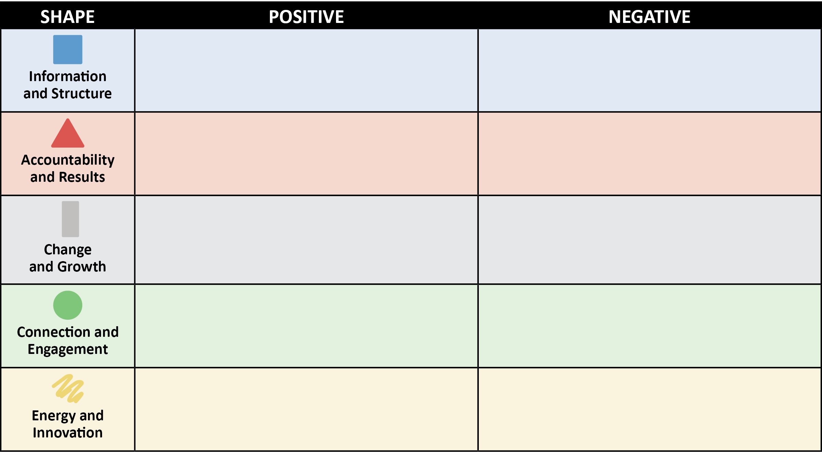
Shape Motivation
Family Activity
What might motivate each Shape?
What might demotivate each Shape?
WHAT MOTIVATES
WHAT DEMOTIVATES
Notes:
SCRIPT: With your family, you will work to complete this chart. This chart can be found in your Participant Workbook. Discuss the possible motivators and demotivators of each Shape and write down your answers in the chart. Once you have brainstormed multiple motivators and demotivators for each Shape, identify your top three for each.
NOTE: Give families about 10 – 12 minutes to complete their charts and identify the top three motivators and demotivators for each Shape. Go through each Shape and ask for volunteers to share their top three positive and negative responses.
.

Slide 83
Shape Motivation
Notes:
SCRIPT: Here are some of the most common responses of motivators and demotivators for each Shape. Feel free to write down any examples from this list in your own chart.

Slide 84
Shape Motivation
What is “Shape Mojo™?”
Your undefined personal way of getting something done related to your unique Shape combination.
It’s what excites and interests you.
It’s your special, “energizing” formula for showing enthusiasm through your Shapes.
Notes:
SCRIPT: Now let’s talk about something we like to call “Shape Mojo”. Simply put, “Shape Mojo” is what excites, interests, and energizes your Shapes. It’s your unique formula for getting things done. When you are “off-track” or not feeling productive, motivated, or successful, it’s time to find your “Shape Mojo” to get it back!

Slide 85
Shape-MOJO™ Game
Notes:
SCRIPT: We are now going to play “Shape-Mojo”!

Slide 86
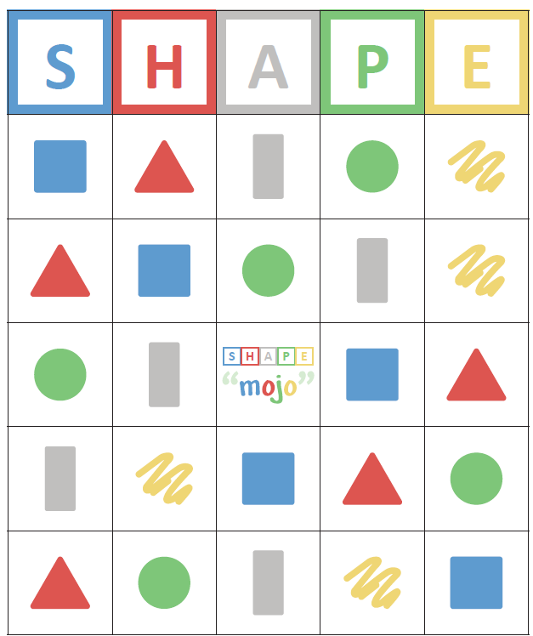
Shape-MOJO™ Game
Notes:
SCRIPT: If you’ve ever played bingo, you will catch on quickly to our version of the game that we call “Shape-Mojo.” This game will help us see how well we know what motivates and demotivates each of the Shapes. In your Shapes for Families Toolkit, you should find the “Shape-Mojo” playing card. There should be one per family. The way the game will work is I will read a statement that motivates one of the Shapes. You and your family will have about 30 seconds to discuss which Shape would be motivated by the statement, then place a chip on that Shape (it doesn’t matter which column or row). I will continue to read statements until one family fills in five spaces that make a diagonal, vertical, or horizonal line. When your family has five spaces filled in either diagonally, vertically, or horizontally, your family can yell out “MOJO!” The family who does this first will win the game.
NOTE: “Shape-Mojo Chips” will either be found in your Facilitator’s kit or in family’s individual toolkits. If you have the chips, distribute them at this time. If they are located in the family’s toolkits, instruct them to pull them out of their toolkit. You can either set these out prior to the workshop or pass them out at this time.
Begin the game. Depending on time and engagement, you can play this game a few times. Feel free to come up with your own statements.
NOTE: Please see the example statements below. Full activity instructions can be found in your Shapes for Families Facilitator Guide.
The game is highly competitive. (Triangle)
You can take some time to think about it before you give me your answer. (Box)
We want you to be the leader of our group. (Triangle)
You get to pick two or three friends to come over and hang out this weekend. (Circle)
Tell me more. (Rectangle)
It’s OK to change your mind. (Rectangle)
Please come up with a way to make this activity more exciting. (Squiggle)
It doesn’t matter if you win or lose as long as you are having fun! (Squiggle)
Let’s determine a budget for our family vacation. (Box)
Here’s the step-by-step detailed plan for each day of our vacation. (Box)
You can paint your bedroom any color you want. (Squiggle)
Let’s sit down and eat together as a family. (Circle)
Receiving a handwritten note or drawing to show appreciation is better than getting money. (Circle)
We will award one winner a trophy or medal (Triangle)
Teamwork is more important than winning. (Circle)
16. Someone who will take time to listen and mentor me, then tell me what I should do. (Rectangle)
17. I need someone who can figure out the best route for our trip in order to save time and money. (Box)
18. I am happiest when everyone in our family is happy. (Circle)
19. Can you come up with some new ideas for us to celebrate New Year’s as a family? (Squiggle)
20. Here’s the summary with three options. (Triangle)
ACTIVITY: Shape-MOJO™ Game Instructions
• Each family should locate their “Shape-Mojo” game board.
• Facilitator will distribute the “Shape-Mojo Chips”
Facilitator will read the following statements one at a time. Give families about 30 seconds between reading statements so they have an opportunity to discuss the answer with their family. Once the family has an answer, they will place a chip on the correct Shape. When a family has five spaces that make a vertical, horizontal, or diagonal line, they can yell out “MOJO!”
The game is highly competitive. (Triangle)
You can take some time to think about it before you give me your answer. (Box)
We want you to be the leader of our group. (Triangle)
You get to pick two or three friends to come over and hang out this weekend. (Circle)
Tell me more. (Rectangle)
It’s OK to change your mind. (Rectangle)
Please come up with a way to make this activity more exciting. (Squiggle)
It doesn’t matter if you win or lose as long as you are having fun! (Squiggle)
Let’s determine a budget for our family vacation. (Box)
Here’s the step-by-step detailed plan for each day of our vacation. (Box)
You can paint your bedroom any color you want. (Squiggle)
Let’s sit down and eat together as a family. (Circle)
Receiving a handwritten note or drawing to show appreciation is better than getting money. (Circle)
We will award one winner a trophy or medal (Triangle)
Teamwork is more important than winning. (Circle)
16. Someone who will take time to listen and mentor me, then tell me what I should do. (Rectangle)
17. I need someone who can figure out the best route for our trip in order to save time and money. (Box)
18. I am happiest when everyone in our family is happy. (Circle)
19. Can you come up with some new ideas for us to celebrate New Year’s as a family? (Squiggle)
20. Here’s the summary with three options. (Triangle)
• Once a family has called out “MOJO”, reveal the answers for each of the statements you’ve read so that all families can check their work.
Depending on time and engagement levels, you can play up to a few rounds of this game.

Slide 87
Shape Motivation
Family-Reflection Questions:
Are you getting what you need for self-motivation?
Is your family getting what it needs for motivation?
Could some of your actions be motivating some while demotivating others?
Notes:
SCRIPT: Take a few minutes to reflect and answer these three questions. Once you have had a chance to reflect individually, share your answers with your family members.
NOTE: Give participants to share with their families. Ask for volunteers to share.

Slide 88
Module 5: Strategic Shaping
Notes:
SCRIPT: It’s now time for our final module of the PsychoGeometrics communication system, Module Five, Strategic Shaping. We will start by introducing the PsychoGeometrics term “Strategic Shaping.” Then we will learn how to use the Strategic Shaping Model to maximize our Shape strengths, manage our Shape challenges, and leverage all five Shapes for the ultimate advantage to communicate effectively.

Slide 89
Strategic Shaping
What is Strategic Shaping?
The process of using all five Shapes to structure your communication for planning, problem solving, and conflict resolution.
Notes:
SCRIPT: Strategic means you have a detailed and planned strategy that has been thoughtfully created to achieve a specific purpose. When you add your knowledge of the Shapes, Strategic Shaping simply means using the strengths of all five Shapes in your approach. It is important to note that while all five Shapes are important to a successful strategy, all five Shapes do not need to be used equally. Similar to a recipe, there may be five important ingredients, but you only need a dash of salt compared to a cup of flour or sugar. The same is true of the five Shapes.
The Strategic Shaping Model is how you create your perfect recipe for effective communication, especially when it comes to planning, problem solving, and conflict resolution.

Slide 90
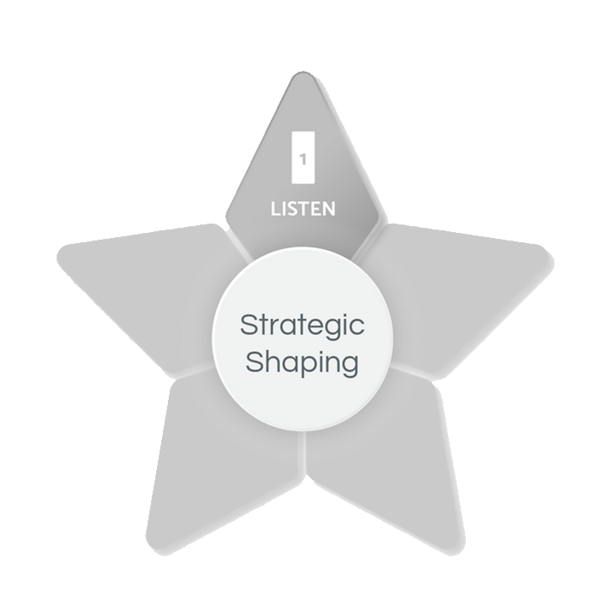
Strategic Shaping
Strategic
Shaping
Model
LISTEN
“I want to understand.
Tell me more.”
Notes:
SCRIPT: Let’s look at the necessary ingredients now.
The first ingredient is the Rectangle. Most people do not think of listening as the first step to creating a successful strategy. However, listening to understand is the key and first step to effective communication, whether it’s planning, problem-solving, or resolving conflict.
For example, let’s say you are trying to solve a problem, or someone has come to you for problem-solving advice. Our natural tendency is to start the problem-solving process by going to our most natural Shapes first, such as your primary and secondary Shapes. Very rarely do we think of the first step of problem solving to be pausing, then asking, and listening. It seems almost counterintuitive to most of us.
This is why the Rectangle is the most valuable skill set we can develop. To train ourselves to start with Rectangle requires conscious thinking since it’s not a natural place for most of us to start.
Think about it. If someone you love asks you to help them solve a problem, how would you naturally respond? A Box would remain calm and ask for the facts. The Triangle would spare you the time it would take to problem solve on your own, and instead, tell you the three things to do, and do now, to relieve your pain. The Circle would want to comfort you. The Squiggle would want to give you 10 ideas then encourage you to try them all until one of them works!
Instead, Strategic Shaping means you intentionally use all five Shapes to help solve the problem. It starts with three little words, “Tell me more.”

Slide 91
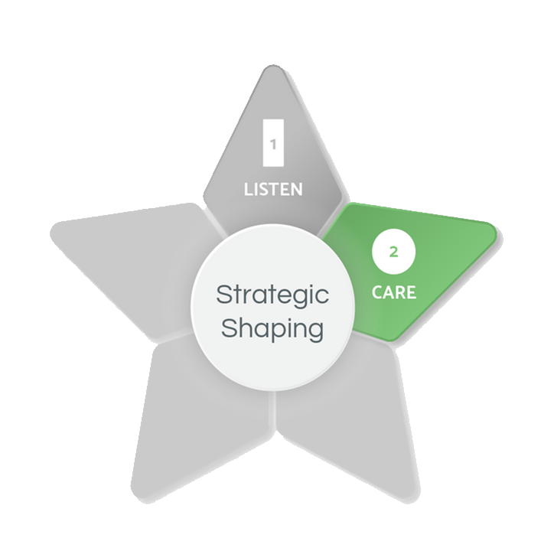
Strategic Shaping
Strategic
Shaping
Model
LISTEN
“I want to understand.
Tell me more.”
CARE
“I want to help.”
Show compassion
or concern.
Notes:
SCRIPT: Secondly, you will definitely need a dose of Circle to ensure a successful recipe. It is implied that you care if you take the time to Rectangle listen for understanding. But to underscore how much you care, the second ingredient is to say it and show it. If the three most important words to problem solving is “tell me more,” then the four most important words to problem solving are, “I want to help.” Make sure your non-verbal communication supports your verbal communication. In other words, if you say you want to help, make sure your facial expressions, body language, and tone of voice is in alignment. Relax your face, soften your tone of voice, and make eye contact as you say you want to help. Extend a hand or, if appropriate in some personal relationships, touch their arm or place your hand on their shoulder to “show” you care. In some cases, when you have a personal relationship already in place with someone, you may even want to offer a hug. Say, “I’m here for you.” The Circle is not only how you show that you care, but also how you connect.

Slide 92
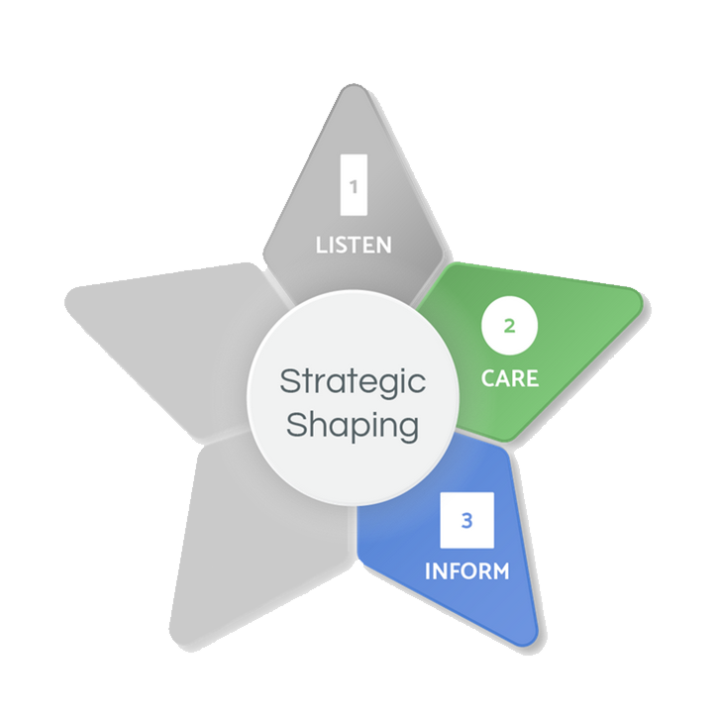
Strategic Shaping
Strategic
Shaping
Model
LISTEN
“I want to understand.
Tell me more.”
CARE
“I want to help.”
Show compassion
or concern.
INFORM
“Let’s consider the facts.”
Be logical.
Notes:
SCRIPT: Next, it’s time to take a step back from emotion and be objective. You can still show you care while wanting to know the facts, as brutal as they may be. It’s hard to help people if you don’t know the non-emotional details of the situation. You can say, “I care about you too much not to know or address the facts. That’s how we will figure this thing out!”

Slide 93
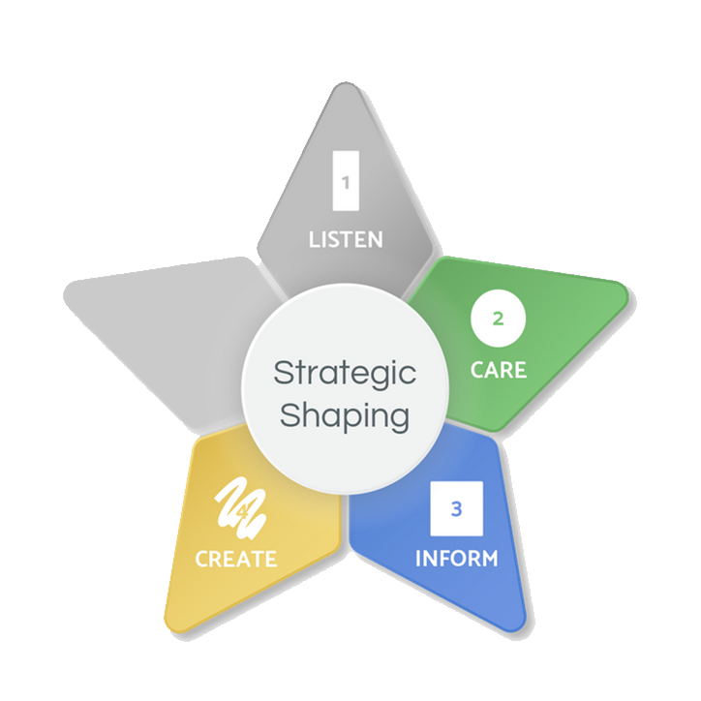
Strategic Shaping
Strategic
Shaping
Model
LISTEN
“I want to understand.
Tell me more.”
CARE
“I want to help.”
Show compassion
or concern.
CREATE
“Let’s find a way!
You got this!”
Be creative.
INFORM
“Let’s consider the facts.”
Be logical.
Notes:
SCRIPT: You have listened to understand. You have said that you care and want to help. You have asked for the facts. Now what? It’s either time to get Squiggle creative, share some inspiration, and words of encouragement. The Squiggle says, “There’s got to be a way. Let’s dig deeper!” Or “If there’s anyone who can do this, it’s you!” The Squiggle may also sense it’s time to take a break and lighten up before continuing the problem-solving process. “Let’s take a break and go have some fun! The problem will still be here tomorrow, and we can tackle it head on then!”

Slide 94
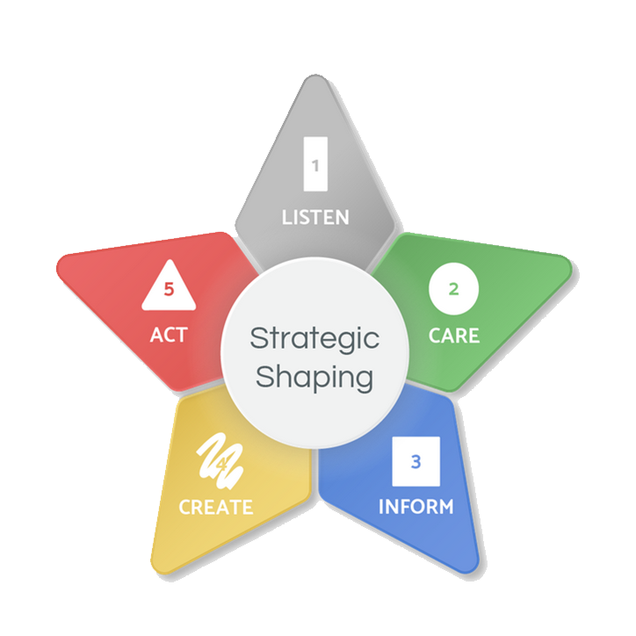
Strategic Shaping
Strategic
Shaping
Model
LISTEN
“I want to understand.
Tell me more.”
ACT
“Let’s get started.”
Take action.
Show responsibility.
CARE
“I want to help.”
Show compassion
or concern.
CREATE
“Let’s find a way!
You got this!”
Be creative.
INFORM
“Let’s consider the facts.”
Be logical.
Notes:
SCRIPT: Let’s recap. You are trying to help someone solve a problem You have used the Strategic Shaping Model for the first four steps.
The person who has come to you for help knows you Rectangle understand and Circle care. They also know you have the Box facts of the situation and that you will Squiggle challenge the status quo, digging deeper for an idea that might not even make sense in the moment, but wind up being the game changer in the end. Now you have earned the right to Triangle advise, recommend, or guide. This is so important to “earn the right.” It starts with the Rectangle. Listening doesn’t mean you have to agree. It means you care enough to understand.
Now is the time to make your recommendation to solve the problem, or initiate responsibility, accountability, and action on the part of the person who has come to you for help. The Triangle may say, “Now that we have talked it out, what do you think should be your next step?”

Slide 95
Strategic Shaping Model – Problem Solving
Strategic Shaping Model for Problem Solving
We tend to communicate using just our natural Shape strengths or using our natural Shape strengths first, sometimes without even thinking about it.
For example, when someone comes to you with a problem, your response typically comes from your primary or secondary Shape, or a blend of both.
shows compassion
stays
calm
wants to
advise
is
innovative
wants to understand
Notes:
SCRIPT: If you want to become a more effective communicator and strengthen the relationships that mean the most to you, the most important words you can say is, “Tell me more. I want to understand.” It takes an open mind and the discipline to use all five Shapes, starting with the Rectangle to communicate effectively, instead of jumping to your primary or secondary Shapes. Keep in mind that you show love, care, and concern through your natural Shapes. Instead of listening to understand as the first step of effective communication, you instinctively jump to your “go to Shapes.” These are your primary and secondary Shapes. It’s like breathing. You don’t even think about it. You just do it. That’s why using the Rectangle has to be a learned skill set, since being in an open-state of mind is not natural for most of us.
Whether the objective is to be an active listener to understand your partner, an open-minded leader to connect with your team, or a more creative, collaborative, or strategic problem solver, adding the Rectangle to your communication style is a game changer.

Slide 96
Strategic Shaping – Problem Solving Scenarios
With your family:
Discuss the following questions for the scenario your family selects:
How might you naturally respond using only your primary and secondary Shapes?
How might your response look differently using all five Shapes?
Notes:
SCRIPT: Now you are going to have the opportunity to practice and apply the Strategic Shaping Model for problem solving. In your Shapes Participant Workbook, you will find five Strategic Shaping Scenarios. Read each scenario as a family and pick one to use in this activity. Scenario #5 is a “create your own scenario.” If none of the other scenarios resonate with you or your family, please feel free to make up your own! Just be sure your scenario includes a communication problem that needs to be solved. With your family, discuss the following questions: 1. How might you naturally respond using only your primary and secondary Shapes? 2. How might your response look differently using all five Shapes? Use your Participant Workbook to capture your thoughts and ideas. Then select one family member to share when we return for large group discussion.
NOTE: Give participants about 15 minutes to work with their family and create a response to their scenario using the Strategic Shaping Model. Ask for a few volunteers to share their responses. Respond to volunteers and facilitate the conversation by asking open-ended questions.

Slide 97
Strategic Shaping – Parent to Child Scenario
Strategic Shaping Scenario #1
You and your family have just moved to a new state. Your middle school-aged daughter is struggling to adjust to her new school. She is missing her old friends and feeling upset that she hasn’t made any new friends yet.
Use the Strategic Shaping Model to plan your response when your daughter comes to tell you about the situation.
Notes:
NOTE: Share this slide during the large group discussion.

Slide 98
Strategic Shaping – Child to Parent Scenario
Strategic Shaping Scenario #2
You’ve just been invited by some kids from school to a movie this Friday night! You’ve recently moved to a new city, and this is the first time you’ve been invited to hang out with friends outside of school. You really want to go but know that your Grandmother is coming to town for the weekend. You are also aware that your dad has planned a family dinner at home.
Use the Strategic Shaping Model to help plan your approach when discussing the movie with your dad.
Notes:
NOTE: Share this slide during the large group discussion.

Slide 99
Strategic Shaping – Parent to Parent Scenario
Strategic Shaping Scenario #3
You and your partner have an elementary-aged son. Lately, he seems to really be struggling in math. Prior to this year, he has always done “ok” in math. He never got A’s (excellent performance), but he typically maintained B’s (good performance), with an occasional C (satisfactory performance). On his last report card, he had a D (less than satisfactory performance) in math and his teacher mentioned her concerns during the last parent/teacher conference. You think it’s time to hire a tutor, but your partner is not as convinced. Your partner says “It’s only one report card! He’ll bring up the grade. He is a smart kid!” You also believe your son is smart but feel strongly that he needs some extra help.
Use the Strategic Shaping Model to address your concerns and guide a conversation with your partner.
Notes:
NOTE: Share this slide during the large group discussion.

Slide 100
Strategic Shaping – Sibling to Sibling Scenario
Strategic Shaping Scenario #4
It’s finally summer vacation! You have a lot of plans this summer including a summer job, high school soccer workouts, a few college campus visits, and hanging out with friends. But none of these plans start until next week so you have the entire week to relax and enjoy the start of summer! On her way out the door for work this morning, your mom hands you a list of household chores and yard work that she would like you and your brother to complete this week. The list doesn’t look that overwhelming for two people; however, your younger brother hasn’t always been known to pull his weight. It seems like you are always the one stuck with most of the work. Although you are only 15 months older, you’ve always felt several years more mature than him.
Use the Strategic Shaping Model to approach your brother about splitting up the chores and yard work and executing your plan.
Notes:
NOTE: Share this slide during the large group discussion.

Slide 101
Strategic Shaping #5 – Create your Own!
Strategic Shaping Scenario #5
If you prefer, please feel free to create your own scenario. Be sure to include a communication problem and then use the Strategic Shaping Model to help solve the problem.
Notes:
NOTE: Share this slide during the large group discussion.

Slide 102
Strategic Shaping
Family-Reflection Question:
What part of the Strategic Shaping Model will help you the most when communicating with your family?
Notes:
SCRIPT: In your Participant Workbook, take a few minutes to reflect and answer this question. Once you have had a chance to reflect individually, share your answers with your family members.
NOTE: Give participants a few minutes to share with their families. Ask for volunteers to share.

Slide 103
Family Applications
Notes:
SCRIPT: Now that we have completed the five modules, we will move on to the Family Applications section of our workshop. This section will include four additional activities. They are 1. How does each Shape show Love?, 2. Building & Shaping Trust, 3. Shaping your way through Change, and 4. The Family Awareness Wheel.

Slide 104
How does your Shape show love?
Notes:
SCRIPT: We will start with discussing how each Shape can show love differently.

Slide 105
How does your Shape show love?
“I remain calm and objective, focusing more on the facts than the feelings.”
“I want to take away your pain and solve your problem as quickly as possible!”
“I fall short showing care and concern for others because I’m overwhelmed by the changes in my own life.”
“I stop what I’m doing and make time to listen and offer comfort.”
“I will be your biggest cheerleader!”
Notes:
SCRIPT: The way one Shape shows love might not be how another Shape shows love. Here are some examples of how each Shape might show they care when someone they love is facing a problem.
NOTE: Read the quotes on the screen. Feel free to add in your own stories where you see fit.
SCRIPT: Now, let’s talk through a potential real-life example. Let’s use the scenario of celebrating someone’s birthday. How might each Shape show love to their family member on their birthday?
NOTE: Pause and ask for a few volunteers to give an example on how each Shape might show someone they love them on their birthday.
SCRIPT: The Box might buy them a functional gift, like a vacuum cleaner; the Triangle might give them a gift card to their favorite store; the Circle might plan an afternoon at the beach to spend time together; while the Squiggle might attempt to bake them a cake from a recipe they found through social media. Since the Rectangle is often consumed by the changes in their own life, they may struggle to come up with an idea or form a plan for someone’s birthday. The unlimited possibilities could be too overwhelming for the Rectangle. It is also possible that someone in Rectangle mode might forget someone’s birthday. It’s not because the Rectangle doesn’t care, they may just be so overwhelmed and self-consumed that it slips their mind. In most cases, the person in Rectangle mode will feel badly and may revert back to their primary Shape to try and make it up to the person they love.

Slide 106
How do your family members show love?
Family Discussion
Knowing each other’s Shapes, discuss your natural ways of showing love.
Discuss how you each prefer to receive love.
Is the way your family member(s) show(s) love the way you want to be loved? Is the way you show love the way your family member(s) want(s) to be loved?
Notes:
SCRIPT: Now let’s talk specifically about how you and your family member(s) show(s) care/love. You will have time to discuss the following prompts/questions 1. Knowing each other’s Shapes, discuss your natural ways of showing care/love. 2. Discuss how you each prefer to receive care/love. 3. Is how you prefer to receive care/love the same as how your family member(s) show(s) care/love? Is how you show care/love the same as how your family member(s) prefer(s) to receive care/love?
NOTE: Give participants about 12 minutes to discuss with their family. After 12 minutes, bring participants back to the larger group and ask for volunteers to share what they discussed. Respond to volunteers and facilitate the conversation by asking open-ended questions.

Slide 107
Building and Shaping Trust
Notes:
SCRIPT: We will now move on to Building and Shaping Trust. In this section, we will discuss how to build trust with each Shape.

Slide 108
Building Trust with each Shape
Do what you say you will do, and do it well, consistently. Ask me what I know and what I think.
Be confident, take action, and produce results. Follow me.
Tell me more. Listen to me, be patient with me, support me, and advise me.
Show you care about me, my team, and my family first. Appreciate me.
Just be straight with me. Give me the flexibility to get my job done.
Notes:
SCRIPT: Building trust can look differently for each Shape. A Box may say “Do what you say you will do, and do it well, consistently. Ask me what I know and what I think.” To build trust with a Box, it’s important to have a logical, proven process, or plan.
A Triangle may say “Be confident, take action, and produce results. Follow me.” To build trust with a Triangle, give them some kind of authority, ownership, or influence.
A Circle may say “Show you care about me, my team, and my family first. Appreciate me.” To build trust with a Circle, show them how much you care and take time to show your appreciation.
A Squiggle may say “Just be straight with me. Give me the flexibility to get my job done.” To build trust with a Squiggle, make it fun or let them have fun, show your willingness to be different or accept differences.
A Rectangle may say “Tell me more. Listen to me, be patient with me, support me, and advise me.” To build trust with a Rectangle, provide them the opportunity to explore and support their growth.

Slide 109
Building and Shaping Trust
Family Discussion
How might you build trust with a family member who is a primary Box? Triangle? Circle? Squiggle?
How might you build trust with a family member who is in Rectangle mode?
How would someone build trust with you?
Notes:
SCRIPT: Now that we have discussed ways of building trust with each Shape, you will have an opportunity to talk with your family. With your family, please discuss how your approach might look differently when building trust with each family member as each Shape.
NOTE: Give families about 10 minutes to discuss the questions. After 10 minutes, bring participants back together for a large group discussion. Go through each Shape and ask for volunteers to share an example of how to build trust with that Shape. Ask for any “ah-hah” moments. Respond to volunteers and facilitate the conversation by asking open-ended questions.

Slide 110
Shaping Your Way through Change
Notes:
SCRIPT: Now we will move on to Shaping Your Way through Change. Change is inevitable. It can be both exciting and scary. You may find yourself faced with having to navigate yourself and your family effectively through change. In order to accomplish this, we will look at what each Shape needs to embrace, manage, and lead change.

Slide 111
How Shapes Respond to Change
Notes:
SCRIPT: First, it’s important to recognize your natural response to change. The Box can be resistant to a change with little information and no proven-track record. Or they could be excited if they get to be part of solving a problem caused by the change. The Triangle can be uncomfortable with change that lessens control but might get excited to overcome a challenge for the big win. The Circle might be concerned or worried about a change that people might not like but they could be motivated by a change that benefits the people they care about in life. The Squiggle is not so worried about change, because after all the Squiggle gets bored easily and change can be fun! But the Squiggle will rebel in response to a change that restricts their independence, freedom, and flexibility. And yet what we sometimes don’t like, don’t want, or causes us to be uncomfortable is exactly what we need for personal growth and change. Regardless of your primary and secondary Shapes, people experiencing a significant change will be thrown into the “unknown” called the Rectangle. Not all people are even aware this is happening, but most people report that when experiencing a significant change in life, they don’t feel like their typical self. A life change can be anything that disrupts your typical thoughts, feelings, moods, behaviors, and interactions with others, such as starting school, finishing school, going back to school, moving to a new city or country, taking a new job, losing or leaving a job, getting married, getting divorced, having a baby, adopting a baby, being an empty nester, losing a close friend or family member, caring for aging parents, experiencing a serious injury or health issue, surviving a natural disaster, or learning how to cope during a pandemic. During significant life changes, you can be both excited and scared. Or a little of both.

Slide 112
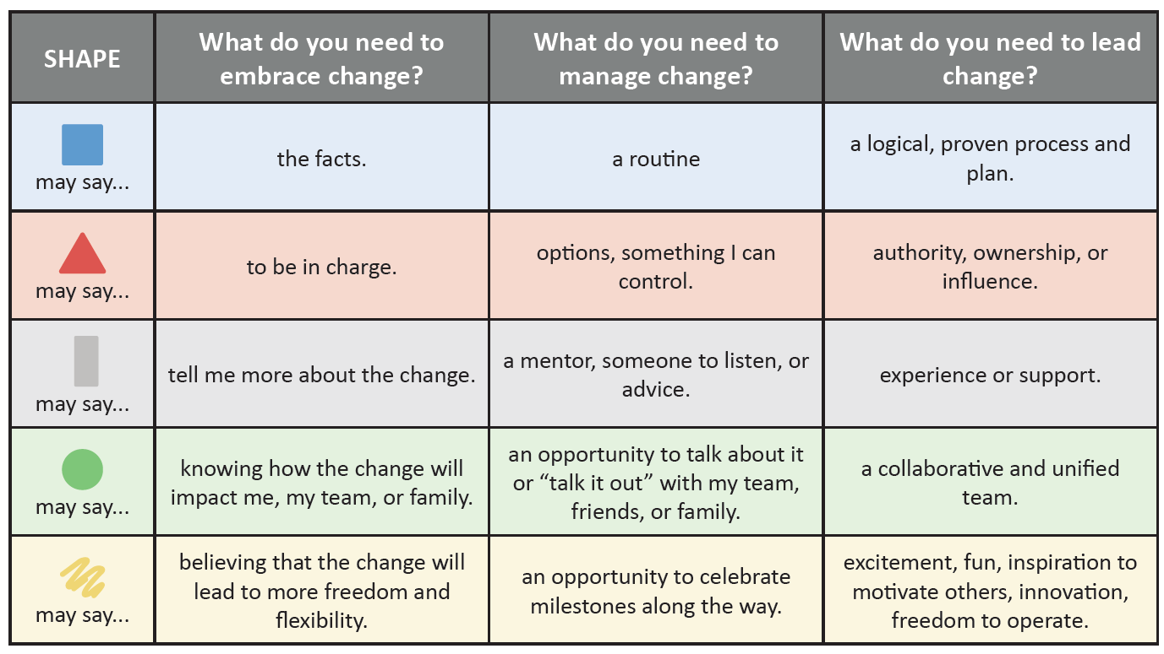
Embracing, Managing, & Leading through Change
Notes:
SCRIPT: Look at what each Shape needs to embrace, manage, and lead change. Take a moment and disucss the things that you need most when embracing, managing, and leading change. Please note that the things you need don’t necessarily have to be in your primary and secondary Shapes. Remember, when going through a change your needs may come from any one of the five Shapes depending upon your specific situation.
NOTE: Give participants a few minutes to discuss their answers. After a few minutes, ask for a few volunteers to share and facilitate the conversation by asking open-ended questions.

Slide 113
Self-Reflection
Family-Reflection Question:
What is your natural response to change?
Notes:
SCRIPT: Now that we’ve learned how each of the five Shapes respond, embrace, manage, and lead change, take a moment to reflect on yourself. With your family, discuss the following question: 1. What is your natural response to change?
NOTE: Give participants about 10 minutes to discuss these question with their family and then ask for a couple of volunteers to share. Facilitate the conversation by asking open-ended questions.

Slide 114
Family Awareness Wheel
Notes:
SCRIPT: Now we are going to do the Family Awareness Wheel activity. The Family Awareness Wheel is a tool utilized for identifying and clarifying a healthy blend of Shape traits or behaviors that your family needs to effectively function and communicate.

Slide 115
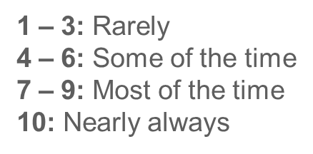
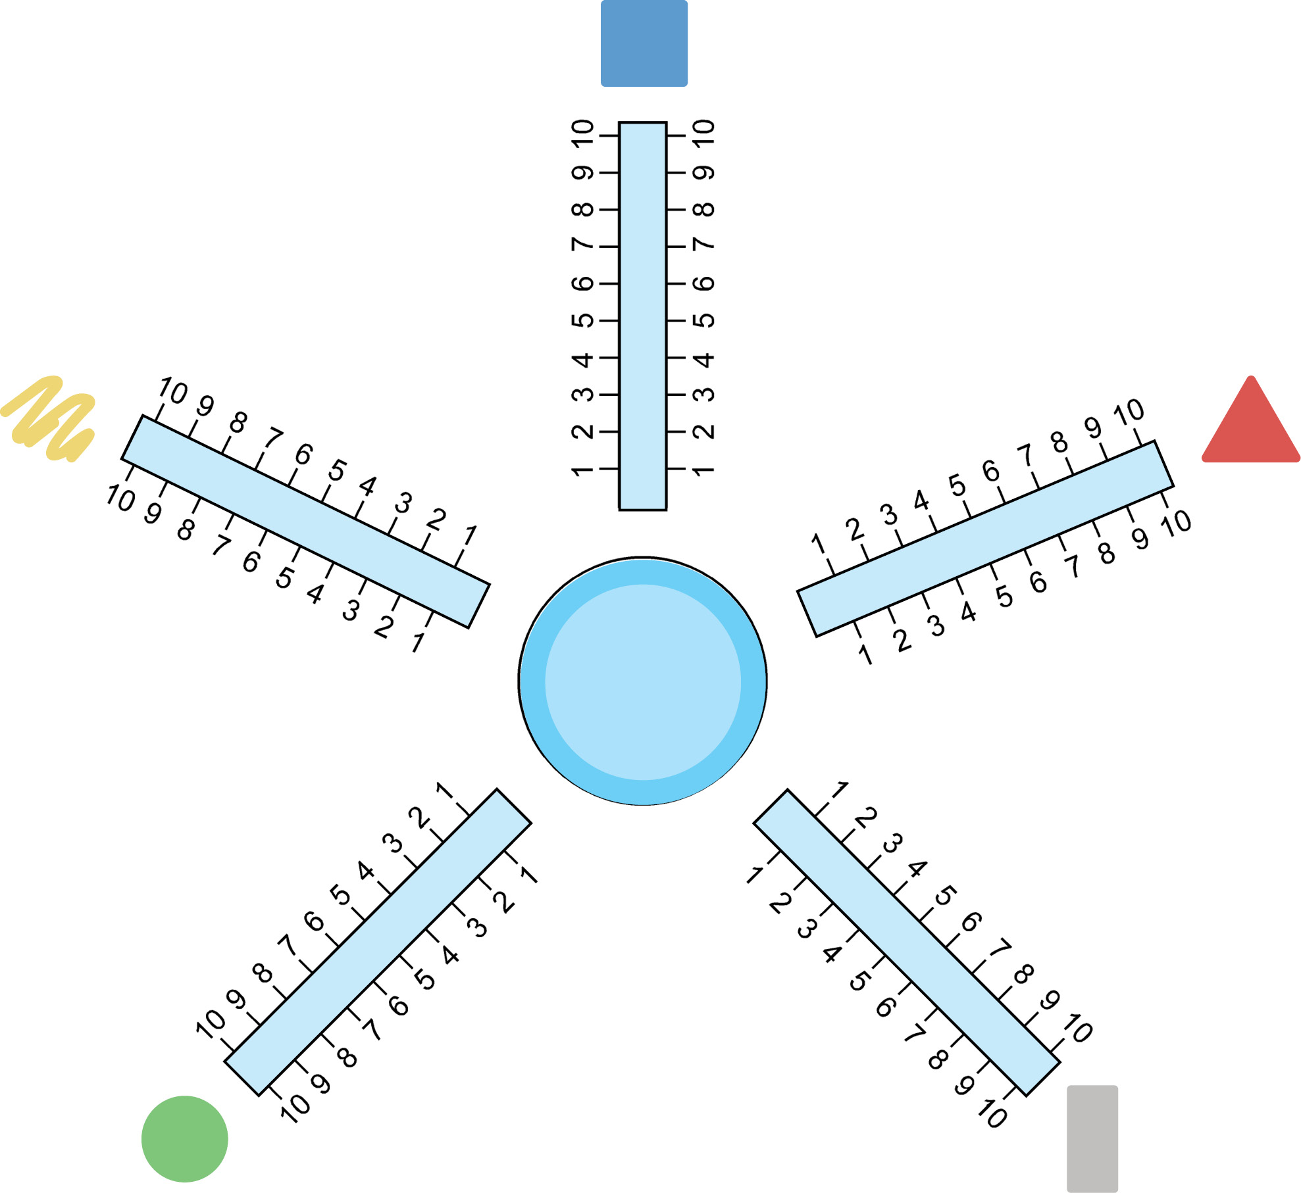
Family Awareness Wheel
Our family has clear rules, guidelines, and/or a weekly routine that we follow consistently.
Our family has clear direction.
Our family can be open-minded and says, “tell me more,” to understand one another.
Our family has a healthy balance of harmony, unity, and is sensitive to the needs of one another.
Our family can be creative, flexible, and knows when to lighten up and have fun!
Organization & Consistency
Creative, Flexible, & Fun
Leadership & Direction
Our
Family
Harmony, EQ, & Caring
Openness & Understanding
Notes:
SCRIPT: To start this activity, let’s look at the five statements that correspond to each Shape. Notice, that each Shape represents a spoke on your Family Awareness Wheel.
NOTE: Read each statement out loud to the participants.
SCRIPT: You will use the Family Awareness Wheel found in your Participant Workbook for this activity. As a family, you will now evaluate how consistently you are using each trait, behavior, or interaction in your family. Read each statement that represents one of the five Shapes. As a family, discuss, evaluate, and rate how consistently your family is using this trait, behavior, or interaction in your family on a weekly basis. Use the scale of 1-10 and place an “X” on the number of each spoke that best represents your family’s evaluation. Here is what the numbers mean: 1 – 3: Rarely; 4 – 6: Some of the time; 7 – 9: Most of the time; or 10: Nearly always. Once you have an “X” on each spoke, you will connect the “X’s” on each spoke to draw your family’s tire.

Slide 116
Family Awareness Wheel
Our family has clear rules, guidelines, or a weekly routine that we follow consistently.
Our family has clear direction.
Our family can be open-minded and often says “tell me more,” in an effort to understand one another.
Our family has a healthy balance of harmony, unity, and is sensitive to the needs of one another.
Our family can be creative, flexible, and knows when to lighten up and have fun!
X
X
X
Our
Family
X
X
Notes:
SCRIPT: Don’t worry if your tire is not a perfect circle! It may resemble something as shown on the screen.
NOTE: Give families about 15 minutes to complete their Family Awareness Wheel. After the 15 minutes, bring everyone back and discuss what their wheels may indicate.
SCRIPT: Take a look at your wheel. What’s working? What’s not? Where may you have a “bump” or “flat tire” in your family’s communication effectiveness? What will you change about your “ride?” As you evolve, you will find that the traits and behaviors you need will also change. It is recommended that you use the Family Awareness Wheel a few times a year to monitor your use of each trait or behavior, or if it’s time to change the Shape traits or behaviors you need to be an effective communicator with your family. As objectives, goals, and other things change around you, you may need to use a different trait or behavior in your communication style to be effective.
NOTE: Give families another five minutes to discuss their “tire.”

Slide 117
Family Awareness Wheel
Share with another Family!
Share where you placed an “X” on each spoke.
Do you need to raise your level of awareness for using any of the Shapes in your family’s communication style? If so, which Shape traits or behaviors?
Organization & Consistency
Creative, Flexible, & Fun
Leadership & Direction
Our
Family
Harmony, EQ, & Caring
Openness & Understanding
Notes:
SCRIPT: Now you will have an opportunity to discuss your Family Awareness Wheel with another family. Please discuss the following two prompts with another family: 1. Share where you placed an “X” on each spoke. 2. Do you need to raise your level of awareness for using any of the Shapes in your family’s communication style? If so, which Shape traits or behaviors?
NOTE: Families will pair up and discuss the prompts. Give participants about 5 – 10 minutes to discuss with another family. Bring participants back to the large group and ask for volunteers to share. After the large group discussion, inform participants that this is a tool they can use moving forward to evaluate often and track their progress.
.

Slide 118
Review & Wrap Up
Notes:
SCRIPT: Over the course of this workshop, you have learned about PsychoGeometrics, the science of behavior and the art of communication. More specifically, you have learned about your communication style, the communication style of others, and how to strengthen your relationships by communicating more effectively. It started with the Shapes Card Game by identifying the traits and behaviors that naturally describe you and the ones that do not. While your natural Shape strengths, or as we have learned, your primary and secondary Shapes will stay with you all your life, it doesn’t mean you are limited to using just those two Shapes. You can now further develop your primary and secondary Shapes and add the other Shapes as learned skill sets to your communication style. This gives you the power to leverage all five Shapes to be the best possible version of yourself and to have an even higher probability of strengthening your relationships.

Slide 119
Workshop Recap
The Five Modules
Module 1: Introduction to PsychoGeometrics
Module 2: Shape Perception
Module 3: Shape Flexing
Module 4: Shape Motivation
Module 5: Strategic Shaping
Family Applications
How does each Shape Show Love?
Building & Shaping Trust
Shaping your Way through Change
Family Awareness Wheel
Notes:
SCRIPT: We spent some dedicated time learning about each of the five modules of the PsychoGeometrics communication system. You were given time to practice and apply what you learned. Of course, learning is a continuous process, but you should have a good understanding of PsychoGeometrics. We also went through our four Family Applications that included, How does each Shape Show Love, Building & Shaping Trust, Shaping your Way through Change, and the Family Awareness Wheel. Now it’s time for more application and practice as you leave this workshop and return to the “real world.”
NOTE: If time permits, or you are looking to expand the length of this workshop, pause here to provide one more teaching moment. Ask your participants to use their pen and sign their name anywhere in their Shapes Participant Workbook. Now ask them, how did that feel? Did they even think about it, or did they just do it? Was it easy or hard? Now ask them to pick up the same pen in their other hand and sign their name again. Ask how did that feel? More than likely, your participants will tell you that it was awkward, uncomfortable, and that they consciously had to think about how to do it. Ask them how does their second signature look compared to their first signature. Chances are, you may hear someone say it looks like a five-year-old tried to do it. Now ask, do you think you could get better at using your non-dominant hand if you practiced every day? What if your next paycheck depended on it?
While you may never be as good at signing your name with your non-dominant hand as you are with your dominant hand, your signature will get better, and it will feel less awkward the more you practice. And, so it is with Shapes. Keep practicing every day by applying Shape Perception, Shape Flexing, Shape Motivation, and Strategic Shaping to your communication style. Little is big, and there is a cumulative value of doing the little things consistently over time. Even so, you will still walk away noticing big changes immediately in how you see yourself, others, and the world now that you know and understand the science of behavior and art of communication.

Slide 120
Objectives Recap
Do you understand your communication style, including strengths and challenges, and the communication style of your family members?
Can you recognize the possible positive and negative perceptions of your communication style by your family members, and your positive and negative perceptions of your family members?
Do you know how to use Shape Flexing to strengthen the effectiveness of your communication approach and responsiveness with each member of your family?
Are you aware of what motivates and demotivates you and your family members and can you adjust your communication accordingly?
Will you be able to apply the Strategic Shaping Model for planning, problem solving, and conflict resolution, making the hard conversations easier and the result all the better?
Notes:
SCRIPT: Now let’s take some time to review what we set out to achieve over the workshop.
NOTE: Give participants a few minutes to read through the objectives.

Slide 121
Review & Wrap Up
Family-Reflection:
Take a moment to reflect on the workshop.
What were your three biggest takeaways?
Notes:
SCRIPT: Before we wrap up, please review your notes in your Shapes Participant Workbook, then reflect and write down your three biggest takeaways.
NOTE: Give participants a few minutes to answer this question and then ask if anyone would like to share their takeaways. Respond to volunteers and facilitate the conversation by asking open-ended questions.

Slide 122
Congratulations!
You are on your way to being a more effective communicator.
Notes:
SCRIPT: Congratulations! You have the knowledge and skill to be a more effective communicator.

