Slide 1
Presented by Your Name, Shapes Certified Facilitator
Notes:
Opening Comments

Slide 2
Presented by Your Name, Shapes Certified Facilitator
Notes:
Opening Comments

Slide 3
Shaping the Success of your Team
It IS What You Say and HOW You Say It!
Notes:
You may use this as your sub-title slide, editing or replacing the sub-title and/or quote, adding a picture or opening story.
1-3 minutes

Slide 4
As a result of taking the
and participating in this session, you will be able to:
Better understand your communication and behavioral style.
Better understand the communication and behavioral style of others.
Recognize the power and value of using each of the Shapes.
Learn what is means to “Shape Flex” and how you can use “Shape Flexing” to strengthen your relationships, your team, and your communication.
Notes:
1-3 minutes

Slide 5
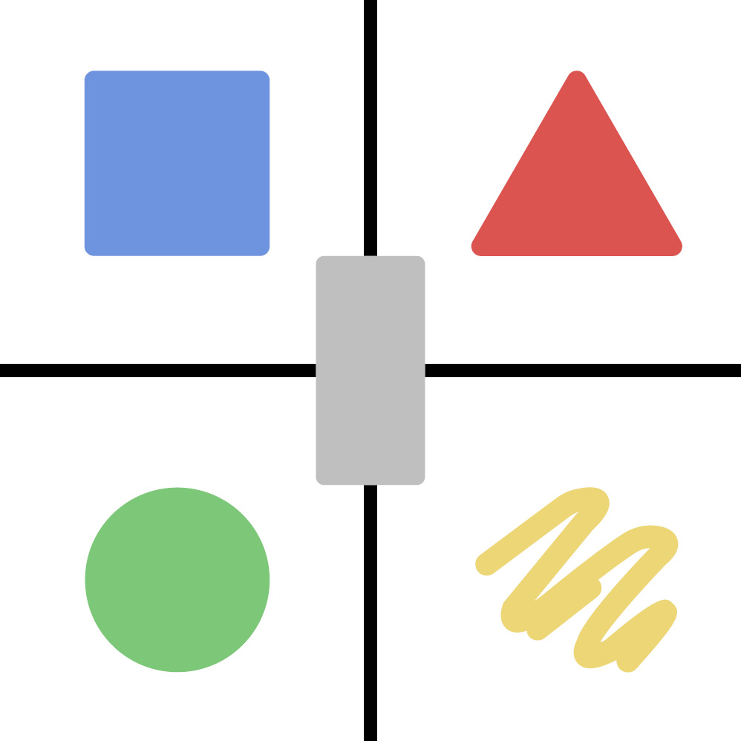
Things to Know about all 5 Shapes
Every shape represents a behavior.
Every shape has value.
Every shape has power.
Every shape has strengths and challenges.
The behavior you exhibit the most is most likely a combination of your primary and secondary shapes (natural strengths).
Maximize your shape strengths for your success. Manage your shape challenges to help prevent failure. This is called “Shape Flexing.”
No matter what your natural shape strengths, it is wise to consider and leverage the behaviors of all five behaviors for effective communication.
Notes:
2-3 minutes
Before we get into the specific traits of each shape, here are some things to know about all five shapes.

Slide 6
Left-Brain Shapes
Logical, Objective, Factual
Written and Verbal
Right-Brain Shapes
Intuitive, Emotional, Creative,
Visual and Auditory
Left Side Thinking:
Logical, Linear, Factual
Right Side Thinking:
Creative, Innovative, Emotional
INFO & STRUCTURE
ACTION &
RESULTS
CHANGE &
GROWTH
CONNECTION & HARMONY
ENERGY & CREATIVITY
Notes:
Now, let’s look at each shape (NOTE TO FACILITATOR: notice with the animation – each shape appears as you click. You are introducing the shapes left brain to right brain. The rectangle comes up last, as it is the one shape that is not a primary or secondary shape, but rather a transitional shape. It is the shape of change and growth. With awareness, willingness, and desire, you can see through the lens of each of the other four shapes when you are in Rectangle mode. As a healthy Rectangle – you are open to exploring, listening, and understanding. Without awareness or understanding that you are in a Rectangle state, you may feel confused, overwhelmed, undecided, and uncomfortable).
5-10 minutes
People with shapes from the left side of the brain tend to have a behavioral style that is logical, linear, factual, and inspired by numbers, spreadsheets, pie-charts, data, goals, winning, the scoreboard or results.
The Left Brain
The box is the most left-brain shape of all five shapes and finds it very difficult to use any of the right-brain traits. The box can be a primary or secondary shape.
The triangle is left-brain, too, but it has some natural ability to use a few of the right-brain traits. The triangle can be a primary or secondary shape.
People who tend to be logical, linear, factual. Inspired by things such as numbers, spreadsheets, pie-charts, data, goals, winning, the scoreboard or results.
The box
The most left-brain
Finds it very difficult to use any of the right-brain traits
Primary or secondary shape
The triangle
Has some natural ability to use a few of the right-brain traits
Primary or secondary shape
The Right Brain
People with a more emotional and creative behavioral style inspired by people, testimonies, stories, teamwork or energy generated by helping others as a group, as part of a cause, or as part of an idea.
The circle
Has some natural ability to use a few of the left-brain traits
Primary or secondary shape
The squiggle
The most right-brain
Finds it difficult to use any of the left-brain traits
Primary or secondary shape

Slide 7
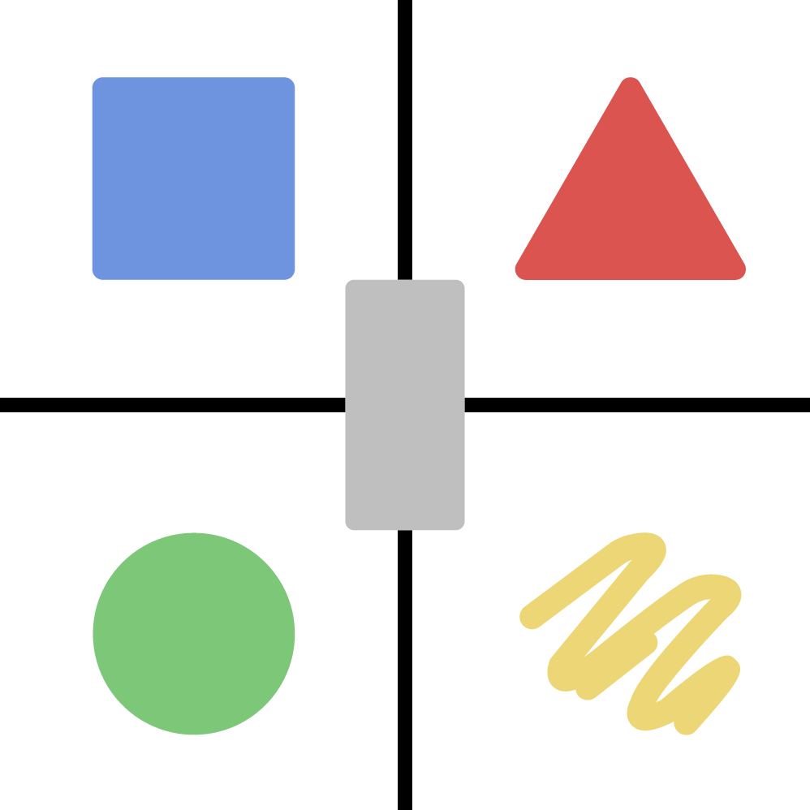
UNDERSTANDING YOUR SCORE
see complete scoring guide in your Shapes Profile Report
0-3 LOW – does not mean below average
4-6 MEDIUM – does not mean average
7+ HIGH – does not mean above average
Just because you score “high” in a shape does not necessarily mean you are good at using that shape.
It means you have a high percentage of that shape within you naturally,
and you have the potential to be great at using it.
The Science of Behavior – The Art of Communicating
Using the Shapes Assessment for Simple, Efficient and Effective Communication.
All content copyrighted by Hite Resources, Inc. and Pgeo, Inc. www.psychogeometrics.com
Notes:
5 minutes (you can reference the scoring guide, but give them time to review and discuss their scoring guide with a partner later).
Take time to look at your scores and profile report now. Remember your total score cannot be more than 21.
If 21 = 100%, you can calculate the percentage of each individual shape as part of your total shapes score of 21.
Think of each shape as an ingredient for effective communication. Just like you don’t need equal parts of all ingredients to make a delicious cake, you don’t need equal parts of all shapes to make effective communication. But you do need all parts.
For example, if you score 2 in a shape, that means that shape is less than 10 percent (9.52% to be exact) of your natural communication style. (2 is considered low; therefore, 10% is considered low).
Low means you have a low percentage of this shape naturally within you. However, you can still use it and use it “well enough” to complement your other shapes. A low score would indicate a potential growth opportunity to develop this shape as a skill set.
Let’s say you score 5 in another shape. This means that this shape represents a little less than 25% of your total shapes score (23.81% to be exact).
Medium means you have a medium amount of this shape naturally within you. A medium score also represents a potential growth opportunity in terms of managing this shape, as in when to use it more, when to use it less, how to use it to complement your Shape Strengths.
And finally let’s say you score 10 in a shape. 10 is considered a “high” score. This means you have a high amount of this shape naturally within you. In fact, scoring 10 in a shape means almost half of your natural communication style comes from this shape (47.62% to be exact). You have the potential at being “great” using this shape, as in it being your shape strength for effective communication.
However, scoring a 10 does not necessarily mean you are already good, or even great, at using this shape, especially in a mindful and healthy manner. Every shape can be used and misused. Every shape can be used with good intent, bad intent, or with no particular intent at all, meaning sometimes people are simply unaware of how using any one of the shapes can be perceived or misperceived by others, whether it’s a positive or negative perception. Shapes as a communication tool is intended to be used in a responsible healthy manner, but it is ultimately up to the user:
a) to be aware of the tool (what it is and what their shapes are – we call this awareness+knowledge)
b) how to use their shapes all shapes (we call this skill – shape flexing), and
c) to have the desire to use Shapes in a healthy and positive manner

Slide 8
Let’s learn more about each Shape!
Notes:
Now, let’s look at each shape individually in a little more depth starting with the most left brain shape, the box.

Slide 9
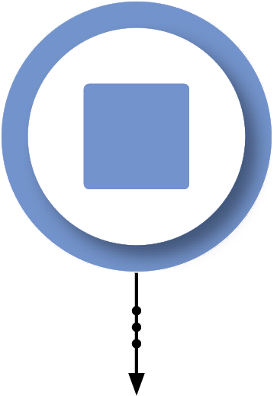
The 5 Shapes
The 5 Shapes
left side thinking
“I don’t make decisions based on emotion.
I make decisions based on facts.”
“If you want a job
done right, you have
to do it yourself.”
logical, linear, factual
“I need time
to think
about it.”
the box
the most left brain
logical
structured
slow to make a decision
detailed
efficient
structure
process-oriented
practical
Notes:
The Box may say, “If you want a job done right, you have to do it yourself!” - “I need time to think about it.” or “I don’t make decisions based on emotion. I make decisions based on facts.”
The Box is the most left brain of the five shapes. When you think of Box behavior, traits such as structured, detailed, process-oriented, logical, slow to make a decision, efficient and practical come to mind.

Slide 10
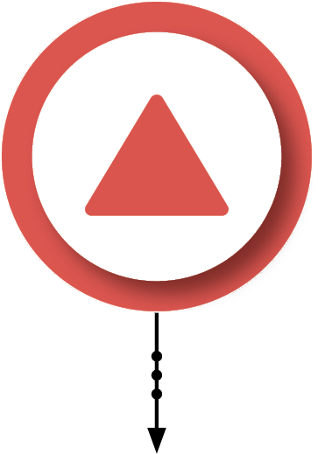
The 5 Shapes
left side thinking
“Be brief, be bright,
give me three options,
be gone.”
“Make a decision, and right or wrong, work to make it right.”
logical, linear, factual
“I don’t need to hear the whole story.”
the triangle
also left brain
action-oriented
less than the box
quick to make a decision
direct
bottom-line
driven
to the point
action
goal-focused
Notes:
The Triangle is also considered a left-brain shape, but less left-brained than the Box. When you think of Triangle behavior, descriptions such as direct, driven, goal-focused, action-oriented, quick to make a decision, bottom-line and to the point, are used.
The Triangle may say, “Make a decision, and right or wrong, work to make it right!” - “I don’t need to hear the whole story.” – “Be brief, be bright, give me three options, be gone.”

Slide 11
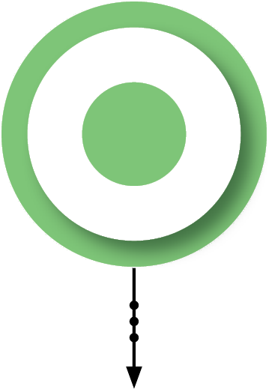
The 5 Shapes
“I know it might not make sense, but my heart, my gut, says this is the right thing to do.”
“I can just sense it, feel it – I don’t need a spreadsheet to know it.”
right side thinking
“I don’t care how much you know until I know how much you care.”
creative, innovative, emotional
the circle
right brain shape
mentor
not as much as squiggle
inclusive
harmony
relationship-oriented
harmony
nurture
sensitive
Notes:
The Circle may say, “I don’t care how much you know, until I know how much you care.” Or “I can just sense it, feel it – I don’t need a spreadsheet to know it.” “I know it might not make sense but my heart, my gut, says this is the right thing to do.”
The Circle is a right brain shape, but not nearly as right-brain as the Squiggle. When you think of Circle traits – words such as harmony, nurture, mentor, inclusive, relationship-oriented, and sensitive come to mind.

Slide 12
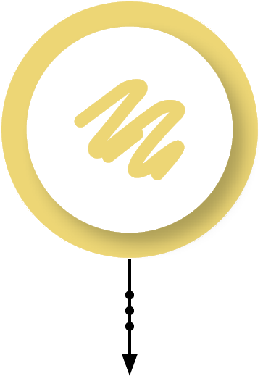
The 5 Shapes
“Just go with the flow.”
“What if we tried this?”
right side thinking
creative, innovative, emotional
“Lighten up, have some fun!”
“You can do it!”
the squiggle
most right brain
energized
opposite of the box
spontaneous
creative
unique
innovation
innovative
Notes:
A Squiggle may say, “You can do it!” - “Lighten up, have some fun!” - “What if we tried this?!” or “Just go with the flow!”
The Squiggle is the most right-brain of all five shapes. It is the complete opposite of the Box. Squiggle behavior can be described as creative, innovative, energized, spontaneous and unique.

Slide 13
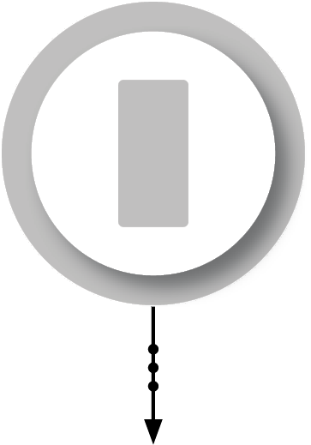
The 5 Shapes
“Before I can decide to change or support the change, I need to consider the people involved, the facts, the opportunities or restrictions, or how it impacts results.”
“Please listen to me, then tell me what to do.”
“What’s next?”
the rectangle
exploring
a turning point
open-minded
growth
undecided
change
Notes:
The Rectangle may say, “Please listen to me, then tell me what to do,” “What’s next?” “Or before I can decide to change or support the change, I need to consider the people involved, the facts, the opportunities or restrictions, or how it impacts results.”
When you think of Rectangle behavior, think exploring, open-minded, undecided, a turning point, and growth.
It is important to know that The Rectangle is neither a left brain or right brain shape. Instead, it is considered a transitional shape, representing change, and having the ability or need to see through and consider each of the other four shapes, using both sides of the brain. In fact, the way you respond to change is directly related to your natural shape strengths and your shape challenges. The Box is typically resistant to doing something new or different that has not yet been proven. The Triangle thrives on knowing exactly what to do and making quick decisions, so change that lessens control is extremely uncomfortable for the Triangle. The Circle first considers how they feel about the change, or how will it make others feel before they decide if they like or support the change. The Squiggle likes change if it provides more freedom and flexibility, highlights uniqueness and includes fun, but challenges any change that seems boring, too rigid, adds more rules or requires conformity.
The Rectangle is truly your key to growth and successful change, but it can be one of your least natural shapes to embrace and use. It requires awareness, consideration, anticipation, courage, open-mindedness, and an understanding of the value of change, even if the exact outcome is unknown, or requires a long, difficult, or sacrificial process.

Slide 14
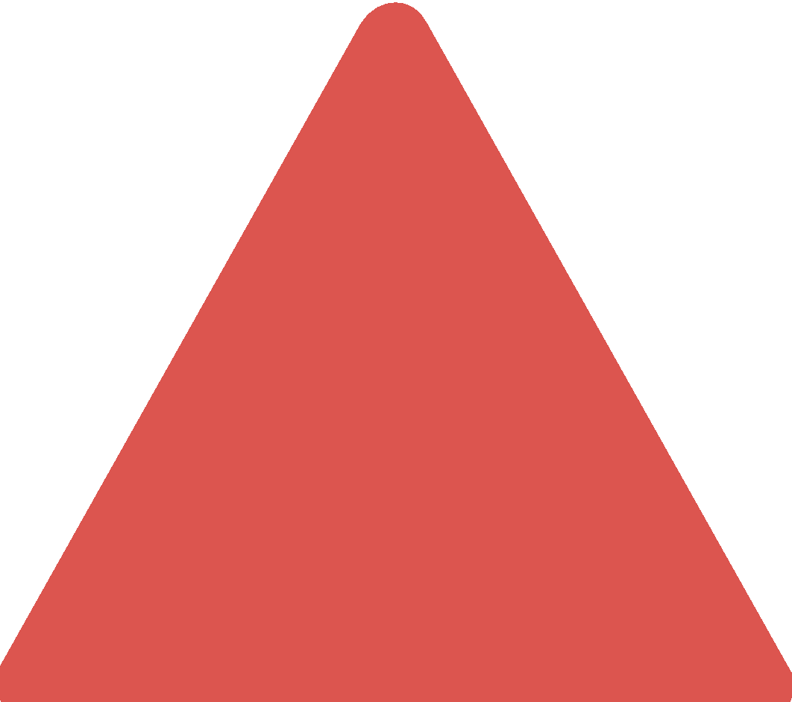
How Each Shape Responds to Change
a transitional shape
left side thinking
right side thinking
logical, linear, factual
creative, innovative, emotional
resistant to change that is new, different, or unproven.
uncomfortable with change that lessens control.
sensitive to the impact from change and how it makes people feel.
likes change that’s fun and promotes freedom, but questions change that is boring, restrictive, or too rigid.
change
Notes:
Let’s go a little deeper with the Rectangle – and personalize it for you and your shape or shapes.
Consider how your shape/your shapes respond(s) to change.

Slide 15
Partner or Small Group Activity – Understanding Your Shapes
Share your Shapes Results with your Partner or in your small group. What is your Primary Shape? Secondary Shape? Lowest Shape Score?
Share an example of how your Shape Strength(s) contribute(s) to effective communication.
Can this same Shape Strength also be a communication challenge? If so, how?
Notes:
Share the highlights of your shape report with a partner.
Ask and discuss the questions.

Slide 16
What’s Next?
Shape Perception
Shape Flexing
Notes:
Promote upcoming sessions, modules like Shape Perception and Shape Flexing. See next slides.

Slide 17
Shape Perception
Perception is Reality, but one’s Reality is not always the Truth.
Notes:
Are people seeing you like you want them to see you? Is their perception of you positive or negative?
Are you seeing people like they want to be seen? Is your perception of them positive or negative?

Slide 18
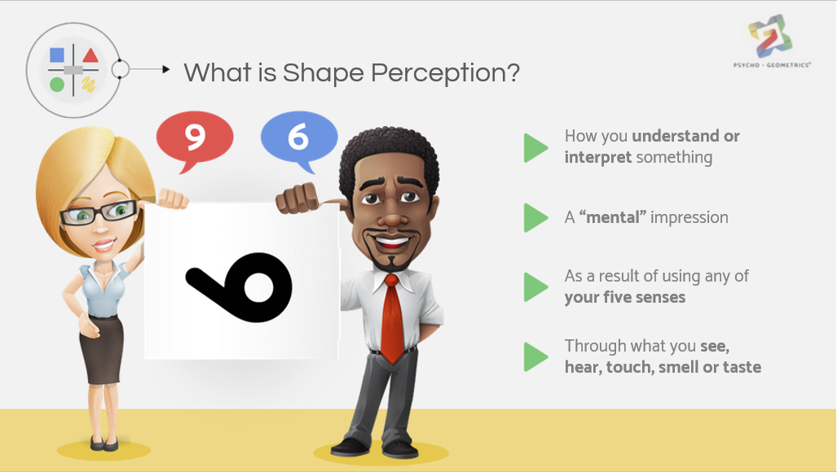
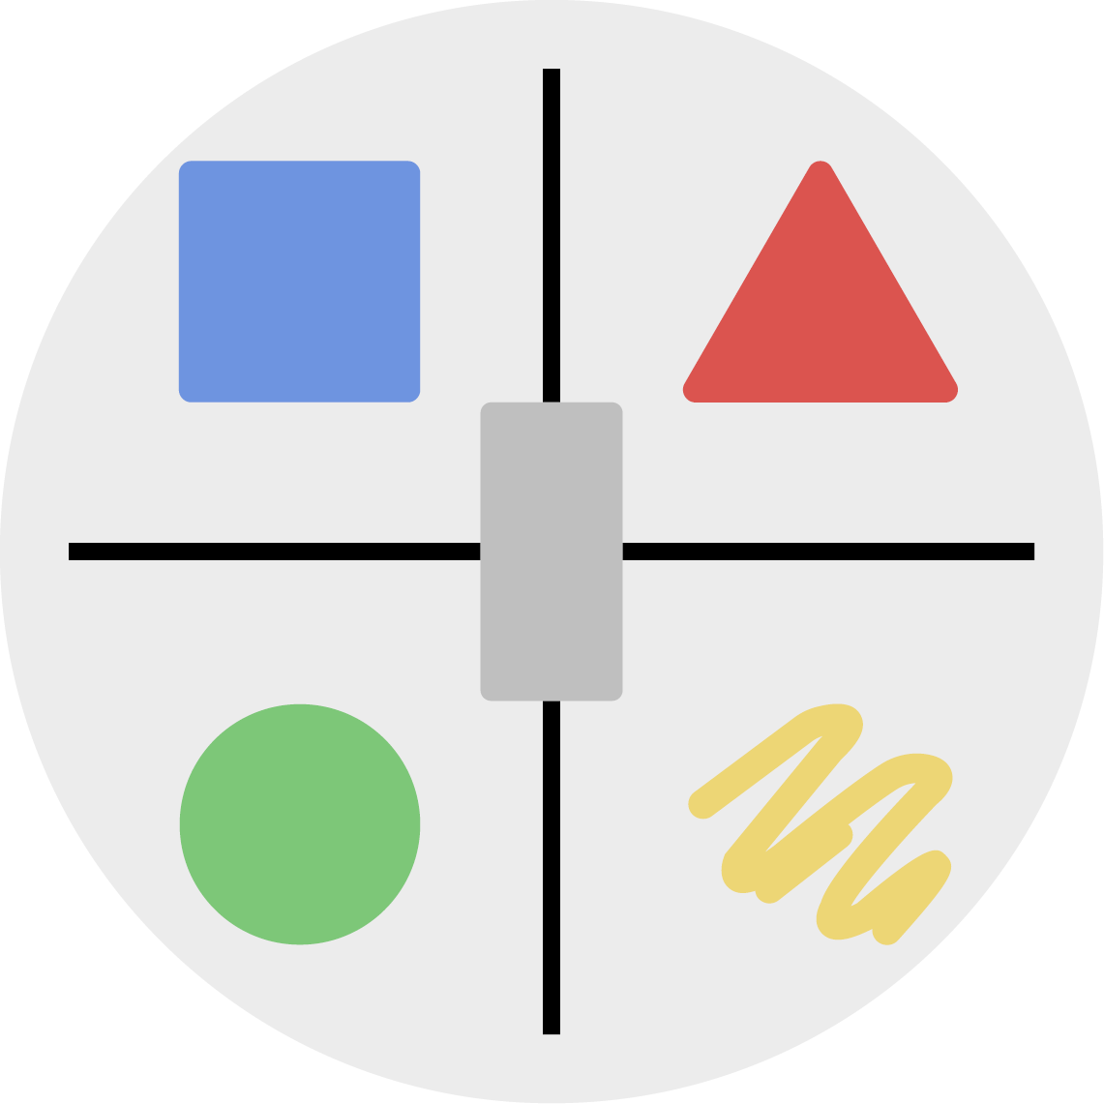
What is Shape Perception?
How you understand or interpret something
A “mental” impression
As a result of using any of your five senses
Through what you see, hear, touch, smell or taste
The Science of Behavior – The Art of Communicating
Using the Shapes Assessment for Simple, Efficient and Effective Communication.
All content copyrighted by Hite Resources, Inc. and Pgeo, Inc. www.psychogeometrics.com
Notes:
Let’s define Shape Perception. What do we mean by “perception”? Perception can be defined as a way you understand or interpret something, a “mental” impression, as a result of using any of your five senses, that is, what you see, hear, touch, smell or taste.
You can’t control others or what they think of you, but you can raise the probability that others understand the person you truly are, and have a positive perception of you, when you are willing to manage your shape behavior. So how do you manage your Shape behavior?

Slide 19
Shape Flexing
Raise the Probability that Others Understand Your Communication Style,
You Understand the Communication Style of others, and
Negative Perceptions change to Positive Ones.
Notes:
By using a tool called Shape Flexing. Raise the probability (see slide)….

Slide 20
What is Shape Flexing?
Adding a specific shape behavior,
or combination of shape behaviors,
to strengthen your
communication effectiveness.
The Science of Behavior – The Art of Communicating
Using the Shapes Assessment for Simple, Efficient and Effective Communication.
All content copyrighted by Hite Resources, Inc. and Pgeo, Inc. www.psychogeometrics.com
Notes:
Shape Flexing typically means adding a specific shape behavior, or combination of shape behaviors, to strengthen your communication effectiveness. Let’s look at some examples as to what it means to shape flex using each of the five shapes.

Slide 21
Stay Connected!
INSERT INFO HERE
See next slide
Notes:
Closing Slide. Customize as you wish – and please invite people to stay connected.
Join our email list. Sign up at our website.
Like, Follow, and Share – Linkedin, Facebook, Instagram, Twitter
Share the Shapes Assessment with a family member or friend.
Your Friends and Family can take the assessment for 50% off. Use the code family or friends. visit www.psychogeometrics.com

Slide 22
Resources
Website
Susan’s
Bio
Shapes
Assessment
Additional
Courses
Facebook
Twitter
Instagram
LinkedIn

