Slide 1
Notes:
eLearning 1.1

Slide 2
Notes:
eLearning 1.3

Slide 3
Notes:
eLearning 1.3

Slide 4
Notes:
eLearning 1.3

Slide 5
Notes:
eLearning 1.4

Slide 6
Notes:
eLearning 1.5

Slide 7
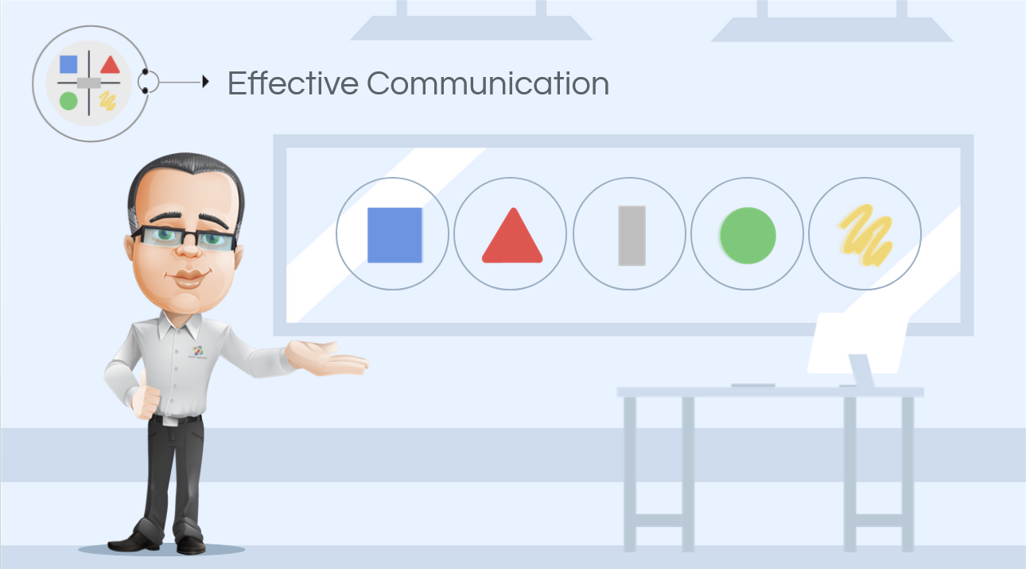
Notes:
eLearning 1.5

Slide 8
Notes:
eLearning 1.5

Slide 9
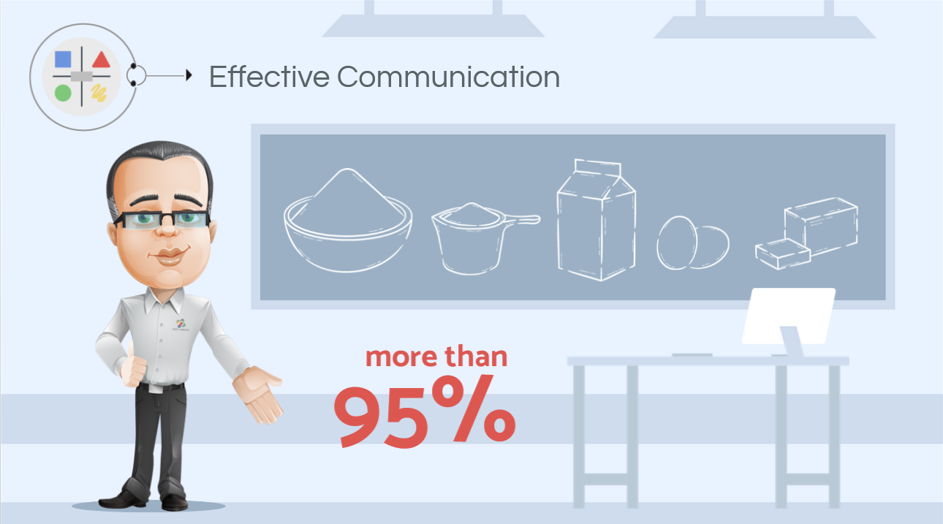
Notes:
eLearning 1.5

Slide 10
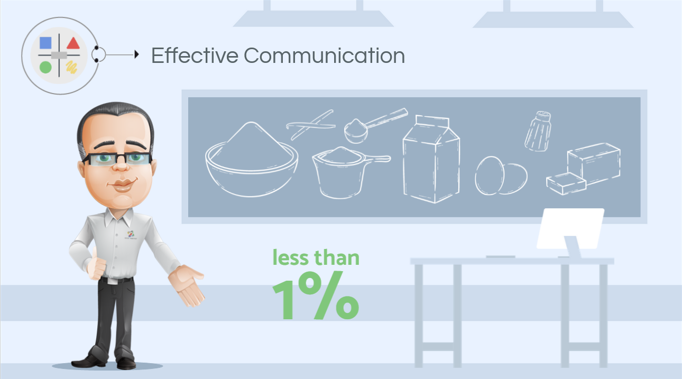
Notes:
eLearning 1.5

Slide 11
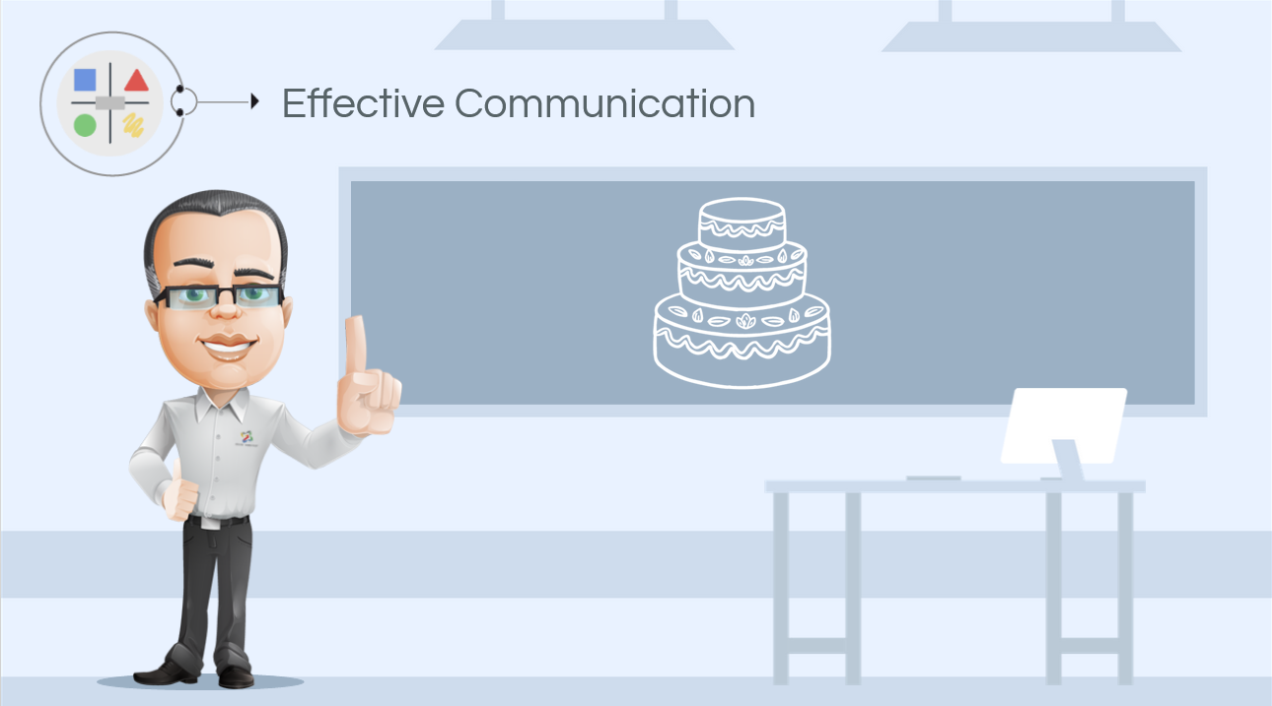
Notes:
eLearning 1.5

Slide 12
Notes:
eLearning 1.6

Slide 13
Notes:
eLearning 1.6

Slide 14
Notes:
eLearning 1.6

Slide 15
Notes:
eLearning 1.6

Slide 16
Notes:
eLearning 1.7

Slide 17
Notes:
eLearning slide 1.8

Slide 18
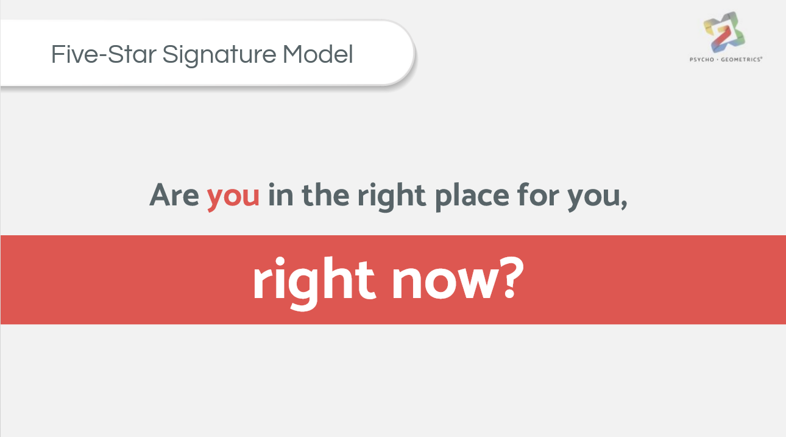
Notes:
eLearning slide 1.8

Slide 19
Notes:
eLearning slide 1.8

Slide 20
Notes:
eLearning slide 1.8

Slide 21
Notes:
eLearning slide 1.8

Slide 22
Notes:
eLearning slide 1.8

Slide 24
Notes:
eLearning slide 1.8

Slide 25
Notes:
eLearning slide 1.9

Slide 26
Notes:
eLearning slide 1.9

Slide 27
Notes:
eLearning slide 1.9

Slide 28
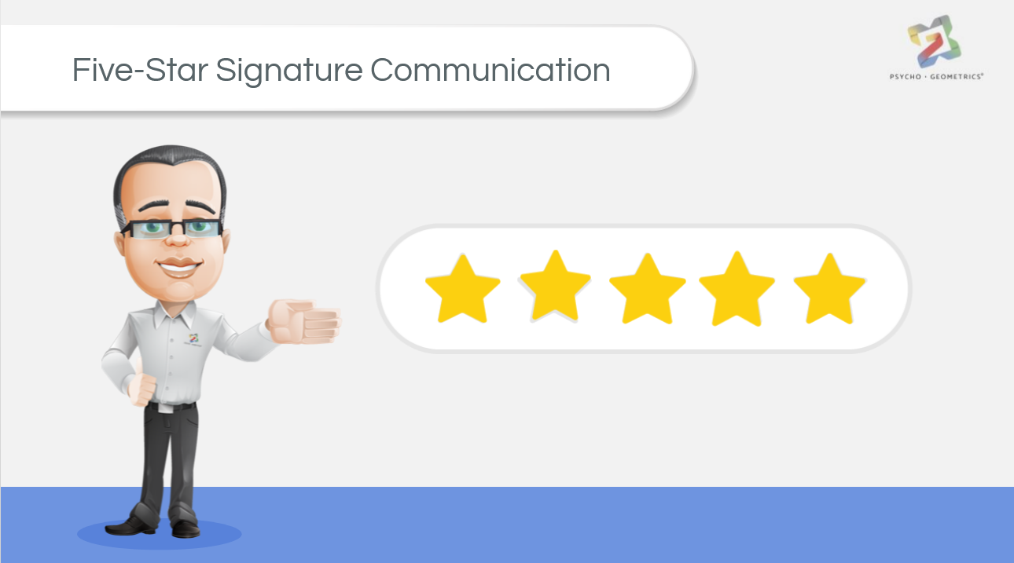
Notes:
eLearning slide 1.10

Slide 29
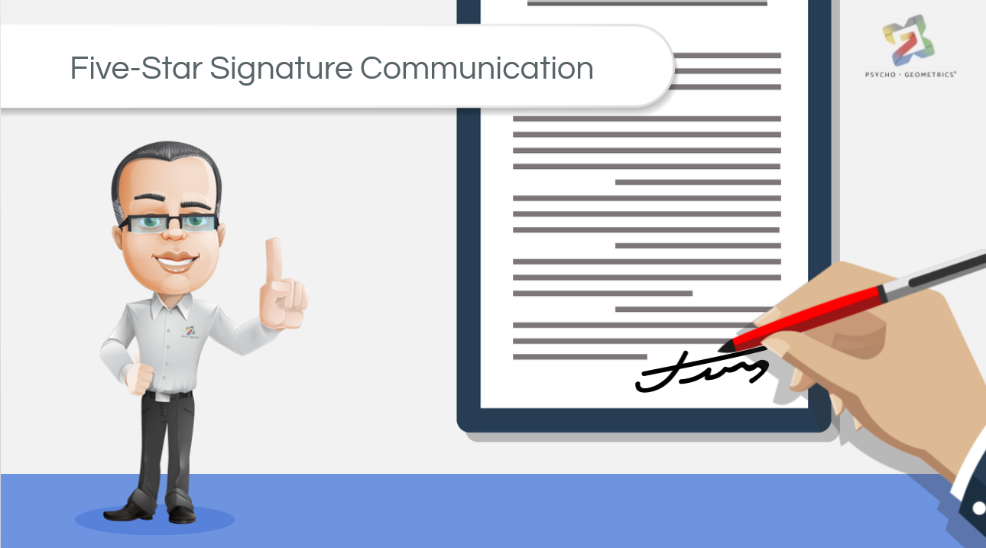
Notes:
eLearning slide 1.10

Slide 30
Notes:
eLearning slide 1.11

Slide 31
Notes:
eLearning slide 1.11

Slide 32
Notes:
eLearning slide 1.11

Slide 33
Notes:
eLearning slide 1.11

Slide 34
Notes:
eLearning slide 1.11

Slide 35
Notes:
eLearning slide 1.11

Slide 36
Notes:
eLearning slide 1.12

Slide 37
Notes:
eLearning slide 1.13

Slide 38
Rating Key
I use this shape in my daily communication:
Rarely= 1-3
Some of the time = 4-6
Most of the time = 7-9
All of the time = 10
Notes:
eLearning slide 1.13

Slide 39
Notes:
eLearning slide 1.14

Slide 40
Notes:
eLearning slide 1.14

Slide 41
Notes:
eLearning slide 1.14

Slide 42
Notes:
eLearning slide 1.14

Slide 43
Notes:
eLearning slide 1.14

Slide 44
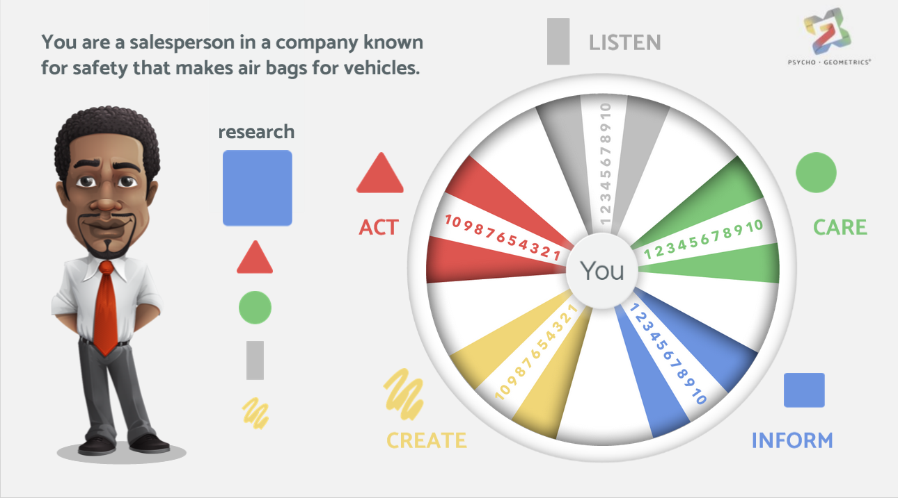
Notes:
eLearning slide 1.15

Slide 45
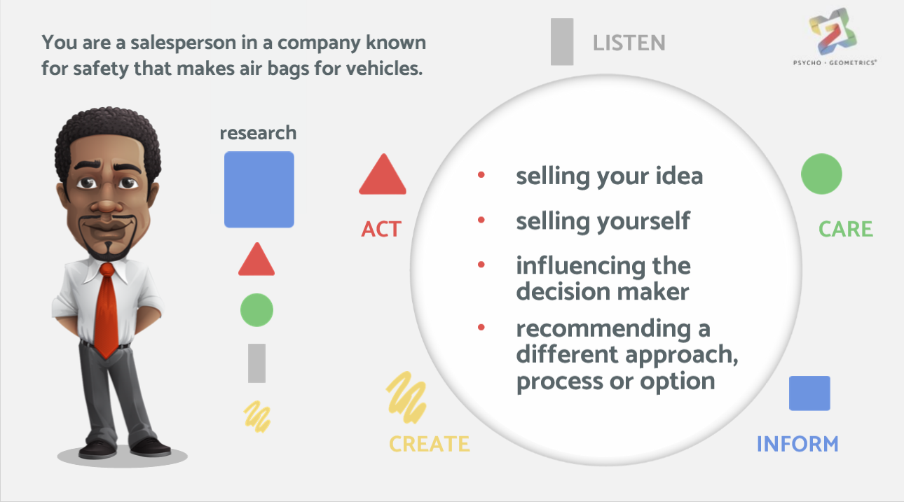
Notes:
eLearning slide 1.15

Slide 46
Notes:
eLearning slide 1.16

Slide 47
Notes:
eLearning slide 1.16

Slide 48
Notes:
eLearning 1.17

Slide 49
Notes:
eLearning 1.17

Slide 50
Notes:
eLearning 1.17

Slide 51
Notes:
eLearning 1.18

Slide 52
Notes:
eLearning 1.18

Slide 53
Notes:
eLearning 1.19

Slide 54
Notes:
eLearning 1.19

Slide 55
Notes:
eLearning 1.19

Slide 56
Notes:
eLearning 1.20

Slide 57
Notes:
eLearning 1.20

Slide 58
Notes:
eLearning 1.20

Slide 59
Notes:
eLearning 1.20

Slide 60
Notes:
eLearning 1.20

Slide 61
Notes:
eLearning 1.20

Slide 62
Notes:
eLearning 1.20

Slide 63
Notes:
eLearning 1.20

Slide 64
Notes:
eLearning 1.20

Slide 65
Notes:
eLearning 1.20

Slide 66
Notes:
eLearning 1.20

Slide 67
Notes:
eLearning 1.20

Slide 68
Notes:
eLearning 1.20

Slide 69
Notes:
eLearning 1.20

Slide 70
Notes:
eLearning 1.21

Slide 71
Notes:
eLearning 1.21

Slide 72
Notes:
eLearning 1.21

Slide 73
Notes:
eLearning 1.21

Slide 74
Notes:
eLearning 1.21

Slide 75
Notes:
eLearning 1.21

Slide 76
Notes:
eLearning 1.22

Slide 77
Notes:
eLearning 1.23

Slide 78
Notes:
Congratulations

