Slide 1
Module 4
The Practical Application of Shape Motivation
Psycho·Geometrics® Copyright 2021 Hite Resources, Inc. and P·Geo, Inc. All rights reserved. psychogeometrics.com
Notes:
Welcome to the continuous digital learning series of Shapes, powered by Psycho·Geometrics®. This is Module 4, which focuses on the practical application of Shape Motivation for effective communication.

Slide 2
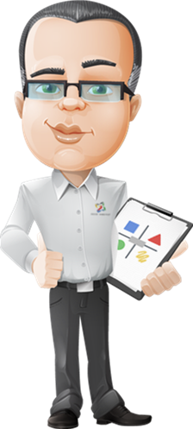
Welcome and Introduction
Shape Motivation
To maximize your experience, we recommend that you take a moment now to review your “shapes”.
Notes:
In this module, you will learn what motivates and demotivates your shapes and the shapes of others, then increase the probability you stay motivated and communicate in a way that motivates others.
To maximize your experience, it is helpful to know your Shape Results, especially your Primary and Secondary Shapes, from the Shapes Assessment, powered by Psycho·Geometrics®. We recommend that you take a moment now to review your “shapes scores.”

Slide 3
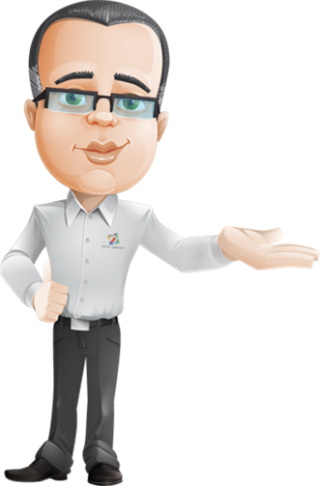
Course Objectives
By the end of this training, you will:
Understand the terms motivation and demotivation and how they relate to the five geometric shapes
Understand the possible motivators and demotivators of your personal shapes and communication style
Understand how you can motivate or demotivate others
Understand how to decide what you may want to change
Notes:
Let’s clarify our objectives. By the end of this module, you will:
Number 1, understand the terms motivation and demotivation and how they relate to the five geometric shapes within the Psycho·Geometrics® Communication System,
Number 2, know how to apply Shape Motivation awareness to your personal shapes and communication style, understanding what motivates and demotivates you to be who you are, what you do, and how you interact with others,
Number 3, know how to apply Shape Motivation awareness to understand others. Specifically, what you say and do, and how you say and do it, that motivates or demotivates others because of who they are, what they do and how they interact with others,
And finally, number 4, you will be prepared to decide how you may change to be more motivated and less demotivated overall. This may include how you modify your communication to motivate, not demotivate others by being true to who you are, how you act, and how you naturally interact in your relationships, with your team, family, friends, and people in general.

Slide 4
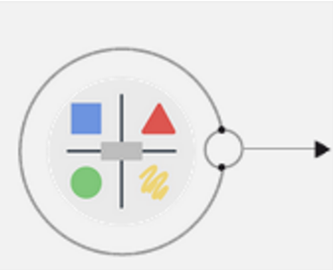
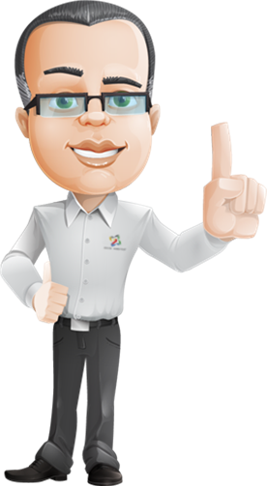
What is Shape Motivation?
driving force
activates shapes behavior
internal state
forward motion
Notes:
To begin, what do we mean by “Shape Motivation”? Motivation can be defined as the driving force behind all action. It is an internal state that stimulates and activates your shapes behavior and gives it direction. It’s a natural force that can propel you forward. In fact, being motivated can keep you in a state of forward motion.

Slide 5
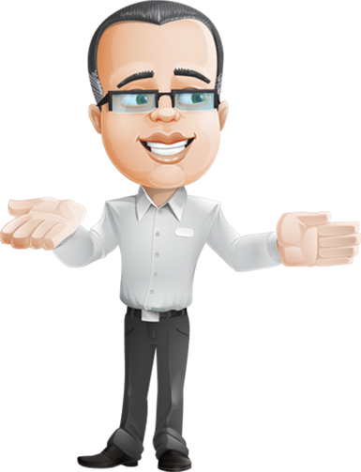
What is Shape Motivation?
as important as the air you breathe
physical
mental
emotional growth
overall health
Notes:
Think of motivation as important as the air you breathe. Motivation can contribute to your physical, mental, and emotional growth and overall health.

Slide 6
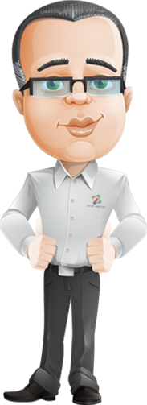
What is Shape Demotivation?
internal state
lack of forward motion
lack of drive
loss of interest
Notes:
While also an internal state, demotivation is the opposite of motivation. It can be defined as a lack of drive or movement. It is also a natural force, but instead of propelling you forward, it can slow you down, cause you to stumble, perhaps even causing you to fall. Demotivation can contribute to a lack of energy or desire to use your Shape Strengths, or manage your Shape Challenges, in order to be the best possible version of who you are, what you do, or how or if you interact with others.

Slide 7
What is Shape Demotivation?
internal state
lack of forward motion
lack of drive
loss of interest
who
what
how
you are
you do
you interact
Notes:
While also an internal state, demotivation is the opposite of motivation. It can be defined as a lack of drive or movement. It is also a natural force, but instead of propelling you forward, it can slow you down, cause you to stumble, perhaps even causing you to fall. Demotivation can contribute to a lack of energy or desire to use your Shape Strengths, or manage your Shape Challenges, in order to be the best possible version of who you are, what you do, or how or if you interact with others.

Slide 8
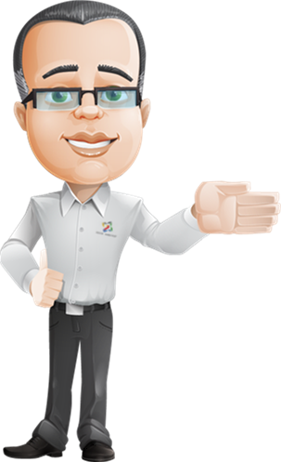
What motivates and demotivates you or others?
What would naturally motivate each shape?
Notes:
Consider each of the five geometric shapes. What would naturally motivate each shape?

Slide 9
What motivates and demotivates you or others?
be brief
be direct
give three options
like to be in control
Notes:
For example, If you have something to say and you want to raise the probability that a Triangle would be interested in hearing it or acting because of it, be brief, direct, and give the Triangle 3 options. Triangles like to be in control.

Slide 10
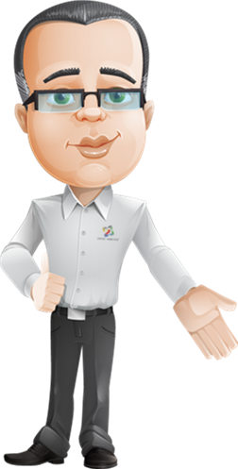
What motivates and demotivates you or others?
What would naturally demotivate each shape?
Notes:
What would naturally demotivate each shape?

Slide 11
What motivates and demotivates you or others?
too emotional
dramatic
take too long
triangles are busy
Notes:
Let’s use the Triangle again as an example. A Triangle would be less likely to openly listen, or act as a result of your communication if you are too emotional, dramatic, or take too long to get to the point. Triangles are busy.

Slide 12
What motivates and demotivates you or others?
What motivates one shape may demotivate another.
Notes:
Keep in mind that what motivates one shape may demotivate another.

Slide 13
What motivates and demotivates you or others?
appreciates consideration to how others may feel
appreciates direct and to the point
Notes:
The Triangle appreciates communication that is direct and to the point, however a Circle may be demotivated if no consideration is given to how others may feel as a result of the communication. Circles don’t care how much you know, until they know how much you care.

Slide 14
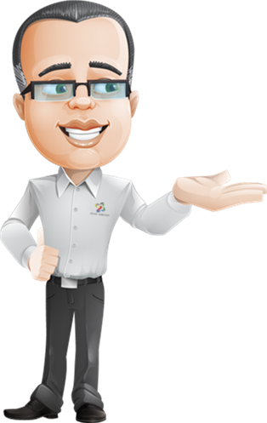
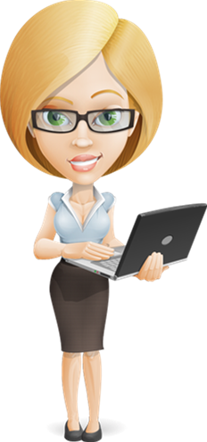
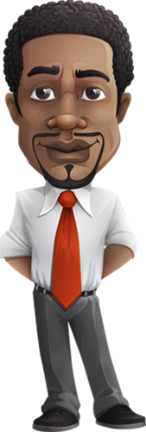
What motivates and demotivates you or others?
Notes:
As you can see, one size does not fit all, which is why Shape Flexing, as explained and illustrated in Module 3, is so important for effective communication. The exact same behavior or situation can motivate one person, but completely demotivate another. Every shape is different, and one shape does not fit all.

Slide 15
What motivates and demotivates you or others?
Four examples of motivators and demotivators
Notes:
Let’s look at four examples of motivators and demotivators.

Slide 16
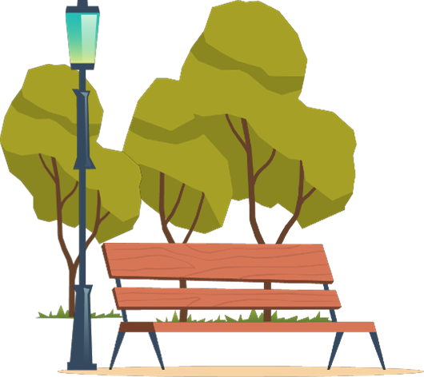
The offsite retreat
Notes:
The Squiggle may find it exciting to be on an offsite retreat without a formal agenda and plenty of time for discussion, socialization, and outdoor activities. The Squiggle, likes the variety and just going with the flow. The Circle, who loves to connect with others personally in a casual, relaxed setting, may also find it motivating. However, for the Triangle or Box, it is unnatural to allocate dollars and time to have casual conversations in a relaxed setting, away from the office. It is also illogical to think you could quantify the dollars and time spent to “strengthen the team” on a spreadsheet or to a board of directors.
Keep in mind that when we use examples about one specific shape, we are referencing 100% of that shape. Of course, no one is 100% of one shape all the time, and everyone has more than one shape that represents their communication style. So, these examples are general examples, considering the traits of only one shape. It is true that a Box does value efficient meetings and prefers to work alone, but a mature, experienced, and healthy Box, regardless of their other shape traits, is smart enough to know that taking a break to have some fun and working with others can be beneficial.

Slide 17
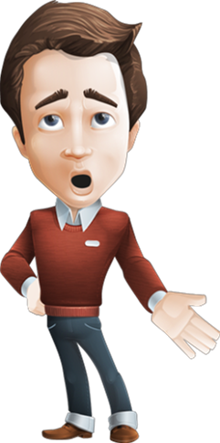
The exploratory meeting
requires an open mind
asking questions
listening
waiting to make decisions
Notes:
An exploratory series of meetings that requires an open mind, asking questions, listening, and waiting to make any decisions for at least 6 months, may be motivating to the uncertain Rectangle. The Rectangle may be experiencing or anticipating change, but this situation may be demotivating to a Triangle, who tends to be impatient.

Slide 18
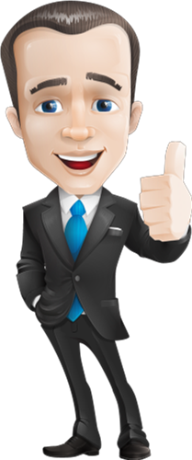
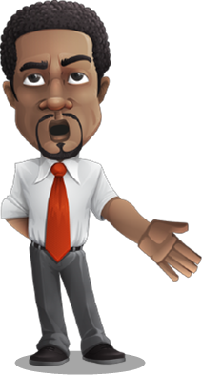
The enthusiastic speaker
Notes:
An enthusiastic speech may be just what a Squiggle needs to get motivated by an upcoming project, but the Box may not be interested because “it is just a bunch of hype and fluff”.

Slide 19
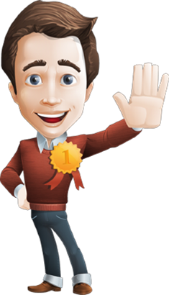
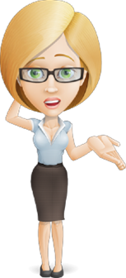
The team contest
Notes:
A contest among the team to recognize individual performance could be highly motivating to a Triangle, who loves to compete, but equally as demotivating to a Circle, who prefers collaboration and teamwork, as opposed to being #1 on the team.

Slide 20
What would be most motivating for a…?
Matching shapes with motivating descriptions.
Notes:
In this exercise, you must match the description to the best shape that would find a situation motivating.

Slide 21
Drag the descriptions to the shape that would find these situations motivating.
Receiving a training and travel budget to participate in an industry event in the location of your choice
Dining with the President of the Company
Donating to a non-profit in honor of your team
Receiving increases in your budget for tools, technology, or research for the next work project
Taking a career break, going to school, or downsizing
Notes:
Drag the descriptions to the shape that would find these situations motivating.

Slide 22
These are the appropriate placements for the possible motivators.
Receiving a training and travel budget to participate in an industry event in the location of your choice
Dining with the President of the Company
Donating to a non-profit in honor of your team
Receiving increases in your budget for tools, technology, or research for the next work project
Taking a career break, going to school, or downsizing
Notes:
These are the appropriate placements for the possible motivators. Remember, it’s important to know what motivates and demotivates you, but also important to know what motivates and demotivates others.

Slide 23
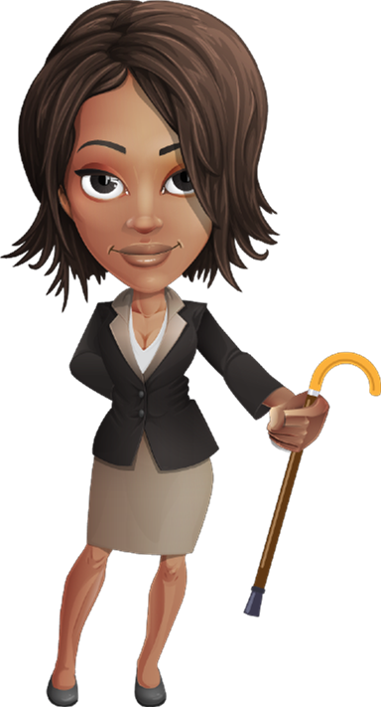
What would be most demotivating for a…?
Matching shapes with demotivating descriptions.
Notes:
If awareness is key, let’s see how well you identify possible demotivators for each shape. In this exercise, you must select the shape that best matches the demotivator for that shape.

Slide 24
Anything too rigid, structured or routine
Conflict, lack of emotion
No advance notice, no agenda
Concern regarding what people think
Short-cuts that compromise quality
Lack of action, lack of control
Negativity, lack of emotion
Too many choices, too much information
Isolation
Lack of confidence
Notes:
Select the appropriate Shape from to best match the demotivators.

Slide 25
Anything too rigid, structured or routine
Squiggle
Conflict, lack of emotion
Circle
No advance notice, no agenda
Box
Concern regarding what people think
Rectangle
Short-cuts that compromise quality
Box
Lack of action, lack of control
Triangle
Negativity, lack of emotion
Squiggle
Too many choices, too much information
Rectangle
Isolation
Circle
Lack of confidence
Triangle
Notes:
These are the correct responses.
Keep in mind, one way to strengthen communication in your personal or professional life, is to approach others in the way they like to be treated. Why would someone be motivated to listen to you and consider what you have to say? If you can communicate with others, aware of their possible shapes and in the way they prefer to “receive” communication, they are more likely to be motivated by your communication style, than demotivated.

Slide 26
Increasing Motivation
awareness
knowledge
skill
genuine desire
You have the power to motivate when you take time to be aware, and you are….
Notes:
With awareness, knowledge, skill and genuine desire, you have the power to raise the probability you stay motivated, as well as motivating others.

Slide 27
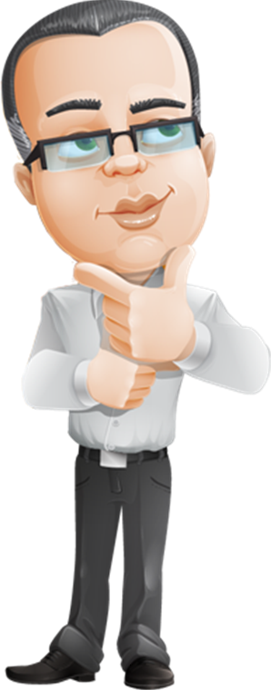
Motivation Application
What motivates others?
Notes:
To raise the probability that you communicate effectively with others, you must consider what motivates others to be interested or excited about what you have to say.

Slide 28
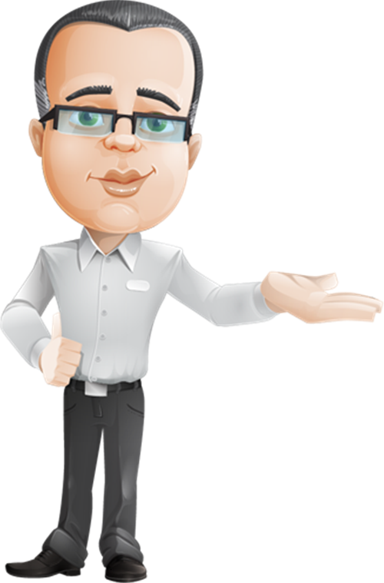
Motivation Application
Convince them to consider your points
Notes:
Even if it is uninteresting to them, you would like to convince them to consider your points, which may lead to something they find motivating.

Slide 29
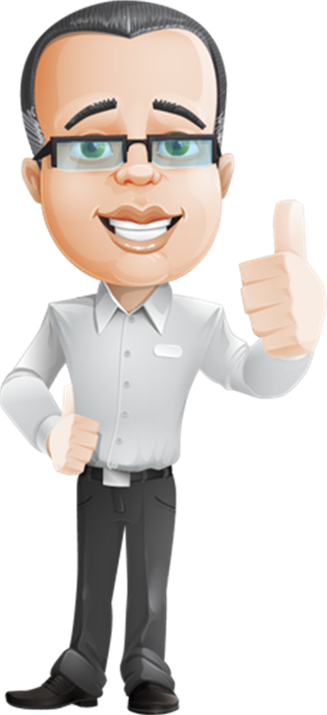
Motivation Application
ask
You be
YOU.
consider
include
share
inform
brainstorm
connect behavior to results
Notes:
Ask, Consider, Include, Share, Inform, Brainstorm, Connect Behavior to Results, then you be you.

Slide 30
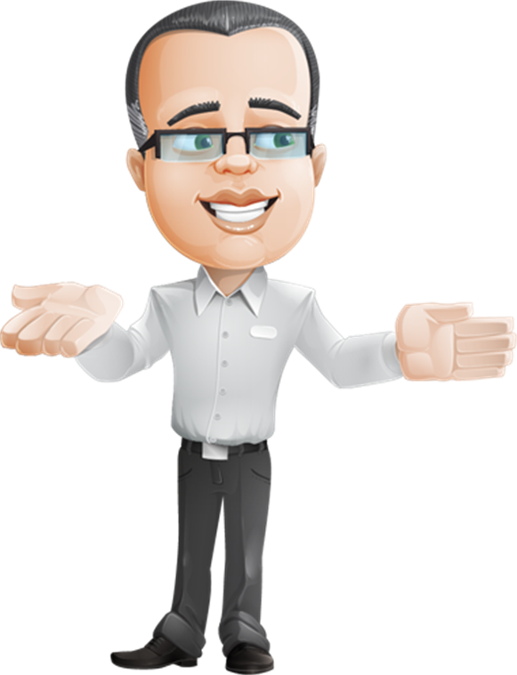
Motivation Application
You can still be you and say what needs to be said,
but what you say and how you say it
is the key to effective communication.
Notes:
You can still be you and say what needs to be said, but what you say and how you say it is the key to effective communication with all people, of all shapes.

Slide 31
Motivation Application
efficient
productive
satisfying
when team members are motivated to participate
Notes:
Granted, it will likely take more time to consider the shape motivators and demotivators prior to your communication, but it will probably make for more efficient, productive, and satisfying meetings when team members are motivated to participate.
Let’s take a moment for some reflection in the following activity.

Slide 32
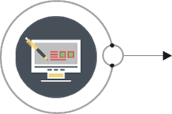
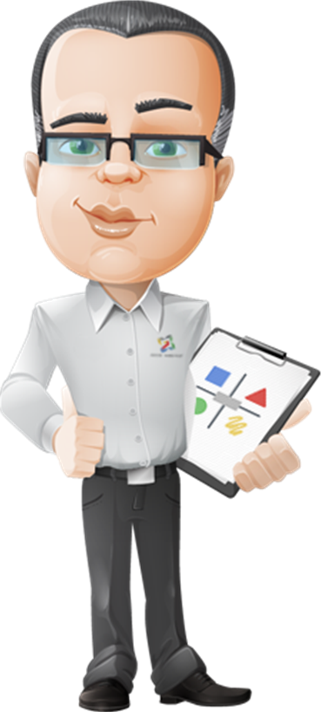
Takeaway Activity
Applying what you’ve learned
You can do this activity now or with:
your work team
your business or life partner
your family or friends
Download this activity
Notes:
You can do this activity alone or with your work team, your business or life partner, your family or friends.

Slide 33
Takeaway Activity
Applying what you’ve learned
You’ve been asked to communicate an accountability team meeting is being scheduled on a weekly basis, same day, same time.
Before you deliver the message, consider how each of the shapes may receive the message.
Who do you think will look forward to this new meeting or who do you think will dread it?
Awareness is Key. Time to reflect is important.
Your communication approach is critical when it comes to keeping yourself motivated and motivating others.
Notes:
You’ve been asked to communicate that an accountability team meeting is being scheduled on a weekly basis, same day, same time. Before you deliver the message, consider how each of the shapes may receive the message.
Who do you think will look forward to this new meeting or who do you think will dread it?

Slide 34
Takeaway Activity
Applying what you’ve learned
How could dreading or looking forward to a meeting impact:
Turnover, morale, open-mindedness, engagement, collaboration, creativity or productivity?
Choose one or more to reflect upon or discuss with your partner.
Awareness is Key. Time to reflect is important.
Your communication approach is critical when it comes to keeping yourself motivated and motivating others.
Notes:
How could dreading or looking forward to a meeting impact such things as turnover, morale, open-mindedness, engagement, collaboration, creativity or productivity? Choose one or more to reflect upon or discuss with your partner.

Slide 35
Course Summary
Now that you have completed this Shape Motivation module, you should:
Understand the terms motivation and demotivation and how they relate to the five geometric shapes
Understand the possible motivators and demotivators of your personal shapes and communication style
Understand how you can motivate or demotivate others
Understand how to decide what you may want to change
Notes:
In summary, now that you have participated in the Shape Motivation module, you should
Number 1, understand motivators and demotivators of each of the five geometric shapes within the Psycho·Geometrics® Communication System,
Number 2, know how to apply Shape Motivation awareness to your personal shapes and communication style, understanding what motivates and demotivates you to be who you are, what you do, and how you interact with others,
Number 3, know how to apply Shape Motivation awareness to understand others, and specifically what you say and do, and how you say and do it, that motivates or demotivates others because of who they are, what they do and how they interact with others,
And finally, number 4, you will be prepared to decide how you may want to change to be more motivated and less demotivated overall. This may include how you modify your communication to motivate, not demotivate others by being true to who you are, how you act, and how you naturally interact in your relationships, with your team, family, friends, and people in general.

Slide 36
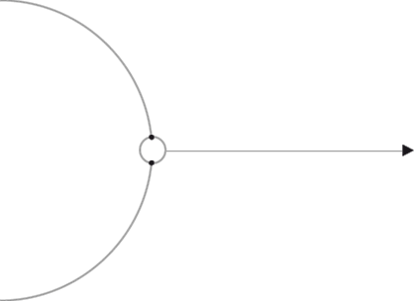
Resources
For more information and to contact us,
visit the Psycho·Geometrics® website.
Website
Susan’s
Bio
Shapes
For Work
Additional
Courses
Facebook
Twitter
Instagram
LinkedIn
Notes:
Click and bookmark these links, plus be sure to download important course resources from the Resources tab, found in the upper right corner of this course.
Website - https://www.psychogeometrics.com/
Susan’s Bio – https://www.psychogeometrics.com/meet-susan
Shapes for Work – https://www.psychogeometrics.com/shapes-for-work
Additional Courses – https://elearning.psychogeometrics.com/
Facebook – https://www.facebook.com/psycho_geometrics-103150451491958
Twitter – https://twitter.com/pgeoshapes
Instagram – https://www.instagram.com/psycho_geometrics/
LinkedIn - https://www.linkedin.com/company/psycho-geometrics/

Slide 37
Congratulations
You are now ready to move to the next application of Psycho·Geometrics®
Module 5: Strategic Shaping
Notes:
You are now ready to move to the next module in this digital learning series of Shapes, powered by Psycho·Geometrics®. Module 5, Strategic Shaping, features a Five-Star Communication Process that identifies the shape order of what to say and the shape style for how to say it. This is especially helpful when preparing communication for different audiences of all shapes, crucial conversations, resolving conflict, and for sales and service excellence.

