Slide 1
Module 3
The Practical Application of Shape Flexing
Notes:
Welcome to this module, the third in the digital learning series in the Psycho·Geometrics® course. Today our focus is on the practical application of Shape Flexing.

Slide 2
Welcome and Introduction
Shape Flexing
To maximize your experience, we recommend that you take a moment now to review your “shapes”.
Notes:
In this module, it is helpful to know your “Shape Results” from the Psycho·Geometrics® Assessment. To maximize your experience, we recommend that you take a moment to review your “shapes.

Slide 3
Course Objectives
By the end of this training, you will:
Understand the Psycho·Geometrics® term Shape Flexing
Understand the difference between the Golden Rule and the Platinum Rule
Understand how to use Shape Flexing for others to practice the Platinum Rule
Understand how to use Shape Flexing for you to enhance and strengthen your personal communication style and change possible negative perceptions into positive ones.
Notes:
By the end of this training, you will:
Number 1, understand the Psycho·Geometrics® term “Shape Flexing”,
Number 2, understand the difference between the Golden Rule and the Platinum Rule,
Number 3, understand how to use Shape Flexing for others to practice the Platinum Rule,
And lastly, number 4, understand how to use Shape Flexing for you to enhance and strengthen your personal communication style, and
change possible negative perceptions into positive ones.
.

Slide 4
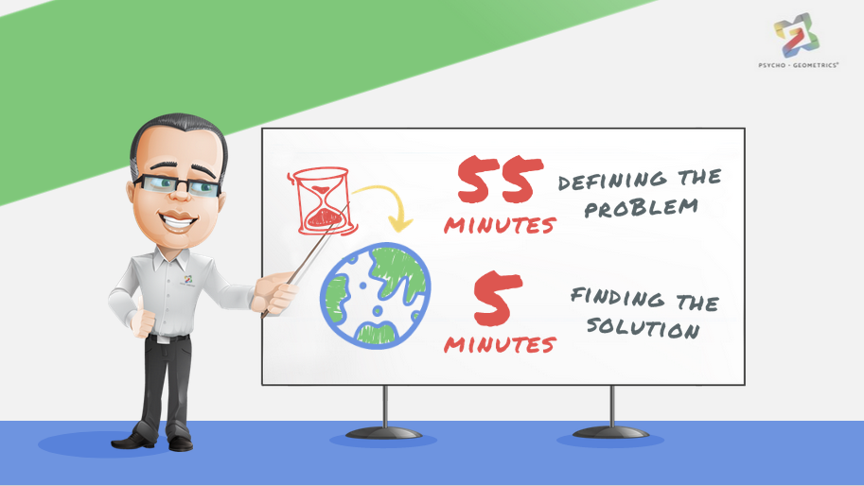
55
MINUTES
DEFINING THE PROBLEM
5
MINUTES
FINDING THE SOLUTION
Notes:
Einstein is quoted as having said that if he had one hour to save the world he would spend ‘fifty-five minutes defining the problem and only five minutes finding the solution’.

Slide 5
SOLVING A PROBLEM
OR SEIZING AN OPPORTUNITY
IS SIMPLY
BEING AWARE
THAT THE PROBLEM OR
OPPORTUNITY EXISTS
AND THEN UNDERSTANDING WHAT
THE PROBLEM OR OPPORTUNITY IS.
Notes:
Solving a problem or seizing an opportunity is simply being aware that the problem or opportunity exists, and then understanding what the problem or opportunity is. Shape Flexing is a valuable tool for personal and professional development and growth. Now, let’s get started!

Slide 6
Shape Flexing
is a valuable tool for personal and professional development and growth.
Notes:
To begin, let’s define Shape Flexing.

Slide 7
What is Shape Flexing?
Flexing
literally means “to bend, especially repeatedly”.
Notes:
What do we mean by “flexing”? Flexing literally means “to bend, especially repeatedly”.

Slide 8
What is Shape Flexing?
Shape Flexing
to embrace the art and skill of using different shape traits and behaviors to
manage
maximize
modify
leverage
minimize
customize
your personal shape communication style to approach others in the way in which they like to be approached.
Notes:
In the context of Shape Flexing, it means to embrace the art and skill of using different shape traits and behaviors to manage, modify, minimize, maximize, “leverage” and customize your personal shape communication style to approach others in the way in which they like to be approached.

Slide 9
What is Shape Flexing?
He would naturally approach and communicate with someone in a
planned,
well-thought out,
direct approach
Notes:
For example, someone who is Box has a meeting with someone who is a Circle Box. Without Shape Flexing, the person with the Box communication style would naturally approach and communicate with someone in a planned, well-thought out, and direct approach.
Although this may be how the Box would like to be approached, it is not necessarily how everyone likes to be approached. In this case, the Box is meeting with the Circle Box.

Slide 10
What is Shape Flexing?
Instead of starting with the facts and an agenda, you may want to start with time for connection.
“Tell me how your wedding went!”
“Last time we talked, you mentioned your daughter had broken her arm. How is she doing now?”
Notes:
To shape flex and raise the probability that the Circle will be receptive, the Box shape flexes, bringing in a touch of Circle to their approach.
This means that instead of starting the communication with the facts and accelerated agenda, you may want to start the communication with designated time for connection and sharing what has happened since the last time you talked. For example, “Tell me how your wedding went!” Or “Last time we talked, you mentioned that your daughter had broken her arm. How is she doing now?”

Slide 11
What is Shape Flexing?
Shape Flexing
Notes:
Let’s look at the five shapes as they apply to Shape Flexing.

Slide 12
What is Shape Flexing?
The Box
four equal sides
contained
factual, objective and non-emotional approach
decreasing the emotion
stick to the agenda
honoring start and stop times
Notes:
The Box is four equal sides and “contained”. When using the Box to Shape Flex, you may choose a factual, objective, and non-emotional approach in your communication. On the other hand, perhaps it’s more about decreasing the emotion of your communication (facial expressions, hand gestures, tone, pace, speed of voice). It could even mean that instead of running late or allowing a meeting to go too long, you use the Box to stick to the agenda, honoring start and stop times.

Slide 13
What is Shape Flexing?
The Triangle
bottom line
to the point
be more direct, brief and action-oriented
make sure the discussion leads to a plan of action
Notes:
The Triangle is bottom line and to the point. Therefore, when using the Triangle to Shape Flex, you may be more direct, brief, and action-oriented in your communication style. Perhaps you have allowed meetings to be more about discussion than action in the past, so flexing to the Triangle simply means you make sure the discussion leads to a plan of action.

Slide 14
What is Shape Flexing?
The Rectangle
oblong
all four shapes
include time to ask and listen
understand before you share your opinion or desire to be understood
Notes:
The Rectangle is oblong, with plenty of room for all four shapes to be within this one shape. When using the Rectangle to Shape Flex, you would make sure your communication includes the time to ask and listen in order to understand before you share your opinion or desire to be understood.

Slide 15
What is Shape Flexing?
The Circle
inclusive shape
increase your level of sensitivity and emotional intelligence
welcoming everyone
asking others to share something about themselves
Notes:
The Circle is an inclusive shape. Shape Flexing using the Circle means you increase your level of sensitivity and emotional intelligence. Instead of the first agenda item being a review of the budget, adding Circle to your own communication style or flexing to the Circle means the first thing on your agenda is welcoming everyone to the meeting, perhaps even asking others to share something about themselves or a recent work accomplishment.

Slide 16
What is Shape Flexing?
The Squiggle
unrestricted, creative
enthusiastic, expressive
use more facial expressions, hand gestures, change in tone, pace or speed of voice
change up the agenda entirely, surprising others
Notes:
Lastly, the Squiggle is unrestricted, creative, enthusiastic and expressive. Shape Flexing using the Squiggle may mean you use more facial expressions, hand gestures, change in tone, pace or speed of your voice to communicate excitement, fun or high energy. It may also mean you change up the agenda entirely, surprising others with bringing in lunch first.

Slide 17
What is Shape Flexing?
Adding a specific shape behavior,
or combination of shape behaviors,
to strengthen your communication effectiveness.
Notes:
Shape Flexing typically means adding a specific shape behavior, or combination of shape behaviors, to strengthen your communication effectiveness.

Slide 18
What is Shape Flexing?
Applying the Rules
means communication that motivates others to listen and communicate with you.
Golden Rule
“Treat others the way you would like to be treated.”
Platinum Rule
“Treat others the way they would like to be treated.”
Notes:
This creates a natural adaptation of the Golden and Platinum Rules. The Golden Rule says, “Treat others the way you would like to be treated”. The Platinum Rule says, “Treat others the way they would like to be treated”.
In other words, in applying these Rules, you will communicate with others in a way that motivates them to listen and communicate with you.

Slide 19
Utilizing Version of Shape Flexing
Shape Flexing For YOU
How you want yourself and your communication to be PERCEIVED
How you want others to SEE YOU
Notes:
Keeping the Golden and Platinum Rules in mind, let’s look at how they create the two versions of Shape Flexing.
Number 1, Shape flexing for you to enhance your communication by adding a specific shape to your communication style. It is about how you want yourself and your communication to be perceived. It means you are using a particular shape, or variation of shapes, in a purposeful way to strengthen the effectiveness of your communication style. It is about how you want others to see you and how people perceive you and your style of communication.

Slide 20
Utilizing Version of Shape Flexing
Shape Flexing For YOU
Shape Flexing For OTHERS
Acknowledging and being respectful of differences
How you want yourself and your communication to be PERCEIVED
How you want other to RESPOND TO YOU
How people RECEIVE
you and your communication
How you want others to SEE YOU
Notes:
Number 2, Shape Flexing for others is about acknowledging and being respectful of differences, making sure you approach others in the way they would like to be approached, without changing the core content of your communication. This version of Shape Flexing is about how you want others to respond to you and how people receive you and your style of communication.

Slide 21
The Box
Adding the Box to your communication:
Keep it professional, objective, on topic
Give others time to prepare
Give advance notice before calling, “stopping in”
Slow it down
Establish an agenda beforehand
Give the option to review materials/access resources
Put it in writing
Notes:
Now let’s look at how you can utilize Shape Flexing for you.
We’ll start with ways you can add the Box to your communication style. If you’re Shape Flexing by adding Box traits to your communication style, keep the following in mind.
Keep it professional, objective and on topic. Give others time to prepare. Give advance notice before calling someone, stopping in to see someone, or asking them a question as they are going from one meeting to the next. Slow it down and give others time to think before replying. Avoid rushing to fill in every pause in the conversation. Establish an agenda beforehand. Consider giving the option to review materials or access resources for those who want more advance or follow up information. And, lastly, put it in writing.

Slide 22
The Box
Shape Flexing to a Box:
Allow them to work with a partner or in a small group before asking the Box to participate in a bigger group
Make sure there are few surprises, crises and chaos
Do not push a Box to make quick decisions
Be calm, unemotional and logical
Be on time
Recognize and reward their hard work
Notes:
When you’re “Shape Flexing” to a Box, the Box has these preferences. When having large meetings, allow the box to work with a partner or in a small group before asking the Box to participate in the bigger group. Make sure there are few surprises, crises and chaos and do not push a Box to make a quick decision. Be calm, unemotional and logical and be on time. And lastly, be sure to recognize and reward their hard work.

Slide 23
The Triangle
Adding the Triangle to your communication:
Be direct and to the point
Speak confidently
Demonstrate your track record
Be prepared to negotiate
Increase the speed of your voice
Consider physical gestures
Avoid “umms”, long pauses
Notes:
Here are ways of Shape Flexing for you by adding Triangle traits to your Communication. Be direct and to the point, getting to the bottom line quickly. Speak confidently and demonstrate your track record. Be prepared to negotiate, agree, or disagree. If you don’t have a response, at least acknowledge a question or request and then give a specific time for follow up. Increase the speed of your voice, pace and consider physical gestures such as #1, #2 or putting a fist in your hand. Avoiding “ummms” or long pauses will also bring some Triangle aspects into your own communication style.

Slide 24
The Triangle
Shape Flexing to a Triangle:
Make the Triangle the leader
Seek out the Triangle’s opinion
Let Triangle’s be the rule-enforcers
Encourage ambitious goal-setting
Confront conflicts head-on, be respectful but frank
Commend Triangles on their achievements
Notes:
If you’re Shape Flexing to a Triangle, consider these adjustments. Make the Triangle the leader by putting them in control or provide options. Seek out the Triangle’s opinion and let Triangles be the rule-enforcers. Encourage ambitious goal setting and confront conflicts head-on. Be respectful but be frank and commend Triangles on their achievements.

Slide 25
The Rectangle
Adding the Rectangle to your communication:
Ask open ended questions
Be a good listener and ask for input
Provide clear instructions and structure for all tasks
Repetition is key
Establish a routine for all activities
Be patient and create a supportive, mentoring relationship
Notes:
Now let’s look at ways of Shape Flexing for you by adding Rectangle traits to your communication. Firstly, ask open ended questions, be a good listener and ask for input. Provide clear instruction and structure for all tasks, and keep in mind that repetition is key. Establish a routine for all activities. Be patient and create a supportive, mentoring relationship with others.

Slide 26
The Rectangle
Shape Flexing to a Rectangle:
Listen and connect before speaking/advising
Discover which role the Rectangle is playing, then adjust your communication to it
Be prepared for many questions
Discuss new projects and ideas
Be clear and concise
Eliminate potential distractions
Keep Rectangles focused on you or your topic
Notes:
When Shape Flexing to a Rectangle, listen and connect before speaking or advising. Discover which role the Rectangle is playing, then adjust your communication to it. Be prepared for many questions! Discuss new projects and ideas and be clear and concise; don’t confuse the issue. Eliminate potential distractions. Keep in mind that Rectangles can get easily overwhelmed, so keep the Rectangle focused on you or your topic at hand.

Slide 27
The Circle
Adding the Circle to your communication:
Be sensitive and acknowledge how things impact people
Use personal connections to build relationships and trust
Sincerely compliment others
Acknowledge birthdays and special occasions
If you make a mistake, be honest
Ask others how they feel, instead of what they think
Notes:
To add Circle to your communication style, be sensitive and acknowledge how things impact people, both personally and professionally. Use personal connections to build a relationship or trust. Sincerely compliment others on their work, choice, or a piece of clothing. Acknowledge birthdays and special occasions. If you make a mistake, be honest; transparency is important. Consider asking others how they feel, instead of what they think.

Slide 28
The Circle
Shape Flexing to a Circle:
Open conversations by acknowledging something you have in common, perhaps a recent work holiday, asking about a personal event
Ask about someone on the team or perhaps a family member
Talk problems out, be available to take a break with the Circle just to “touch base”
Establish an agenda beforehand
Create a group consensus
Use emotion
Shake hands, smile, be warm and friendly
Notes:
If you are Shape Flexing to a Circle, consider opening conversations by acknowledging something you have in common, perhaps a recent work holiday, asking about a personal event (without being too personal), ask about someone on the team or perhaps a family member. Talk problems out perhaps by inviting the Circle to lunch to discuss the issue or take a break with the Circle just to “touch base”. Create a group consensus. Use emotion. Let the Circle know how important this is to you. Shake hands, smile, be warm and friendly.

Slide 29
The Squiggle
Adding the Squiggle to your communication:
Do something unexpected
Create periods of urgency balanced by time off
Create an exciting/fun atmosphere and be creative
Be positive, but embrace the facts, just remember to follow up with hope and optimism
Be straightforward with others
Notes:
Now let’s look at ways of Shape Flexing for you by adding Squiggle to your communication. Do something unexpected, such as surprising others with a change in agenda, eating dessert first, or just “going with the flow.” Create periods of urgency balanced by time off. Create an exciting and fun atmosphere. Be creative; not the same old, same old. Be positive, but embrace the facts, even if the facts are brutal. Just remember to follow up with hope and optimism! Be straightforward with others, but don’t be doom and gloom.

Slide 30
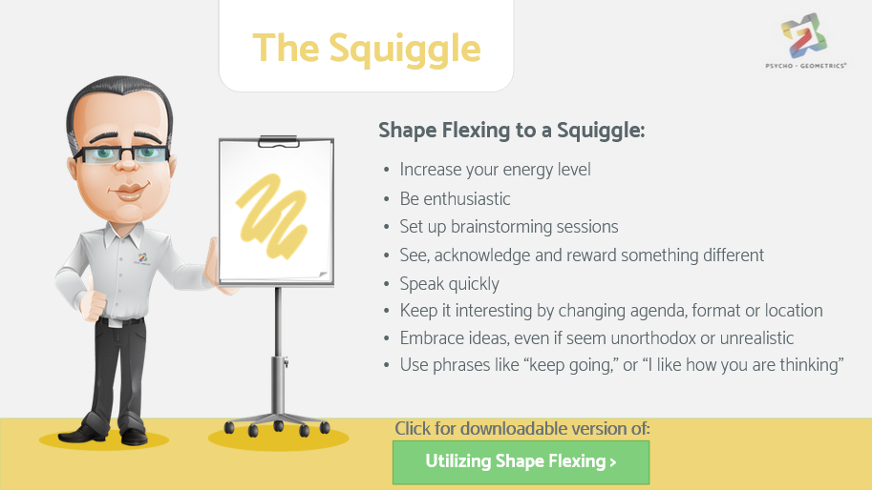
The Squiggle
Shape Flexing to a Squiggle:
Increase your energy level
Be enthusiastic
Set up brainstorming sessions
See, acknowledge and reward something different
Speak quickly
Keep it interesting by changing agenda, format or location
Embrace ideas, even if seen unorthodox or unrealistic
Use phrases like “keep going”, or “I like how you are thinking”
Notes:
Note to presenter: you may create handouts from the embedded file on the slide: Utilize Shape Flexing
When you are Shape Flexing to a Squiggle, increase your energy level and be enthusiastic, considering tone of voice, pace, physical gestures, and facial expressions. Set up a brainstorming session. See, acknowledge and reward something different; see the value in thinking differently. Speak quickly; the Squiggle is impatient and on the move! Make it interesting by changing agenda, format or location. Embrace ideas, even if they seem unorthodox or unrealistic at first. Use phrases like “keep going,” or “I like how you are thinking”.

Slide 31
What is Shape Flexing?
Approaching others in the way they want to be approached
Golden Rule
Platinum Rule
Make choices in how to use more of a shapes’ traits for your own development
Adopt shapes’ traits for better communication with other shapes
Notes:
Now let’s look at some exercises to help you Shape Flex in the two ways we’ve discussed, that is, making choices in how to use more of a shapes’ traits for your own development or to adopt shapes traits for better communication with other shapes. (The Golden and Platinum Rules!)In this multiple choice, help Derek choose how best to communicate with Triangle.

Slide 32
Learn to Shape Flex Exercise
Derek wants to Flex to better communicate with his Triangle employee, Angela.
From the following choices, pick those that will best help Derek communicate with Angela.
a
Be prepared for many questions
b
Seek out Angela’s opinion
c
Commend Angela on her achievements
d
Create a group consensus in meetings
Notes:
Note to presenter: See next slide for correct responses.
In this multiple choice, help Derek choose how best to communicate with Triangle.

Slide 33
Learn to Shape Flex Exercise
Derek wants to Flex to better communicate with his Triangle employee, Angela.
From the following choices, pick those that will best help Derek communicate with Angela.
a
Be prepared for many questions
b
Seek out Angela’s opinion
c
Commend Angela on her achievements
d
Create a group consensus in meetings
Notes:
Correct responses:
B & C are best choices to help Derek communicate with Angela. Seeking out a Triangle’s opinion and commending their achievements will help improve communication with the Triangle.

Slide 34
Learn to Shape Flex Exercise
Cheryl wants to Flex and use more Box traits. Choose one.
From the following choices, pick one that will best help Cheryl adopt Box traits.
Ask others how they feel, instead of what they think
Ask others how they feel, instead of what they think
Keep it professional, objective, and on topic
Do something unexpected
Notes:
Note to presenter: See next slide for correct response.
Choose one option to help Cheryl pick a trait that Boxes may utilize.

Slide 35
Learn to Shape Flex Exercise
Cheryl wants to Flex and use more Box traits. Choose one.
From the following choices, pick those that will best help Cheryl adopt Box traits.
Ask others how they feel, instead of what they think
Ask others how they feel, instead of what they think
Keep it professional, objective, and on topic
Do something unexpected
Notes:
Correct answer is the middle choice. Being professional, objective and on topic will help you flex your own shape traits to be more “Box-like”.

Slide 36
Takeaway Activity
Applying what you’ve learned
Working with yourself. Take a few minutes to reflect on the following:
List some of the people in your life who exhibit Circle traits,.
What Circle traits should I consider using to communicate more effectively with these people?
Note: You may substitute “Circle” for any shape that you wish to work with.
Notes:
Note to presenter: You may create handouts from the embedded file on this slide for learners to work on the activity.
The next three activities are to exercise your skills learned from this Shape Flexing training module.
For this first exercise, working with yourself, take a few minutes to reflect on the following questions:
Who do I know that is a primary Circle and what Circle traits can I learn more about?
How can I add more positive Circle traits to my communication style? Please note, you may substitute “Circle” for any shape that you wish to work with

Slide 37
Takeaway Activity
Applying what you’ve learned
Working with others.
Choose a friend, family member or co-worker as a partner in this exercise.
What would your partner tell you to do to increase, decrease or manage your Squiggle to be more effective?
Note: You may substitute “Squiggle” for any shape that you wish to work with.
Notes:
For this exercise, working with others, chose a friend, family member or co-worker as a partner. Ask your partner, “If I wanted to add more Squiggle to my communication style, what would you suggest?”

Slide 38
Takeaway Activity
Applying what you’ve learned
Working with others.
Choose a friend, family member or co-worker as a partner in this exercise.
What shape traits would you suggest your partner flex to so they may improve their own communication style?
What shape traits would your partner suggest you flex to so that you may improve your communication style?
Notes:
Continue working with you partner and discuss the following:
What shape traits would you suggest your partner flex to so they may improve their own communication style?
What shape traits would your partner suggest you flex to so that you may improve your communication style?

Slide 39
Now that you have participated in this Shape Flexing module, you should:
Understand the Psycho·Geometrics® term Shape Flexing
Understand the difference between the Golden Rule and the Platinum Rule
Understand how to use Shape Flexing for others to practice the Platinum Rule
Understand how to use Shape Flexing for you to enhance and strengthen your personal communication style and change possible negative perceptions into positive ones.
Notes:
Now that you have participated in this Shape Flexing module, you should:
Number1, understand the Psycho·Geometrics® term “Shape Flexing”,
Number 2, understand the difference between the Golden Rule and the Platinum Rule,
Number 3, understand how to use Shape Flexing for others to practice the Platinum Rule,
And lastly, number 4, understand how to use Shape Flexing for you to enhance and strengthen your personal communication style, and change possible negative perceptions into positive ones.

Slide 40
Resources
Resources
Website
Susan’s
Bio
Shapes
For Work
Additional
Courses
Facebook
Twitter
Instagram
LinkedIn
Notes:
(Note to speaker: Links on-screen are active.)

Slide 41
Congratulations
You are now ready to move to the next application of Psycho·Geometrics®
Module 4: Shape Motivation
Notes:
Congratulations! You have now completed this module.

Slide 42
You are now ready to move to the next application of Psycho·Geometrics®
Module 4: Shape Motivation
Discover what motivates and demotivates you, as well as what motivates and demotivates others.
Make sure you are getting what you need to stay motivated and engaged. Then learn how to approach and communicate with others in a way that will motivate them to listen, act, engage, or respond in an effective manor.
Notes:
You are now ready to move to the next application of Psycho·Geometrics®, Module 4: Shaping Your Communication, where you will acquire the knowledge and skills for strategic communication, whether it’s responding to a customer or employee concern, a client request for information, or having a crucial conversation with a colleague, partner, or friend

