Slide 1
Welcome
Notes:
(Note to speaker/facilitator: you may print the notes section by going to the File menu>Export>Create Handouts)
Welcome to Course 1, Part 1, an Introduction to PsychoGeometrics®.

Slide 2
Welcome Video by Susan Hite
Click on video to play
Notes:
(Note to speaker: Click to play video. Transcript below. )
Hi, I’m Susan Hite and I just wanted to take a moment to welcome you to our virtual training series. You know, it has been quite the privilege to travel around the world sharing PsychoGeometrics® with people thousands of people representing more than 30 countries and now, it is really exciting to thing that we can bring you this program virtually. I think you’ll find it to be quite unique and it is our goal to make sure we provide a logical, proven, creative, intuitive, and fun way to understand your communication strengths and challenges and the communication strengths and challenges of others. We also intend to make sure you have the knowledge and the skills to truly strengthen your communication and your relationships. PsychoGeometrics®, stronger communication, stronger relationships, better and measurable results.

Slide 3
Course Objectives
Notes:
By the end of the course, you will have a basic understanding of these objectives.

Slide 4
Section 1
Notes:
Section 1, Introduction to PsychoGeometrics®, What it is, why use it, how to use it and the results you can expect from using this tool.

Slide 5
What is PsychoGeometrics®?
Notes:
What is PsychoGeometrics®? It is a communications system featuring five geometric shapes, that explains the Science of Behavior and the Art of Communicating.

Slide 6
Notes:
Created by Dr. Susan Dellinger in 1978 and then in the early 2000’s, in partnership with Dr. Jack Wolf, PsychoGeometrics® was scientifically validated and further developed as a communications system.

Slide 7
Notes:
PsychoGeometrics® uses five shapes to identify traits and behaviors and provides the tool called Shape Flexing, making communication more efficient and effective.

Slide 8
Notes:
In fact, 98% of people who have experienced using PsychoGeometrics® say it has not only helped strengthen their communication, but it has also helped strengthen their personal and professional relationships.

Slide 9
Notes:
(Note to speaker: Employee Engagement file embedded on-screen)
From colleagues and work teams to partners, families and friends, the PsychoGeometrics® System supports the top 10 Drivers of Engagement.
And what makes this different from comparable systems is that you can take the Assessment in just 15 minutes, the System embeds change and growth, uses easy to remember geometric shapes, easy to use shape flexing, and a customized ‘one size does not fit all’ approach.

Slide 10
Why should I use PsychoGeometrics®?
Notes:
Why would you use PsychoGeometrics®?
It has been said that 93% of communication is what you see and what you hear.

Slide 11
Notes:
And that Words are only 7% of communication; so WHAT you Say and HOW you Say it is important for effective communication. PsychoGeometrics® represents all three parts of communication.

Slide 12
Notes:
It can be applied to the way you lead people, manage projects, sell or serve customers, strengthen relationships, communicate among teams, across departments and even beyond borders. PsychoGeometrics® quickly becomes a common, shared, and respected language. It raises awareness of personal communication preferences and differences and shows you how to embrace those differences quickly and effectively with tools such as Shape Flexing and Strategic Shaping.

Slide 13
Notes:
These tools can simplify, manage, improve, and strengthen natural talents, learned skills and processes for effective communication, stronger teams and relationships.
In addition, it aids managers, team members, and leaders in identifying and clarifying instructions or expectations. PsychoGeometrics® embraces and utilizes the strengths of diversity and provides structure for strategic brainstorming, as well as in innovation, problem-solving situations. The results will help reduce tension, increase traction and overall performance.

Slide 14
Notes:
How can you use PsychoGeometrics®?
At the end of Part 1 of this course, you will take a 15-minute online Assessment that identifies your traits, behaviors, and interactions with others.
This information can be immediately applied to current, real-time communication and to written or virtual learning modules designed to strengthen communication and achieve specific communication objectives, such as listening for understanding to change negative perceptions into positive ones or building trust with others or within the team.

Slide 15
Notes:
You can also take the same 15-minute PsychoGeometrics® Assessment to measure progress and as a 360° Feedback Tool, during onboarding or orientation processes, during a merger or acquisition, and as a team building activity. It has also been proven highly effective in keeping people and teams connected as more people are working virtually than ever before.

Slide 16
What about results?
Notes:
What about the Results of PsychoGeometrics®?
PsychoGeometrics® gives you the tools to have a powerful, influential and effective voice on any platform with any audience, while still being authentic.

Slide 17
Notes:
As a result, understanding how to effectively use “shape behavior” will impact and influence the outcome. For example, companies that use the PsychoGeometrics® system have enjoyed tangible results such as higher engagement scores, increased productivity, lower turnover, increased sales, fewer internal and external complaints, quicker resolutions, and more efficient processes, saving measurable time and money.
Let’s move on to the next section, where we take a few more minutes to learn the best way to take the Assessment for the best and most accurate results.

Slide 18
Section 2: The Assessment
Notes:
Section 2, introduction to the PsychoGeometrics® Assessment.

Slide 19
The Assessment
Notes:
How can you gain the best results from the PsychoGeometrics® Assessment?
Firstly, it’s important to know that this is an Assessment and not a test. What’s the difference? When you take the PsychoGeometrics® Assessment, there are NO wrong answers.
In fact:
You don’t have to prepare or study to take the PsychoGeometrics® Assessment
You just get to be your natural self. Choose your responses based on how you naturally are; not how you have learned to be
You don’t get a grade, but you do get a shapes score. It doesn’t matter what you score, but it does matter that you understand and know how to use your score
The PsychoGeometrics® Assessment is simple, easy, and fun to take
And it’s quick! It typically only takes 15 minutes to take the PsychoGeometrics® Assessment!

Slide 20
The 3 Sections
Notes:
You will be answering questions and choosing answers through 3 parts in the Assessment, that is, the traits, behavior and relating sections.
Remember, it’s important to complete each section by choosing the responses that best represent your “natural” traits and behaviors. You only want to choose the responses that fit you naturally, not something you have learned to be or do. Things that you must think about being or doing are typically more representative of your learned skill sets and behavior. This Assessment is designed to capture your natural talents and strengths, not the skills you have learned and developed.

Slide 21
Notes:
When you do something natural, it’s something you do without even thinking about it. It’s like breathing; you are doing it now, but you are not even aware that you are doing it. It’s just something your body is designed to do naturally.

Slide 22
Notes:
The way you communicate is also something you “just do” based on the strengths and talents with which you were born. You act, behave, and relate based on what feels natural, or comfortable for you.

Slide 23
Notes:
Although you won’t be timed, it’s best to go with your first choice, rather than thinking through or analyzing your answers.

Slide 24
Notes:
At the beginning of each section, you will receive the instructions to choose only 7 responses in each category. Even though you may agree or identify with more than 7 in each category, limit yourself to the 7 selections per section that best represent you. At the end of the Assessment, you will have chosen a total of 21 responses out of 89 choices.

Slide 25
Notes:
This PsychoGeometrics® Assessment will help you determine and understand your natural traits and behaviors, describing who you are, how you act, and how you relate to others.

Slide 26
Notes:
It will help you recognize your natural talents and strengths, what you naturally like and dislike, sometimes not even realizing why, and it will help you gain insight into why you get along well with certain people but have stress and conflict with others.

Slide 27
Notes:
The art of understanding is the first step toward being effective with your communication. More specifically, understanding yourself is the first step in understanding others and increasing your ability to successfully communicate and relate to them.

Slide 28
Launch the Assessment
Notes:
Now that you’ve had a chance to learn a little about PsychoGeometrics® and the Assessment, it’s time to launch!
After you complete the Assessment and before you come back to take Part 2 of this introductory course, give yourself a few minutes to review your results and your score in your Shapes Profile Report. When you return, we’ll help you understand the outcome and show you more of the exciting world of “Shapes”!

Slide 29
Part 2
Notes:
You will now begin Part 2 of the course, which focuses on reviewing and understanding your Assessment results.

Slide 30
The Results
Notes:
Now that you have your results, let’s review some key points to keep in mind.
Every shape represents a behavior, every shape has value, every shape has power, and every shape has its strengths and its challenges.
The behavior you exhibit most is likely a combination of your primary and secondary shapes, which represent your natural shape strengths. In other words, what you are naturally good at doing. However, this does not mean 100% of your communication comes from just these two shapes. It simply means your natural behavior comes from the blend of those two shapes and is typically what you use most of the time. The rest of your behavior consists of a blend of the remaining three shapes.

Slide 31
Key Points
Notes:
Your primary shape is indicated by the shape in which you score the highest number of points. Your secondary shape is indicated by the shape in which you score the second-highest number of points.

Slide 32
Notes:
It is possible to have a tie. If this happens, it may mean your general behavior is derived from the blend of three shapes, not just two.

Slide 33
Notes:
There are also other reasons for a tie, which is explained in your Shapes Profile Report.

Slide 34
Key Points 3
Notes:
In general, the idea is that you should maximize your shape strengths for success and manage your shape challenges to help prevent failure.

Slide 35
Notes:
No matter what your natural shape strengths, the Science behind PsychoGeometrics® suggests that in order to communicate more simply, effectively and efficiently you will need to utilize the behaviors of all five shapes, regardless of whether you are naturally good at using them or you need to develop certain skill sets to learn how to use them.

Slide 36
Section 2 review of the 5 shapes
Notes:
Section 3, Review of the 5 Shapes.

Slide 37
The 5 shapes
Notes:
Now for basic descriptions of the 5 Shapes and their traits.

Slide 38
The Box
Notes:
The Box is the most left brain of the five shapes. When you think of Box behavior, traits such as structured, detailed, process-oriented, logical, slow to make a decision, efficient and practical come to mind. The Box may say, “If you want a job done right, you have to do it yourself!” - “I need time to think about it.” or “I don’t make decisions based on emotion. I make decisions based on facts.”

Slide 39
The box
Notes:
(No narration)

Slide 40
The Triangle
Notes:
The Triangle is also considered a left-brain shape, but less left-brained than the Box. When you think of Triangle behavior, descriptions such as direct, driven, goal-focused, action-oriented, quick to make a decision, bottom-line and to the point, are used. The Triangle may say, “Make a decision, and right or wrong, work to make it right!” - “I don’t need to hear the whole story.” – “Be brief, be bright, give me three options, be gone.”

Slide 41
The triangle
Notes:
(No narration)

Slide 42
The Circle
Notes:
The Circle is a right brain shape, but not nearly as right-brain as the Squiggle. When you think of Circle traits – words such as harmony, nurture, mentor, inclusive, relationship-oriented, and sensitive come to mind. The Circle may say, “I don’t care how much you know, until I know how much you care.” Or “I can just sense it, feel it; I don’t need a spreadsheet to know it.” “I know it might not make sense but my heart, my gut, says this is the right thing to do.”

Slide 43
The Circle
Notes:
(No narration)

Slide 44
The Squiggle
Notes:
The Squiggle is the most right-brain of all five shapes. It is the complete opposite of the Box. Squiggle behavior can be described as creative, innovative, energized, spontaneous and unique. A Squiggle may say, “You can do it!” - “Lighten up, have some fun!” - “What if we tried this?!” or “Just go with the flow!”

Slide 45
The Squiggle
Notes:
(No narration)

Slide 46
The Rectangle
Notes:
When you think of Rectangle behavior, think exploring, open-minded, undecided, a turning point, and growth. The Rectangle may say, “Please listen to me, then tell me what to do,” “What’s next?” “Or before I can decide to change or support the change, I need to consider the people involved, the facts, the opportunities or restrictions, or how it impacts results.”
It is important to know that The Rectangle is neither a left brain or right brain shape. Instead, it is considered a transitional shape, representing change, and having the ability or need to see through and consider each of the other four shapes, using both sides of the brain. In fact, the way you respond to change is directly related to your natural shape strengths and your shape challenges. The Box is typically resistant to doing something new or different that has not yet been proven. The Triangle thrives on knowing exactly what to do and making quick decisions, so change that lessens control is extremely uncomfortable for the Triangle. The Circle first considers how they feel about the change, or how will it make others feel before they decide if they like or support the change. The Squiggle likes change if it provides more freedom and flexibility, highlights uniqueness and includes fun, but challenges any change that seems boring, too rigid, adds more rules or requires conformity.
The Rectangle is truly your key to growth and successful change, but it can be one of your least natural shapes to embrace and use. It requires awareness, consideration, anticipation, courage, open-mindedness, and an understanding of the value of change, even if the exact outcome is unknown, or requires a long, difficult, or sacrificial process.

Slide 47
The Rectangle
Notes:
(No narration)

Slide 48
Notes:
(No narration)

Slide 49
Notes:
(No narration)

Slide 50
The Shapes Menu
Notes:
Now we will review each shape’s communication style, thinking style, traits, behaviors and interactivity styles in more detail.

Slide 51
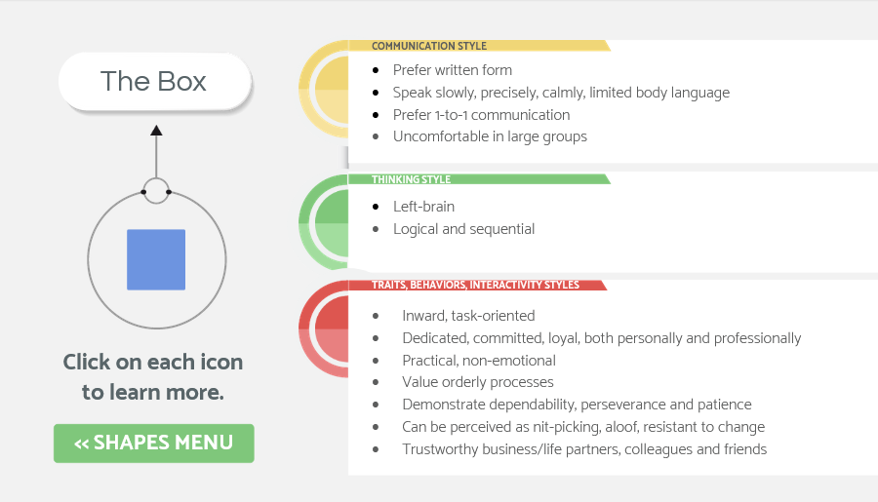
Box
Notes:
(No narration)

Slide 52
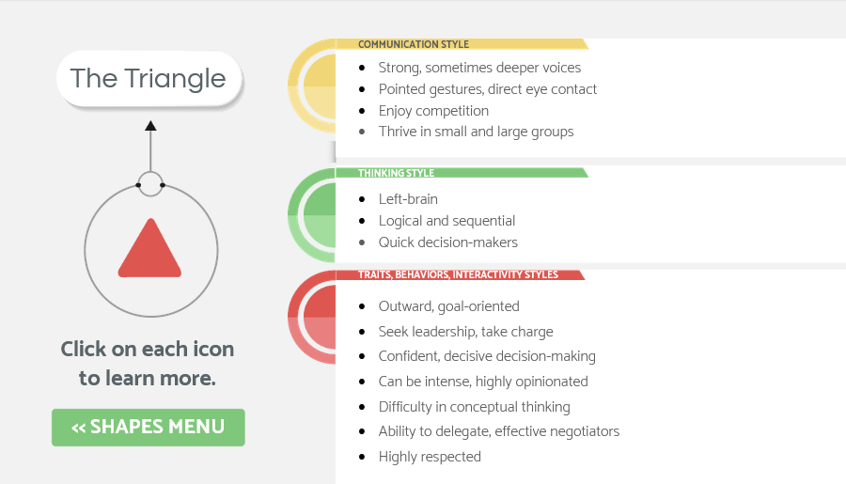
Triangle
Notes:
(No narration)

Slide 53
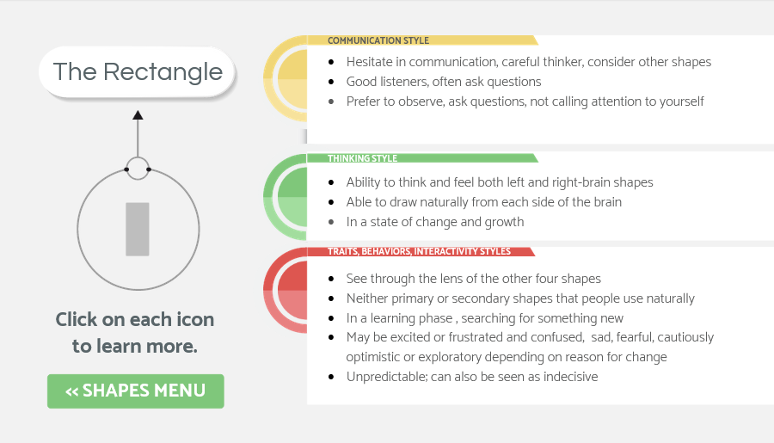
Rectangle
Notes:
(No narration)

Slide 54
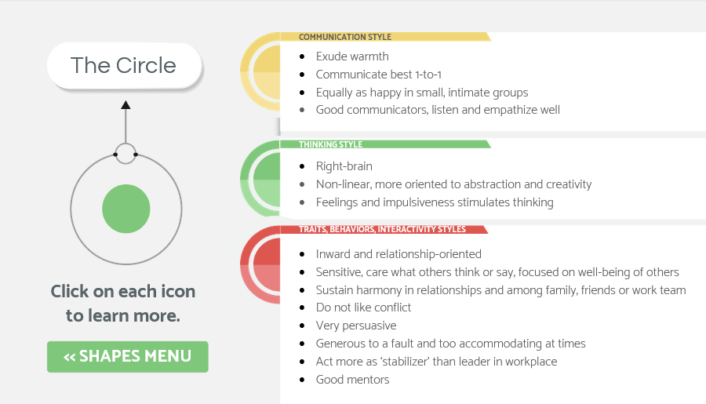
Circle
Notes:
(No narration)

Slide 55
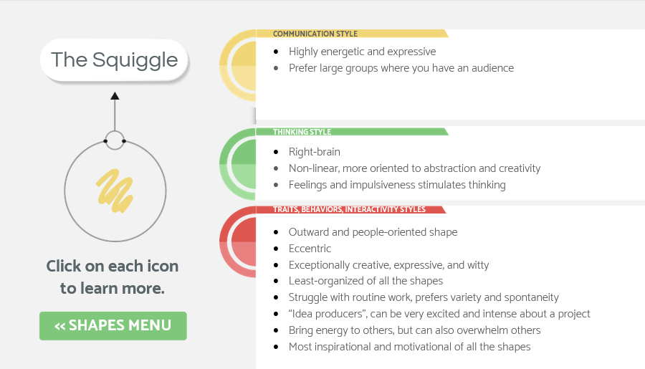
Squiggle
Notes:
(No narration)

Slide 56
Reflection
Notes:
This is a good place to momentarily stop and ask yourself some questions, such as those seen on-screen.

Slide 57
Reflection
Notes:
(No narration)

Slide 58
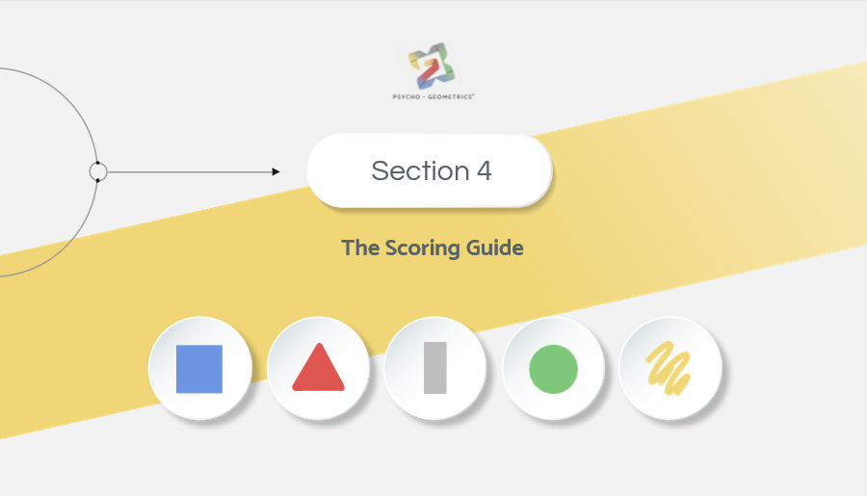
Section 4 Scoring Guide
Notes:
Section 4, The Scoring Guide.

Slide 59
Shapes Profile Report
Notes:
Now we’ll look at how to understand the scoring of your Assessment
Your total shape score cannot be less or more than 21. It should be 21 exactly (7 points from each of the three sections on your Assessment). If you Score 3 or less in a shape, it is considered a low score. 4-6 is a medium score and 7 or more equals a high score.

Slide 60
Low scores
Notes:
A low score means you have a low percentage score (out of 21) of this shape naturally within. It is likely not a comfortable shape for you to use and your least preferred shape to use for communicating. However, it can be a development opportunity to recognize, develop and strengthen this shape behavior as a skill set, often managing, counterbalancing, or maximizing your shape strengths as part of Shape Flexing.

Slide 61
Medium score
Notes:
A Medium score means you have a medium percentage score (out of 21) of this shape naturally within. You have more natural ability to use it than a low shape score, and typically it is less awkward for you to use it as part of your communication style, but it’s probably not your “go-to” shape or preferred shape for communicating. Similar to a low shape score, a medium shape score shape can be strengthened as a skill set and also serve the purpose of managing, counterbalancing or maximizing your shape strengths as part of Shape Flexing.

Slide 62
High score
Notes:
A High score means you have a high percentage score (out of 21) of this shape naturally within. It has the potential to be your greatest, or at least one of your greatest shape strengths for communicating. It is likely your most preferred shape to use for communicating. This is because it’s natural for you to use, you find you enjoy using it, and that you can be a very effective communicator by using it. Keep in mind, managing your high shape scores is key. Just because this shape score is high, it does not mean you are great at using it.

Slide 63
Notes:
However, you have the potential to be great using a high score shape, and it can be your strongest communication shape because it represents your natural shape strength.

Slide 64
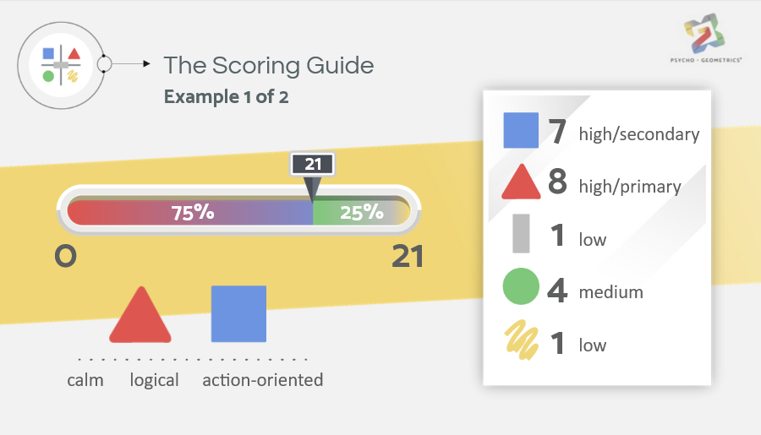
Notes:
In this example, your circle score is a 4 (medium), your triangle score is an 8 (high and your primary shape), and your box score is a 7 (high and your secondary). You also have 1 rectangle (low) and 1 squiggle (low). Your triangle and box scores combine for 15 out of 21 possible points, indicating nearly 75% of your behavior comes from these two shapes (triangle and box) leaving only 25% of your behavior to the remaining three shapes. Let’s assume that because your natural way of showing care and concern is through your triangle and box, you tend to show someone you care by being calm, logical and action oriented. When you communicate first in this manner, the circle in you may come a little too late for some people.

Slide 65
Notes:
For example: your friend lost her job. She is a primary circle. You absolutely care about helping your friend, which stems from your circle, but because you tend to use your triangle and box first, which are your most natural shapes to show you care, you’re thinking:
“Let’s get the facts then I can tell her what to do.”
You don’t necessarily think circle first, at least not naturally.

Slide 66
Notes:
Therefore, your natural response is NOT, “I am so sorry. That’s terrible. Are you ok? How are you feeling? Do you want to talk about it?”

Slide 67
Notes:
With awareness, knowledge, skill and desire, you can teach yourself to start with your medium score of circle first, and still be genuine, even though that may not be as natural or as easy for you. You don’t have to be great at using your Circle, but you have to remember to use it, or be good enough using it, so you can then use your natural triangle and box strengths.

Slide 68
Notes:
This is an example of Shape Flexing. It would sound like this:
“I am so sorry to hear this. When you are ready to think about a plan for next steps, I can help you with that.”

Slide 69
Notes:
Although the thing your friend may ultimately need most is your level, logical and box thinking head with your confident, action-oriented, triangle recommendations, she may not want or appreciate your box and triangle unless you start with your circle, showing care and compassion.

Slide 70
Notes:
It’s great if you can be aware of the best shape approach in a situation like this, but it’s also great if the friend knows what she needs and can communicate it. Otherwise:
she doesn’t get her circle need met by you,
she doesn’t see your triangle and box as the way you “show” your circle care,
it doesn’t go well when you reach out with your triangle and box, and instead of helping, you wind up causing more stress,
and both of you are wondering: What happened?! Why this conflict or tension?

Slide 71
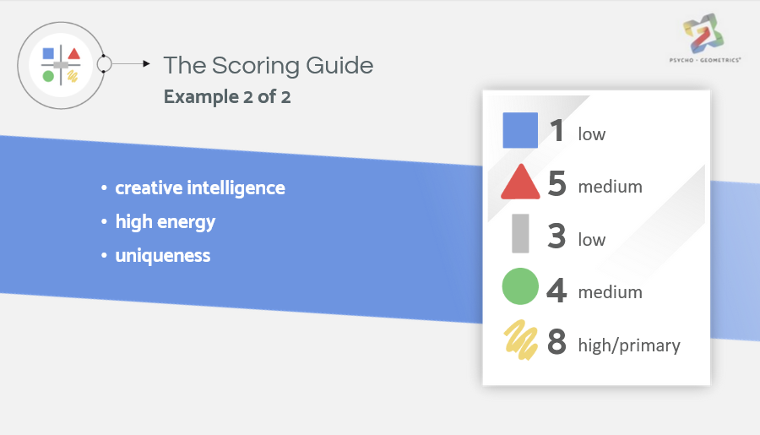
Scoring example 2
Notes:
In this example, if you score 1 in box (a low score) and 8 in squiggle (a high score), then let’s assume the squiggle is your primary shape. This indicates that creative intelligence, high energy, and uniqueness are the things that can help you succeed the most in life.

Slide 72
Notes:
Managed enthusiasm, excitement and creativity represents a healthy, effective squiggle. However, a squiggle that is not managed in a healthy or effective manner is all over the place, speaks before thinking, is known for having great ideas but ones that never materialize because there’s no box-like plan. Therefore, a high shape score of 8 in squiggle doesn’t necessarily mean you are using your squiggle shape well.

Slide 73
Notes:
It means you have many of the squiggle traits within you and that you have the natural potential to use your Squiggle behavior extremely well.

Slide 74
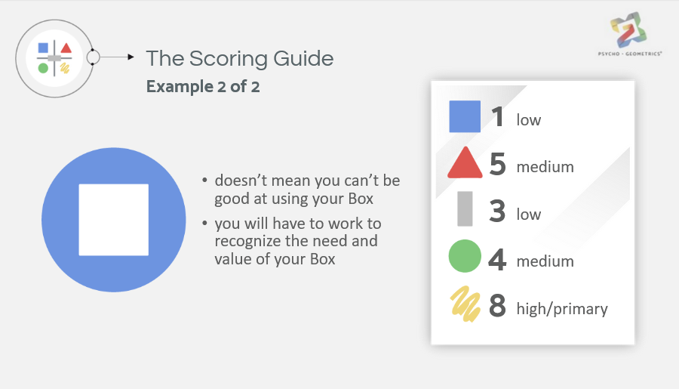
Notes:
By the same token, a low box score doesn’t necessarily mean you can’t be good at using your box, it just means you will have to work to recognize the need and value of your Box, to develop your box skills and be good enough at using your box so that your squiggle can be great.

Slide 75
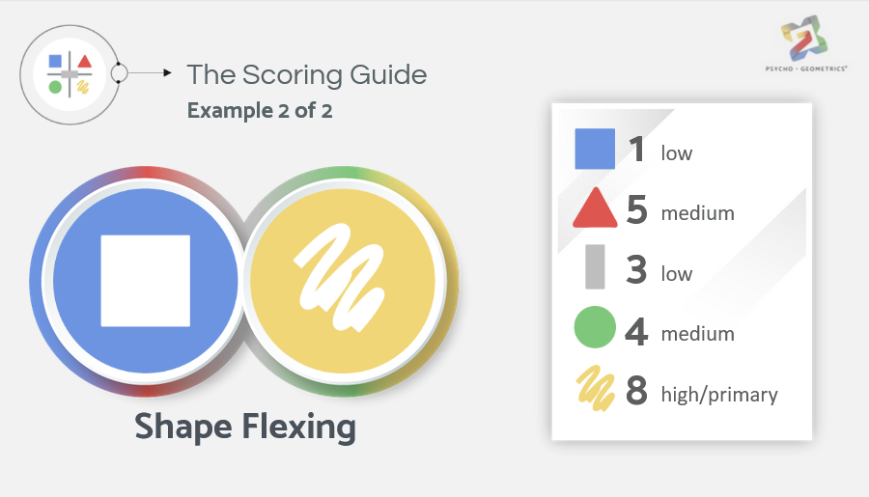
Notes:
This is an example of Shape Flexing. Without Shape Flexing, the low score in your box is what could keep your primary squiggle from being as successful as possible, or in some cases, to completely fail.

Slide 76
Self-evaluation and reflection
Notes:
Now that you have had time to review your shapes profile and have learned about the scores, let’s assess your understanding of the scoring guide. Looking at your shapes profile, what does your report say are your natural strengths?

Slide 77
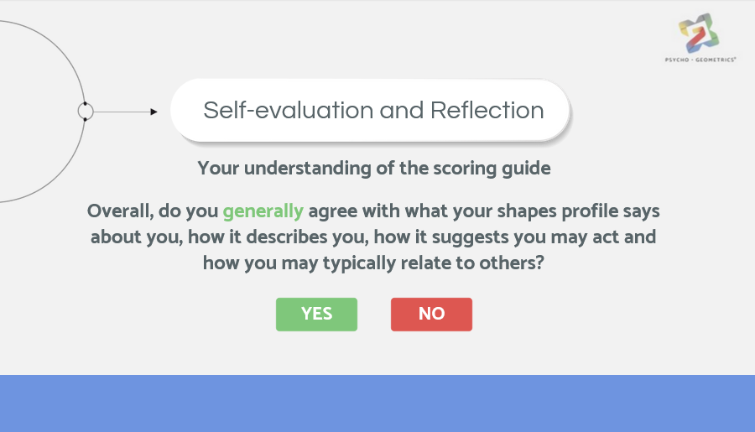
Notes:
Overall, do you generally agree with what your shapes profile says about you, how it describes you, how it suggests you may act and how you may typically relate to others?

Slide 78
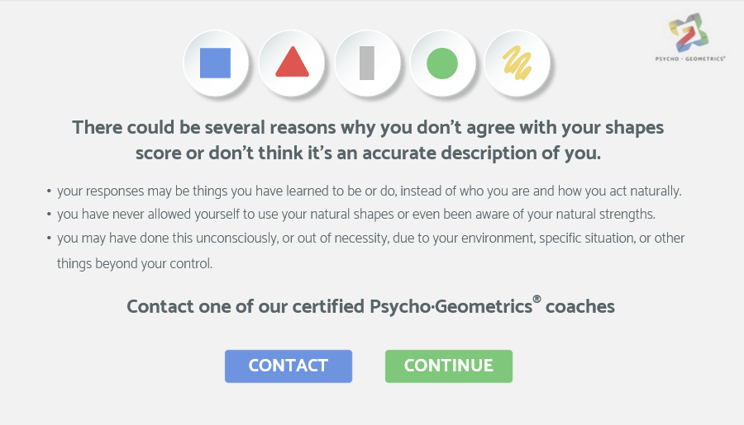
No reponse
Notes:
(Pop up box for those who selected ‘No’)
There could be several reasons why you don’t agree with your shapes score or don’t think it’s an accurate description of you. You may have chosen your responses as things you have learned to be or do, instead of who you are and how you act naturally. Or perhaps, due to some environmental circumstances, you have never allowed yourself to use your natural shapes or even been aware of your natural strengths. You may have done this unconsciously, or out of necessity, due to your environment, specific situation, or other things beyond your control.
It’s ok if you don’t agree with your shapes score. However, if you are interested in understanding why you may not agree with your shapes score, or how to get another report that might be a more accurate description of your shape profile, you can contact one of our certified PsychoGeometrics® coaches or subject matter experts.

Slide 79
Section 5 Knowledge check
Notes:
Section 5, now it is time for you to check your knowledge of the material in Course 1, Parts 1 and 2. Don’t worry, there is no pass or fail. Press next to continue.
(no audio in the Knowledge check exercises)

Slide 80
Notes:
1) True

Slide 81
Notes:
2) True

Slide 82
Notes:
3) False

Slide 83
Notes:
4) True

Slide 84
Notes:
5) True

Slide 85
Notes:
6) True

Slide 86
Notes:
7) True

Slide 87
Notes:
8) False. You can use the right-brain shapes, but they won’t come as naturally to you. However, you can develop the skills needed to use your right-brain shapes. You need all 5 shapes to be effective in your communication, but people tend to mostly use their primary and secondary shapes, without even thinking about using the other shapes., However, you can develop the skills needed to use your right-brain shapes.

Slide 88
Notes:
9) True

Slide 89
Notes:
10) Left is correct

Slide 90
Notes:
11) Right is correct

Slide 91
Notes:
12) Right is correct

Slide 92
Notes:
13) Right is correct

Slide 93
Notes:
14) Right is correct

Slide 94
Notes:
15) See next slide for correct answers

Slide 96
Notes:
16) See next slide for correct answers

Slide 98
Notes:
Now that you have taken the course, you should have a basic understanding of
What PsychoGeometrics® is and its use as a communications tool
How to evaluate
your outcome of the PsychoGeometrics® Assessment, and
the scoring guide.
The meaning of the 5 PsychoGeometrics® shapes and what they mean to you in terms of who you are, what you do, and how you interact with others

Slide 99
Notes:
Thank you so much for taking the first steps in understanding PsychoGeometrics® and taking this introductory course.
Come back to enrich your knowledge, maximize your shape strengths, and improve your communication skills even more by enrolling in additional courses that meet your specific objectives.

Slide 100
Website
Susan’s
Bio
Shapes
For Work
Additional
Courses
Facebook
Twitter
Instagram
LinkedIn
Notes:
(Note to speaker: Links on-screen are active.)

